Slide 1
Steve Lindo
“Articulando el apetito de riesgo con los riesgos no financieros”
Profesor de Gestión de Riesgos
Columbia University
Director
SRL Advisory Services

Slide 2
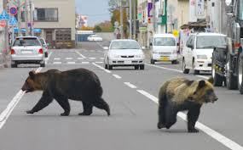
¿Qué
tienen
The information contained in this document is proprietary to SRL Advisory Services and is intended for participants in Asobancaria’s Seventeenth Annual Financial Risk Conference. Its contents may be shared with other parties provided that the source is acknowledged.

Slide 3
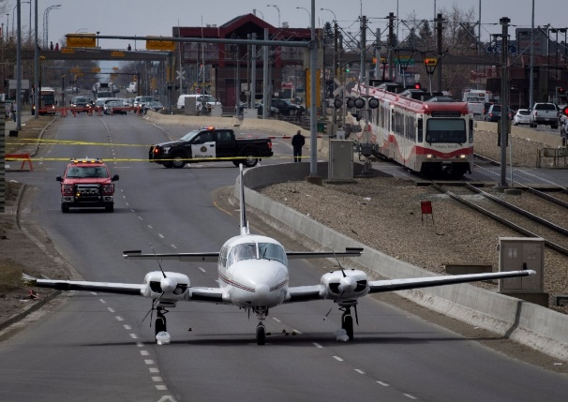
en
común
The information contained in this document is proprietary to SRL Advisory Services and is intended for participants in Asobancaria’s Seventeenth Annual Financial Risk Conference. Its contents may be shared with other parties provided that the source is acknowledged.

Slide 4
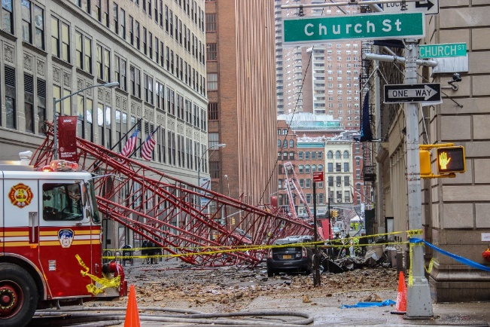
todas estas
The information contained in this document is proprietary to SRL Advisory Services and is intended for participants in Asobancaria’s Seventeenth Annual Financial Risk Conference. Its contents may be shared with other parties provided that the source is acknowledged.

Slide 5
¡Dame el dinero!
situaciones?
The information contained in this document is proprietary to SRL Advisory Services and is intended for participants in Asobancaria’s Seventeenth Annual Financial Risk Conference. Its contents may be shared with other parties provided that the source is acknowledged.

Slide 6
Probabilidad baja
Alto impacto
The information contained in this document is proprietary to SRL Advisory Services and is intended for participants in Asobancaria’s Seventeenth Annual Financial Risk Conference. Its contents may be shared with other parties provided that the source is acknowledged.

Slide 7
Las pérdidas no financieras de los bancos han sido enormes
Bank | Amount | Description
Bank of America | $37.0bn | US residential mortgage lending and securitization
BNP Paribas | $8.9bn | Business with sanctioned countries
Credit Suisse | $5,3bn | US residential mortgage securitization
Deutsche Bank | $7.2bn | US residential mortgage securitization
Deutsche Bank | $2.2bn | LIBOR collusion
Goldman Sachs | $5.0bn | US residential mortgage securitization
HSBC | $1.9bn | AML negligence
JP Morgan Chase | $18.3bn | US residential mortgage lending and securitization
Morgan Stanley | $3.2bn | US residential mortgage securitization
Société Générale | $6.6bn | Rogue trader
UBS | $1.5bn | LIBOR collusion
Various | $1.3bn | Carbanak/Cobalt cyber attacks
Wells Fargo | $7.4bn | US residential mortgage lending and securitization
Wells Fargo | $5.2bn | Unauthorized bank accounts
Total | $110.8bn | (Note: These numbers do not include private claims or litigation)
The information contained in this document is proprietary to SRL Advisory Services and is intended for participants in Asobancaria’s Seventeenth Annual Financial Risk Conference. Its contents may be shared with other parties provided that the source is acknowledged.

Slide 8
Las pérdidas no financieras de bancos han sido enormes
¿Qué tienen en común estas pérdidas?
The information contained in this document is proprietary to SRL Advisory Services and is intended for participants in Asobancaria’s Seventeenth Annual Financial Risk Conference. Its contents may be shared with other parties provided that the source is acknowledged.

Slide 9
Dos especies diferentes
Riesgos financieros
Cuantificación bien probada de pérdidas previstas
Competencia de gestión de riesgos estandarizada para toda la industria
Frecuencia previsible
Severidad baja
Marco regulatorio preceptivo y granulado
Riesgos no financieros
Cuantificación de pérdidas previstas no creíble
Competencia de gestión de riesgos no estandarizada
Frecuencia no previsible
Severidad alta
Marco regulatorio vago y no granulado
The information contained in this document is proprietary to SRL Advisory Services and is intended for participants in Asobancaria’s Seventeenth Annual Financial Risk Conference. Its contents may be shared with other parties provided that the source is acknowledged.

Slide 10
Dos especies diferentes
The information contained in this document is proprietary to SRL Advisory Services and is intended for participants in Asobancaria’s Seventeenth Annual Financial Risk Conference. Its contents may be shared with other parties provided that the source is acknowledged.

Slide 11
Encuesta en vivo
¿Cuál de las siguientes opciones describe mejor cómo se miden los riesgos no financieros en su banco?
a. Fórmula de capital regulatorio
b. Modelo estadístico
c. Juicio de expertos
d. No se mide
e. No lo sé
The information contained in this document is proprietary to SRL Advisory Services and is intended for participants in Asobancaria’s Seventeenth Annual Financial Risk Conference. Its contents may be shared with other parties provided that the source is acknowledged.

Slide 12
Contraste entre las normas actuales
Riesgos financieros
Prácticas universales y probadas para la gestión de riesgos de crédito, mercado y liquidez
Alineación global de reguladores
Riesgos no financieros
No existen prácticas universales
Método de medición IMA abandonado por los reguladores, fórmula sencilla adoptada en su lugar
¿Debe esto preocuparnos?
The information contained in this document is proprietary to SRL Advisory Services and is intended for participants in Asobancaria’s Seventeenth Annual Financial Risk Conference. Its contents may be shared with other parties provided that the source is acknowledged.

Slide 13
Contraste entre las competencias actuales
Riesgos financieros
Alta competencia
Baja gravedad
Riesgos no financieros
Baja competencia
Alta gravedad
Esto explica por qué articular el apetito de riesgo con los riesgos no financieros es tan importante
The information contained in this document is proprietary to SRL Advisory Services and is intended for participants in Asobancaria’s Seventeenth Annual Financial Risk Conference. Its contents may be shared with other parties provided that the source is acknowledged.

Slide 14
El BCBS reconoce algunos riesgos no financieros
Riesgos intrínsicos | Ejemplo
Controles internos | Société Générale
Cumplimiento con las normas | Wells Fargo
Blanqueo de dinero | HSBC
Sistemas Informáticos | Bank of America
Integridad de los datos | IFRS-9
Riesgos intrínsicos | Ejemplo
Modelos estatísticos | JPMorgan
Mala conducta | Wells Fargo
Cultura institucional | Countrywide
El fraude | Madoff
Cambio organizativo | GMAC
Legal | Goldman Sachs
The information contained in this document is proprietary to SRL Advisory Services and is intended for participants in Asobancaria’s Seventeenth Annual Financial Risk Conference. Its contents may be shared with other parties provided that the source is acknowledged.
Internal controls
Compliance
AML
Legal
Systems
Data integrity
Models
Conduct
Culture
Fraud
Organizational change

Slide 15
Riesgos financieros que no son reconocidos por el BCBS
Riesgos extrínsicos | Ejemplo
Riesgo de la agencia | Goldman
Riesgo estratégico | AIG
Modelo empresarial | Northern Rock
Productos defectuosos | PPI
La reputación | Wells Fargo
Complejidad | JPMorgan
Riesgos extrínsicos | Ejemplo
Influencias geopolíticas | Brexit
Catástrofes naturales | Tsunami
Ataque cibernético | Banco Central de Bangladesh
La guerra y el terrorismo | 9/11
Cambios tecnológicos | Blockchain
Cambios en la regulación | Riesgo operativo
Cambios en los impuestos | Ganancias extranjeras
Proveedores de servicios | Procesos externalizados
The information contained in this document is proprietary to SRL Advisory Services and is intended for participants in Asobancaria’s Seventeenth Annual Financial Risk Conference. Its contents may be shared with other parties provided that the source is acknowledged.
Internal controls
Compliance
AML
Legal
Systems
Data integrity
Models
Conduct
Culture
Fraud
Organizational change

Slide 16
Encuesta en vivo
¿Cuál de las siguientes frases describe mejor cómo se articula en su banco los riesgos no financieros con el apetito de riesgo?
Los riesgos no financieros se describen en detalle en la declaración del apetito de riesgos
Los riesgos no financieros se mencionan en la declaración del apetito de riesgos
Los riesgos no financieros no se mencionan en la declaración del apetito de riesgos
d. No hay declaración del apetito de riesgos
The information contained in this document is proprietary to SRL Advisory Services and is intended for participants in Asobancaria’s Seventeenth Annual Financial Risk Conference. Its contents may be shared with other parties provided that the source is acknowledged.

Slide 17
Diferencias en las declaraciones de riesgos financieros y no financieros
Apetito de riesgos financieros
Tipos de riesgo aceptables
Normas de análisis de riesgos
Normas de medición de riesgos
Monitoreo de riesgos
Normas de notificación y las consecuencias del no cumplimiento
Controles internos
Transparencia
Apetito de riesgos no financieros
Actividades de tolerancia cero
Normas de conducta
Código de conducta
Responsabilidad del individuo
Notificar infracciones
Seguridad del sistema informático y protección de los datos personales
Consecuencias del no cumplimiento
Prueba de las defensas
Umbrales
The information contained in this document is proprietary to SRL Advisory Services and is intended for participants in Asobancaria’s Seventeenth Annual Financial Risk Conference. Its contents may be shared with other parties provided that the source is acknowledged.

Slide 18
Diez mandamientos del apetito de riesgos no financieros
1. Actividades de tolerancia cero | Ejemplos: Fraude interno, la corrupción, no cumplir con las normas reglamentarias, daño a la reputación
2. Código de conducta | Ejemplos: Observar la ley, cumplir con todos los compromisos, tratar a todos con el respeto
3. Notificar infracciones | O del código de conducta o del apetito de riesgo
4. Notificar preocupaciones | Actividades inusuales o sospechosas
5. Sistema Informático y protección de los datos personales | Ningun lapso, o consciente o inconsciente
The information contained in this document is proprietary to SRL Advisory Services and is intended for participants in Asobancaria’s Seventeenth Annual Financial Risk Conference. Its contents may be shared with other parties provided that the source is acknowledged.

Slide 19
Diez mandamientos del apetito de riesgos no financieros
6. Responsabilidad del individuo | Por escrito, en lo que respecta a la gestión de riesgos no financieros
7. Consecuencias de no cumplimiento | .. con las normas del apetito de riesgos o del código de conducta, intencionado o no intencionado
8. Afirmación anual | Del código de conducta y del apetito de riesgos
9. Prueba de las defensas | Diseñar y probar al menos una vez al año escenarios para los riesgos no financieros mas importantes
10. Umbrales | Establecer con base en los escenarios
The information contained in this document is proprietary to SRL Advisory Services and is intended for participants in Asobancaria’s Seventeenth Annual Financial Risk Conference. Its contents may be shared with other parties provided that the source is acknowledged.

Slide 20
Diseño y prueba de escenarios para los riesgos no financieros
Riesgos de alto impacto, pero sin precedente en su banco
Especificar la cadena de acciones y acontecimientos
Cuantificar (estimar) las pérdidas
Identificar los huecos y debilidades que se pueden corregir
The information contained in this document is proprietary to SRL Advisory Services and is intended for participants in Asobancaria’s Seventeenth Annual Financial Risk Conference. Its contents may be shared with other parties provided that the source is acknowledged.

Slide 21
Conclusión
Los reguladores se han conformado con una formula de capital conservadora
A los bancos recae la iniciativa de gestionar y medir sus riesgos no financieros
Las herramientas mas fuertes son
Declaración de apetito de riesgos
La disciplina y los procesos
La economía conductista
Pruebas de las defensas
The information contained in this document is proprietary to SRL Advisory Services and is intended for participants in Asobancaria’s Seventeenth Annual Financial Risk Conference. Its contents may be shared with other parties provided that the source is acknowledged.

Slide 22
Recuerden, a seguir se muestra lo que acontece cuando el apetito de riesgo de un banco esta mal articulado o incompleto…
The information contained in this document is proprietary to SRL Advisory Services and is intended for participants in Asobancaria’s Seventeenth Annual Financial Risk Conference. Its contents may be shared with other parties provided that the source is acknowledged.

Slide 23
Articulando el apetito de riesgo con los riesgos no financieros
… and remember, this is what happens when your non-financial risk appetite is poorly articulated!
The information contained in this document is proprietary to SRL Advisory Services and is intended for participants in Asobancaria’s Seventeenth Annual Financial Risk Conference. Its contents may be shared with other parties provided that the source is acknowledged.

Slide 24
Steve Lindo
“Articulando el apetito de riesgo con los riesgos no financieros”
steve.lindo@gmail.com
+1-612-865-6647
Cartagena
26 de octubre, 2018

