Slide 1

Evolution of Basel Solvency Framework
July 2018
Jaime Vázquez
Policy Advisor, Regulatory Affairs
IIF

Slide 2
Basel Solvency Framework: Evolution
Regulation has evolved overtime in response to experience during crisis, evolution of the sector and technological capabilities, emergence of new risks, etc…
Basel I
Basel 1.5
Basel II
Basel 2.5
Basel III
Basel IV
1988
1993
2006
2009
2010
2017
Credit Risk
8% RWA
Credit Risk +
  SA
  IRB
Op Risk
Higher Capital Ratios
Capital Buffers
FRTB
Liquidity ratios
Leverage ratio
Market Risk
VaR Models
Market Risk
Stress VaR
Modified RWA’s
Less Internal Models

Slide 3
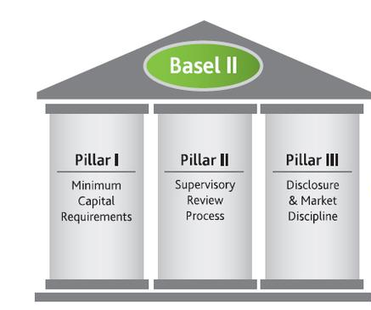
Basel II Framework
Capital Adequacy Ratio
CET 1 + AT1 + Tier 2 Capital
Risk Weighted Assets
Capital to cover Unexpected Losses (Average Unexpected Losses Through the Cycle)

Slide 4
Basel II: Internal Models

Slide 5
Basel II: Internal Models

Slide 6

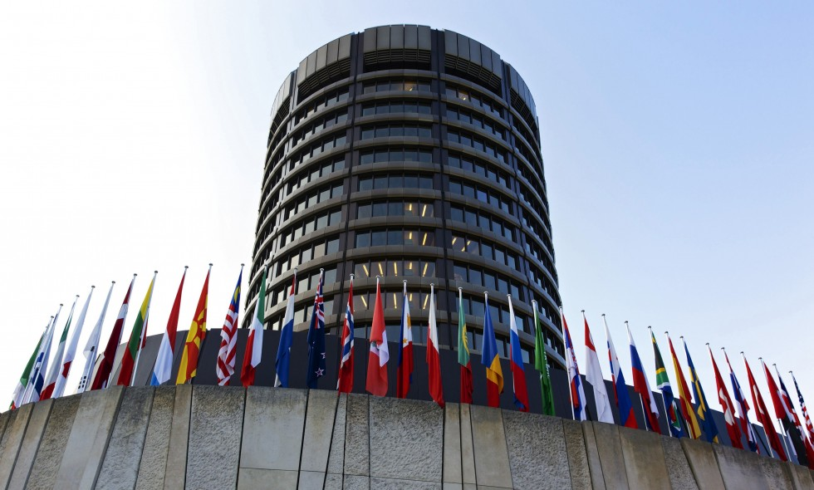
Financial Crisis
Strengthening the Resilience of the Banking Sector:
Basel III

Slide 7
What Went Wrong with Basel II?
Insufficient high-quality capital
Failure to capture key exposures
Insufficient risk coverage
The financial crisis highlighted the need to revisit some of the risk sensitivity assumptions underlying financial instruments such as OTC derivatives – Counterparty risk, Wrong-way risk and Liquidity risk
Such as complex trading activities, re-securitizations and exposures to off-balance sheet vehicles
Prevented banks to absorb losses as a going concern
Basel II Accentuated Procyclicality

Slide 8
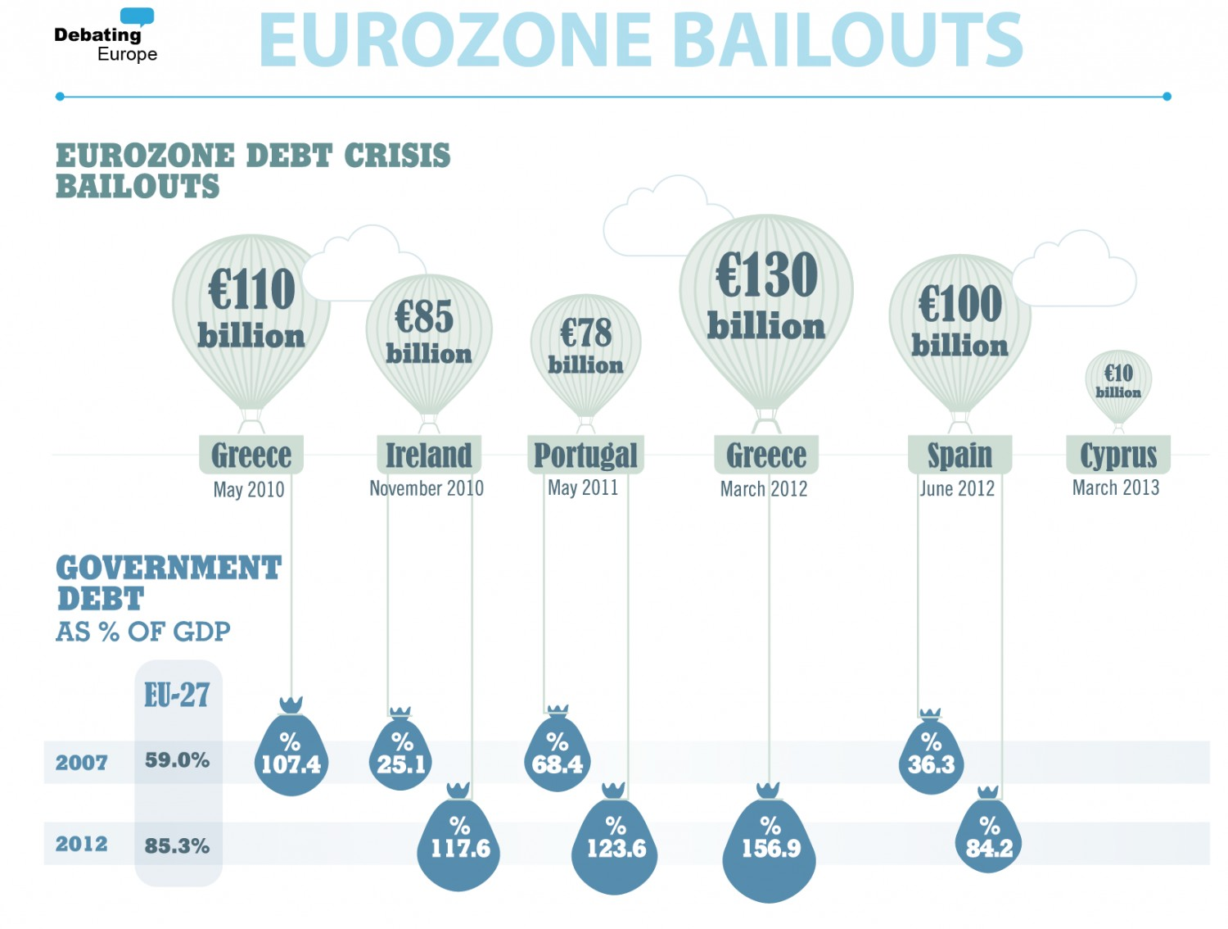
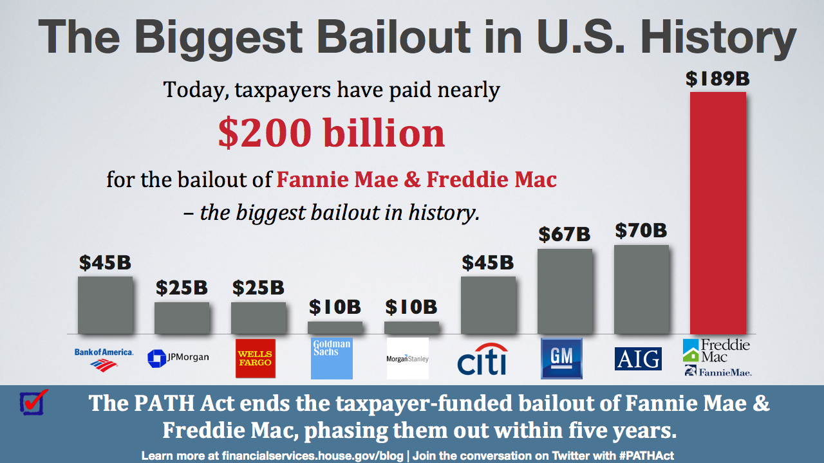
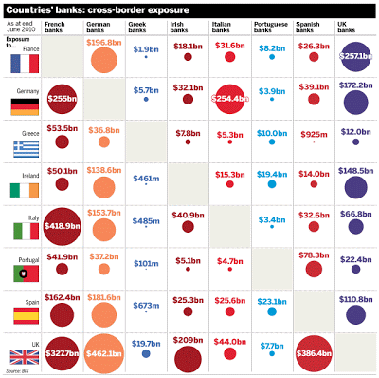
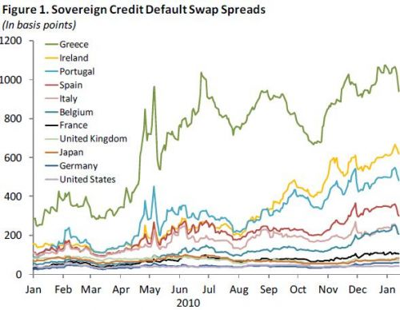
What Went Wrong with Basel II?
Bail Outs
Link Bank
&
Sovereign debt
Financial Instability
Procyclicality

Slide 9
Bail outs for European Banks: ~€600 billion euros
Capital-like Aid Instruments (billions of euro)
Year | 2008 | 2009 | 2010 | 2011 | 2012 | Total 2008-2012
Total Bailouts | 125.0 | 170.2 | 147.4 | 35.0 | 126.3 | 603.9
By Country:
Germany | 29.8 | 57.7 | 51.7 | 3.6 | 1.3 | 144.1
United Kingdom | 49.4 | 50.1 | 34.6 | 3.2 | 0.0 | 137.3
Spain | 0.0 | 1.3 | 12.4 | 8.5 | 66.0 | 88.1
Ireland | 0.0 | 11.0 | 37.9 | 16.5 | 0.0 | 65.4
Greece | 0.0 | 3.8 | 0.0 | 2.6 | 30.9 | 37.3
France | 13.2 | 10.5 | 0.0 | 0.0 | 2.6 | 26.2
Others | 32.6 | 35.9 | 11.0 | 0.5 | 25.4 | 105.4
Total Amount
€ 603.9 billion
Note: Total Approved Bailout amounts €1.43 trillion euros; Source: European Commission

Slide 10
Basel III: Fixing the shortcomings of Basel II
More Capital & Higher Quality
Clear definition of CET1, AT1 and T2
Increase in Capital Requirements
Systemic Risk & Interconectedness
G-SIB / D-SIB Buffers
Promoting use of CCP
Higher K Requirements for:
  Trading & Derivatives
  Complex Securitizations
  Off Balance Sheet (SPV’s)
  Inter-financial sector exposures
Addressing Procyclicality
Conservation Buffer
Countercyclical Buffer
Promoting Forward Looking Provisions

Slide 11
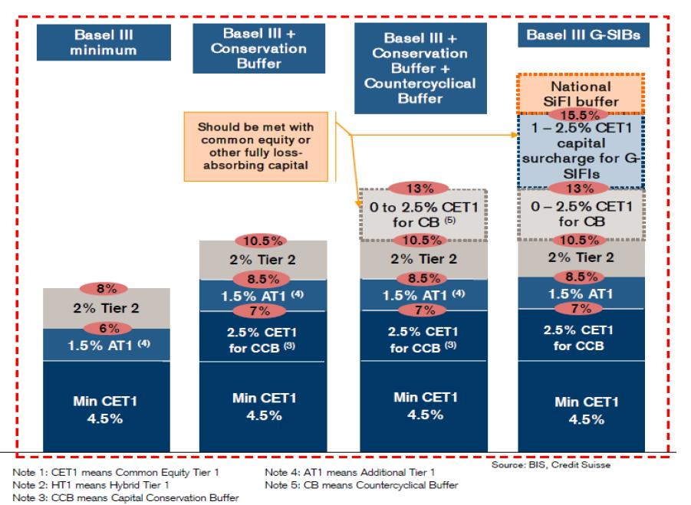
Basel III Solvency Framework

Slide 12
Basel III: Fixing the shortcomings of Basel II
Leverage Ratio
Simple Measure
Data include US and EU banks; Source: Reuters, FDIC

Slide 13
Basel III: Fixing the shortcomings of Basel II
Enhancing Risk Coverage
Basel 2.5:
  Trading Book & complex securitizations
  Stress VaR & IRC
Counterparty Credit Risk:
  stressed inputs
  Wrong Way Risk
CVA
Liquidity Ratios
LCR & NSFR

Slide 14
Basel III: Implementation Issues
1
2
3
CET1 Deductions:
  DTA
  Minority Interest
  Intangible Assets
AT1 & T2 Instruments
Write down vs Conversion
Triggers
Suitability of Investors
Phase Outs
Can Insurers buy AT1’s?
Issuance of CET1
Amount
Timing
Not funded
4
5
6
6
CVA for OTC Derivatives
Complex modelling
CVA Hedges
Pillar 2:
  Stress Testing
  Risk Data Aggregation
Addressing Systemic Risk:
Resolution Frameworks
Building Loss Absorption Capacity

Slide 15
Basel III: Impacts
Source: BIS

Slide 16
Basel III: Impacts
Data include US and EU banks; Source: Reuters, FDIC

Slide 17
Promoting Forward Looking Provisions: IFRS9
Probability
Standardized Approach
Expected Loss
99.9% percentile
 |  | Standardized Approach
1 | Adjustment of Specific Provisions | Specific provisions are netted from the exposure value
2 | Adjustment of General Provisions | General provisions recognized in TIER II up to 1.25% of credit risk RWA’s
Internal Models
To be covered by provisions
To be covered by capital
Accounting Provisions Less
than
Accounting Provisions More than
Expected Losses
Expected Losses
Expected loss
Unexpected loss
provisions
1
year expected
Tier II (Capped)
1
year expected loss amount
capital
loss amount
Accounting
Deduction CET1
provisions
Accounting provisions
- CET1

Slide 18
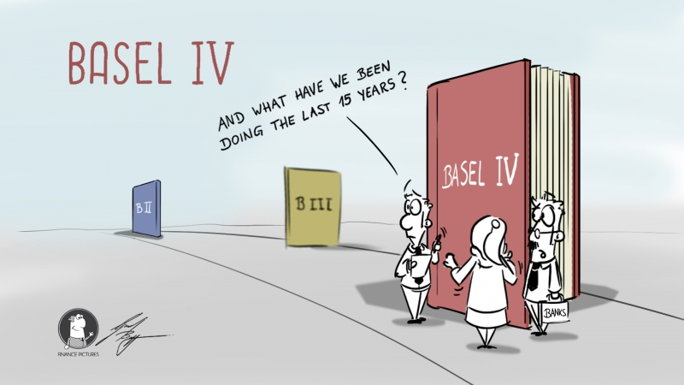
Finalizing Basel III => “Basel IV”

Slide 19
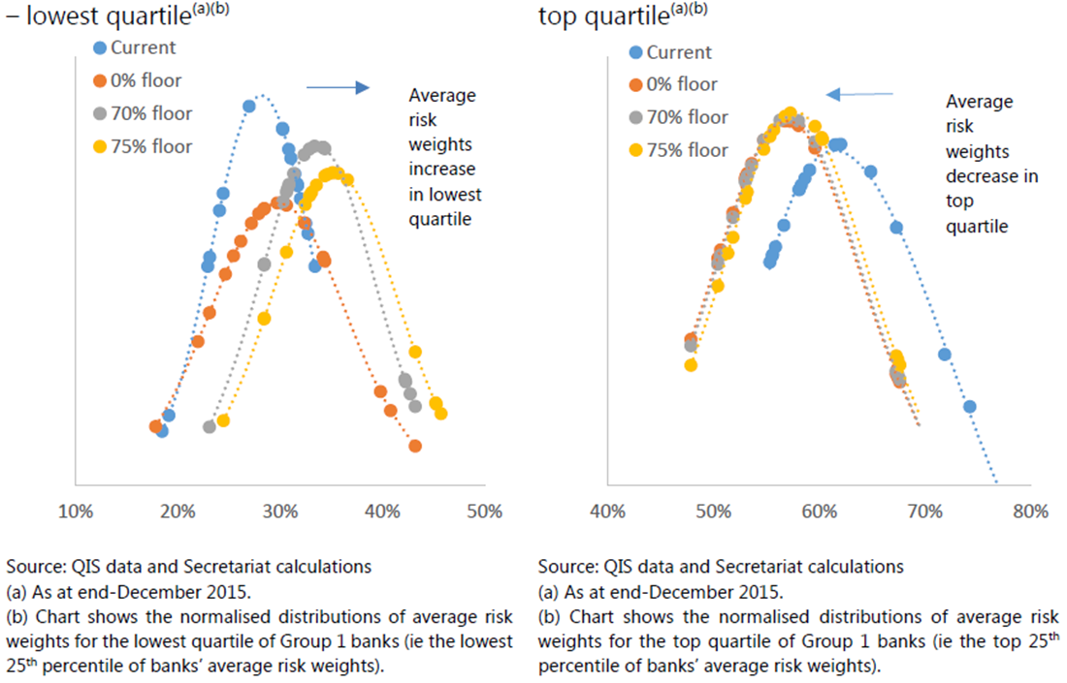

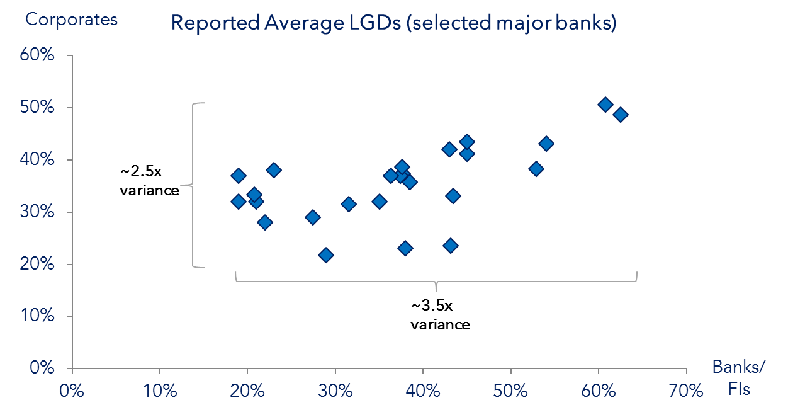
Objectives of Basel IV
Distribution of average risk weights Group 1 banks
Restore credibility in RWA calculation
Risk Sensitivity
Simplicity
Comparability
Average LGD’s for sample of major banks
With “no significant increase in capital requirements”… overall…

Slide 20



Overview of Basel IV Final Package
1
2
Credit Risk
Operational Risk
Credit Risk
Credit Risk
Standard Approach
Range of RW
Use of Ratings
Standard Approach SMA
Size & Loss History
National Discretions
Simple
Comparable
Risk Sensitive
Internal Model Approach *
Banks & FI
Large & Mid Corp
SME
Retail
Equities
AIRB
FIRB
Internal Model Approach
AMA
3
CVA
Credit Risk
Approaches
Internal Model
Standard
Basic
* Scaling factor 1.06 to be removed after output floor phase in.

Slide 21

Overview of Basel IV Final Package
4
5
Floors
Leverage Ratio
Credit Risk
Credit Risk
Input Floors
PD’s
LGD’s
AIRB
FIRB
Main Changes
Level:
“Exposure” definitions
Capital Distribution Constrains:
National Discretion:
Non G-SIB’s
G-SIB’s
3%
3% + 50% G-SIB Buffer
N/A
Mainly Derivatives
Output Floor
Level:
Scope:
Phase In
National Discretion:
72.5%
CET1 & Leverage Ratio
Exceptional & Temporary
Aggregated:
( Credit + Market + Operational )
6
2022
2027
Implementation
Credit Risk
50%
55%
60%
65%
70%
72.5%
Cap during Phase In
2022

Slide 22
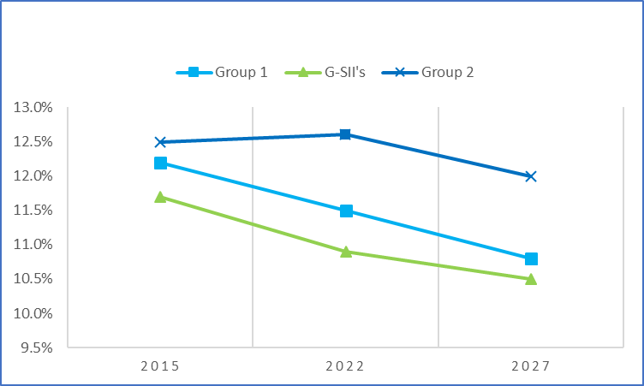
Overview of Basel IV Final Package: Impacts
Changes in T1 MRC at Target Level % (G20)
Risk-Weighted CET1 Capital Ratio % (Europe)
Changes in Tier 1 MRC¹ | Group 1² | Of whish: G-SIBs | Group 2 banks
Max | 52% | 43% | 37%
75th percentile | 13% | 17% | 5%
Median | 1% | 10% | 1%
25th percentile | (8%) | (9%) | (0%)
Min | (28%) | (28%) | (47%)
12,5%
12,6%
12,2%
12%
11,5%
1,1 Bn
11,7%
10,8%
16,4 Bn
10,9%
16,4 Bn
Minimum required Tier 1 capital at the target level combines risk-based as well as leverage ratio capital requirements and includes capital conservation buffers and G-SIB surcharges where applicable.
Group 1 banks are those that have a Tier 1 capital of more than €3bn and are internationally active. All other banks are considered Group 2 banks.
10,5%
Source: BCBS Basel III Monitoring Report
Source: EBA Ad hoc cumulative impact assessment of the Basel reform package
FRTB impacts are not included…..

Slide 23
Overview of Basel IV Final Package: Impacts
BCBS’ impact analysis showed a very moderate aggregate impact globally
On average, Group 1 banks’ Tier 1 capital levels will decrease by 50 bps, while Group 2 banks will increase by 380 bps1
Within the Group 1 banks, there is a wide dispersion of impacts:
  Maximum increase of 52%
  13% increase at the upper quartile
  7% reduction at the lower quartile
Banks incurring an increase in required capital, in aggregate, will need to raise €28bn and €92bn in CET1 and Total Capital respectively (Most capital shortfall from G-SIBs)
At the portfolio level, the variance in required capital under IRB versus SA is more pronounced
For example, the variance from the minimum to maximum in mortgage IRB risk weights as a proportion to mortgage SA risk weights for Group 1 banks is greater than 10 times
The application of the Output Floor will have an impact on bank’s portfolios once implemented

Slide 24
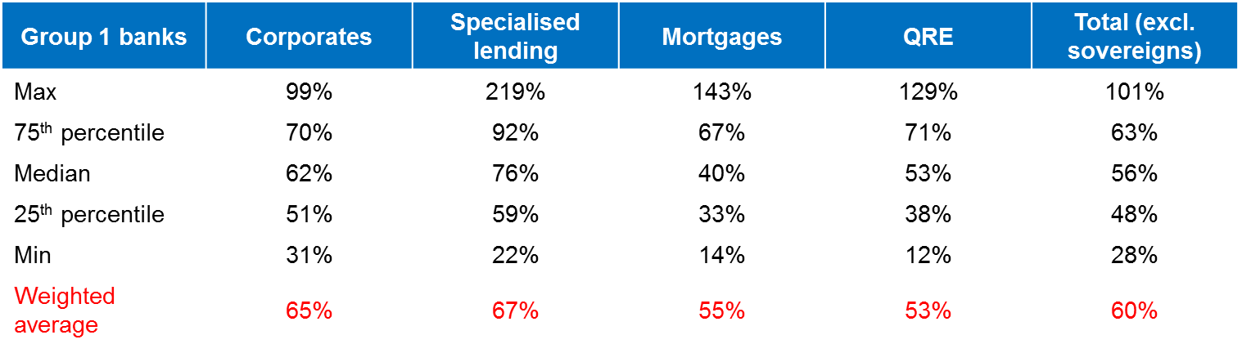
Overview of Basel IV Final Package: Impacts
Percentage of final IRB risk weights to final standardized approach risk weights
Output Floor
(Impacts)

Slide 25
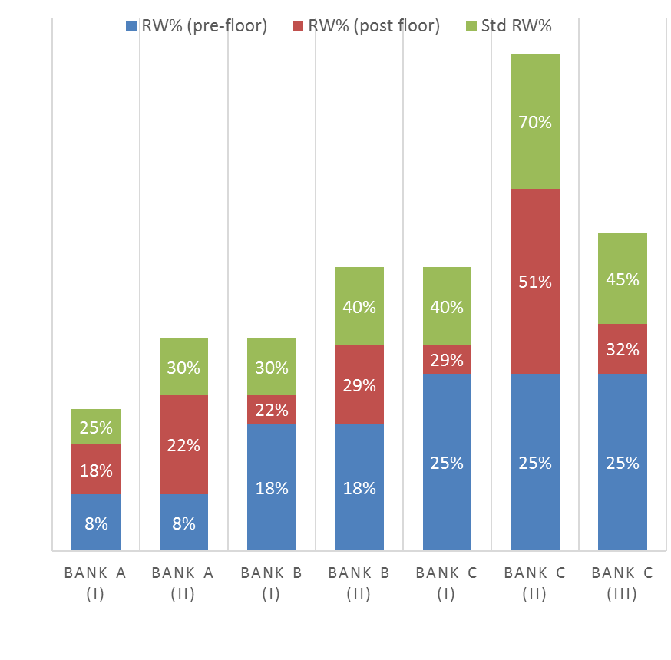
Overview of Basel IV Final Package: Impacts
The Output Floor will have materially different impacts on banks due to the characteristics of their mortgage exposures
All banks apply the same LGD
Bank A, B and C mortgage PDs are 0.25%, 0.75% and 1.25% respectively
Bank A(i) has mortgage LTV of 55%, versus Bank A(ii) of 80%
Bank B(i) has mortgage LTV of 65%, versus Bank B(ii) of 85%
Bank C(i) has mortgage LTV of 85%, versus Bank C(ii) and Bank C(iii) of >100%
Bank C(iii)’s supervisor has applied LTV splitting
Output Floor
(Mortgages)

Slide 26
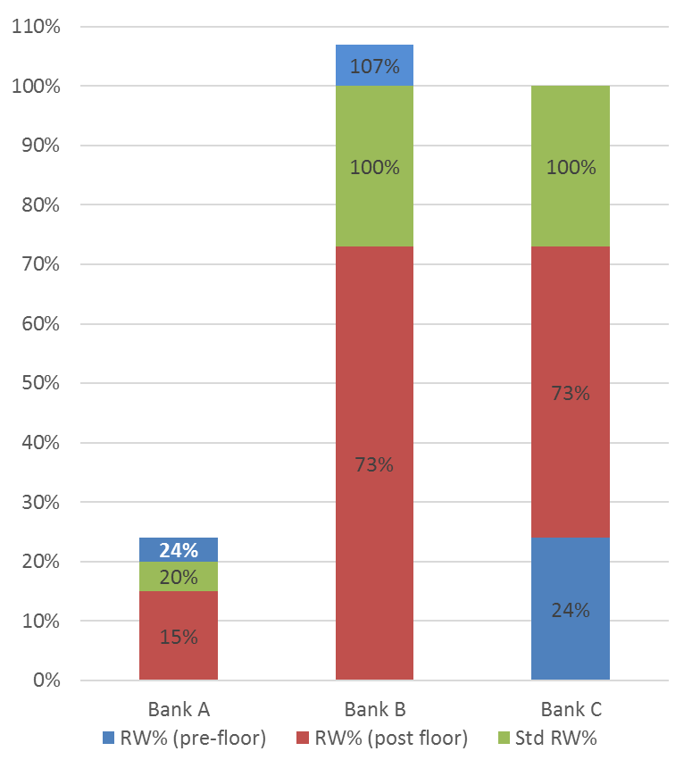
Overview of Basel IV Final Package: Impacts
Output Floor will materially impact unrated corporate exposures despite having investment grade status
All banks’ corporate exposures are unsecured
Bank A lends to a corporate with PD ~0.1% and S&P credit rating of AA (high investment grade)
Bank B lends to a corporate with PD ~2.5% and S&P credit rating of BB+ (sub-investment grade)
Bank C lends to a corporate with the same PD as Bank A’s exposure, however is not externally rated
Output Floor
(Corporates)

Slide 27





Basel IV: Wins & Worries
Wins:
Watering down initial proposals
Long Implementation
Worries:
Less risk sensitivity
Implementation: Level playing field, fragmentation & Unintended consequences
Big picture: IFRS9/CECL, Sovereigns, Pillar II, etc
Wins:
Level of Output floor and phase in
Still Internal Models
Worries:
Implementation in EU:
  Mortgages in SA & IRB
  Specialized Lending
  Unrated corporates
  Equities under SA only
  Op Risk
Wins:
Output floor
Less Internal Models
Delay FRTB
Worries:
Market risk implementation
Future of Internal Models in USA
Wins:
N/A
Worries:
Reduces development of capital markets
SA penalizes trade finance, corporates and hedging

Slide 28
Going Forward: For Emerging Markets…
Trade Finance:
  Banks/Financials & Large Corporates: IRB FIRB-SA
  SA does not fully recognize the underlying risk profile for banks and large corporates.
  SA penalize all off balance sheet exposures.

Slide 29
Going Forward: For Emerging Markets…
Corporate Borrowing:
  Large corporates & their subsidiaries: IRB FIRB-SA
  SA: unrated counterparties get 100% RW.
  Smaller corporates and SME’s: still allowed to IRB, but impact through the floors.
  Loans in foreign currency: 150% RW

Slide 30
Going Forward: For Emerging Markets…
Infrastructures:
  Normally financed with a project finance: IRB SA
  This approach uses a slotting criterion that is not risk sensitive.

Slide 31

Open Issues Basel IV
Specialized Lending
Untouched in Basel III, but under discussion…
Market Risk
Implementation postponed until 2022
Main discussions on:
  Large gap Internal Models vs Standard
  P&L Attribution Test: Cliff effect
  Non-modelable risk factors
  Default risk charge
Basel III
AIRB
FIRB
Slotting
Slotting
Sovereign Risk
“Sovereigns” untouched in Basel III
“Discussion Paper” published:
  Pillar I: SA vs IRB vs FIRB
  Concentration risk
  Pillar II: Stress testing, monitoring
  Pillar III: further disclosures
IFRS9/CECL
Pending proposal for long term treatment of provisions in the capital framework
Concerns:
  Procyclicality
  Overlapping / Time horizon
Other Issues:

Slide 32
Conclusions
Basel III & IV: Opportunity & Challenge
1
2
Not Cheap: Capital & Implementation Cost
3
Complex: Strategic decisions / Models / Provisions / Stress Testing / Resolution / Supervision / Pillar II / Governance / Compliance / Reporting
4
Impacts in the Real Economy
Enhanced Accountability for Top Management: Governance & Risk Data Aggregation are key
5

