Slide 1

IFRS9: challenges ahead
Speaker: Manuel Pérez de Castro

Slide 2

The information and views set out in this presentation are those of the author, and do not necessarily reflect the official opinion of Grupo Santander. Responsibility for this information and views lies entirely with the author

Slide 3

Index
1. IFRS9 in a nutshell: recap
2. First time application: low impact?
3. Implementation costs and the modelling lifecycle
4. What’s next? Challenges ahead
5. Conclusions and Q&A

Slide 4
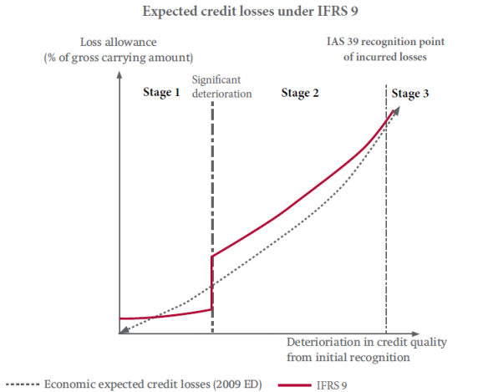
1. IFRS9 in a nutshell: recap
Motivation
‘…too little, too late…’
“…strengthen accounting recognition of loan-loss provisions by incorporating a broader range of credit information…”
DECLARATION ON STRENGTHENING THE FINANCIAL SYSTEM –
LONDON SUMMIT, 2 APRIL 2009

Slide 5

1. IFRS9 in a nutshell: recap
Motivation: in IAS39…
‘Known’ past events
12m Incurred losses
I know 5% of my customers have become unemployed and this will result in future losses
+1Y
t
Today
I still don’t know it, but 2% of my customers have lost their job and will cause me losses
On average, 3% of my customers lose their job in the next year, resulting in losses for the entity
‘Unknown’ past events
IBNR
Future events
Stylized example, not exhaustive

Slide 6
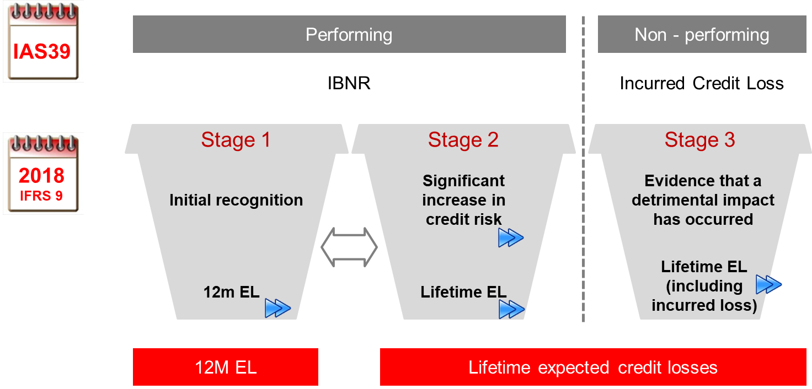

1. IFRS9 in a nutshell: recap
Motivation: under IFRS9…
Includes forward looking information

Slide 7
1. IFRS9 in a nutshell: recap
Motivation
‘…too much, too early…?’

Slide 8
Index
1. IFRS9 in a nutshell: recap
2. First time application: low impact?
3. Implementation costs and the modelling lifecycle
4. What’s next? Challenges ahead
5. Conclusions and Q&A

Slide 9
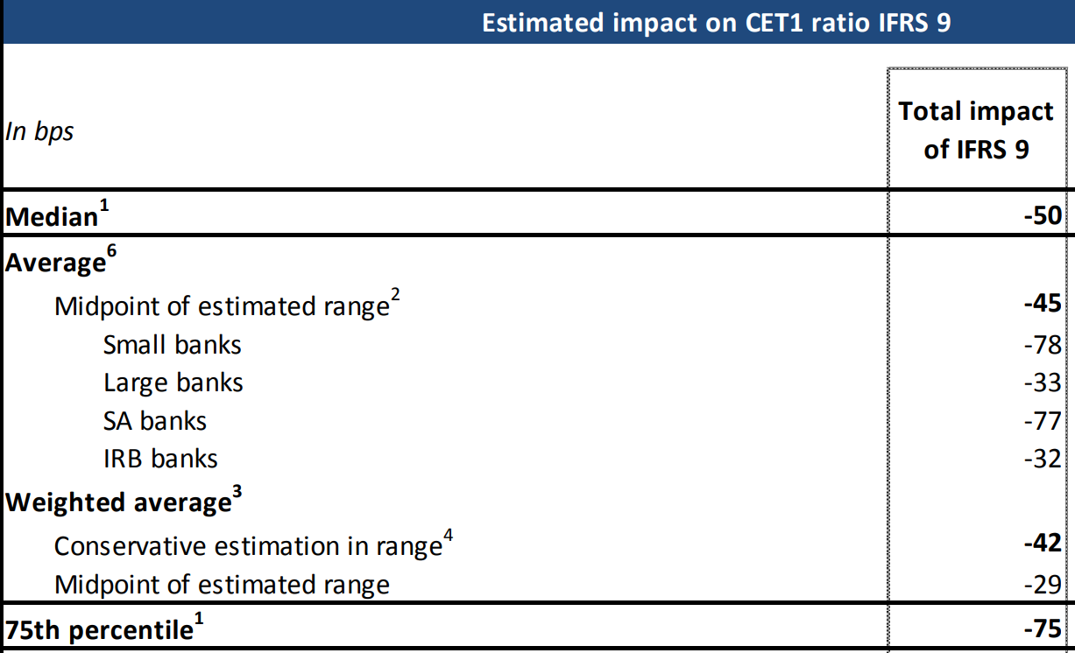
2. First time application: low impact?
Sample of banks
Realized…
Expected…
Source: EBA report on results form the second EBA impact assessment of IFRS9, April 2017
Source: entities’ financial reports and Moody’s ‘report, April 2018

Slide 10
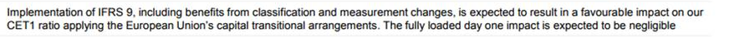

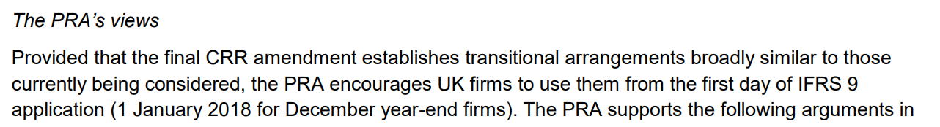

2. First time application: low impact?
Sample of banks
But then… why would a bank with negligible impact use transitional arrangements?
Source: HSBC results presentation, 4Q17
And… why would a supervisor recommend it?
Source: ‘Dear CEO’ letter

Slide 11
Index
1. IFRS9 in a nutshell: recap
2. First time application: low impact?
3. Implementation costs and the modelling lifecycle
4. What’s next? Challenges ahead
5. Conclusions and Q&A

Slide 12
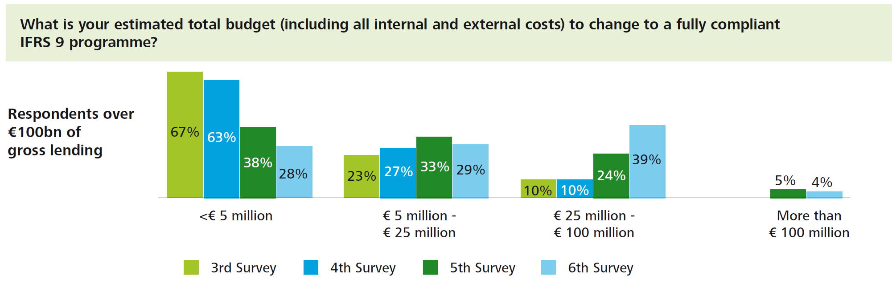

3. Implementation costs and the modelling lifecycle
Costs
IFRS9 programme has involved relevant costs for the industry…
Source: extract from Deloitte’s ‘Sixth Global IFRS Banking Survey’, 2016

Slide 13



3. Implementation costs and the modelling lifecycle
Costs
…and not only economic costs
Over 200 people involved in our main geographies
More than 50 Corporate training sessions
More than 245 internal policies and guidelines produced/reviewed
Source: internal estimates

Slide 14
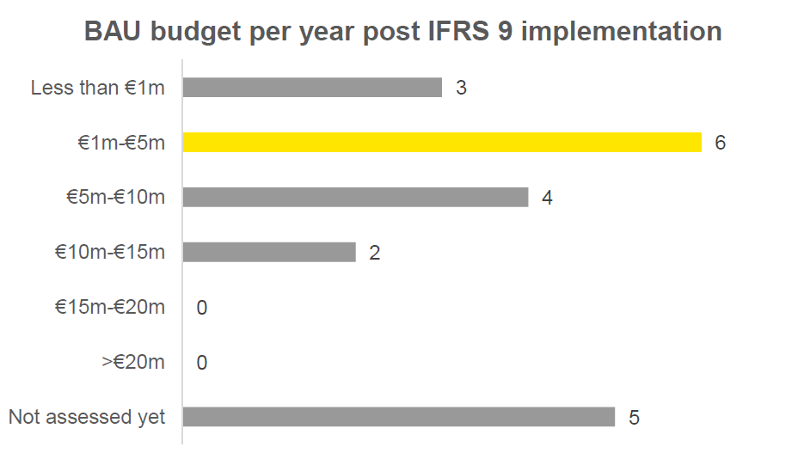
3. Implementation costs and the modelling lifecycle
Costs
And it is not over yet
Source: extracts from ‘EY IFRS 9 Banking Survey’, 2018

Slide 15

3. Implementation costs and the modelling lifecycle
Costs
Are these costs worth it?

Slide 16
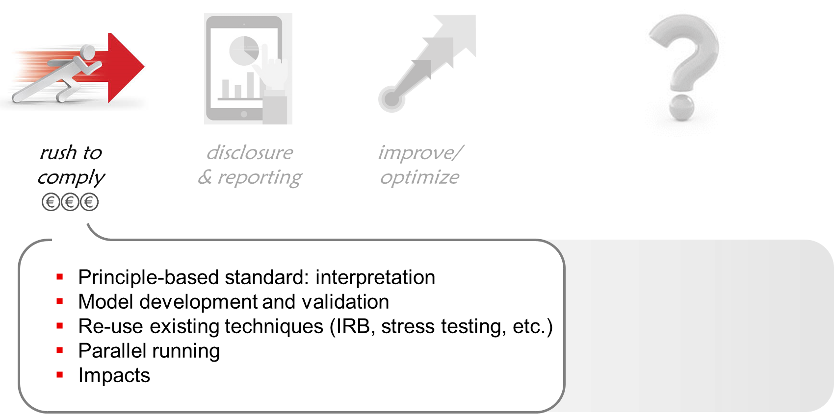
3. Implementation costs and the modelling lifecycle
The modelling lifecycle

Slide 17
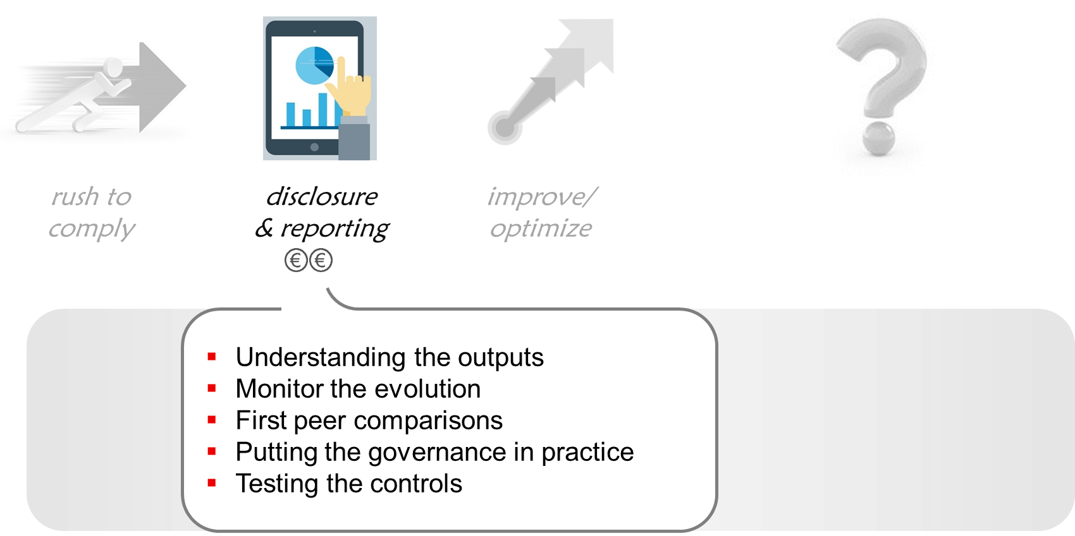
3. Implementation costs and the modelling lifecycle
The modelling lifecycle

Slide 18
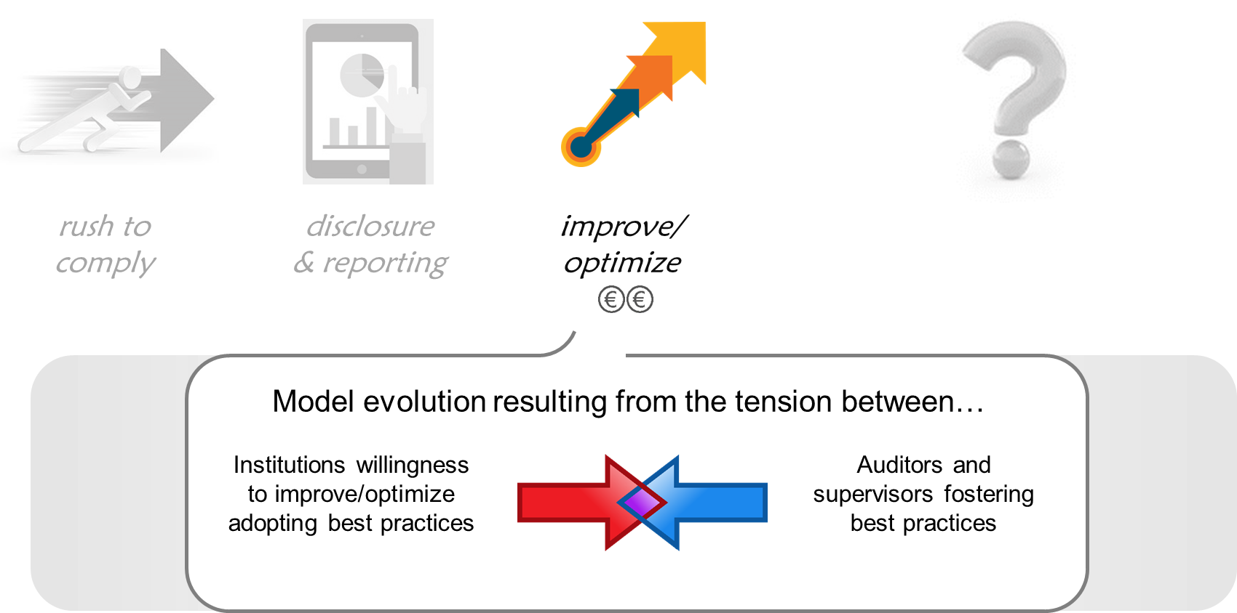
3. Implementation costs and the modelling lifecycle
The modelling lifecycle

Slide 19

3. Implementation costs and the modelling lifecycle
The modelling lifecycle

Slide 20
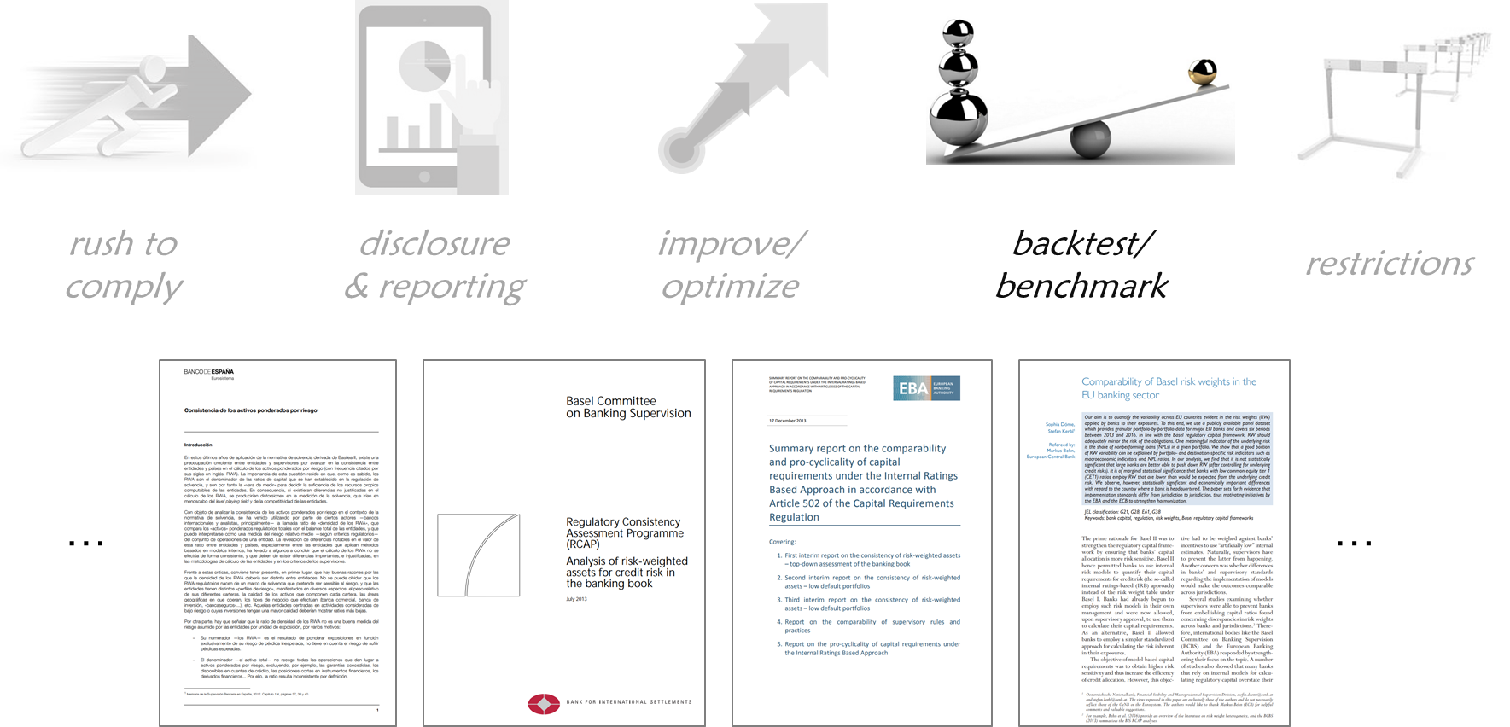
3. Implementation costs and the modelling lifecycle
The modelling lifecycle

Slide 21
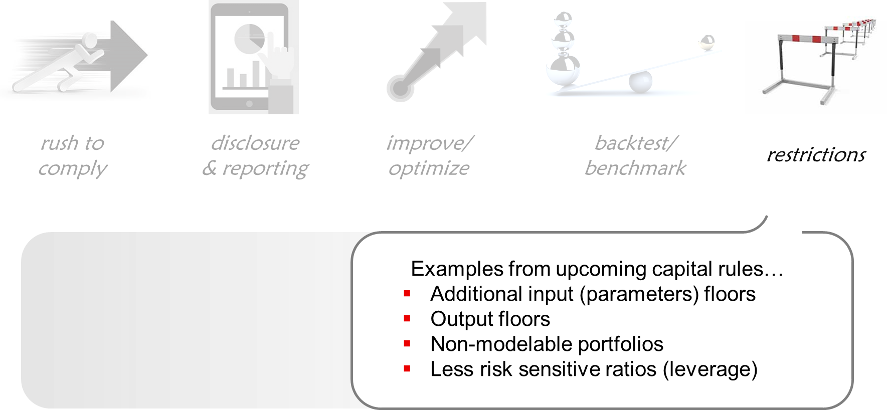
3. Implementation costs and the modelling lifecycle
The modelling lifecycle

Slide 22
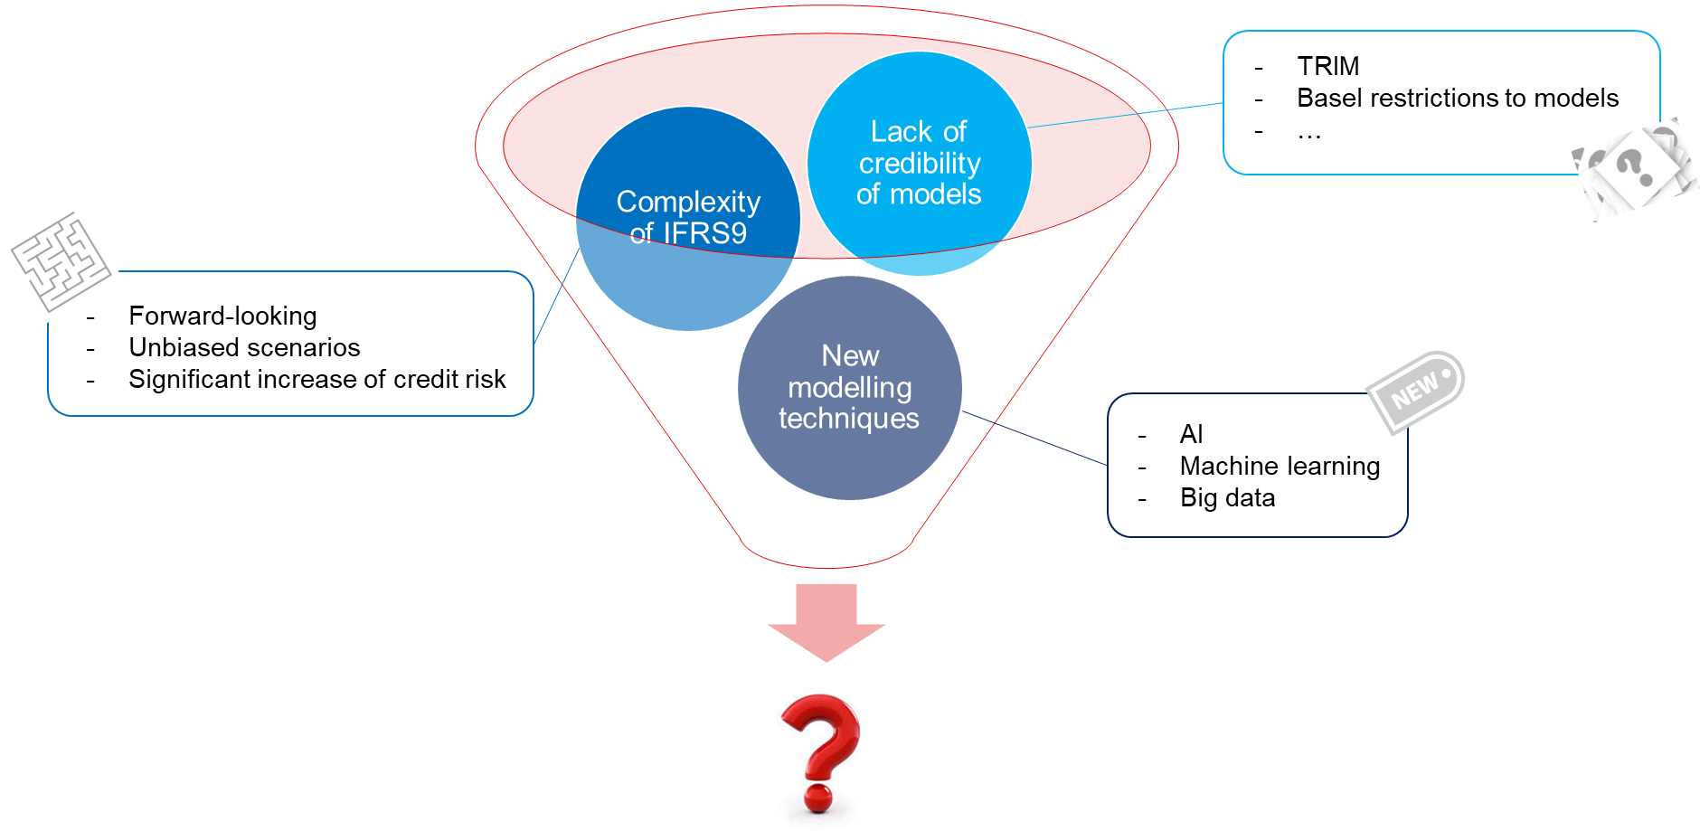
3. Implementation costs and the modelling lifecycle
The modelling lifecycle
A challenging landscape for modelling

Slide 23
Index
1. IFRS9 in a nutshell: recap
2. First time application: low impact?
3. Implementation costs and the modelling lifecycle
4. What’s next? Challenges ahead
5. Conclusions and Q&A

Slide 24



4. What’next? Challenges ahead
Disclosure
Global-local balance
IFRS9 BAU
challenges
Governance and control
Forecasting and backtesting
Side effects

Slide 25
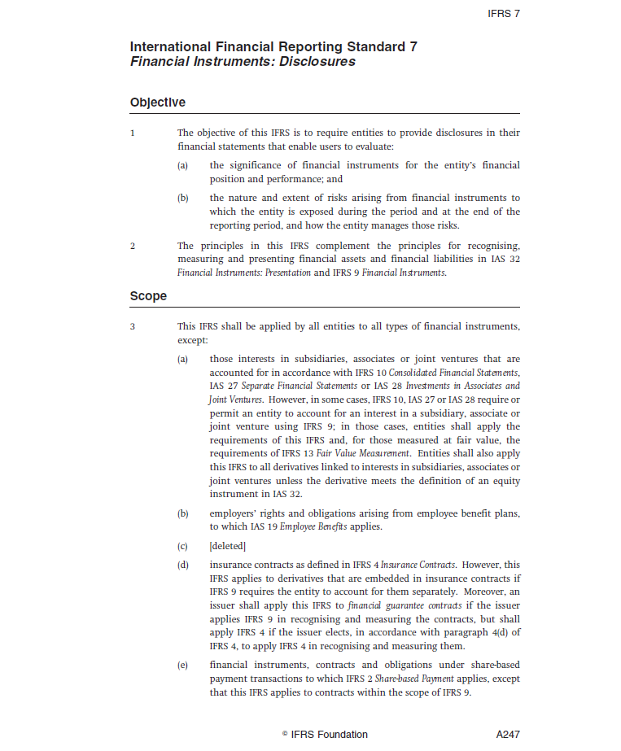
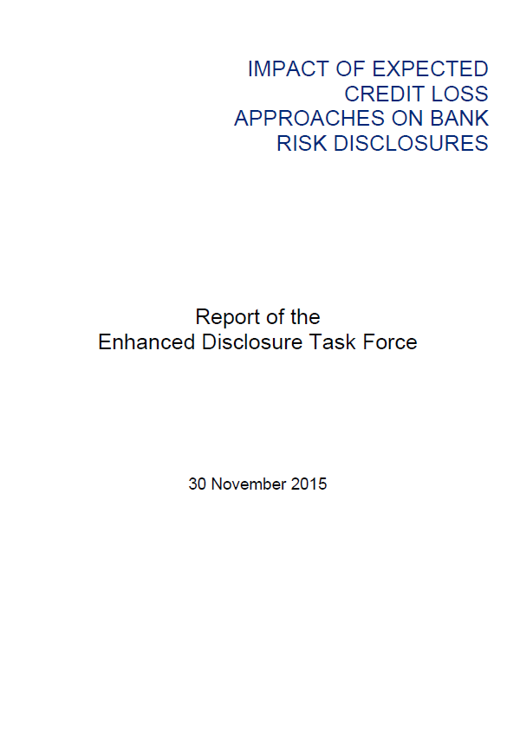
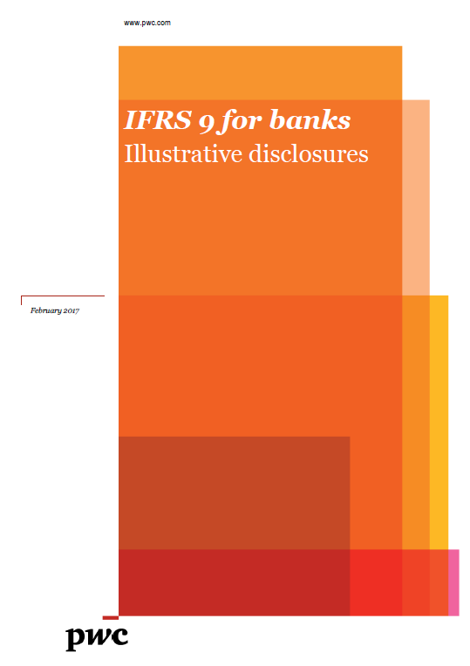
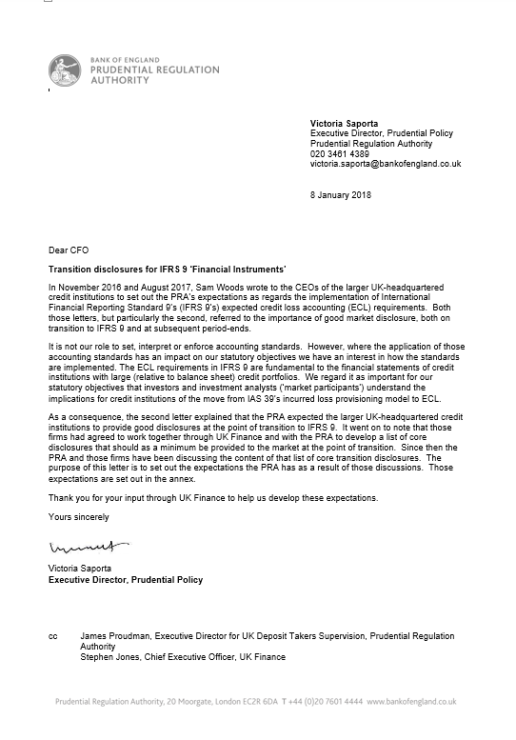
4. What’next? Challenges ahead
Disclosure: increasing pressure from standard enforcers
Guidance and best practices
IFRS7 + IAS34
EDTF
Enhanced Disclosures Task Force
PwC
PriceWaterhouseCoopers
PRA
‘Dear CFO’ expectations

Slide 26
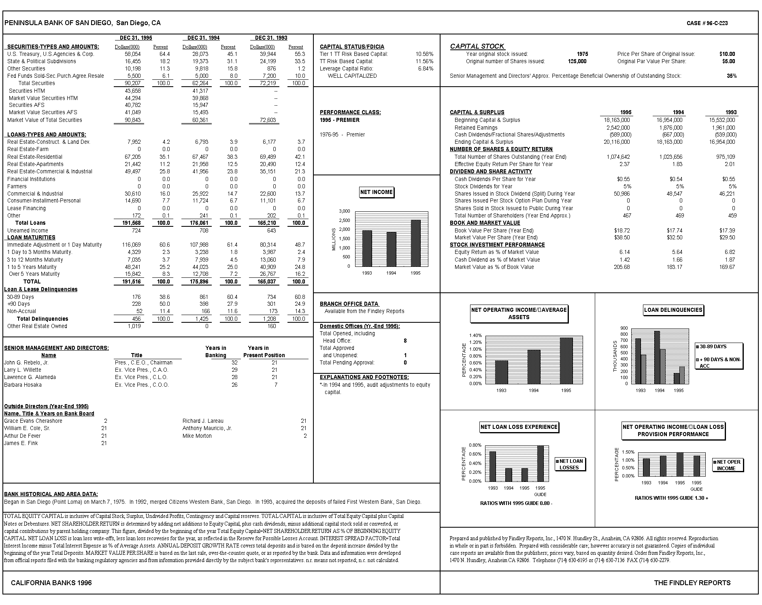
4. What’next? Challenges ahead
Disclosure: are we ready to understand disclosure?
Month | Stage 1 | Stage 2 | Stage 3
January Coverage Ratio | 1% | 6% | 40%
Sample bank ABC
Nothing changes in ABC
bank but the quality of the assets
-No model update
-No scenario update
-No criteria update
-No new assets
Month | Stage 1 | Stage 2 | Stage 3
February Coverage Ratio | 1.53% | 7% | 40%

Slide 27
4. What’next? Challenges ahead
Disclosure: are we ready to understand disclosure?
Month | Stage 1 | Stage 2 | Stage 3
January Coverage Ratio | 1% | 6% | 40%
Sample bank ABC
Nothing changes in ABC
bank but the quality of the assets
-No model update
-No scenario update
-No criteria update
-No new assets
Month | Stage 1 | Stage 2 | Stage 3
February Coverage Ratio | 1.53% | 7% | 40%
Decreasing credit quality?

Slide 28
4. What’next? Challenges ahead
Disclosure: are we ready to understand disclosure?
Month | Stage 1 | Stage 2 | Stage 3
January Assets Detail
Asset 3
1,000,000 €Bn EL: 4%
Asset 4
1,000,000 €Bn EL: 7%
Asset 1
1,000,000 €Bn EL: 1.2%
Asset 2
1,000,000 €Bn EL: 0.8%
Asset 6
1,000,000 €Bn EL: 40%
Asset 5
1,000,000 €Bn EL: 7%
Month | Stage 1 | Stage 2 | Stage 3
February Assets Detail
Asset 1
1,000,000 €Bn EL: 1.2%
Asset 2
1,000,000 €Bn EL: 0.8%
Asset 4
1,000,000 €Bn EL: 7%
Asset 5
1,000,000 €Bn EL: 7%
Asset 6
1,000,000 €Bn EL: 40%
Asset 3
1,000,000 €Bn EL: 2.6%
Increasing credit quality!

Slide 29


4. What’next? Challenges ahead
Disclosure
Important to strike the right (and timely) balance between…
MINIMUM DISCLOSURE
EXTENSIVE DISCLOSURE
Progressive disclosure adapted to market preparedness
Perceived by external stakeholders as a sign of healthy and transparent implementation
Pressure from investors and analysts
Potential misunderstood information

Slide 30
4. What’next? Challenges ahead
Disclosure
Global-local balance
IFRS9 BAU
challenges
Governance and control
Forecasting and backtesting
Side effects

Slide 31

4. What’next? Challenges ahead
Global-local balance
Equilibrium in three axis
IFRS9
Local GAAP
IFRS9 ‘standard’
IFRS9 ‘tropical’
IFRS9 centralized
IFRS9 decentralized

Slide 32
4. What’next? Challenges ahead
Disclosure
Global-local balance
IFRS9 BAU
challenges
Governance and control
Forecasting and backtesting
Side effects

Slide 33


4. What’next? Challenges ahead
Forecasting and bakctesting
BACKTESTING
FORECASTING
What and how backtest?
Expected loss backtest?
Regulatory exercises: ICAAP / ST
Budget and PXX
Month-end estimate

Slide 34
4. Consensus VS Insight
Main challenges of a scenario framework
0 of 62
Number of recessions accurately predicted by economists in 2008 and 2009
Source: “Can economists forecast recessions? Some evidence from the Great Recession”, Hites Ahir and Prakash Loungani, 2014

Slide 35
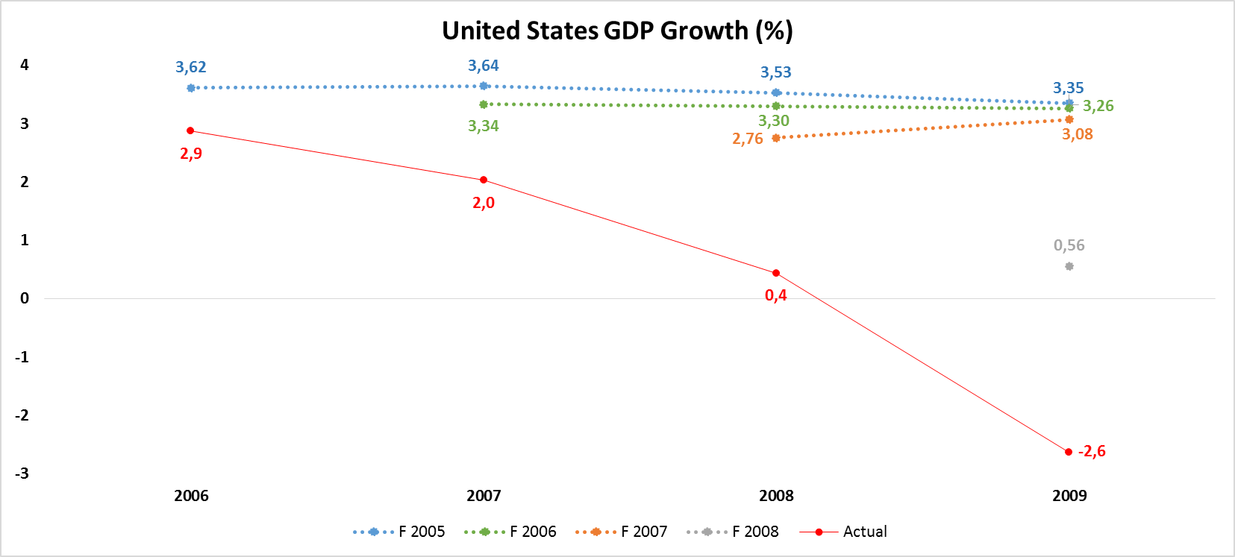
4. Consensus VS Insight
Main challenges of a scenario framework
IMF estimates of US GDP before the 2008 crisis
2006
2007
2008
2009
Source: elaborated from IMF World Economic Outlook reports

Slide 36
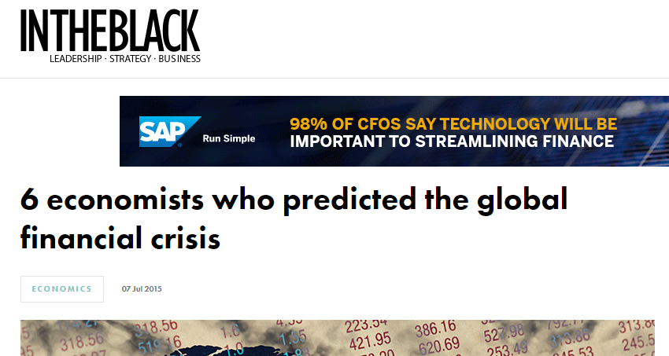
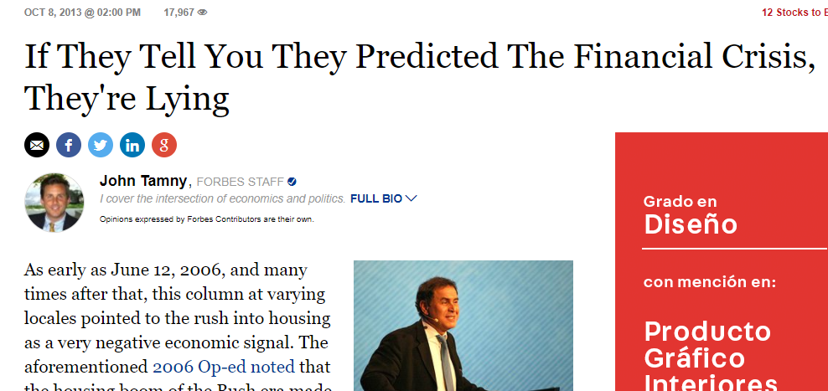
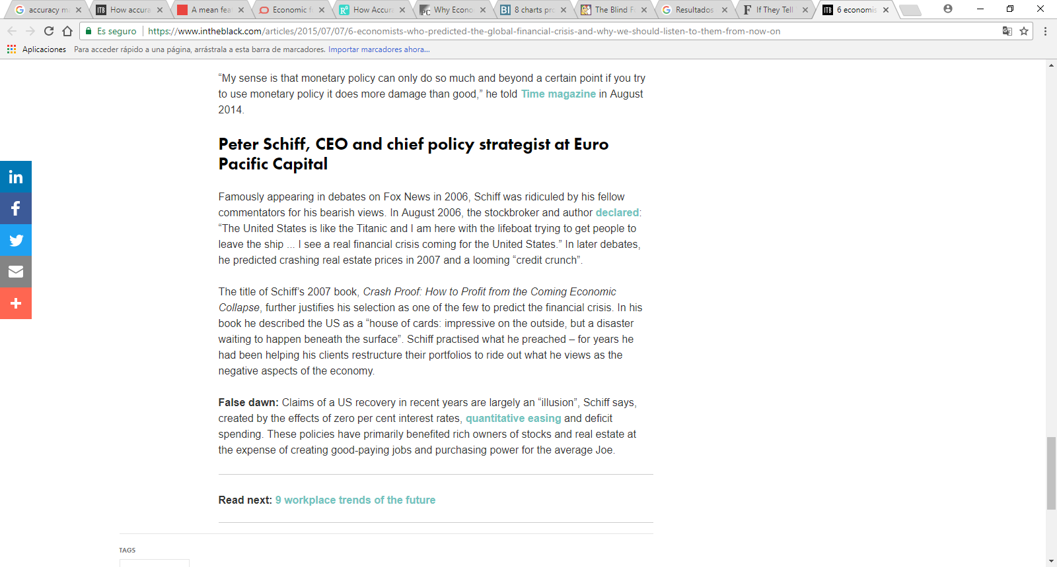
4. Consensus VS Insight
Main challenges of a scenario framework
Potential issues going against consensus
External audit concerns signing accounts
Supervisory add-ons in capital
Investors mistrust
In-house questioning
Being ridiculed in media?

Slide 37
4. What’next? Challenges ahead
Disclosure
Global-local balance
IFRS9 BAU
challenges
Governance and control
Forecasting and backtesting
Side effects

Slide 38

4. What’next? Challenges ahead
Side effects
But shouldn’t losses be independent of the accounting regime?
“As an accounting change, IFRS 9 should logically have no impact on the economics of banks, or on their fundamental creditworthiness.”

Slide 39

4. What’next? Challenges ahead
Side effects: procyclicality
Is IFRS9 more or less procyclical than IAS39? An accounting standard is more procyclical if…
(choose one definition)
…it requires more provisions in the worst moment of the economic cycle”?
OR…
…it reinforces mechanisms through which the financial system can amplify business fluctuations and possibly cause or exacerbate financial instability”* ?
* Adapted from FSF (2008)

Slide 40

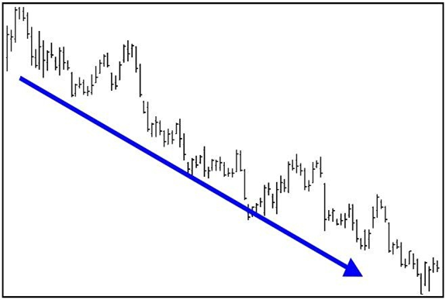



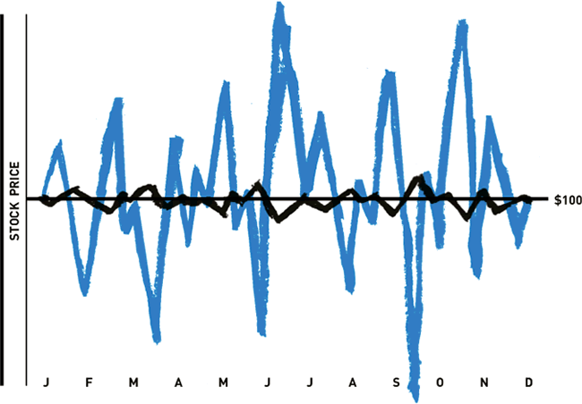
4. What’next? Challenges ahead
Side effects: procyclicality
IFRS9 stock of provisions
K
At the beginning of a potential crisis, outlook might be both:
-Bearish
-Uncertain
Adverse scenarios will be over weighted
IFRS9 will require more provisions
Less available regulatory capital
Banks might protect their ability to comply with capital ratios in a volatile environment by cutting lending
More impact in stress test
Higher P2G expectations
+ stage 2 cliff effect!
Uncertainty will produce volatile forecasts…
…and more volatile provisions
PROCYCLICAL FEEDBACK!

Slide 41
4. What’next? Challenges ahead
Disclosure
Global-local balance
IFRS9 BAU
challenges
Governance and control
Forecasting and backtesting
Side effects

Slide 42

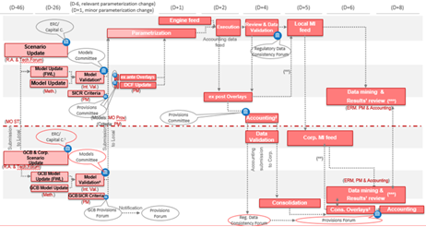
4. What’next? Challenges ahead
Governance and control
Ain’t an easy workflow…
Under the scrutiny of…
Internal audit
External auditors
Supervisors
…

Slide 43
Index
1. IFRS9 in a nutshell: recap
2. First time application: low impact?
3. Implementation costs and the modelling lifecycle
4. What’s next? Challenges ahead
5. Conclusions and Q&A

Slide 44


5. Conclusions and Q&A
Wrapping-up
Now you have to decide between…
OR…

Slide 45
Appendix

