Slide 1

Professor Moorad Choudhry
Strategic ALM and the Balance Sheet: The Future of Best-Practice Bank Risk Management

Slide 2
The market enviroment
The market environment is creating a three-dimensional optimisation challenge for banks…
…or at least, banks that are serious about competing and serious about being well-respected by customers and peers alike.
“Balance sheet optimisation” is no longer what it used to mean pre-crash: basically doing what one needs to do to make more money / higher RoC.
Today it has to mean structuring the balance sheet to meet - equally - the competing needs of Regulators, Customers and Shareholders.
This is the “3D” challenge.
But first, an interlude…

Slide 3

Let’s remind ourselves…
When looking at all the regulation that has been implemented since 2008, perhaps culminating not so much with Basel III but with the UK’s SMR regime, we should remember that it wasn’t as if prior to 2008 banks operated in a lawless “Wild West” environment.
All failed banks, from the biggest to the smallest, had more or less the same committees and governance structures in place that they do now. All of their committees operated, at least theoretically, under strict and in-depth Terms of Reference that laid out committee structure, responsibilities, lines of control and accountabilities.

Slide 4
Let’s remind ourselves…
It didn’t matter in which continent the bank headquarters was located, all banks were run more or less run on similar lines when it came to governance and ALM – theoretically in any case.
And yet in every country affected by 2007-2008, some banks failed while others didn’t. This should be the first indication that what “good” looks like in a bank isn’t simply “what the regulator requires us to do”, or what the bank has written on the wall in Head Office as its Mission Statement. There’s a bit more to it than that…
The future of bank risk management has to revolve around two things: culture, and the balance sheet…

Slide 5
What good looks like…
Imagine a world where financial institutions weren’t regulated…what would good look like then?
Culture would play the dominant role, and it’s much more likely that banks that had a genuine interest in ensuring sustained success and viability would look after their customers at least as well as they serviced the needs of shareholders and employees.
In an unregulated world, the answer to this question would focus on the reality of the operating environment, rather than the theory (or simply saying what sounds right).

Slide 6
What good looks like…
Good governance would be less about the terms of reference of the Board committees, the bank’s governance structure and three lines of defence, and more about the fact that all employees are risk managers at their banks, and that all employees should be the first and last line of defence when it comes to good conduct principles.
Yes, compliance with Basel III rules is very important, and yes robust balance sheet management and stewardship of capital and liquidity are essential pre-requisites of a well-run bank. But these are minimum requirements, not a reflection of best-practice.

Slide 7
More interludes…
What is “Asset-Liability Management”?
And how might implementing “Basel III” in any jurisdiction – beyond the obvious “more capital and liquidity buffers” – impact the ALM discipline?
….

Slide 8
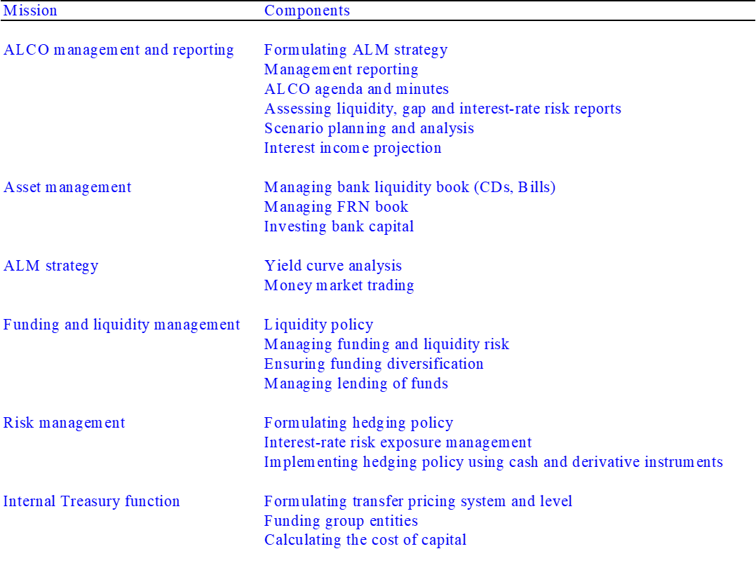
Traditional ALM and ALCO approach
Source: Choudhry (2007)

Slide 9
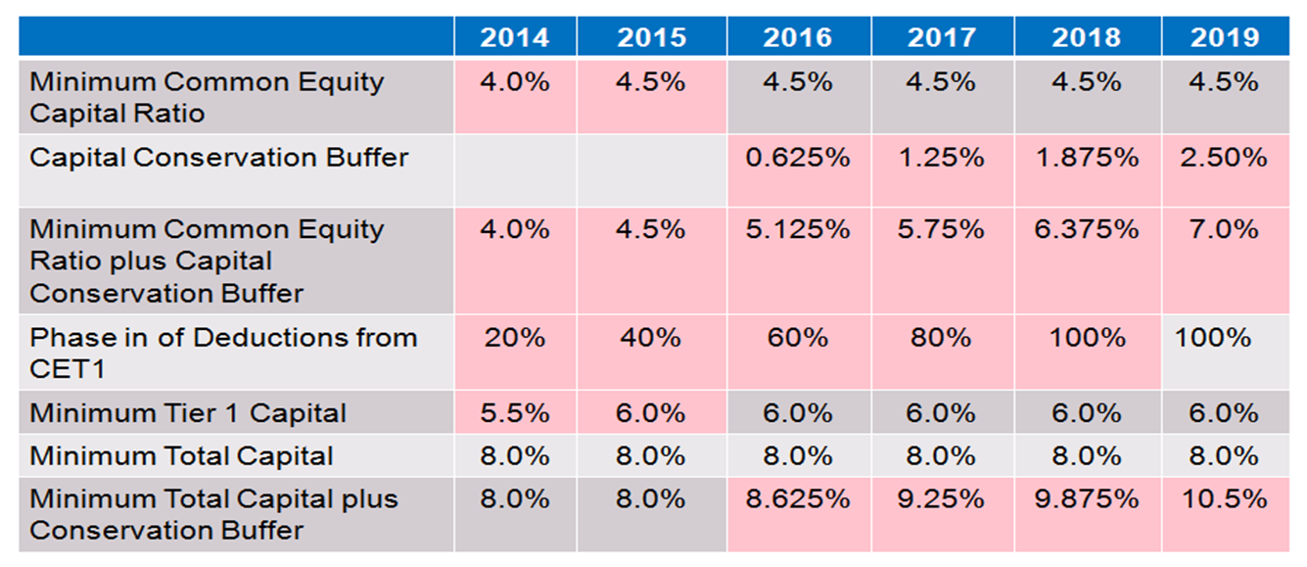
Capital Ratio Changes and Additional Buffers
PRA implemented changes to Deductions from 1 January 2014 without a transition period
Table excludes Counter-cyclical Buffer and Systemic Risk Buffer, plus regulator’s “Add-on”

Slide 10
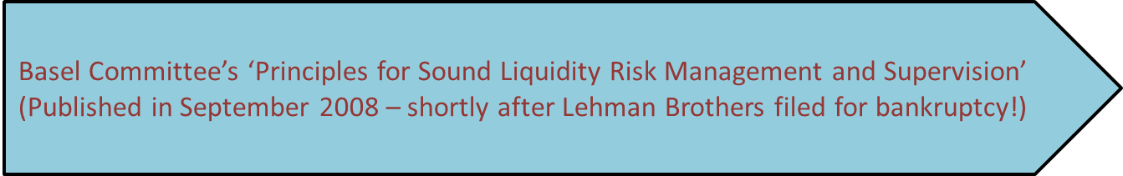

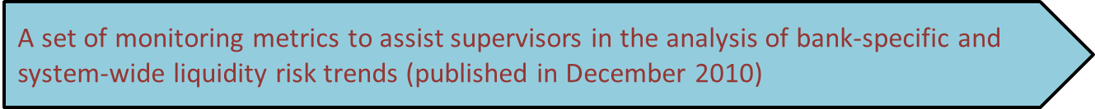
BCBS Liquidity Rules
The Basel Committee has adopted a three pronged approach to address the weaknesses in bank liquidity management that were evident during the financial crisis:
And again there is the regulator’s “Pillar 2” liquidity add-on…

Slide 11
Cost of Basel 3 Implementation
System changes- amendments to existing calculations
New Policies, e.g., HR on Remuneration
Reporting infrastructure, e.g., COREP
Restructure of capital instruments – inc. legal input on compliance
Data quality improvement
QIS Calibration studies
Programme Management/
Co-ordination
System Changes – New Calculations, e.g., CVA Charge
Training and Education

Slide 12
Mitigating the Impacts of Basel 3
Increase Resources to Achieve Compliance
Decrease Risk
Re-Design Customer Offering
Manage Balance Sheets more efficiently
Adopt more sophisticated calculation methodologies (Standardised to Advanced)
Hedging (e.g., CDS)
Exit business lines that are no longer viable
Restructure transactions with customers
Re-design products
Review product pricing
Exit business lines
Restructure and/or Collapse legal entities
Improve data collection processes
Increase holdings of Liquid Assets
Increase Capital

Slide 13
ALM and “Strategic ALM”
The first formal reference to “asset-liability management” as a balance sheet risk management discipline in banks dates from the early 1970s.
Like banking generally, it hasn’t changed much since then (ignore pseudo-scientific product development, “rocket science” and growth in balance sheet size).
But if we wish to optimise the balance sheet to meet the needs – equally – of all three of the bank’s stakeholders, the approach to ALM has to change.

Slide 14
Strategic ALM and Risk Management
A single, integrated approach that ties in asset origination with liabilities raising. The two parts of the business process (assets and liabilities) are integrated and aligned.
No more “silo’d” organization.
A business strategy approach at the bank-wide level driven by balance sheet ALM considerations.
Asset type is relevant and appropriate to funding type and source…
….and funding type and source is appropriate to asset type

Slide 15
Strategic ALM and Risk Management
An explicit, articulated liabilities strategy that looks to optimise the funding mix and align to asset origination.
A high-level, strategic discipline driven from the top down…
It addresses the 3D optimisation problem:
    - Regulator requirements
    - Customer franchise requirements
    - Shareholder requirements

Slide 16
Which means…
Proactive balance sheet management (BSM)…
…not the “reactive” balance sheet management philosophy of traditional banking practice.
Consider the process by which ALM is undertaken at banks…
  - Business lines – which at the large banks are many and varied and geographically dispersed – go out and originate business according to a supposed high level strategy that is often not clear even to the line head
  - This creates the balance sheet exposure that is then “risk managed” by the risk triumvirate of Treasury, Finance and Risk.

Slide 17
Which means…
Proactive BSM means the asset-side product line is managed by a business head who is closely aligned (in strategic terms) with the liabilities-side product line head.
To be effective the process needs to look in granular detail at the product types and how they are funded / deployed.
ONLY THEN can the bank start to think in terms of optimising the balance sheet Proactive, not reactive, ALM practice.

Slide 18
3 Key Stakeholders: The balance sheet management challenge
The “sweet spot” for structuring assets and liabilities origination …each stakeholder has different, and sometimes competing, requirements and needs

Slide 19
Integrated balance sheet management: Theory “Policy guide” for A-L mix
Assets should be appropriate to liability types… and liabilities types should be appropriate to asset types.
Why?

Slide 20
Integrated balance sheet approach: Practice
Defined and articulated liquidity risk tolerance appetite
    - Maintenance of adequate liquidity via HQLA
    - Correct and fit for purpose allocation of liquidity costs to business lines (FTP)
    - Identification and measurement of all liquidity risk exposures
    - Design and use of adequate stress testing policy and scenarios
    - Realistic CFP
    Adequate risk management of intraday liquidity risk
Strong public disclosure to promote market discipline

Slide 21
Integrated balance sheet approach: Practice
Franchise liabilities concerns integrated into the funding model: customer funding cheaper than wholesale?
A balance sheet strategy that ties the Liabilities in with the Assets, and vice-versa: no longer operating in isolation, but one that matches the quality and requirements of one with the other.
Integrate the Net Interest Rate (NIM) enhancement strategy into the liquidity risk management regime, and make a premier steering metric.

Slide 22
Implementing strategic ALM
A strategic ALM integrated balance sheet origination process will increase the likelihood of arriving at a balance sheet shape and structure that maximises the desired outcomes for each of the 3 stakeholders.
From an ALM perspective, it means integrating the following processes into one:
    Capital planning and management (inc the ICAAP process)
    Liquidity risk management (inc ILAAP process)
    * Call it “ICLAAP” – merge the process into one, ideally overlapping with the Recovery Plan
    Capital and liquidity stress testing
    IRRBB
    FTP
    Internal curve construction process.
…within the “triumvirate” of Risk, Finance and Treasury, overseen by Treasury – all owned and driven by ALCO.

Slide 23

Making it happen…
Illustrations to make a point

Slide 24
Principles of liquidity and funding
A bank’s funding structure should be assessed on an aggregate balance sheet approach:
    The quality and adequacy of the funding structure (liabilities) should be measured alongside the capital and asset side of the balance sheet.
    This gives a more holistic picture of the robustness and resilience of the funding model, under BAU and in stress.
    One of the original liquidity principles (see Ch. 12 of “Principles of Banking”): robustness of funding is almost as much a function of the liquidity, maturity and product type of the asset base as it is of the type and composition of the liabilities mix.

Slide 25
Principles of liquidity and funding
Stylised illustration:
    Liquid assets versus illiquid share.
    How much illiquid funded by unstable and/or short-term liabilities.
    Breakdown of liabilities:
      Retail deposits: stable and less stable
      Wholesale funding: secured, senior unsecured
      Capital: subordinated / hybrid; equity

Slide 26
Liability side…
Genuinely robust liquidity and funding management policy and procedure
Active liability management, for example
  Defined liquidity risk tolerance appetite
  Debt buy-backs, especially more expensive instruments issued post-crash, and/or no longer qualify as Tier 2 capital
  Develop wider investor base
  Develop a private placement programme
  Maintenance of adequate liquidity plus adequate HQLA
  Fit-for-purpose allocation of liquidity costs to business lines (FTP)
  Identification and measurement of all liquidity risk exposures
  Design and use of adequate stress testing policy and scenarios
  Adequate risk management of intraday liquidity risk
  Strong public disclosure to promote market discipline
Note funding is not a substitute for capital!

Slide 27
Asset side…
Increase liquid assets as share of balance sheet
  The LCR is a 30-day metric. It should be seen as more of a minimum than the maximum. That said, there is an “optimum” share that addresses liq risk concerns and also returns/ROE concerns.
De-link the bank – sovereign risk exposure connection
  The LCR doesn’t have to be sovereign debt. It could be cash (IMHO going down the CBs, RMBS and equity route is risky…
Beware relaxing loan origination standards as the cycle moves into bull market phase.

Slide 28
Asset side…
Address asset quality problems. Ring-fence NPLs and impaired loans? (A sort of “non-core” part of the balance sheet that indicates you are addressing the problem and looking at disposal .
Reduce leverage.
Assets funded by….appropriate type of funding.
Review the bank’s operating model. Retail-wholesale mix? Franchise viability? Comparative advantage?
Limit asset encumbrance: this contradicts pressure for secured funding.

Slide 29
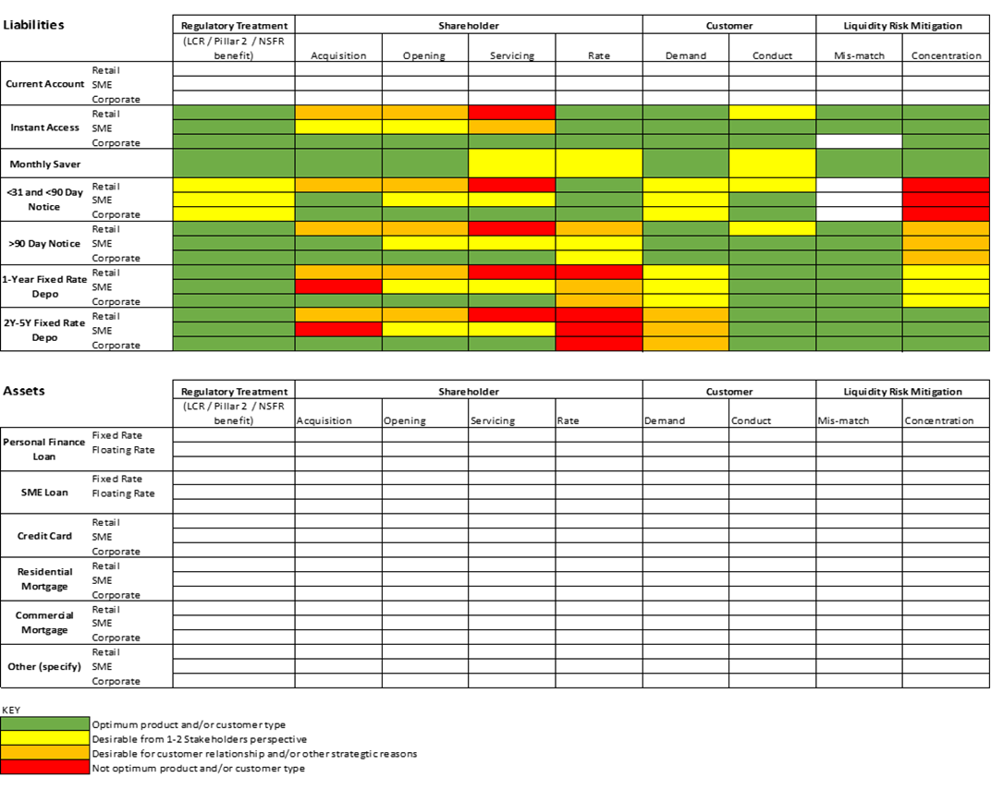
Customer product suite: the strategic ALM approach

Slide 30
Managing IRRBB Hedging: via Strategic ALM
Management of Interest Rate Risk in the Banking Book – a “Strategic ALM” approach
IRRBB is actively managed through a combination of:
  Netted off positions
  On-balance sheet natural hedging opportunities and/or using cash instruments
  Off-balance-sheet hedging activities
Hedging is transacted on both:
  A portfolio basis for smaller high volume deposits and advances
  An individual basis for larger, longer-dated deposits and fixed rate advances

Slide 31
Managing IRRBB Hedging: via Strategic ALM
Off-balance sheet derivative instruments:
  Interest-rate-related instruments used include interest rate swaps and forward rate agreements
  Basis products, caps, floors and swaptions may be used to a lesser extent
Natural hedges exist on-balance sheet:
  Banks should use natural hedges, in order to reduce reliance on derivatives: EXAMPLES??
  EG., a bank may use a portion of the liquid asset portfolio (“HQLA”) as repricing and basis risk hedges for its senior unsecured and subordinated debt respectively
On-balance sheet fixed rate instruments:
  Liquid asset portfolio
  Fixed rate advances / deposits – inc retail customers
  Senior unsecured debt / Subordinated debt

Slide 32
Benchmarking with one’s peers
To be more, rather than less, certain of best-practice demands a benchmarking process with the market and with one’s peers
Managing a bank in blissful ignorance, often with a belief that one knows best, is a recipe, ultimately, for disaster
However you wish to do it – market statistics, attending trade events, presenting, interacting, networking, etc – it is a vital part of the “proactive balance sheet management and strategic ALM” process
It can be formal (see next slide) and/or informal but it must be done

Slide 33
Global banks: Funding & Capital “Heatmap”

Slide 34
Secondary liquidity
Primary liquidity
HQLA

Slide 35
LDRs

Slide 36
Post-crash Operating Model Framework for Governance of the Balance Sheet

Slide 37
The Board risk appetite statement
Start with the Board risk appetite statement… an articulated explicit statement of Board appetite for and tolerance balance sheet risk, incorporating qualitative and quantitative metrics and limits, becomes the most important document the Board must sign off on...

Slide 38
Template Board Risk appetite statement
Strategic Objective
ABC Bank aims to become the Commercial Bank that is respected and trusted by all its stakeholders providing “concierge banking services for ultimate customer service quality", through: committed people; recognising that our long term sustainability is dependent on having sufficient capital and liquidity to meet liabilities as they fall due through the cycle; the protection of our reputation; and the integrity of our relationship with our customers and wider stakeholders.
Target Credit Rating
Credit rating in line with ABC’s closest peers and country bank average (A/A-)
Risk appetite pillars
Capital Adequacy | Stable Earnings Growth | Liquidity & Funding | Stakeholder Confidence
Maintain sufficient capital, quantity and quality, substantially over Regulatory minimums, to cover existing projected risks in extreme but plausible scenarios | Be an agile, sustainable UK Retail and Corporate commercial bank that maintains its capital adequacy in terms of amount and quality, and hence is able to withstand appropriate capital related stress. | Be an agile, sustainable UK Retail and Corporate bank that has stable and efficient access to funding and liquidity, and hence is able to withstand appropriate liquidity related stress, with relevant liquid asset holdings. | Be an agile, sustainable UKK Retail and Corporate commercial bank that is respected and trusted by all its stakeholders and hence maintains stakeholder confidence at all times.
CET1 ratio Total Capital Ratio Leverage ratio 3. Available capital | Earnings volatility Return on Capital Return on RWA Cost to income ratio | Loan to deposit ratio High Quality Liquid Assets portfolio minimum Coverage of net outflows under a funding stress NSFR minimum Wholesale funding limits 6. Internal funds pricing regime | Employees Regulators Investors Customers 5. Ratings agencies

Slide 39
Paramount importance of ALCO
What executive committees have a responsibility for oversight of balance sheet risk?
    Exec ctee
    Risk Management Cttee (CRO chaired)
    Credit risk cttee
    ALCO
The executive committee that is most closely concerned with balance sheet risk on a strategic and integrated basis (both sides of the balance sheet and all aspects of risk) is the Asset-Liability Committee
Given this, what is the most effective way to ensure above-satisfactory and effective governance from Board perspective?

Slide 40
Recommended organisation structure*
Board
Executive Committee
ALCO
“Technical ALCO”
Credit Risk Cttee
Product Pricing Committee
* Does not show every committee!

Slide 41
Recommendations
The 5-Point Guide to “Best-Practice”
Avoid a cult of personality: the best-run banks aren’t high-profile in the media and their CEO is rarely, if ever in the newspaper headlines. Both EXCO and ALCO are more effective when they are genuine debating forums and not in thrall to the domineering personality of one person;
Recognise that the balance sheet is everything, that the ALCO must be effective, and that the governance framework for managing capital and liquidity must be robust, to ensure that the balance sheet is long-term viable(for example, the CEO should not chair the ALCO);

Slide 42
Recommendations
The 5-Point Guide to “Best-Practice”
Operate a culture that stresses that all bank employees are “risk managers”, and that “compliance” is not solely the responsibility of the Compliance department. In other words, conduct risk and compliance should not be viewed as a tick-box bureaucratic process;
Recognise that setting the key driver of the bank’s business model as return on capital and P&L, even if unspoken, raises the probability of falling foul of conduct risk rules and best-practice governance standards;
Treat customers fairly because it’s the right thing to do, not because there are rules on good conduct published by the regulator, divergence from which is punishable with fines.

Slide 43
Conclusions
One could say that the best way to implement “strategic ALM” – which at heart means a proactive management of the balance sheet, such that one arrives at a structural balance sheet position by design rather than well-intended accident – is to have the Head of Lending sat next to the Head of Deposits (with thanks to Colin Johnson, Birmingham & Mid-Shires Building Society, circa 2002…☺ )
Failing that, in the Basel III era in order to meet the 3D optimisation challenge one must seek to achieve balance sheet optimisation, and that calls for the “triumvirate” to have a bigger influence in origination and customer pricing
This is now the modern approach to “risk management” in banks
Without this approach, it will be difficult to optimise the A-L mix that addresses the three-pipe problem of regulatory compliance, NIM enhancement and customer franchise satisfaction

Slide 44
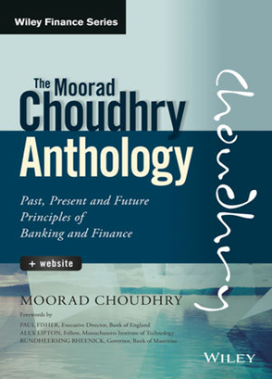
Reference
Moorad Choudhry Anthology: Past, Present and Future Principles of Banking and Finance, Singapore: John Wiley & Sons Ltd 2018, chapters 16-18
Email: mooradchoudhry@gmail.com

Slide 45
DISCLAIMER
The material in this presentation is based on information that we consider reliable, but we do not warrant that it is accurate or complete, and it should not be relied on as such. Opinions expressed are current opinions only. We are not soliciting any action based upon this material. Neither the author, his employers, any operating arm of his employers nor any affiliated body can be held liable or responsible for any outcomes resulting from actions arising as a result of delivering this presentation. This presentation does not constitute investment advice nor should it be considered as such.
The views expressed in this presentation represent those of Moorad Choudhry in his individual private capacity and should not be taken to be the views of any employer or any affiliated body, including Cambridge & Counties Bank Ltd or BTRM, or of Moorad Choudhry as an employee of any institution or affiliated body. Either he or his employers may or may not hold, or have recently held, a position in any security identified in this document.
This presentation is © Moorad Choudhry 2018. No part of this presentation may be copied, reproduced, distributed or stored in any form including electronically without express written permission in advance from the author.

Slide 46
Professor Moorad Choudhry
Strategic ALM and the Balance Sheet: The Future of Best-Practice Bank Risk Management

