Slide 1

-
Building Cyber Resilience
Risks, Regulation, and Strategies

Slide 2



Introduction
Rico Brandenburg
Principal
Risk & Public Policy and Digital Technology & Analytics
Jaime Vázquez
Policy Advisor
Regulatory Affairs

Slide 3
Agenda
Cyber risk: Why is cyber risk hear to stay and how does innovation impact the level of cyber risk going forward?
Regulatory environment: In what ways can cyber events impact financial stability and what are the regulatory challenges?
Cyber program: How do banks build an effective program while complying with an ever-increasing number of regulations across jurisdictions?
Resilience regulation: How are financial regulators responding to the challenges of cyber risk?
Key challenges: What are the key challenges for financial institutions to deliver the transformational change required for cyber resilience?

Slide 4

cyber risk today
Managing cyber risk is more than managing technology
Hacking is pervasive, lucrative, and easier than ever
1 in 3
>60%
$200
$1,500
organizations suffered a data breach through insiders ¹
malware installed using phishing ²
typical market price for online services payment record³
cost of ready-to-use malware to target ATMs⁵
Workers are a major attack vector
Humans viewed as the weakest link
7.89 billion records breached in 2017⁴
“Barriers to entry” are decreasing
Sources: 1. Forcepoint 2017 Report 2. F5 2017 Evolving Risk Landscape Report; 3. Experian 2017 Report; 4. 2017 Year End Data Breach QuickView Report; 5. The Register 2017

Slide 5




The future of cyber risk
Digitized world
Our lives are becoming more digitized every day
Pace of innovation
Companies are innovating more and more rapidly
Technology complexity
Technology is getting more intelligent, sophisticated, and pervasive
Data sharing and interchange
Growing interconnectedness combined with massive increase in velocity, volume, and variety of data
Attack sophistication
Actors are increasingly organized, sophisticated, and devious

Slide 6
Cyber risk Impact of innovation
 | Digitization | Number of end points
 | Open APIs / Microservices | Interconnectedness and velocity of data
 | “Internet of things” | Large amounts of data, increasing variety and concentration
 | Advanced computing | Ineffectiveness of existing security approaches
 | Robotics | Backdoor for cyber criminals
 | Advanced analytics / AI | Sophistication of cyber-attacks
 | Distributed ledger (blockchain) | Better data integrity and security
 | Biometrics | New vector for fraud and identity theft
 | Advanced encryption | Disguising data in a more secure way

Slide 7
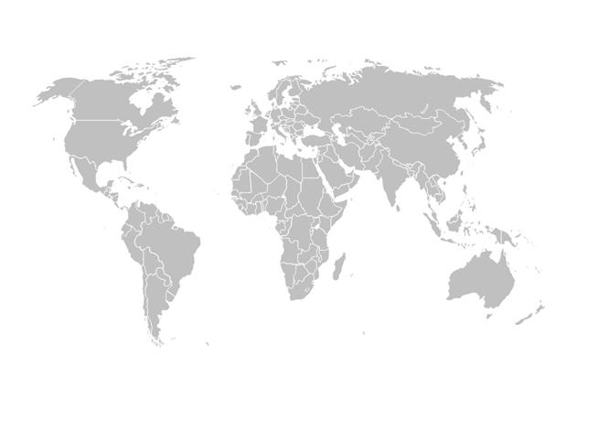
CYBER AND FINANCIAL STABILITY
Financial Sector a target
Heavy investments in cybersecurity
Cyber-risk is global in nature
Concerns with cyber-risk:
Lack of confidence
Financial stability
“Sand in the wheels” for innovation
Lack of qualified resources
What could be improved?
Fragmentation
Consequences of fragmentation:
Over-regulation
Overlaps/ contradictions
Cost of compliance
Efficiency?
Jurisdictions issuing regulation:
Frameworks
Guidance
Rules
No international coordination

Slide 8
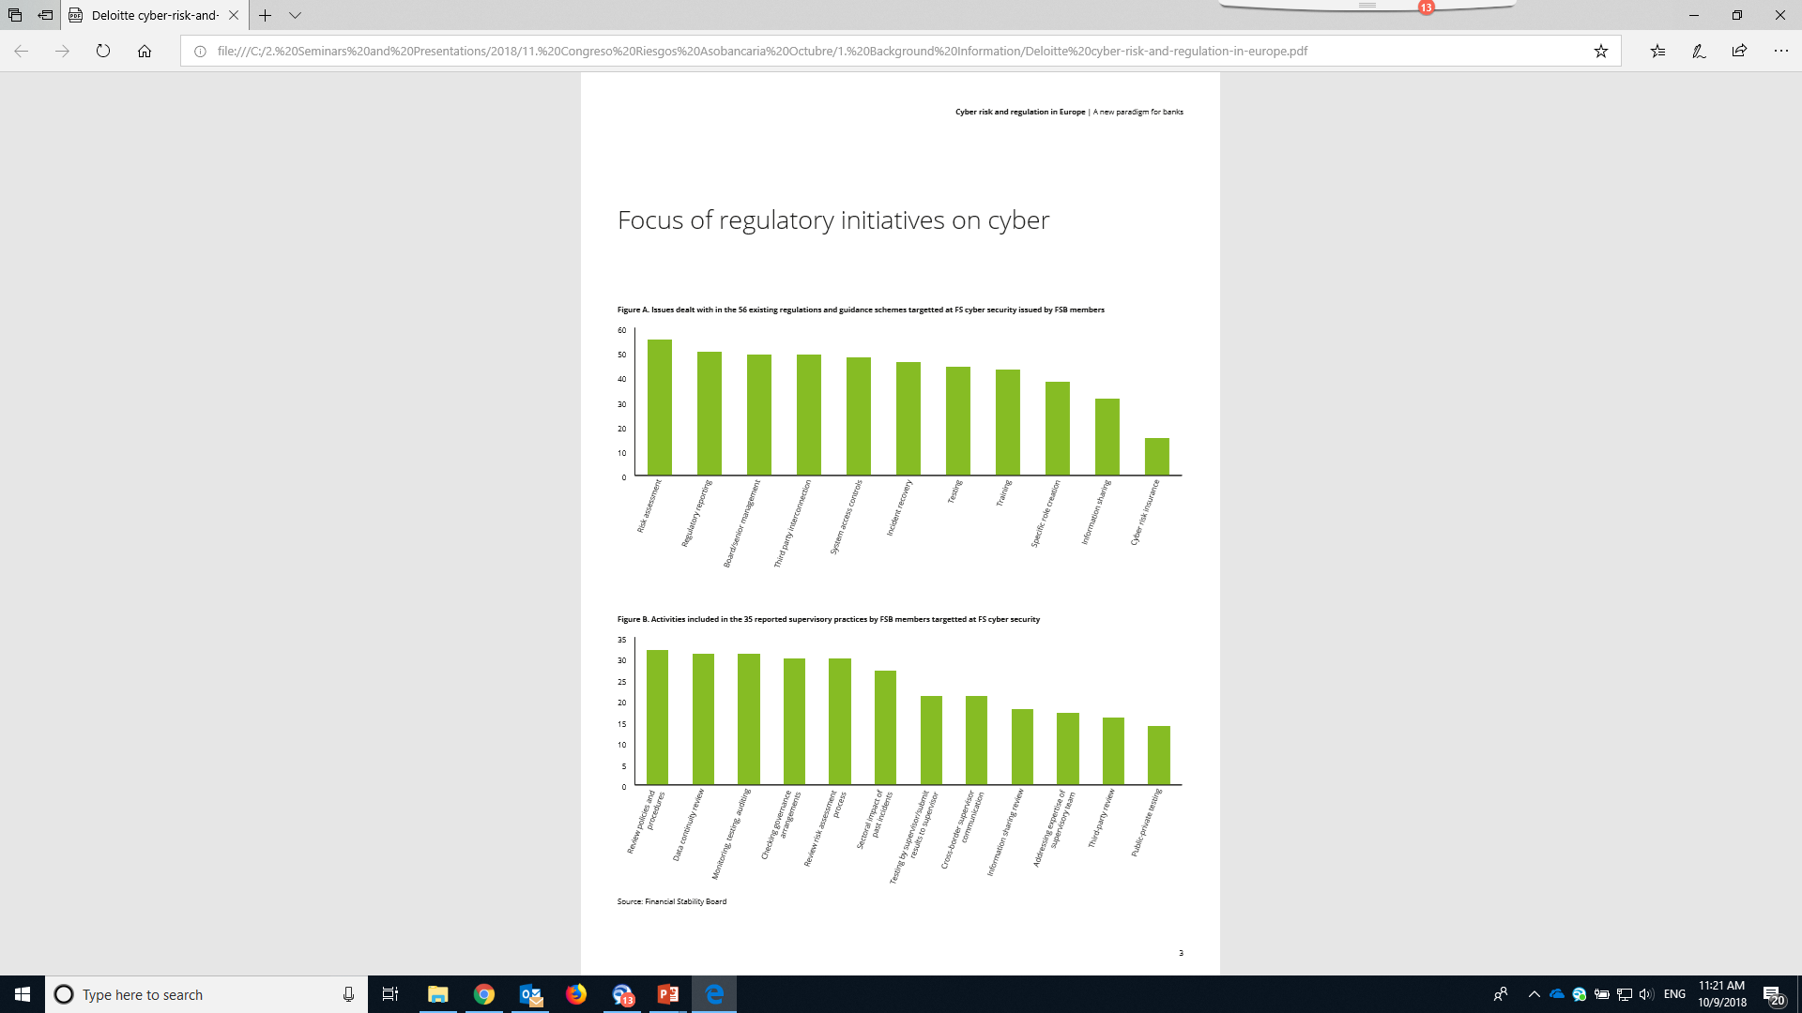
FSB STOCKTAKE
“All FSB member jurisdictions report drawing upon a small body of previously developed national or international guidance or standards…”
“There were 56 schemes of regulations and guidance reported as targeted to cybersecurity and/or IT risk, ..and “..35 schemes of reported supervisory practices…”
72% of Jurisdictions Reporting Near-Term Plans to Issue New Regulations, Guidance or Supervisory Practices

Slide 9
REGULATORY FRAGMENTATION
Incident Reporting
Multiple authorities to report to
Different definitions & taxonomies
Efficiency?
Sharing Information
Confidentiality / Legal constrains / International agreements
Concerns:
  Public-private vs private only platforms
  Two-way info sharing
  Consequences of sharing: reputation, market confidence, liabilities
  Usefulness of the info that can be shared
Regulatory Fragmentation: “..occurs when financial institutions must comply with different regulations in the same or in different jurisdictions that are duplicative, similar (but not identical), conflicting and in some cases well-intentioned, but do not actually enhance cyber-resilience.”
Use of Cloud
Level playing field.
Geolocalization of data
Data Protection
Conflicting objectives. E.g. GDPR vs PSD II
What data can be shared: effectivity.
Geolocalization of data
Unclear responsibilities in a data breach
Pen Testing
Multiple frameworks: inefficient.
Public and private sectors to work together

Slide 10
Cyber program & Regulation
CYBER RESILIENCE FRAMEWORK
BUSINESS SERVICE Focus
MEASUREMENT & TRANSPARENCY
THIRD PARTY RISK MANAGEMENT
RESPONSE &
RECOVERY
Colombia: Circular Externa 007 de 2018
Brazil: Cybersecurity regulation, GDPR
European Union: GDPR
United Kingdom: Operational resilience*
United States: NYDFS Cybersecurity regulation, SEC Cybersecurity Disclosures, California GDPR
Singapore: Cybersecurity Act 2018
* Discussion paper
Notes:
Select Themes Notes:
Linkage to business services: Managing all assets (hardware, software, data, etc.) based on their connection to business processes and the business outcomes they support
Masurement and transparency: Providing Board and senior management with the information they need to make key cyber risk management decisions
Security by design: Considering cyber risk upfront in all business decisions and technology design
Third party risk management: Implementing appropriate assurance mechanisms to gain visibility into and manage cyber risk from third parties
Response and recovery: Developing core capabilities to restore normal operations in the event of a cyber-related incident

Slide 11
Cyber resilience framework
Alignment & Integration
Risk reduction: Reduced severity and likelihood incidents
Cost avoidance: Integrated approach allows to “secure more for less”
Organizational focus: Prioritization of investment on critical business services
Simplification: “Resilience by design” to reduce complexity and increase transparency
Business ownership: Operating model and capabilities to enable the business
Business opportunities: Adaptiveness to exploit opportunities arising from change
Objectives
Impact tolerance
Strategy
Talent and culture
Integrated operating model across risk types
End-to-end business service framework
Visibility & Actionability
Cyber risk reporting capabilities
Resilience measurement
Integrated business decision
Identification & prioritization
Preparation & Improvement
Incident detection capabilities
Integrated resilience testing
Scenario framework
Integrated resilience playbooks
Predictive analytics and tools
Risk assess-ment
Quanti-fication
Response and recovery
Unified incident command
Conti-nuous improve-ment
Security architecture
Resilience by design

Slide 12
BUSINESS SERVICE Focus
Inter-asset linkages: Data model, structure, taxonomy, and approach
Inventory maintenance: Evergreen inventories in spite of business changes
Governance and accountability: Operating model for expanded asset management scope
Cyber risk assessment: Linking cyber risks to business outcomes
Business services
Driven by emerging focus on operational resilience
Third party
services
Driven by regulatory
emphasis on third parties
Data
Driven by desire to identify and
protect “crown jewel” data assets
Hardware and software
Traditional realm of asset management, driven initially by financial goals

Slide 13


Measurement & transparency
Communicating technical cyber risk content for non-technical executives Expanding beyond purely qualitative reporting and developing robust quantitative metrics Meaningful, cascadable and forward-looking risk indicators Clearly defined thresholds and tracking over time Link to cyber risk appetite
CURRENT STATUS
Succinct summary of key risks and facts highlighted in the dashboard
CYBER
PROGRAM
Status and appropriateness of initiatives to improve the cyber posture
EXTERNAL ENVIRONMENT
Recent and upcoming events that could / can impact aspects of the perimeter
INTERNAL ENVIRONMENT
Effectiveness of the defenses, including IT defenses, workers, and third parties
INCIDENT RESPONSE
Effectiveness of the response and recovery mechanisms
EXPOSURE
Sizing of cyber risk in dollar terms

Slide 14
Third party risk management
Comprehensive inventory and linkage to business services
Understanding of third party services and dependencies
Risk-based cyber control framework (e.g. diligence, continuous monitoring)
Coordinated cyber preparedness testing with third parties
Contractual security provisions and recourse mechanisms
Affiliates
Partners
Counterparties
Fourth parties
Data purchasers
Vendors
Data providers
Technology providers
Service providers
Traditional scope
Emerging scope

Slide 15
Response & recovery
Decision-making: Clear articulation of accountabilities for consequential decisions in response to a cyber incident
Data integrity: Identifying the “last known good” and restoring data integrity and customer confidence
Third-parties: Integration of third-parties into the response and recovery framework
Scenarios: Forward-looking identification of risk scenarios that could impact critical business services
Breach notification: Meeting stringent regulatory reporting requirements and identifying all customers impact
Governance
Incident preparedness and response organization
Incident response and recovery playbooks
Testing and training

Slide 16
Need for Global Framework
Incentives
Regulatory solution
Considerations
Aligned
  Reduce incidents
  Financial Stability
  Build resilience
Global
Progressive
Wide scope
Financial Institutions
&
Public Sector
Framework
Do not create Fragmentation
  Convergence to leading practices
  Reduce unnecessary burden
Not Aligned
  Breach reporting
  Data protection
  Data ownership
  When unclear liabilities
Rules
&
Standards
Create Fragmentation
  Lack of International coordination
  No Convergence to leading practices
  Do not Maximize efficiency & resilience
  Do not Reduce unnecessary burden

Slide 17
FRAMEWORK COMPONENTS
1
2
3
Global & Based on US NIST
  Already used in many jurisdictions
Based on Principles
  Promoting resilience
  Improving cyber-posture
Embedded into the ERM
  As the best way to operationalize it.
4
5
6
Promotes clear Governance
  Identify, Protect, Detect, Respond & Recover
  Involvement of top management
Assumes different Starting Points
  Allows for evolution within institutions
6
Encourage international coordination
  Key for a resilient financial system

Slide 18
Conclusions
1
FSB together with other authorities to develop a global Framework
2
Reduce current fragmentation and avoid new one going forward
3
Promote international coordination and related initiatives
4
Improve efficiency fighting cyber-attacks by changing legal frameworks as necessary
5
Include in the debate third party vendors and critical non-financial infrastructures
21

Slide 19



Regulation - What to expect…
3
Governance
4
Public
Policy
Cyber Security
vs
Cyber Resilience
2
Supervision
1
Pressure on Banks’ Boards
Quantification of Cyber risk
Enhanced Supervision
Pillar 2 Assesment
Testing Resilience
Legal barriers to information sharing
Cross-border barriers
Systemic vulnerabilities
Focus on respond & recover
21

Slide 20
Key challenges
Acquiring expertise
Unique mix of cyber, IT, risk, and business expertise and experience
Breaking silos
Integration of risk management frameworks as well as alignment of approaches and processes across business, risk and IT
Changing culture
Culture shift from “managing cyber is an IT responsibility” to “managing cyber is everyone’s responsibility”
Managing complexity
Building cyber into the very fabric of the organization requires fundamental changes to how the organization operates
Keeping up with innovation
Comprehensive understanding of how and where cyber can impact the business given continuous evolution of business processes

Slide 21

Building Cyber Resilience
Risks, Regulation, and Strategies

