Slide 1



The Fourth Industrial Revolution
Blockchain The Next Frontier
18ª Congreso Latinoamericano de Tecnología e Innovación Financiera
Cartagena, Colombia
Driss R. Temsamani
Latin America Head of Digital Channels and Enterprise Banking
driss.r.temsamani@citi.com
Notes:
We are now living in a world where the past will not be a predictor of the future. Bend history and change the world. Tough for incumbents to accept, but it is the new reality. Those physical assets are delivering ever diminishing returns. Many things are up in the air, and everything is to be played for.
But what if you could get a head start? At Citi, lots of risk, but amazing opportunity. Head start. 200 M consumer accounts, one of the largest card issuer in world, $3-5 Tn in trade flows every day, largest FX business, operate in 150+ countries – world that’s globalizing, urbanizing and digitizing – Citi is global, largely digital and concentrated in the urban centres of trade and commerce around the world. Everyone wants a piece of our pie – amazing assets, great head start, we know that what got us here, will not get us there.
Before My role – What do I mean by digital: Define digital: term we use to define a profoundly different future, supported by reimagined business and operating models. It impacts society, our values and beliefs – naturally, and will redefine our expectations of financial services. We are moving towards a Digital Age unconstrained from the physical, memory and computational constraints of humanity.
Our vision and strategy: help understand and contextualize the future and shape who we want to be in that future. Identify and acquire the critical capabilities to achieve our digital ambition, and oversee the transformation across our enterprise.
Fast, uncertain? Exponential times. Andy McAfee of MIT says – living in the 2nd half of the chess board – reference to Chess example:
Second half of chess board…2⁶⁴-1 = Mount Everest: After 32 squares about 4 billion grains of rice, a large field, Emperor could remain as emperor and the inventor could remain an inventor. After that one of them was going to get into trouble.
Exponential growth is something banking has understood - it is after the mathematical underpinning of the miracle of compound interest

Slide 2
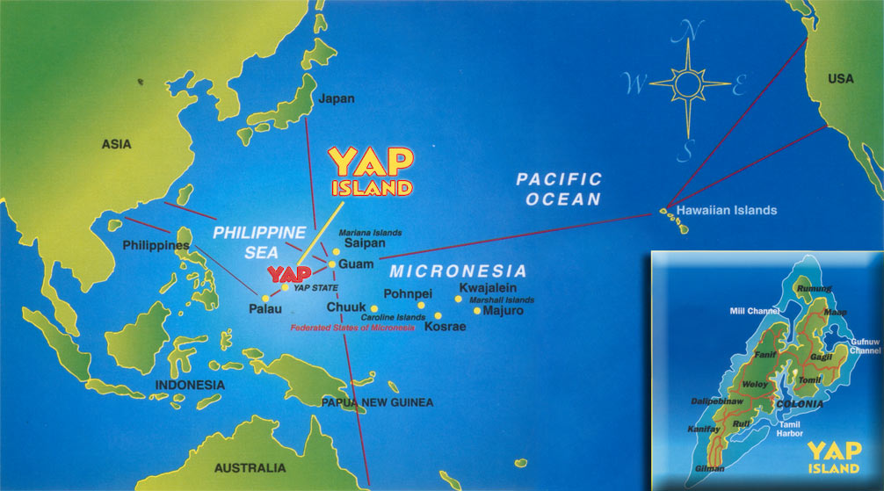

Slide 3
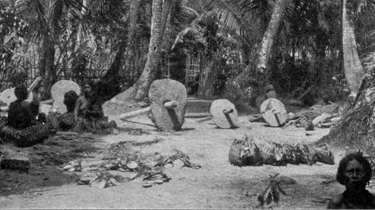

Slide 4
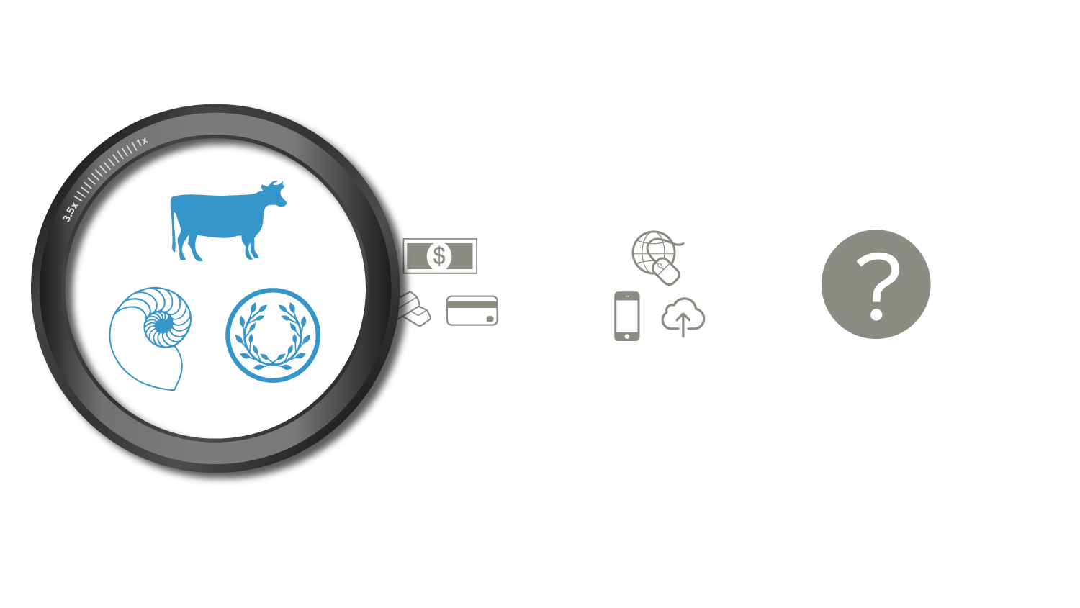
Evolution Of Money
Livestock, Shekels,
Shells

Slide 5
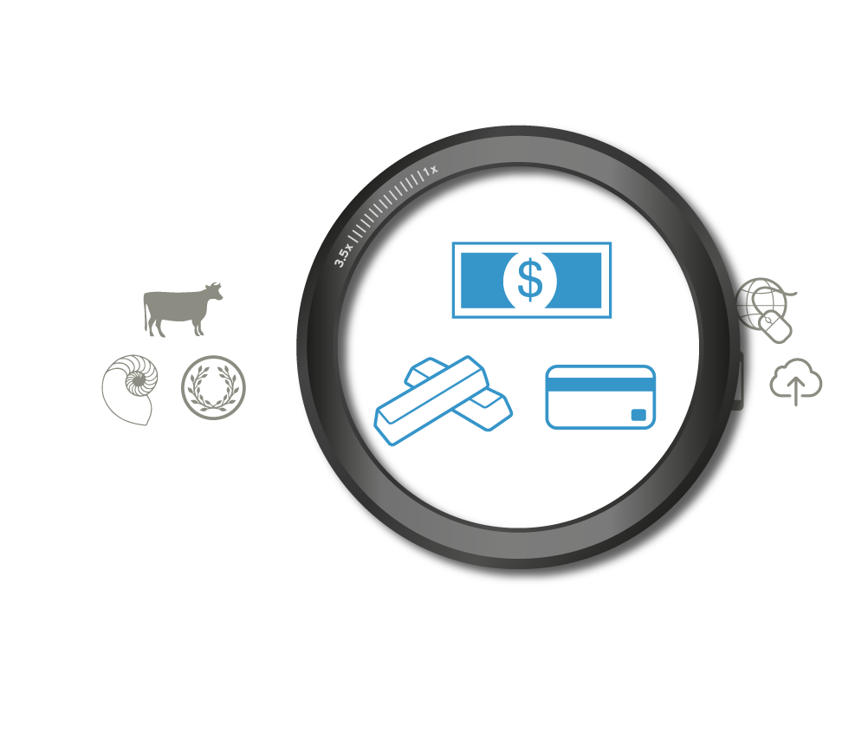
Evolution Of Money
Gold, Dollar,
Credit Card

Slide 6
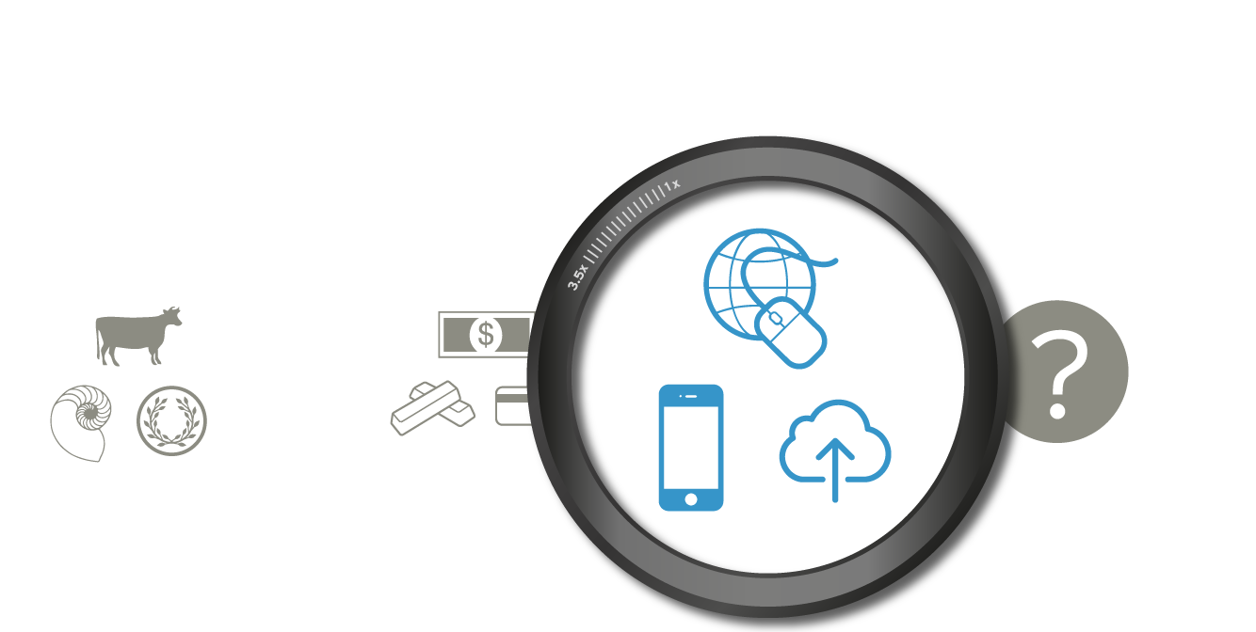
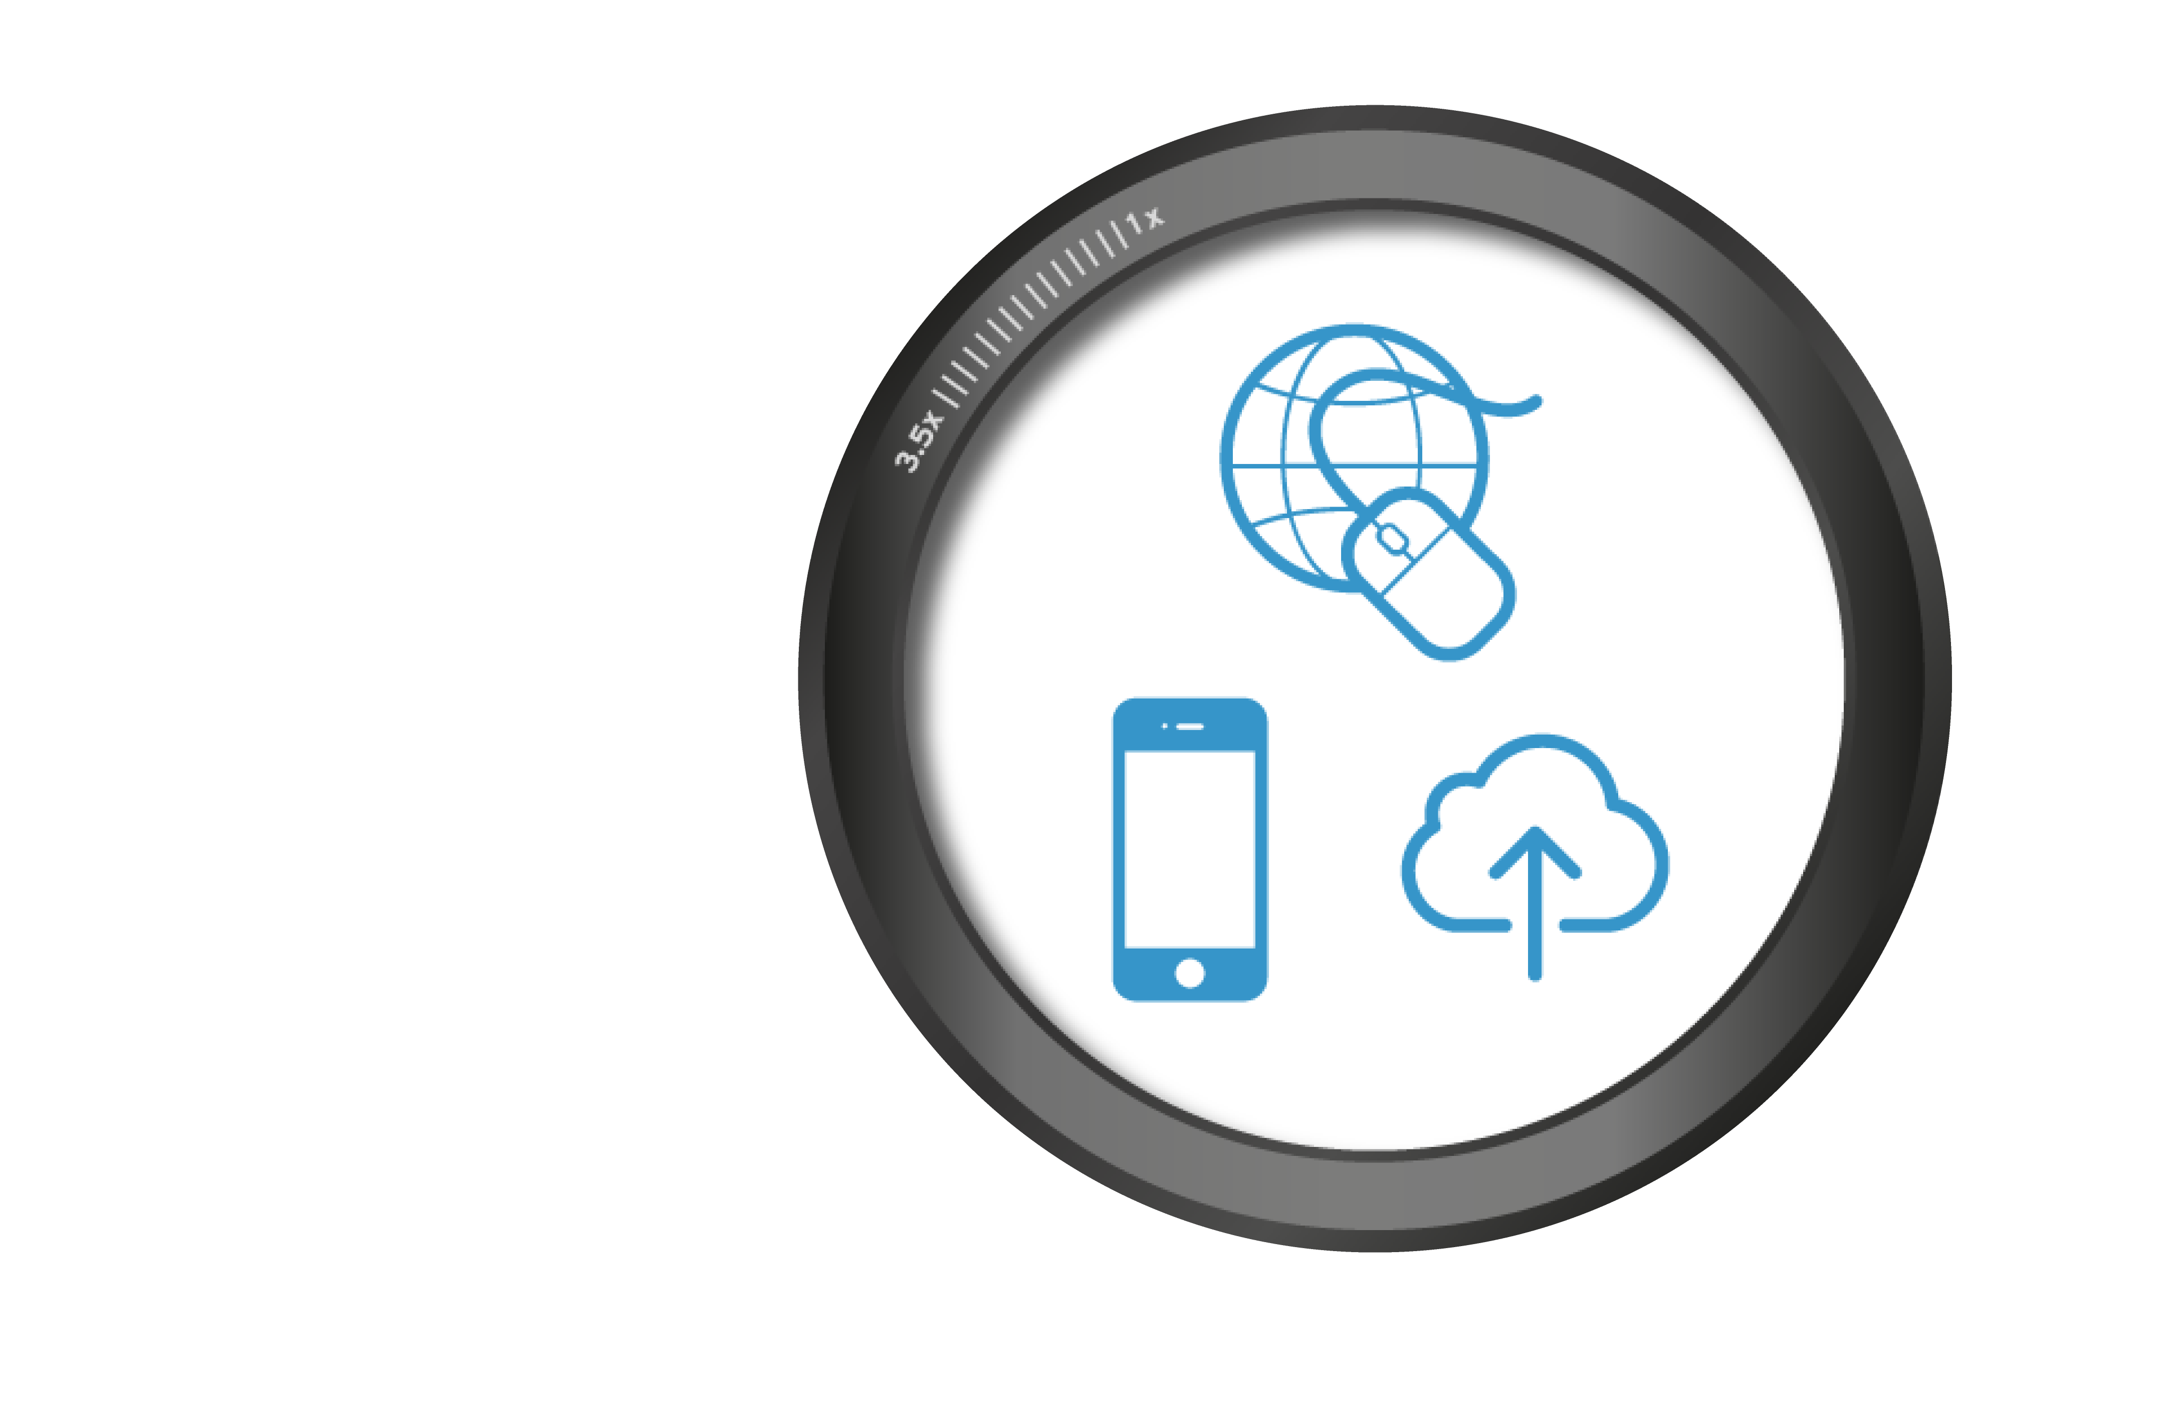
Evolution Of Money
Web, Mobile,
Cloud

Slide 7
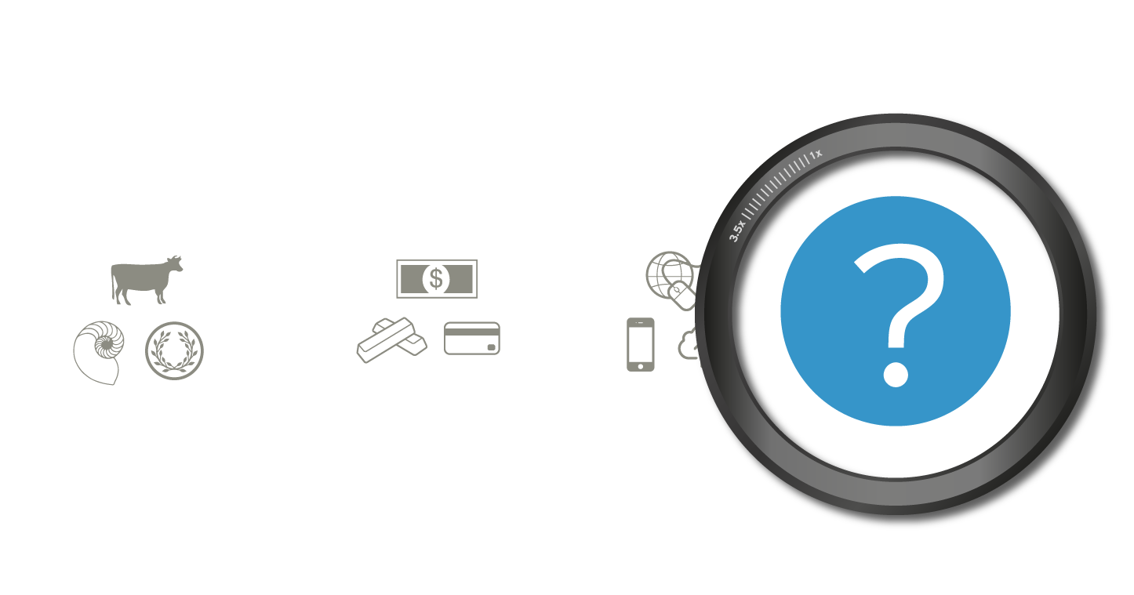
Evolution Of Money
What’s next?

Slide 8
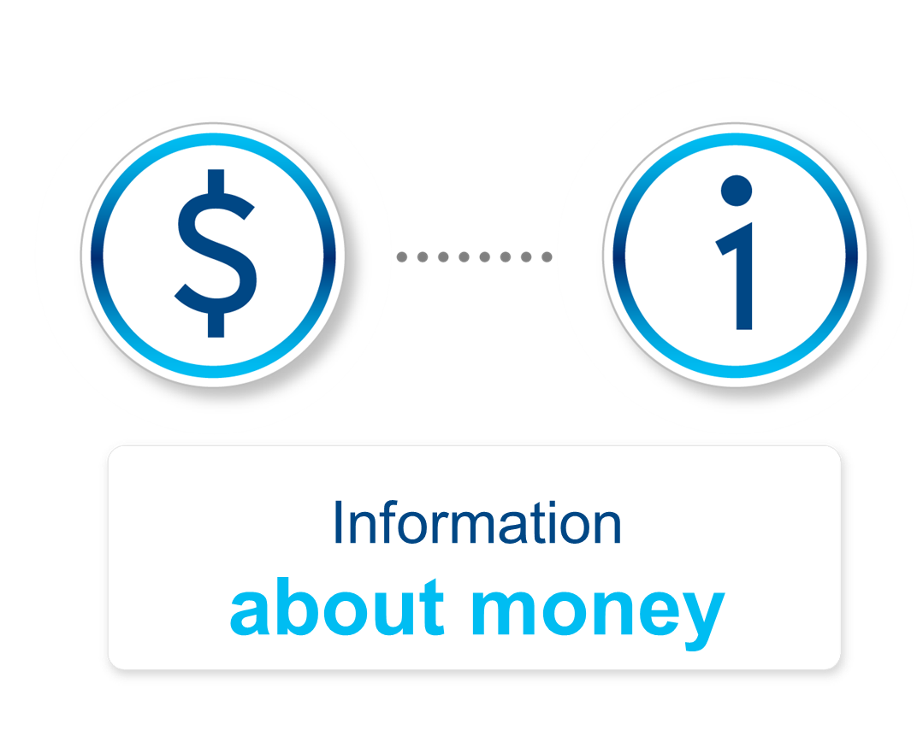
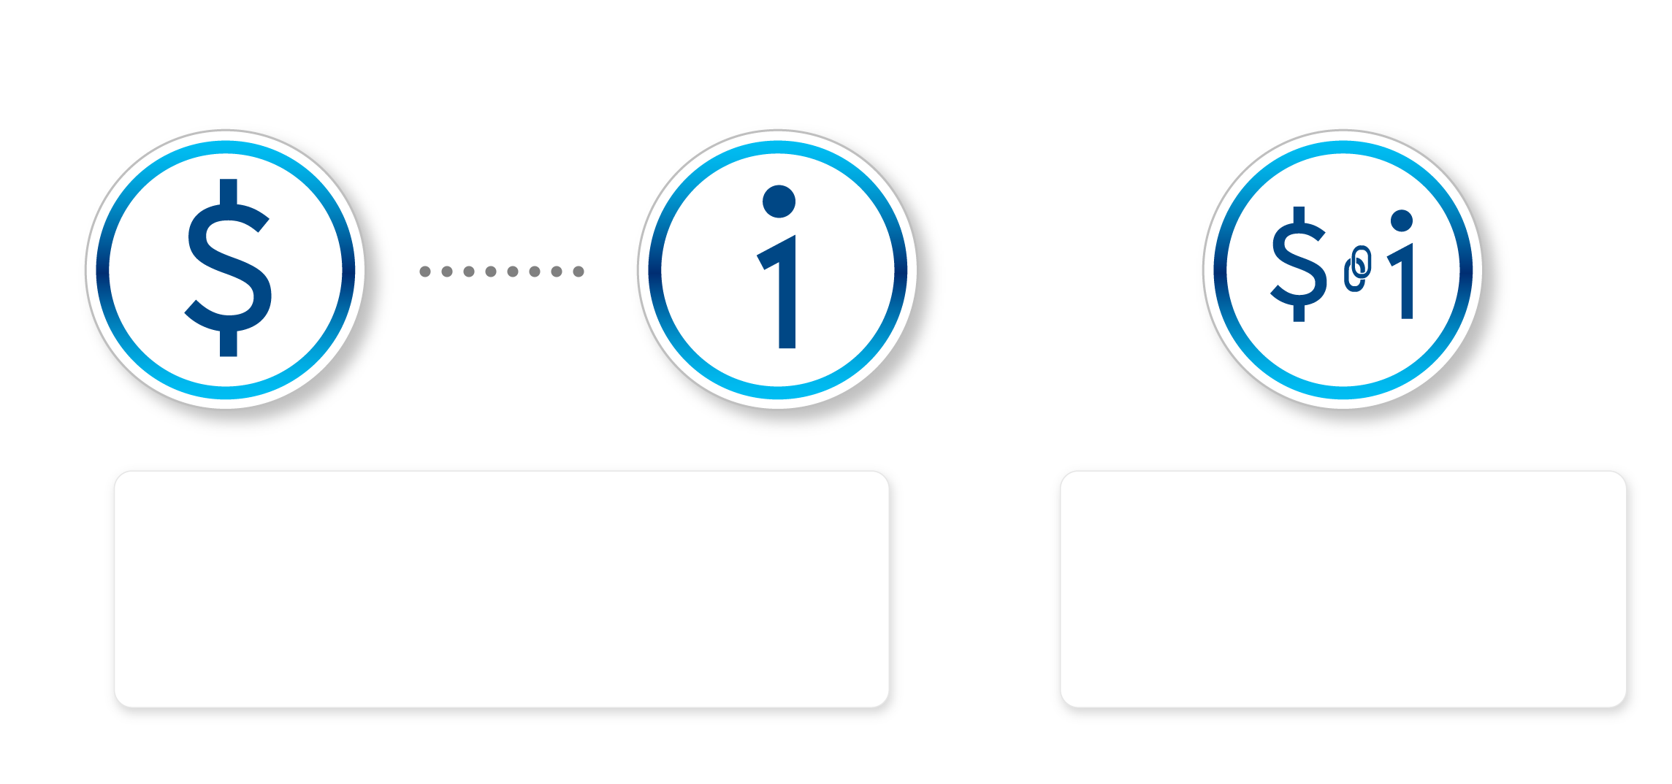
Information
about money
Money as
Information

Slide 9

Evolution of Money in context of Global Growth
As connected as we feel today with services such as the Internet, the reality is that much of the world is still isolated.
90%
Despite the fact that
of currency is all digital,
the process of transferring it is still inefficient and creates inconvenient barriers that inhibit the growth of a global system.

Slide 10
Evolution of Money in context of Global Growth
As connected as we feel today with services such as the Internet, the reality is that much of the world is still isolated.
90%
39%
of the world’s population, which is almost 3 billion people, do not have access to banks.
Despite the fact that
of currency is all digital,
the process of transferring it is still inefficient and creates inconvenient barriers that inhibit the growth of a global system.

Slide 11
Evolution of Money in context of Global Growth
As connected as we feel today with services such as the Internet, the reality is that much of the world is still isolated.
90%
39%
of the world’s population, which is almost 3 billion people, do not have access to banks.
Despite the fact that
of currency is all digital,
the process of transferring it is still inefficient and creates inconvenient barriers that inhibit the growth of a global system.
The inter-connectivity of the world and globalization of human interaction applies pressure for the need of an
Try to move large amounts of money across borders, and you can feel the friction depending on the country you’re in, and you’ll realize how expensive and slow it can be.
Identity.

Slide 12
Identify and Evolution of Trust
Local
Institutional
Distributed

Slide 13
The shift from an Internet of Information
Web
Sites
Photos
Docs
Information
PDFs
PPT Slides
Email

Slide 14
To an Internet of Value
Reputation
Social Capital
Money
Intellectual Property
Loyalty Points
Attestations
Identity
Assets
Contacts
Deeds
Carbon Credits
Energy
Assets
Coupons
Other Financial Assets
Bonds
Music
Art
Votes
Premiums
Stocks
Other
Futures
Receivables
Visual
Art
Film
Swaps
IOUs

Slide 15
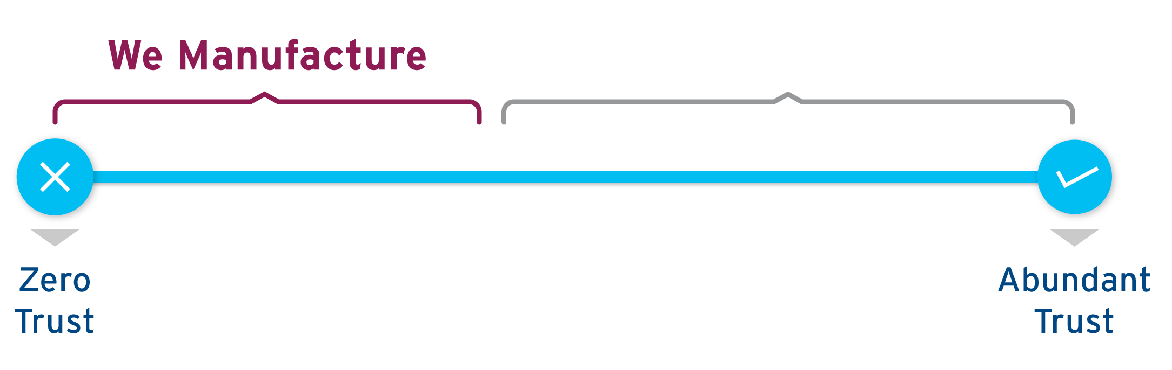
Requires an Internet built on Trust

Slide 16
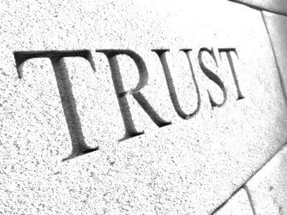
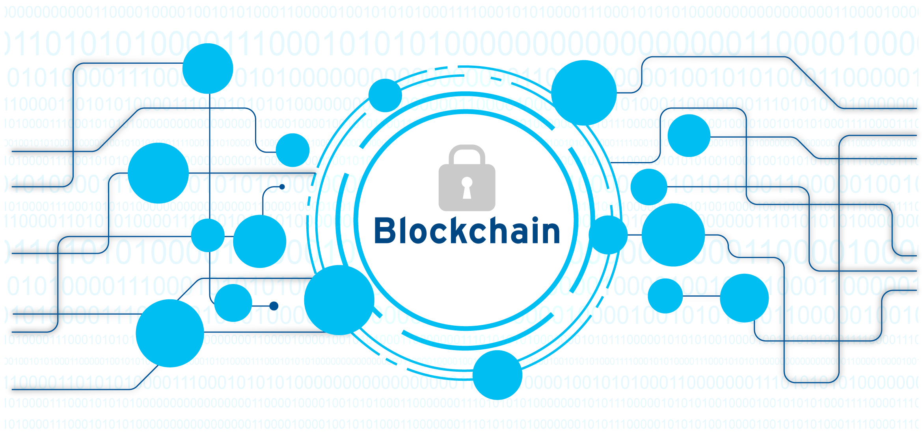

Slide 17
That the focus of blockchain is wrapped up with Bitcoin is not surprising given that its market value surged from less than $20 billion to more than $200 billion over the course of 2017
Yet Bitcoin is only the first application of blockchain technology that has captured the attention of government and industry.
1 Cryptocurrency market value is subject to high variation due to the specific volatility of the market.
2 Deep shift: Technology tipping points and societal impact, World Economic Forum, September 2015, weforum.org.

Slide 18
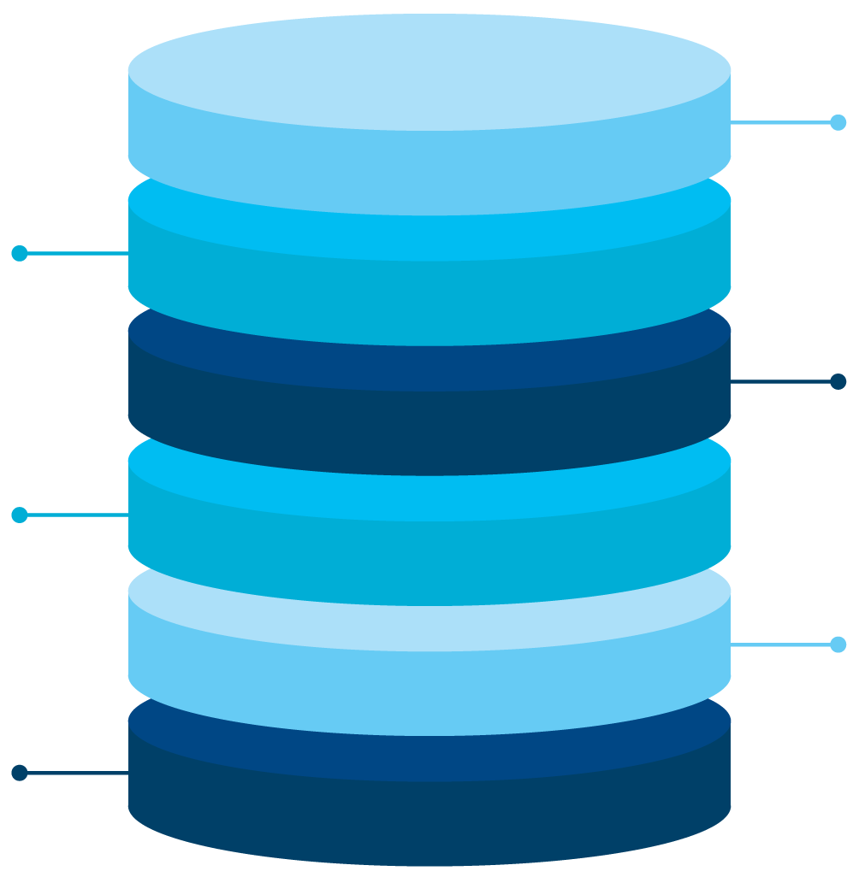

Blockchain under the hood
Digital Token
Smart Contracts
Efficient transfer of digital assets
Embedded business logic facilitates automated execution of contractual terms
Auditable Ledger
Irrevocable and immutable ledger entries can be used to verify existence, process & provenance
Inbuilt Consensus
Single source of truth removes friction caused by intermediaries
Customized Control
Choice of blockchain designs to (e.g. private, permissioned or public) offers tailored control and transparency
Distributed Network
Network operation spread amongst participants ensures high up-time and reliability
Closed
Private
Permissioned
Public
Open

Slide 19
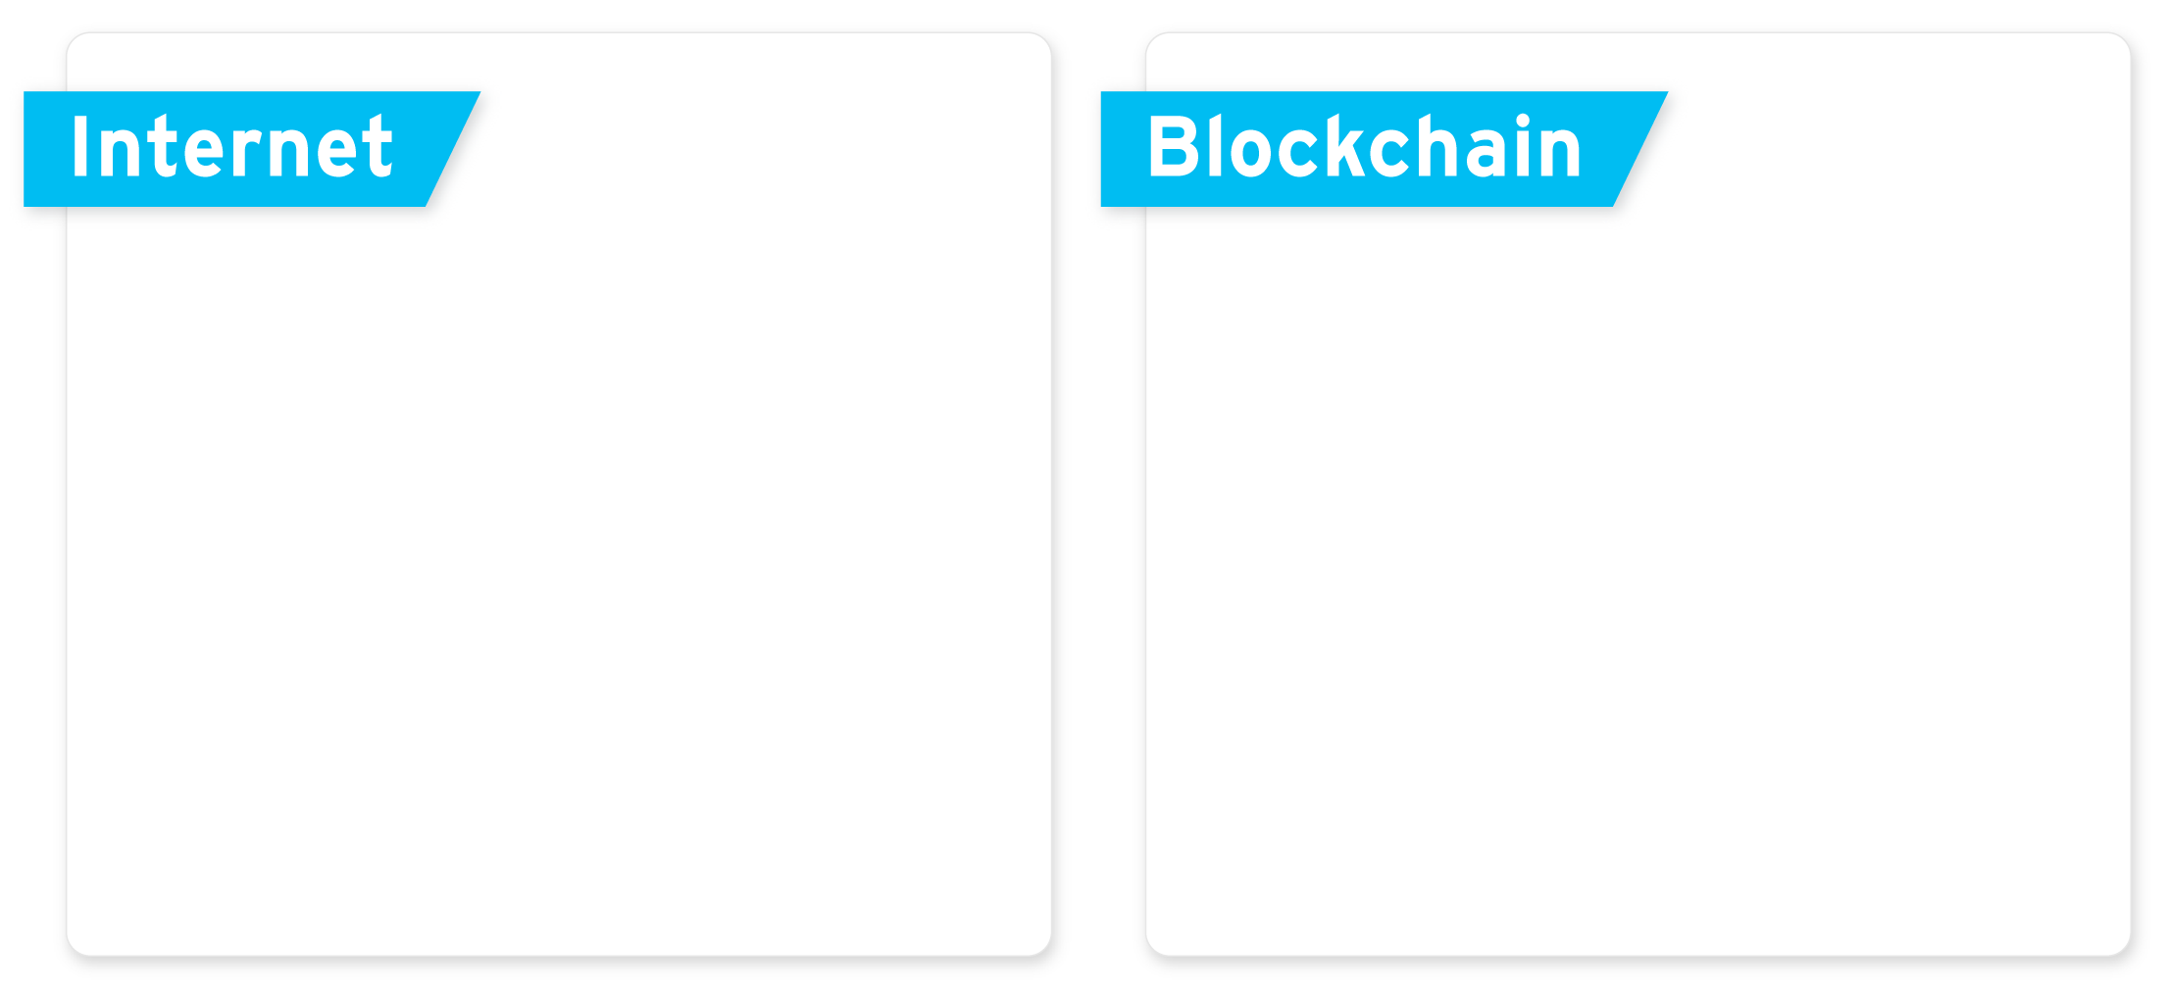

Blockchain: The internet of Value
With the Blockchain technology, for the first time in history, we are able to make online Assets transfers.
Transfer
Transfer
Originals
Copies
Originals

Slide 20
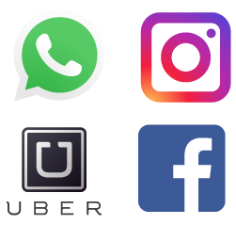
Blockchain: The internet of Value
The Blockchain has one single ledger which is distributed across the entire network.
Node
Node
Node
Node
Server
Node
Node

Slide 21
Citi Bridge to horizon
Citigroup, Nasdaq Team Up
The companies are working to link the bank to Nasdaq’s blockchain platform

Slide 22
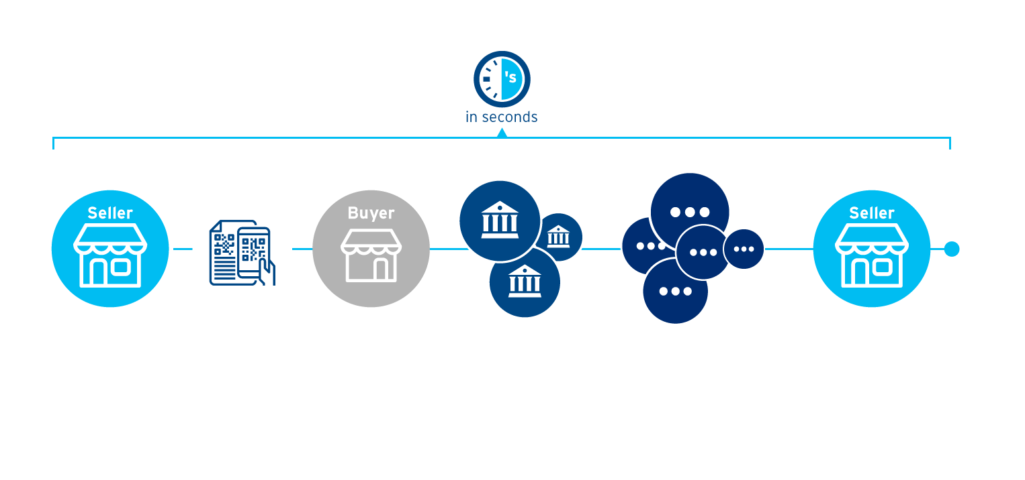
Fund Transfer Flow
Business to Business
Issues Invoice to Buyer
Assumption:
Business has online Digital Currency Account (Wallet)
Receives invoice containing wallet address and reference ID and sends Payment
CitiConnect for Blockchain

Slide 23
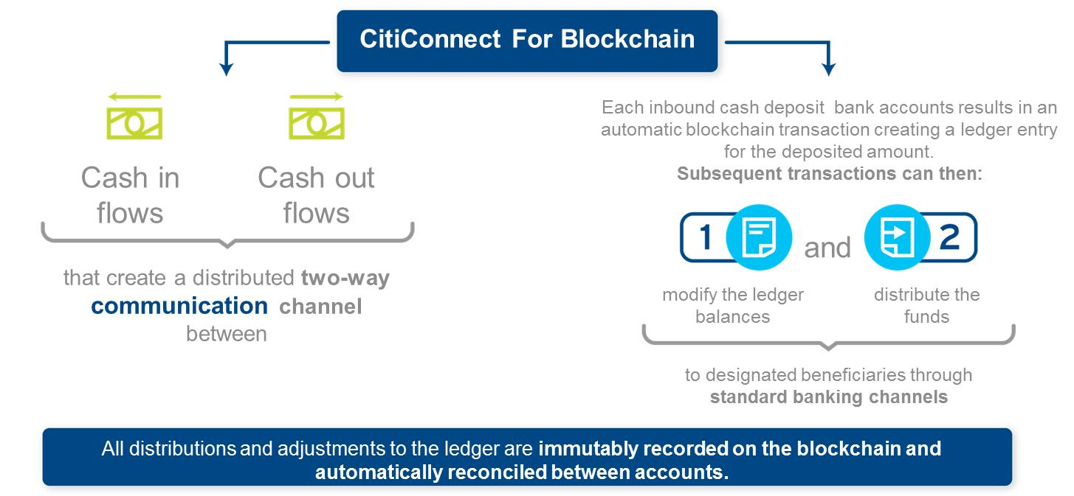
Fund Transfer Flow
Issues Invoice to Buyer
Assumption:
Business has online Digital Currency Account (Wallet)
Receives invoice containing wallet address and reference ID and sends Payment
Transactions commited to Blockchain
Receives Funds

Slide 24
Fund Transfer Flow
Business to Business
Issues Invoice to Buyer
Assumption:
Business has online Digital Currency Account (Wallet)
Receives invoice containing wallet address and reference ID and sends Payment
Citi Executes
The Transaction
Transactions commited to Blockchain
Receives Funds

Slide 25

So what does all this mean for businesses?

Slide 26
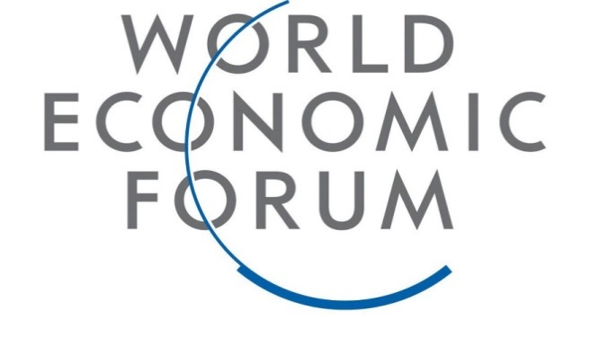
Blockchain was a priority topic at Davos;
a World Economic Forum survey suggested that:
10%
2027
of global GDP will flow on blockchain by
1 Cryptocurrency market value is subject to high variation due to the specific volatility of the market.
2 Deep shift: Technology tipping points and societal impact, World Economic Forum, September 2015, weforum.org.

Slide 27

The potential economic impact
Increase
Share of the Pie
Reduce
Operating Costs
Capture
“Share Shift”
Potential to move 220 million individuals to the formal economy
Over $300 bn in savings from lower costs of cash handling
$1 trillion in flows from the informal to the formal economy

Slide 28
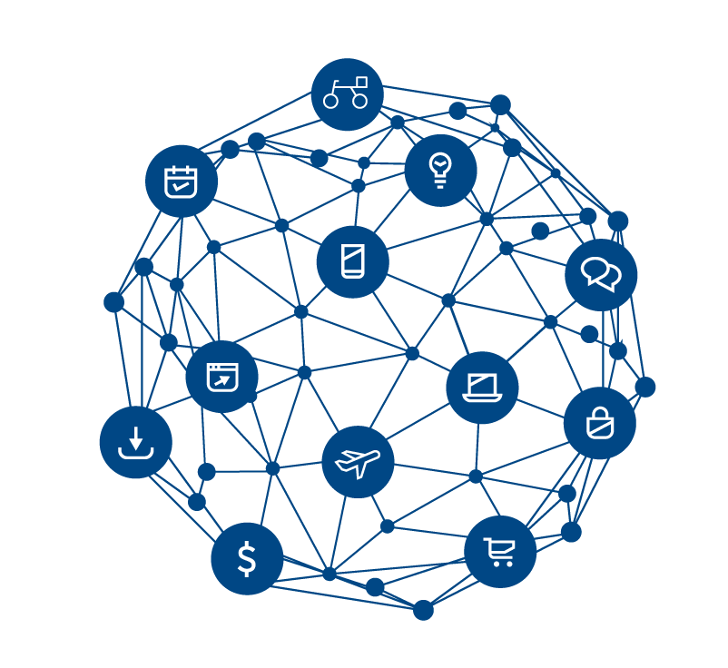
You can’t connect the dots looking forward; you can only connect them looking backwards. So you have to trust
that the dots will somehow connect…
Steve Jobs

Slide 29
IRS Circular 230 Disclosure: Citigroup Inc. and its affiliates do not provide tax or legal advise. Any discussion of tax matters in these materials (i) is not intended or written to be used, and cannot be used or relied upon, by you for the purpose of avoiding any tax penalties and (ii) may have been written in connection with the “promotion or marketing” of any transaction contemplated hereby (“Transaction”). Accordingly, you should seek advice based on your particular circumstances from an independent tax advisor.
Any terms set forth herein are intended for discussion purposes only and are subject to the final terms as set forth in separate definitive written agreements. This presentation is not a commitment or firm offer and does not obligate us to enter into such a commitment, nor are we acting as a fiduciary to you. By accepting this presentation, subject to applicable law or regulation, you agree to keep confidential the information contained herein and the existence of and proposed terms for any Transaction.
We are required to obtain, verify and record certain information that identifies each entity that enters into a formal business relationship with us. We will ask for your complete name, street address, and taxpayer ID number. We may also request corporate formation documents, or other forms of identification, to verify information provided.
© 2018 Citibank, N.A. All rights reserved. Citi and Citi and Arc Design are trademarks and service marks of Citigroup Inc. or its affiliates and are used and registered throughout the world.

