Slide 1
6 Laws of Customer Experience
2º Congreso de Sostenibilidad
Jen Rodstrom, CCXP
CX Transformist
Temkin Group
February 2018
Notes:
Great to be with you today. I am excited to be here, and I’d like to thank Asobancaria for inviting me to participate. Before we get started I want to introduce myself and the company I work for, Temkin Group.
My name is Jen Rodstrom and I am a Customer Experience Transformist with Temkin Group. As a student I studied international relations and Spanish, and I’ve had the good fortune to be able to bring some of that to bear in my current role, though clearly not enough to do this entire presentation in Spanish. This is my first, of what I hope will be many visits to Colombia, I’ve been fortunate to visit some of your neighbors in Latin America

Slide 2
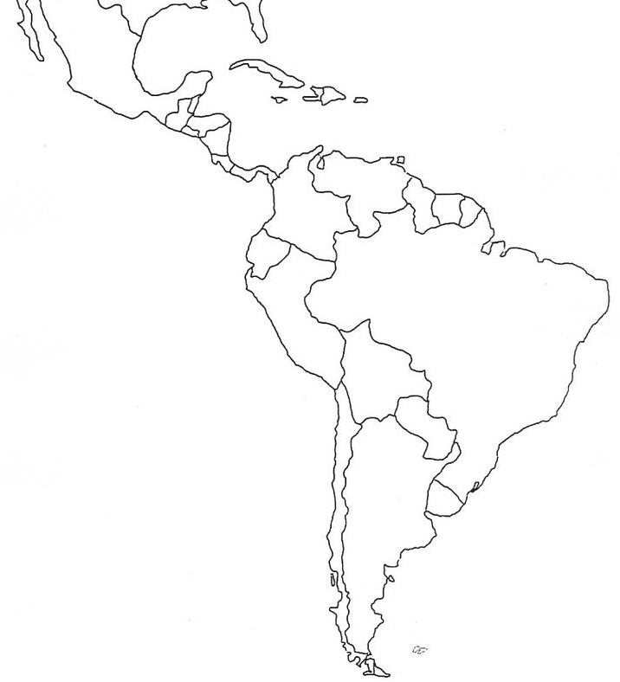
Mexico
Guatemala
Costa Rica
Colombia
Brazil
Chile
Notes:
Costa Rica in 1993
Mexico in 1995 & again in 1997
Guatemala in 1997
Chile & Brazil in 2016
Colombia this year

Slide 3
About Temkin Group
Independent research and advisory company completely focused on customer experience (CX)
Helps many of the world’s largest brands accelerate their transformational journeys towards customer-centricity
What we have learned:
CX drives loyalty
CX is a journey, not a project
Improvement requires systemic change
Notes:
At Temkin Group we’ve learned form our work and research with 100s of companies that
customer experience = loyalty
CX is journey not a project
Improvement requires systemic change
Customer experience is a reflection of the company’s culture and operating procedures
To truly change customer experience companies need to understand The Fundamental Truths That Define How Organizations Treat Customers – we call this the 6 Laws of CX

Slide 4
The 6 Laws Of Customer Experience
The Fundamental Truths That Define How Organizations Treat Customers

Slide 5
Every Interaction Creates a Personal Reaction
LAW #1

Slide 6
What is Customer Experience (CX)?
The perception that customers have of their interactions with an organization
Degree to which customers can accomplish their goals
Success
Effort
The difficulty or ease in accomplishing their goals
Customer Experience
Emotion
How the interaction makes customers feel
Notes:
Perception: we don’t know what the CX is until our customers tell us.
Perception: we don’t know what the CX is until our customers tell us.
SUCCESS: Degree to which customer can accomplish the goal
do the task … can check the box Yes even if the experience is awful
How many companies start with functional requirements? Not many get past that. Functional requirements can be customer neutral – don’t need to know the customers / functional often independent of customer
EFFORT: Difficulty or ease in accomplishing the goal
Easy … effort score
If poor, customer might not be able to even complete the functional
More and more companies looking at ease of use …
EMOTION: How the interaction makes the customer feel
Most people have functional view of customers, what are we going to allow them to do – rarely design for or measure emotions
Emotional element is actually the greatest driver of promoters (in our research)
If emotional requirements are lacking – won’t get raving fans
KEY – embed this thinking – F / A / E across the organization.
Move beyond functional – ease of use and emotional are customer dependent, as well as reliant on what’s going on at that time
CJM can move people around the curve from functional to accessible and emotional understanding and thinking about what the customer needs

Slide 7
Digital Camera purchaser
Notes:
Now imagine you are a company building a web page for someone looking to purchase a digital camera?
Digital photography buff who wants to by a Digital SLR Canon camera
Non-technie abuela who wants to buy a “nice” camera for her grandson for less than $150
An experience is in the eye of the beholder. An experience can be good for one person and bad for another.
How to think:
Start every project with a clear picture of the customer in mind – who are you trying to serve?
Make sure you understand the customer’s perceptions of how they view all 3 elements of the experience – success/effort/emotion
Empower employees to respond to customers so they can make adjustments for customer needs, which vary from one interaction to another

Slide 8
People Are Instinctively
Self-Centered
LAW #2
Notes:
Everyone looks at the world through their own frame of reference. This presents a challenge for customer experience because employees often have a completely different perspective than their customers.

Slide 9
“It’s like looking in the mirror. When I looked at our organization based on our internal data, I saw Brad Pitt…”
- SVP of Sales And Service

Slide 10
“…but when I looked at the customer feedback data we looked more like the hunchback of Notre Dame.”
- SVP of Sales And Service
Notes:
People are instinctively self-centered-centered
How to take advantage of Law #2?
You know more than your customers do, so continually find ways to think about what your customers know and care about
Shift your thinking from what the company is trying to do to what the customer is trying to do
Don’t let company organization drive experiences – customers shouldn't’ have to know about how you are organized to navigate the various processes or procedures they face when trying to get things done with your company

Slide 11
Customer Familiarity Breeds Alignment
LAW #3

Slide 12
Design for your customers’ journey…
When a USAA member calls in to change an address…
Are you going on active duty?
If yes, then…
Do you want to put your auto insurance on hold?
Have you executed a power of attorney?
Have you executed a healthcare proxy?
Do you have enough life insurance?
Notes:
Mission – financial well-being of members
Key – we know our members
Part of empathy … understand how the experience fits into the broader journey.
Care about why customer is there and what customer is going to do next.
Behaviors will change if thinking this way – purpose + empathy

Slide 13
Five questions that drive Customer Journey Thinking™
Who is the customer?
What is the customer’s real goal?
What did the customer do right before? (three times)
What will the customer do right afterwards? (three times)
What will make the customer happy?
Notes:
Who is the customer? Start by recognizing that different customers have different needs. So it’s important to understand who the person is before we think about their specific journey. This is a great place to use personas as a mechanism for describing the customer.
What is the customer’s real goal? Customers aren’t usually contacting your company because they want to, they’re doing it because of a deeper need. To understand how customers will view an interaction and what’s shaping their expectations, you need to think about what they are really trying to accomplish.
What did the customer do right before? (repeat three times) When customers interact with your company, it’s almost always part of a longer journey. So you need to think about where they’ve been prior to the interaction in order to understand how they will respond to an interaction with your company. In many cases, these previous interactions will include people and organizations outside of your company. After you’ve answered this question, ask and answer it at least two more times.
What will the customer do right afterwards? (repeat three times) When customers interact with your company, it’s almost never the last step on their journey. So you need to think about what they will do next to understand how you can best help them. In many cases, these subsequent interactions will include people and organizations outside of your company. After you’ve answered this question, ask and answer it at least two more times.
What will make the customer happy? Rather than just aiming to satisfy customers’ basic needs, think about what it will take to provide each customer with the most positive experience–given what employees know about customers’ real goals and their entire journeys. The focus on customers’ emotional state will help employees stay mindful of customers’ holistic needs and raise overall organizational empathy.

Slide 14
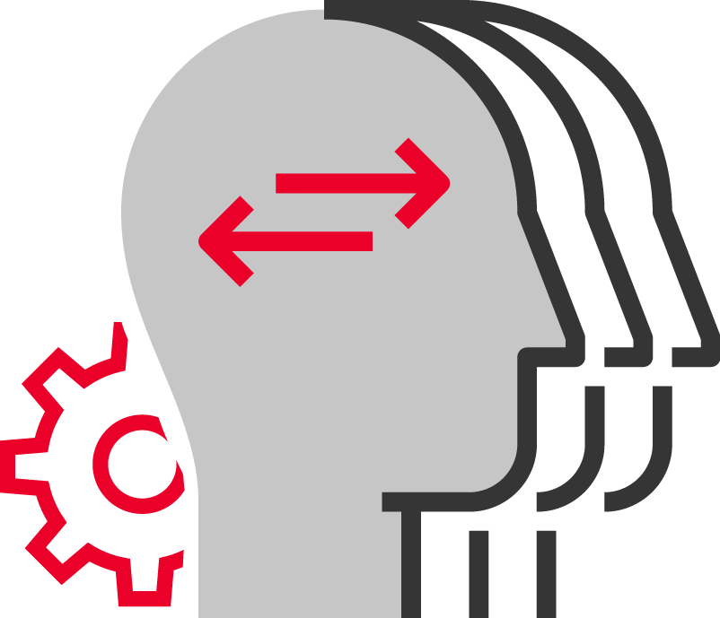
Unengaged Employees Don’t Create Engaged Customers
LAW #4
Notes:
If a company wants to sustain great customer experience, then its employees must buy into the mission of the company and must be aligned with the effot

Slide 16
Engaged employees are valuable assets
Employees That Are Likely to Do These Things
Base: 5,626 full-time U.S. employees
Source: Temkin Group report, “Employee Engagement Benchmark Study, 2017”
Notes:
Engaged employees are valuable assets.
Data from Temkin Group’s Employee Engagement Benchmark Index.
Look at the difference between highly engaged and disengaged employees and the likelihood they will demonstrate a number of behaviors that are beneficial to the organization… review results
How to take advantage of Law #4:
Communicate, communicate, communicate – All important messages need to be delivered consistently and persistently so they are heard, understood and internalized by employees
Listen and act on employee feedback. Make it a regular practice to ask for feedback and let employees know how you’ve used their ideas to make things better
Support employees with active feedback and coaching. While some new skills can be learned in the classroom, feedback and coaching are important to embed new behaviors into employees’ daily routines

Slide 17
Employees Do What Is Measured, Incented, and Celebrated
LAW #5
Notes:
Employees conform to the environment they are in. The metrics that are tracked, the activities that are rewarded, and the actions that are celebrated all drive how employees behave.

Slide 18
Employees do what is measured, incented & celebrated
“Don’t hate the player, hate the game”
- Ice-T (musician, rapper, actor)
Notes:
To take advantage of Law #5:
Find ways to celebrate the employees and teams who deliver excellent customer experiences
Clearly define good behaviors that specifically translate the CX vision to what employees do in their daily role and then align measurements and incentives to those behaviors.
Watch out for mixed messages by taking the time to ensure measurements, incentives, and celebrations are working together and focused on the right behaviors.

Slide 19
You Can’t Fake It
LAW #6
Notes:
Employees can sense when customer experience is not really a top priority with the company’s leaders. And customers can tell when the company isn’t committed.

Slide 20
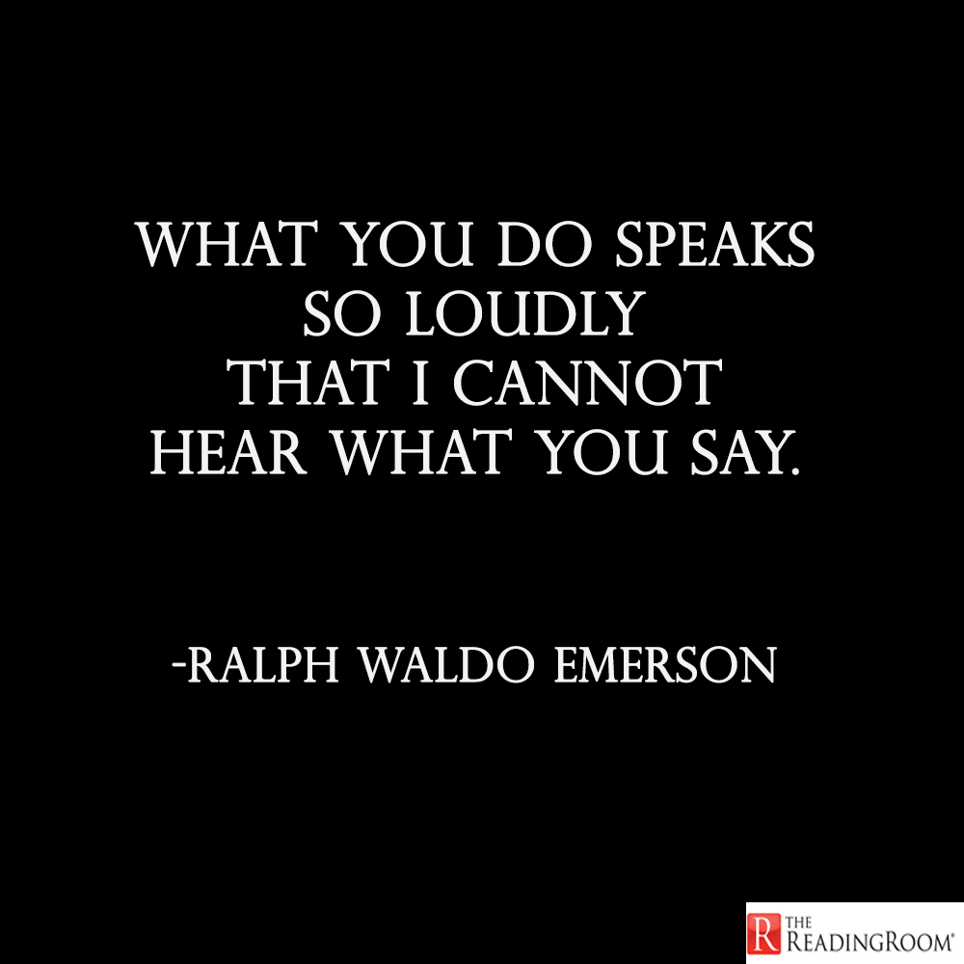
Notes:
To take advantage of Law #6
Don’t hide behind a 4th priority. If you aren’t fully committed, then don’t’ start a major initiative as it will likely fail and make it harder to re-engage employees in the future
Model behaviors you want to see in others and think about how people will view your decisions and what they indicate to the importance of CX
Marketing should reinforce the new ways customers are being treated, so only advertise when employees believe

Slide 21
Six Laws of Customer Experience
Law #1: Every interaction creates a personal reaction.
Law #2: People are instinctively self-centered.
Law #3: Customer familiarity breeds alignment.
Law #4: Unengaged employees don't create engaged customers.
Law #5: Employees do what is measured, incented, and celebrated.
Law #6: You can't fake it.

Slide 22
¡Muchas gracias!
Jen Rodstrom, CCXP
CX Transformist
Temkin Group
www.temkingroup.com
Email: jen@temkingroup.com
Twitter: @jen_rodstrom

