Slide 1

FinTech: Tecnologías disruptivas para la prevención del fraude
Kelsey Blakely and Kathy Breiz, Square Inc. USA

Slide 2

Agenda
Understanding Square
Managing Risk in FinTech
Risk Management Today
Risk Management Tomorrow

Slide 3

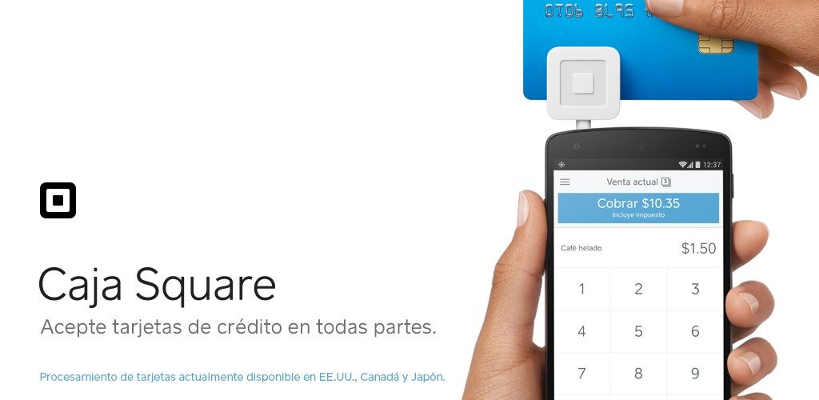
Square: What do we do?
Notes:
Balancing tradeoffs in innovation and product launches vs. fraud risk

Slide 4


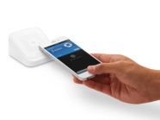

Square’s timeline
IPO
NFC reader
P2P payments
Consumer lending
2013
2015
2017
2009
2014
2016
Micro-financing for merchants
Instant deposit
E-commerce
Square founded
Notes:
Colombia liability shift in 2008!
70% of people in Latin America do not have a bank account

Slide 5
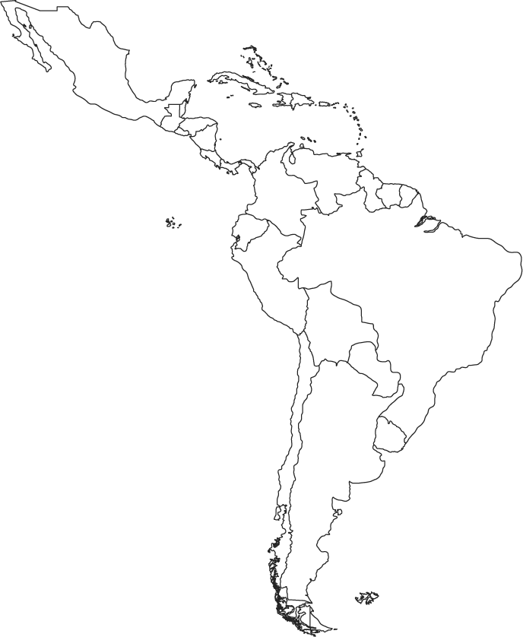
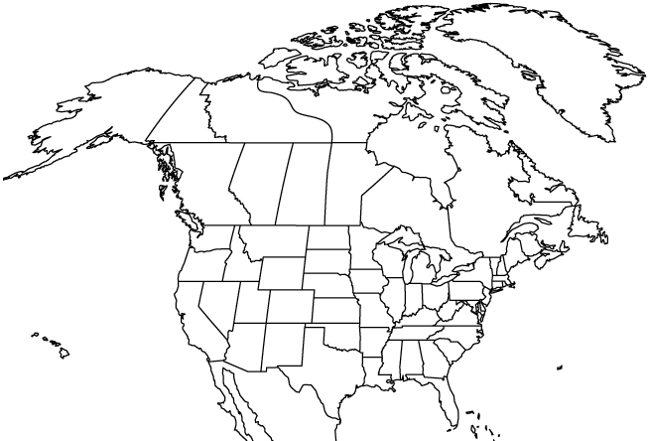
Mobile phone subscribers
524M
313M
Latin America
North America
Source: GSMA Institute. The Mobile Economy 2017. https://www.gsma.com/mobileeconomy/
Notes:
Balancing tradeoffs in innovation and product launches vs. fraud risk

Slide 6
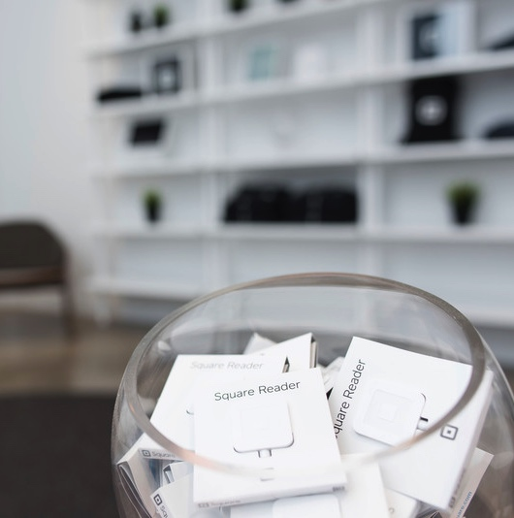
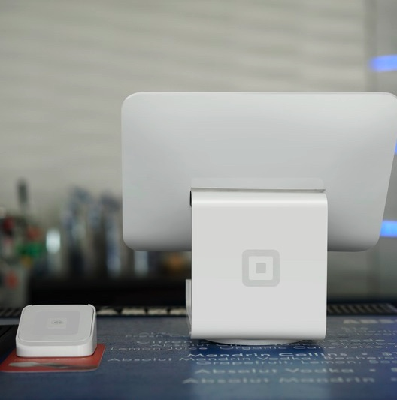
Managing risk in FinTech
This?
Or
That?
Notes:
Balancing tradeoffs in innovation and product launches vs. fraud risk

Slide 7

Risk Management Today
Protecting your business from ‘bad’ customers

Slide 8

Fraud Trend: Bad Buyers
I provided the individual with training for his 3 children then his brother’s kids 3 more. He asked me to pay his driver for him as he would be out of town. $2,150 went to the driver and $650 went to my fee.

Slide 9
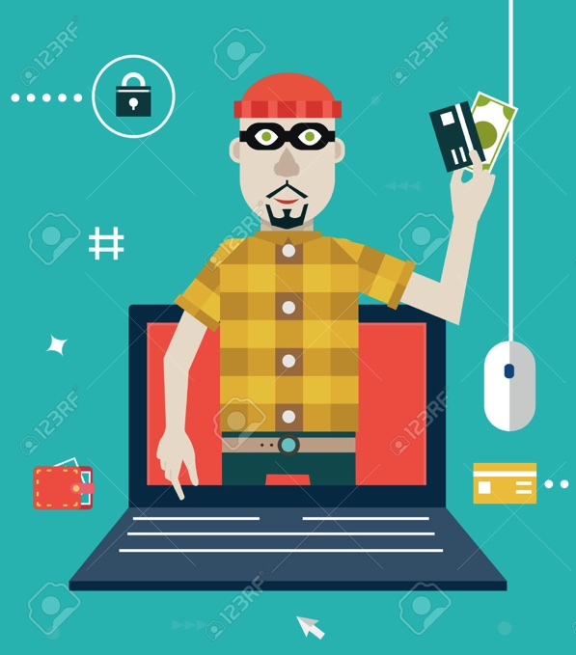
Fraud Trend: Fake Account
  Accounts opened for the sole purpose of monetizing or testing the viability of stolen credit cards

Slide 10

Risk Management Tomorrow
Maximize your good to bad customer ratio

Slide 11
Risk Management Tomorrow
1. Moving “upstream” to stop fake accounts
2. Never saying no to legitimate customers
3. Managing fraud and non fraud loss appropriately
4. Evolving machine learning and heuristics to know the difference
5. Getting the right mix of automation vs. human intervention
6. Sharing data across the industry

Slide 12
Gracias
Notes:
Balancing tradeoffs in innovation and product launches vs. fraud risk

Slide 13
appendix

Slide 14
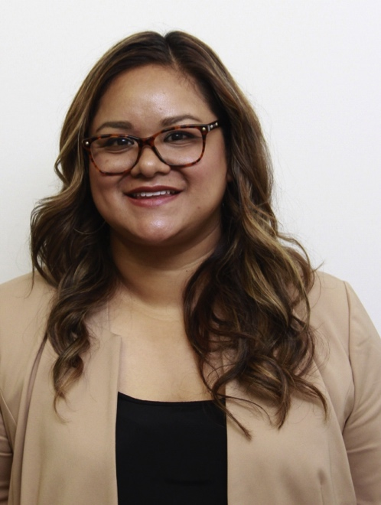
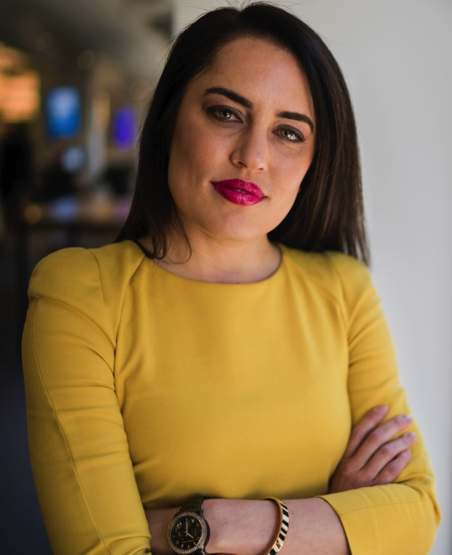
About Us
Kelsey leads the Fraud Analytics team at Square. Prior to joining Square, Kelsey was part of the Risk team at Visa and spent eight years at the Federal Reserve Bank of San Francisco. She holds a masters degree in Public Policy from Duke University.
Kathy leads two Risk Operations teams at Square. Kathy has an extensive career in banking. She held positions at Bank of America, Grater Bay Bank, and the Federal Reserve Bank. She holds a masters degree in Organizational Development from the University of San Francisco
Kathy Breiz
Kelsey Blakely

