Slide 1

Faster.
Easier.
Stronger.
ANTi-impersonation, credit risk underwriting and customer onboarding

Slide 2

Who we help.
From Online lenders through to retail banks, consumer finance and more
Affordability / Anti-Impersonation / Anti-Money Laundering / Conduct Risk Management / Credit Risk & Regulation Management / Credit Risk Underwriting / Financial Crime / Fraud Prevention & Detection / Identify Payment Windows / Know Your Customer
Notes:
Industries / use cases / etc

Slide 3
How it works.
Getting started in three easy steps
Embed the DirectID Widget in your customer onboarding or decisioning process
build your own user experience or let us host it for you
Have your consumers authenticate to their existing online bank account
currently averaging 24 seconds and covering over 4500 banks in 31 countries
Leverage the Bank Verified Identity or use the Live Financial Data for easier, faster & stronger
with rich insights either through the RESTful API or online dashboard

Slide 4
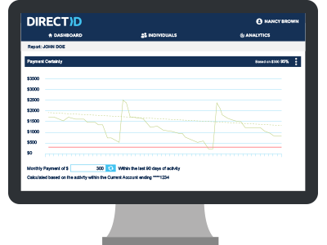
DirectID for Onboardng.
Anti-Impersonation
Accelerated Processing
Credit Risk & Regulation
Conduct Risk Management

Slide 5
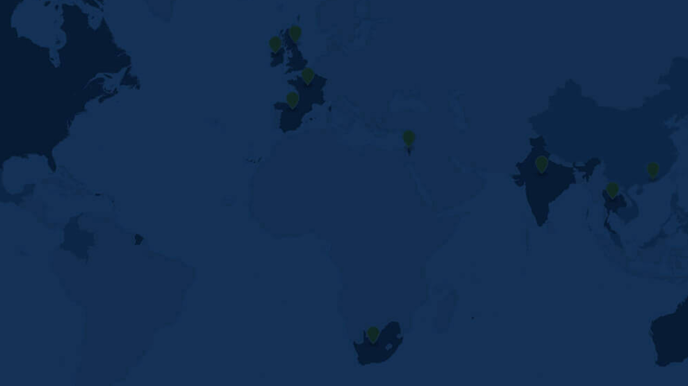
Coverage.
31 countries, 4,500 banks and over 500m potential customers.
Australia, Canada, France, Hong Kong, India, Ireland, Israel, New Zealand, Singapore, South Africa, Spain, Thailand, United Arab Emirates, United Kingdom and the United States & more

Slide 6
















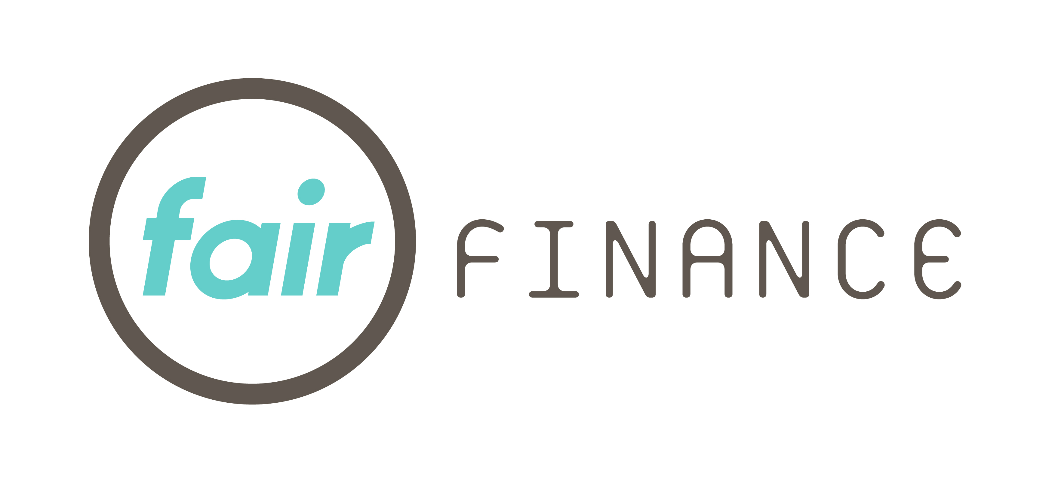










Customers.
And partners
Notes:
Customers and partners

