Slide 1
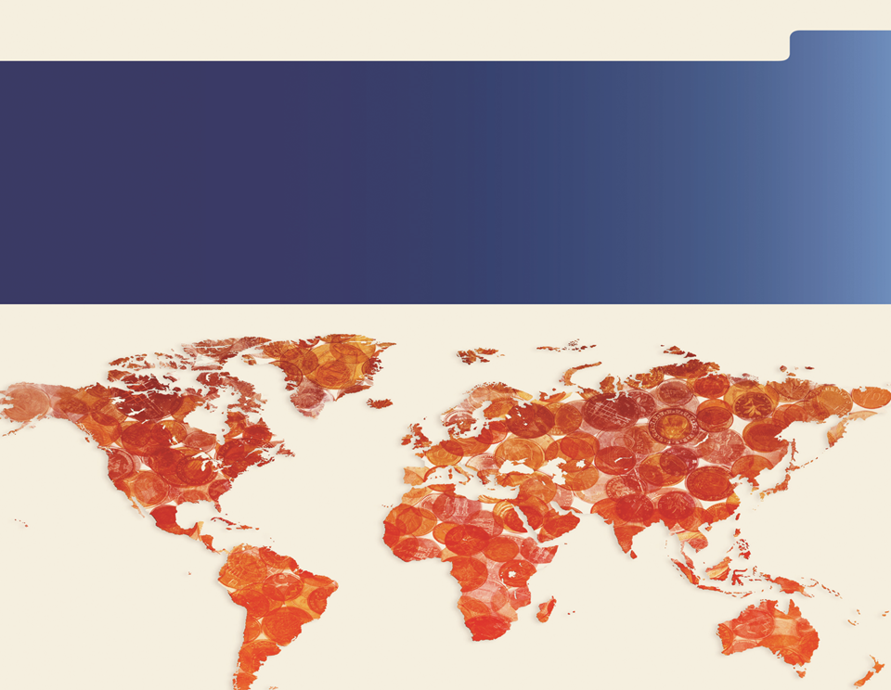
Asli Demirguc-Kunt
Director of Research
World Bank Group
Financial Inclusion

Slide 2
Why financial inclusion ?
Intro Measurement and Impact Public Policy Focus Areas Main Messages
Increased policy interest
  Over 60 countries: formal targets and strategies for financial inclusion
  WBG President: has called for achieving universal financial access by 2020
Critical role in reducing poverty, boosting shared prosperity
Enables poor people to save and borrow, allowing them to build assets, invest in education and entrepreneurial ventures, thus improving their livelihoods
New data and empirical evidence on financial inclusion and its impact

Slide 3
Intro Measurement and Impact Public Policy Focus Areas Main Messages
Global views: Financial Development Barometer
Source: Financial Development Barometer (poll of financial sector officials and experts from 21 developed and 54 developing economies).

Slide 4
Defining financial inclusion
Intro Measurement and Impact Public Policy Focus Areas Main Messages
Financial inclusion = share of individuals and firms that use financial services
… does not mean finance for all at all costs
Some have no demand or need for financial services
But for many, the use of financial services is constrained by market and government failures
That is why it is important to measure not only actual use of financial services, but also the barriers to access

Slide 5
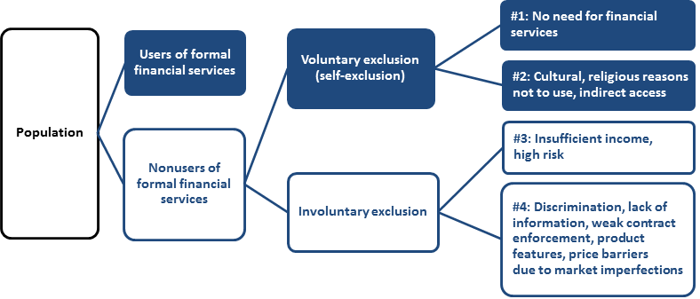
Defining financial inclusion
Intro Measurement and Impact Public Policy Focus Areas Main Messages
Notes:
Financial inclusion = share of individuals and firms that use financial services
… does not mean finance for all at all costs
Some have no demand or need for financial services
But for many, the use of financial services is constrained by market and government failures
That is why it is important to measure not only actual use of financial services, but also the barriers to access
Examples of market failures: asymmetric information, consumers' and providers’ departures from rationality,…
This chart illustrates the distinction between the use of and access to financial services.
Actual use is easier to observe empirically. Some individuals and firms may have access to, but choose not to use some financial services. Some may have indirect access, for example, by being able to use someone else’s bank account. Others may not use financial services because they do not need them or because of cultural or religious reasons. The nonusers include individuals who prefer to deal in cash and firms without promising investment projects. From a policy maker’s viewpoint, nonusers do not constitute an issue because their nonuse is driven by lack of demand. However, financial literacy can still improve awareness and generate demand. Also, nonuse for religious reasons can be addressed by allowing the entry of financial institutions that offer, for instance, Shari’a-compliant financial services.
Some customers may be involuntarily excluded from the use of financial services. This is illustrated by the “involuntary exclusion” box in figure 1.1. Several groups belong to this category. One notable group consists of individuals and firms that are unbankable from the perspective of commercial financial institutions and markets because they have insufficient income or represent an excessive lending risk. In this case, lack of use may not be caused by market or government failure. Other groups in this category may not have access because of discrimination, lack of information, shortcomings in contract enforcement, a poor information environment, shortcomings in product features that may make a product inappropriate for some customer groups, price barriers because of market imperfections, ill-informed regulations, or the political capture of regulators. If high prices exclude large parts of the population, this may be a symptom of underdeveloped physical or institutional infrastructure, regulatory barriers, or lack of competition. Financial exclusion deserves policy action if it is driven by barriers that restrict access by individuals for whom the marginal benefit of using a financial service would otherwise be greater than the marginal cost of providing the service.
In considering involuntarily excluded users, one must distinguish between those individuals facing price barriers and financial exclusion arising because of high idiosyncratic risk or poor project quality (those people identified as group #3 in the figure) and those individuals facing such barriers because of market imperfections such as asymmetric information (group #4 in the figure).

Slide 6
Measuring financial inclusion – Global Findex
Intro Measurement and Impact Public Policy Focus Areas Main Messages
  Global Findex dataset is based on interviews with almost 150,000 adults in over 140 countries worldwide, 97% of world’s population.
  First launched in 2011 with funding from the Bill & Melinda Gates Foundation – and collected in partnership with Gallup, Inc. – the Global Financial Inclusion (Global Findex) Database Project was initiated to create and maintain a public, user-side database that measures financial inclusion in a consistent manner over a broad range of countries over time.
  Why a global, user database on financial inclusion?
  Facilitates a better understanding of how adults worldwide save, borrow, make payments, and manage risk – and how these behaviors fit together.
  Measures the degree to which certain subgroups – such as the poor, women, and rural residents - are excluded from formal financial systems.
  Can be used to track global policy and progress on improving access to financial services.
  Can be used to examine relationship between financial inclusion and other development outcomes (on individual or country level).
  Complements provider and country-owned financial inclusion data

Slide 7
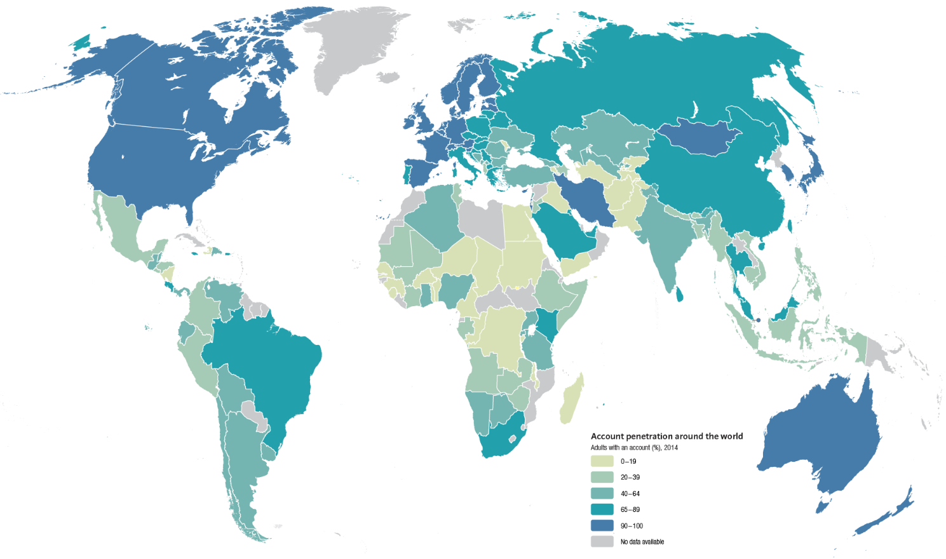
Measuring financial inclusion
Intro Measurement and Impact Public Policy Focus Areas Main Messages
Globally, about 62 % of adults have a bank account
The other 2 Billion remain “unbanked”
Adults with accounts at a formal financial institution
Source: Global Financial Inclusion (Global Findex) Database, worldbank.org/globalfindex

Slide 8
Intro Measurement and Impact Public Policy Focus Areas Main Messages
There has been significant growth in financial inclusion
Adults with an account (%), 2014
Globally, account ownership is 62% in 2014, up from 51% in 2011.
Globally, the number of unbanked adults fell to 2 billion, down from 2.5 billion in 2011.
Globally, only 2% of adults have mobile money account – and only 1% has a mobile money account only
+11 PP

Slide 9
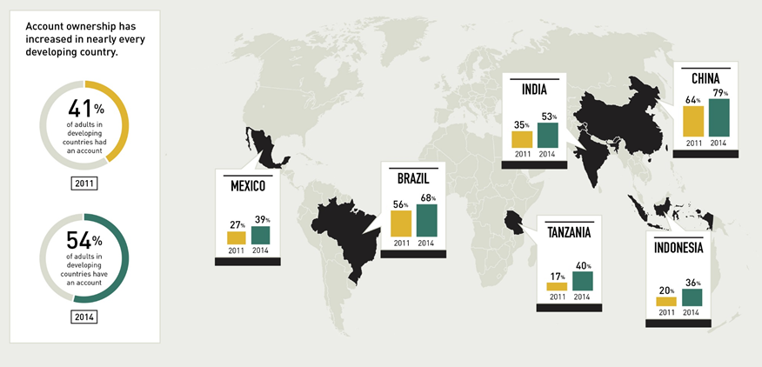
Intro Measurement and Impact Public Policy Focus Areas Main Messages
Examples include Mexico, Brazil, India,
China, Tanzania, and Indonesia
Source: Global Findex Database, World Bank, Washington, DC. http://www.worldbank.org/globalfindex

Slide 10
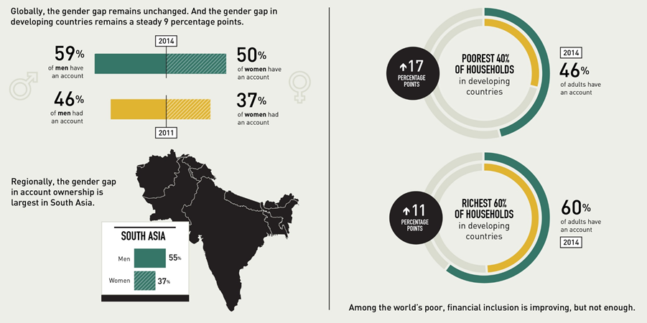
Intro Measurement and Impact Public Policy Focus Areas Main Messages
Still, There Are Opportunities to Expand Financial Inclusion, Particularly among Women and the Poor
Source: Global Findex Database, World Bank, Washington, DC. http://www.worldbank.org/globalfindex

Slide 11
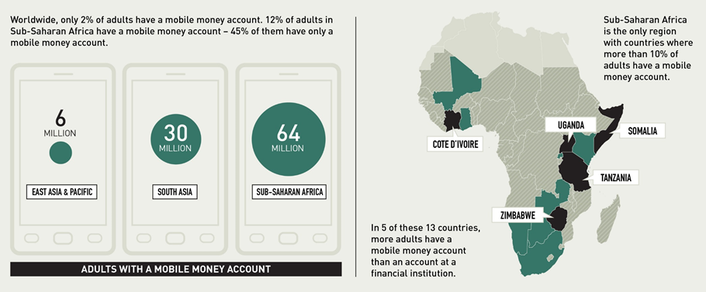
Intro Measurement and Impact Public Policy Focus Areas Main Messages
In Sub-Saharan Africa, Mobile Money Account Ownership Is Driving a Huge Expansion of Financial Inclusion
Source: Global Findex Database, World Bank, Washington, DC. http://www.worldbank.org/globalfindex

Slide 12
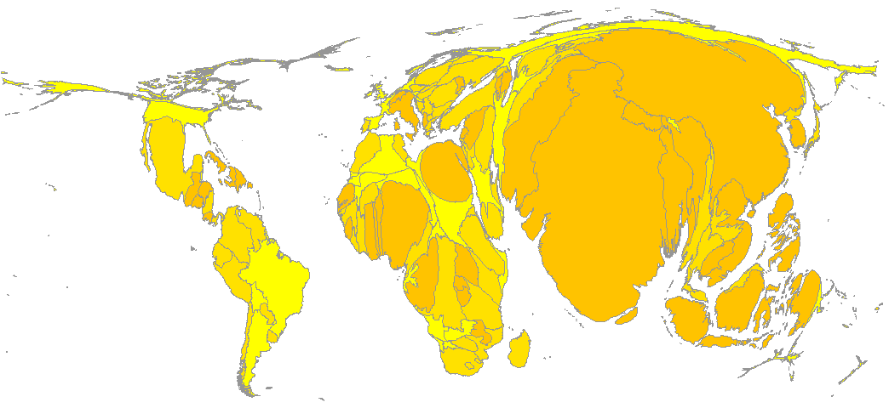
Where do the unbanked live?
Intro Measurement and Impact Public Policy Focus Areas Main Messages
Source: Global Findex Database, World Bank, Washington, DC. http://www.worldbank.org/globalfindex

Slide 13
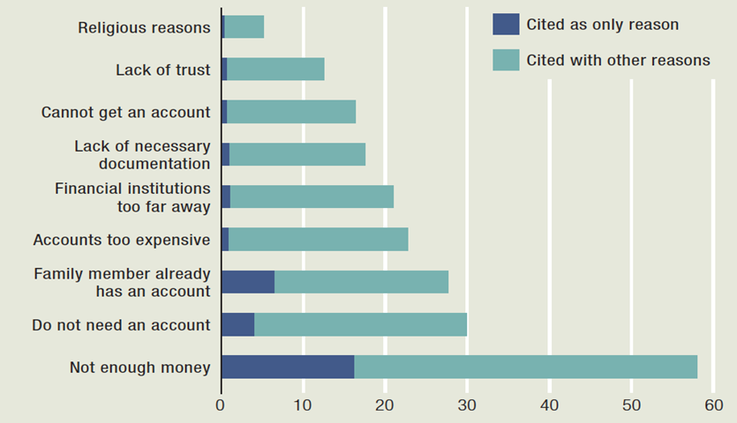
Intro Measurement and Impact Public Policy Focus Areas Main Messages
Self-reported Barriers to Use of an Account at a Financial Institution
Adults without an account reporting barrier as a reason for not having one (%), 2014
Note: Respondents could choose more than one reason
Source: Global Findex Database, World Bank, Washington, DC. http://www.worldbank.org/globalfindex

Slide 14
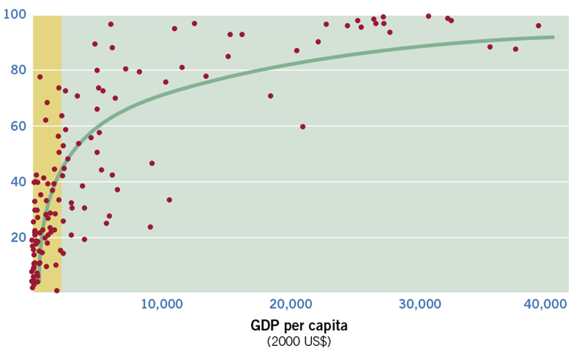
Intro Measurement and Impact Public Policy Focus Areas Main Messages
National Income Explains Much of the Variation in Account Penetration across All Economies—but Far Less among Lower-income Ones
Adults with an account at a formal financial institution (%)
Note: GDP per capita data are for 2010
Source: Dermiguc-Kunt and Klapper 2010; World Development Indicators database

Slide 15
Financial inequality and economic inequality
Intro Measurement and Impact Public Policy Focus Areas Main Messages
Source: Calculations based on Demirgüç-Kunt and Klapper 2012; World Development Indicators database, World Bank.
Note: Higher values of Gini mean more inequality. Data on Gini are for 2009 or the latest available year. Account penetration is share of adults who had an account at a formal financial institution in 2011.

Slide 16
Evidence on impact of financial inclusion
Intro Measurement and Impact Public Policy Focus Areas Main Messages
Empirical evidence on impact varies by the type of financial services
Basic payments, savings: strong evidence on benefits, especially for the poor
Insurance products: also some evidence of a positive impact
Access to credit: mixed picture
  firms: a positive effect on growth, especially start ups, small and medium enterprises
  microenterprises and individuals: evidence on benefits for smoothing consumption, but not always for entrepreneurial ventures

Slide 17
Financial inclusion policy – overall findings from research
Intro Measurement and Impact Public Policy Focus Areas Main Messages
  Policy should focus on addressing market and government failures
  Not on promoting financial inclusion for inclusion’s sake, and certainly not on making everybody borrow
  Direct government interventions in credit markets tend to be politicized and less successful, particularly in weak institutional environments
Role for government in creating legal and regulatory framework and competition policy
  Examples: protecting creditor rights, regulating business conduct, ensuring a competitive environment among financial service providers, improving information systems (credit bureaus, collateral registries), overseeing recourse mechanisms to protect consumers

Slide 18
Financial inclusion policy – overall findings from research
Intro Measurement and Impact Public Policy Focus Areas Main Messages
  Allen, Demirguc-Kunt, Klapper and Martinez Peria (JFI, 2016) explores the individual and country characteristics associated with financial inclusion and the policies that are effective among those most likely to be excluded: poor, rural, female or the young.
  Using global findex data they show:
  Likelihood of owning/using an account is higher among richer, older, educated, urban, employed and married men.
  Greater financial inclusion is associated with lower account costs, greater proximity to financial intermediaries (branch and ATM penetration), stronger legal rights, and more politically stable environments

Slide 19
Financial inclusion policy – overall findings from research
Intro Measurement and Impact Public Policy Focus Areas Main Messages
  Findings on policies:
  Policies such as offering basic or low-fee accounts, granting exemptions from KYC requirements, strong consumer protection and encouraging the use of bank accounts for government payments, practice of agent/correspondent banking increase the likelihood of owning/using a bank account among rural residents.
  Correspondent banking is especially important to increase use of accounts by the poorest.
  Women and youth are somewhat harder to entice
  Studying barriers and focusing on financially excluded individuals who report “not having enough money” as their only barrier:
  Presence of basic or low-fee accounts, correspondent banking, consumer protection, accounts to receive G2P payments lower the likelihood that these individuals cite lack of funds as a barrier

Slide 20
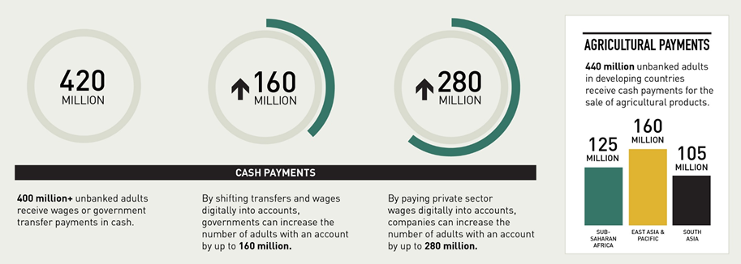
Intro Measurement and Impact Public Policy Focus Areas Main Messages
In Developing Countries, Moving Away from Cash Can Significantly Increase Financial Inclusion
Source: Global Findex Database, World Bank, Washington, DC. http://www.worldbank.org/globalfindex

Slide 21
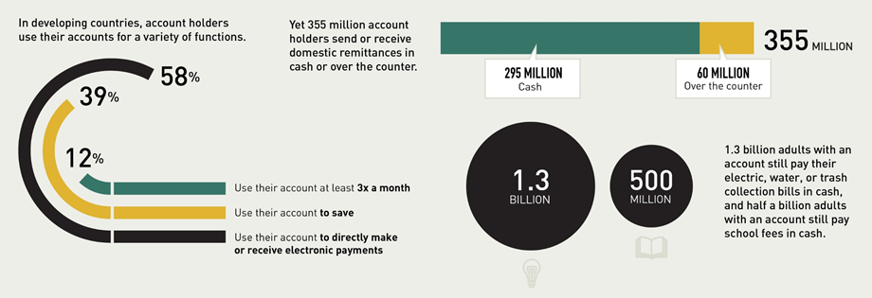
Intro Measurement and Impact Public Policy Focus Areas Main Messages
But What Really Matters Is Whether People Actually Use their Accounts
Source: Global Findex Database, World Bank, Washington, DC. http://www.worldbank.org/globalfindex
Notes:
…and also opportunities to increase account usage

Slide 22
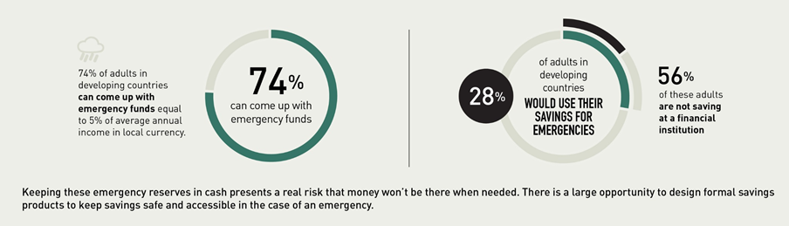
Intro Measurement and Impact Public Policy Focus Areas Main Messages
Financial Inclusion Helps Families Weather Emergencies
Having a safe place to save money can prevent people from falling into extreme poverty when disaster strikes.
Source: Global Findex Database, World Bank, Washington, DC. http://www.worldbank.org/globalfindex

Slide 23
Promoting financial inclusion: focus areas
Intro Measurement and Impact Public Policy Focus Areas Main Messages
Promoting financial inclusion
I. Promise of technology
II. Product design, business models
III. Financial capability

Slide 24
I. Promise of technology
Intro Measurement and Impact Public Policy Focus Areas Main Messages
Technological innovations reduce transaction costs, increase financial security
Scope for scaling up, illustrated e.g. by growth in phone subscriptions
Source: World Development Indicators

Slide 25
I. Promise of technology
Intro Measurement and Impact Public Policy Focus Areas Main Messages
Example: fingerprinting in Malawi (% of balances repaid on time)
Source: Calculations based on Gine, Goldberg, and Yang (2012).

Slide 26
I. Promise of technology
Intro Measurement and Impact Public Policy Focus Areas Main Messages
To harness the promise of new technologies…
…. regulators need to allow competing financial service providers and consumers to take advantage of technological innovations…
…coupled with strong prudential regulation and supervision to prevent overextension.

Slide 27
II. Product design, business models
Intro Measurement and Impact Public Policy Focus Areas Main Messages
Product design that addresses market failures, meets consumers’ needs and overcomes behavioral problems can foster wider use of financial services
Example 1: commitment accounts
Note: The exchange rate was MK145/USD during the study period.
Source: Brune, Giné, and others (2011).

Slide 28
II. Product design, business models
Intro Measurement and Impact Public Policy Focus Areas Main Messages
Example 2: index insurance
New evidence: lack of trust, liquidity constraints constrain demand
(field experiment in India by Cole and others, 2012)
What helps: designing products to pay often and fast, an endorsement
by a well-regarded institution, simplification and consumer education
Source: Giné and Yang, 2009

Slide 29
II. Product design, business models
Intro Measurement and Impact Public Policy Focus Areas Main Messages
Example of an innovative business model: Banco Azteca, Mexico
Improved access can be achieved by leveraging existing relationships
Source: Bruhn and Love (forthcoming)

Slide 30

III. Financial capability
Intro Measurement and Impact Public Policy Focus Areas Main Messages
Classroom-based financial education for general population do not work
Financial literacy can be increased by well-designed, targeted interventions
More likely to work in “teachable moments” (e.g., new job, new mortgage)
Especially beneficial for people with limited financial skills
It helps to leverage social networks (e.g., involve both parents and children)
“Rule of thumb” training helps by avoiding information overload
New delivery channels show promise—example: messages in soap operas

Slide 31
III. Financial capability
Intro Measurement and Impact Public Policy Focus Areas Main Messages
Financial literacy messages seem to have a real-world effect…
… but the effect is short-lived – need to repeat / reinforce
Source: Berg and Zia (2013)

Slide 32
Main messages
Intro Measurement and Impact Public Policy Focus Areas Main Messages
Financial inclusion: critical role in sustainable development, reducing poverty, boosting shared prosperity
Financial inclusion varies widely around the world; poor people and young and small firms face the greatest barriers
Innovative technologies, services, business models, and delivery channels hold much promise for increasing financial inclusion
The role of policy is to address market and government failures, not to increase inclusion for inclusion’s sake
Key areas: strengthening regulations, improving information environment, ensuring competition among providers, educating & protecting customers; so that the private sector has the incentive to embrace new technologies and products
Direct interventions (government banks, subsidies, bailing out borrowers..) tend not to work in sustainably increasing inclusion
Offering basic low-fee accounts, reducing onerous documentation requirements, correspondent/agent banking, digitalization – receiving government payments into bank accounts can increase inclusion

Slide 33
Thank you!
Global Financial Development Report (GFDR) on Financial Inclusion:
www.worldbank.org/financialdevelopment
Global Findex Data and Papers:
Demirguc-Kunt, A. and L. Klapper, “Measuring Financial Inclusion: Explaining Variation in the Use of Financial Services across and within Countries,” Brookings Papers on Economic Activity, Spring 2013.
Demirguc-Kunt, A., L. Klapper, D. Singer and P. Van Oudheusden, “ The Global Findex Database 2014: Measuring Financial Inclusion around the World,” World Bank Policy Research Working Paper 7255.
Allen, F., A. Demirguc-Kunt, L. Klapper and M. S. Martinez Peria, “The Foundations of Financial Inclusion: Understanding Ownership and Use of Formal Accounts,” Journal of Financial Intermediation, forthcoming (2016).
www.worldbank.org/globalfindex

