Slide 1
Everyday Payments
Cómo las tecnologías digitales revolucionan el mercado de pagos
Congreso Asobancaria
28 de Abril de 2016
Notes:
FOCUS
Renew Technology
Scope - Optimize investments
Card issuers invested in technology to provide a service which usually has fix costs to be amortized. They cannot afford to lose competitiveness.
Banks can use the expertise they already have as Card issuers and payment providers and integrate new and existing technologies. They need to renew their existing legacy systems and processes to extract maximum efficiency and performance, while innovating with new technologies.
Create further value
Scope - Taking the lead against competitors
Banks can attract customer and build cross sell opportunities
Non-bank card service provider need to be on the front line by widening your offer range, offering digitally enabled Cards and even dematerialized Cards
Invest to save
Scope - Decrease costs
Card dematerialization would decrease costs of plastic embossing
Additional security as the customer should not open his wallet – this would decrease the risk of Lost/Stolen circumstances and indirectly decreases the costs for the Bank
Improve transaction success
Scope - Increase revenues and customer satisfaction
As MIF gets regulated, Card Issuers need to increase the volume of transaction to sustain their business. The Card must become an easy way of purchase, so customer must be able to recover all relevant information quickly and safely (i.e. open to buy) before making the payment.
Take advantage of the opportunity to localize the customer. When walking by a partner store he could receive notifications about points or rewards. This would also boost partnerships between cards and stores.
VALUE PROPOSITION
Time Saving
Helps customers to make deals and shop instantly because most of the consumers are impulsive shoppers
Smart buy
In London the contactless card can be used to access the metro line. As time goes more and more merchants are allowing contactless cards for small value purchases. The customer is not requested to enter the PIN.
Safer Purchase
Customers would be keen to use the card if they don’t have to open their wallet
IMPACT ON OPERATING MODEL
Terms and Conditions should be reviewed and shaped for the product
Customer might have to sign a new contract
New Card initiation process
Complaints management handling
New card number could be assigned, replacing the one currently in the hands of the customer where he might have third party recurrent payments set up (i.e. phone bill)
IMPACT ON TECHNOLOGY
Provide relevant information to third parties (open to buy, balance, single transaction/daily/monthly limit, loyalties, membership rewards). Build feed automation.
Ensure compliance with regulatory, risk management, security (PCI DSS) and privacy mandates
Provide new card issuing services to make it fit for mobile technology
Implementing mobile analytics

Slide 2
3 temas para la presentación de hoy…
Desafíos y riesgos en el mercado de pagos
Everyday Payments como visión estratégica
Alternativas para la creación de valor en pagos digitales

Slide 3
Connected devices + Internet of Things
…complejidad en el ecosistema
Sensors
Devices
Networks
APIs
Apps
Data
212B
Sensors expected
by 2020
50B
Connected Devices expected
by 2020
2.5B
Connections accessing
4G-LTE networks
by 2020
75%
Fortune 1000 could offer public APIs
by end of 2014.
4.4B
Total number of app
users by 2017
16EB
Mobile data traffic per month by 2018
Location
Billing
Touch Interfaces
User Data
Motion
Mapping
Transaction Data
Gesture
Tracking
Chemical
Social
Field Data
Light
Augmented
Reality
Search
Inventory
Data
Heat
Sound
Marketing
Voice
Recognition
Performance Data
Notes:
DEVICES, DEVICES AND MORE DEVICES
Estimates forecast up to 50 billion connected devices worldwide by 2020. If just one percent of those devices were enabled for payment, it would create between 250 and 500 million new opportunities for commerce activity.

Slide 4
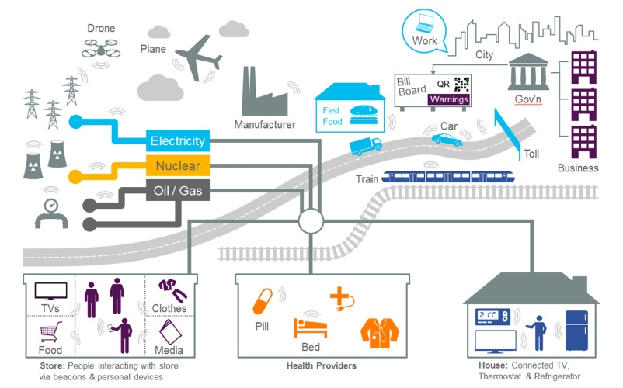
Entorno del mercado de pagos en 2020 - 2022
TEMÁTICAS DOMINANTES
COMERCIO DIGITAL
Real-time account-to-account payments
Addressing Services
Cross-border Commerce
HCE/Tokenised/De-materialised Cards
Crypto Currencies
Digital Wallets
USA y EU 2015:
$132bn ventas mCommerce
25% CAGR
New Entrants
APIs
4

Slide 5

Simple. Personal. Everyday.

Slide 6
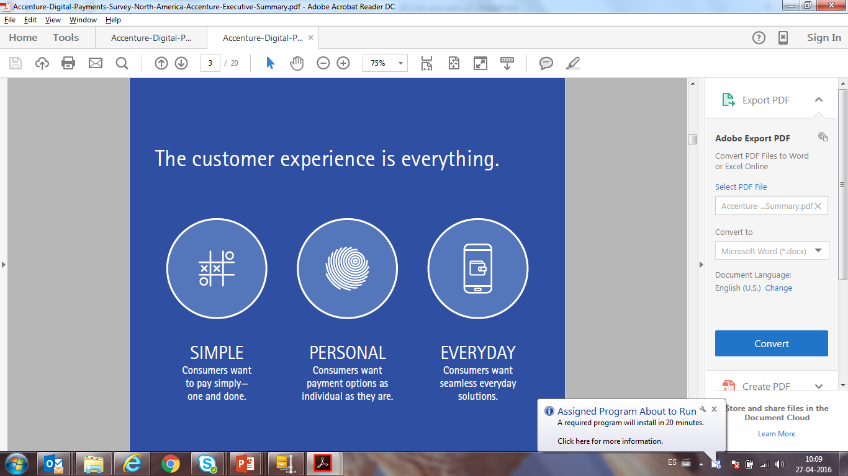
En lo referente a pagos…el cliente manda
…por lo tanto la experiencia de cliente lo es todo
SIMPLE
Clientes buscan pagar de manera simple…“one and done”
PERSONAL
Clientes quieren opciones de pago que sean personalizadas como ellos
EVERYDAY
Clientes demandan soluciones integradas para sus necesidades de todos los días
Notes:
When It Comes to Payments Today, the Customer Rules
Consumer expectations are shaping the future of payments even as new trends evolve and emerge. To win in digital payments, providers must keep it simple, make it personal, and ensure that payment methods are seamlessly integrated into everyday life
KEEP IT SIMPLE: Consumers want to pay with ease-one and done
Usage Expected to Rise: In 2020, consumers expect to use digital payments more including digital wallet (
MAKE IT PERSONAL: Consumers want payment options that are as individual as they are
Incentives Drive Usage Both users and non-users of mobile payments indicate they would increase usage if discounts were offered
MAKING THE EVERYDAY EASY: Consumers want seamless everyday solutions
Connected Commerce Consumers reported interest in initiating payments through smart devices such as cars and appliances
Millennials New data suggest Millennials are key drivers as early adopters of mobile payments

Slide 7
El negocio tradicional de pagos está cambiando
Desafíos de mercado
Palancas estratégicas
Clientes
Alcanzar el siguiente nivel de Customer Centricity
Experiencia de cliente y conexión con el ecosistema
Big data & Analytics
Industria de Pagos
Competencia
Fragmentación en la Cadena de Valor
Digital leader: Apple, PayPal, Amazon, Google
Challengers: Transferwise, Square, Stripe
Participar en el crecimiento del Mercado
Tecnología
Apertura, accesibilidad e inter-conexión
APIs
Blockchain
Internet of things
Cybersecurity
Invertir en nuevos servicios
Eficiencia
Presión sobre las plataformas de Pagos
Tecnologías “legado” para gestión de pagos y procesamiento de transacciones con tarjetas
Alcanzar la excelencia operativa
Convertirse en un proveedor de
Everyday
Payments
Regulación
Regulación sobre el Mercado de Pagos
Cap sobre interchange fees (ej.: IF Reg.)
Acceso a cuentas para otros proveedores (ej.: PSD2)
7
Notes:
Traditional payments business is changing - becoming an Everyday Payment Provider is a strategic lever to overcome multiple challenges

Slide 8


Dilemas a lo largo de la cadena de valor de pagos
Ofrecer nuevas experiencias en adquirencia multi-producto y multi-canal incorporando servicios de valor agregado (ej.: reporting, expense mgmt., loyalty)
Migrar infraestructura, tecnología, operaciones, sistemas, procesos, fraude, sistemas de riesgos de batch a 24/7/365 en tiempo real
3
4
Adquirencia
Procesa-
miento
Adoptar modelos de identificación segura para pagos digitales (ej.: biometrics)
2
5
Proveer disponibilidad inmediata de fondos utilizando infraestructura actual y mejorando la gestión de liquidez
Evaluar crypto-protocols (ej.: Ripple, Ethereum)
Autenti-
cación
Clearing
1
6
Permitir el acceso a terceras partes para la iniciación y servicios de información (ej.: PSD2)
Proveer disponibilidad inmediata de fondos utilizando nuevas infraestructuras real time
Implementar infraestructura de liquidación en tiempo real
Iniciación
Liquidación
Digitalizar la experiencia de cliente
Digitalizar operaciones
Riesgo desintermediación:
  Ingresos
  Datos de cliente y puntos de contacto
Riesgos de ejecución:
  Altas inversiones
  Complejidad de cambio
Source: Accenture Research
8
Notes:
Payment executives will have to answer several questions across the value chain to become an Everyday Payments Provider

Slide 9
El riesgo de desintermediación
PIN debit card case
Cadena de Valor
Iniciación
Autenticación
Adquirencia
Procesamiento
Clearing
Liquidación
Hoy
Bancos Retail
Emisores tarjetas de crédito
Bancos Retail
Barclaycard
First Data
Equens
Visa
Mastercard
China Union Pay
Merchant service charge
(1.4% of billed value)
Interchange fee
40%
Acquirer margin
25%
Processor fee
5%
Network fee
30%
Futuro
(% of rev. at risk)
Apple Pay
(~30%¹)
Square
(100%²)
PayPal, Alipay, Bitcoin
(100%³)
A2A payments
(~70%¹)
Real Time Payments
(~80-90%⁴)
Focos
Digitalizar la experiencia de cliente
Digitalizar operaciones
Notes: 1) 30% of interchange fees – 2) 100% of acquirer margin –3) 100% of merchant service charge - 4) Card processor fee and network fee converted into a processing fee 80%-90% cheaper - Source: Accenture Research analysis on JPMC, FED and Lafferty data
9
Notes:
It is clear that digital is enabling new ways to provide payments services and its impact as well as its potential can’t be underestimated

Slide 10
Ingresos en riesgo en el negocio de pagos
Evolución de ingresos por pagos retail (caso seleccionado EU)
(%, € Bn)
Convertirse en un proveedor de Everyday
Payments
+12.3%
8.2
-32.7%
7.2
-47%
?
-5.0%
-2.6%
-3.5%
-3.4%
4.3
APIs,
Identity mgmt.
Instant payments
Blockchain
Ingresos 2015
Crecimiento Orgánico 2015 - 2020
Ingresos 2020
Cap en interchange fees
Digital wallets (e.g. PayPal)
Apple Pay
Innovative acquirers (e.g.: Square)
A2A payments
Ingresos 2020 después de disrupción
Transformación Digital
Nuevos Competidores
Notes:
Issuing, acquiring and processing fees included
Only cards and account to account payments revenues considered
Interest income from credit cards and cross border retail payments excluded
A2A cannibalise card revenues
Assumptions:
Digital wallets reach a market share of 13% of retail payments volumes
20% of card transactions initiated through Apple Pay in 2020
Innovative acquirers acquire 20% of card transactions in 2020
Account to account payments initiate 20% of retail payments transactions in 2020
Source: Accenture Research
10
Notes:
Up to half of the payments revenues are at risk and new competitors coming from digital may offset all benefits from organic growth

Slide 11
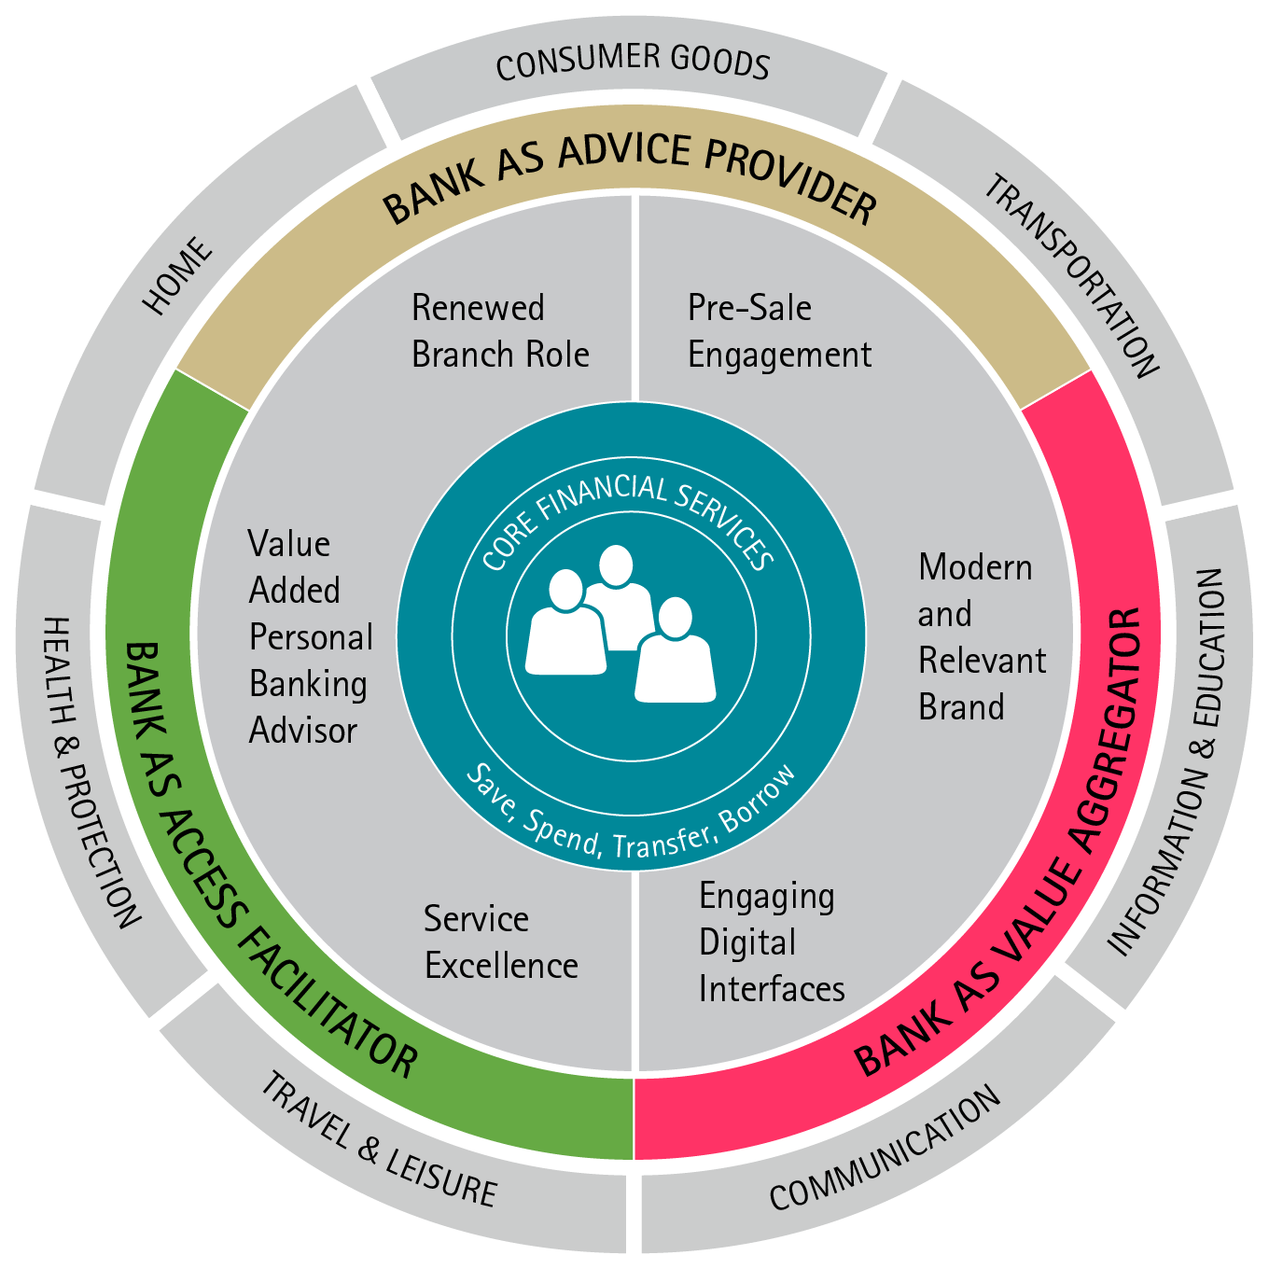
Nuestra visión de Everyday Payments
…en el contexto del Everyday Bank
Everyday Payments… es posicionarse en el centro de las transacciones diarias del cliente
Pagos Digitales…emergen como catalizador para los proveedores de Everyday Payments
Proveedores de Everyday Payments…socios de confianza e indispensables tanto para necesidades financieras como no-financieras
Notes:
Accenture’s vision for Everyday Payments has been created with reference to the “Everyday Bank”— Accenture’s point of view on how digital is revolutionizing banking and the customer ecosystem

Slide 12
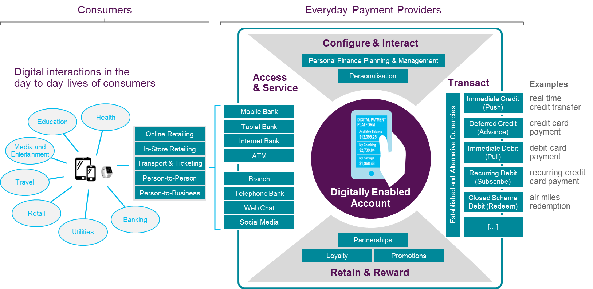


Evolución hacia las cuentas Digitally-Enabled
“Dumb” Funding Account
Digitally-Enabled Account
Notes:
The move to digitally-enabled accounts is inevitable, and presents traditional incumbent banks and payment providers with a stark choice
The Risk of Dumb Accounts…The alternative is dumb accounts - customer interaction, customer insight and branding are lost to third parties

Slide 13
5 prioridades en el ámbito de pagos digitales
Cliente Digital
Negocio Digital
Digitalizar la Experiencia de Cliente
Disrupción de Mercado
1. Soportar Pagos Polimórficos
4. Block-chain para pagos
1
2
3
5. Apalancar la infraestructura para pagos inmediatos
2. Facilitar acceso a servicios de pago vía APIs
Proveedor de Everyday Payments
Foco Externo
Empresa Digital
Digitalización Parcial
4
3. Considerar la agenda de los merchants
5
Digitalizar Operaciones
Business
as Usual
Foco Interno
Source: Accenture Research
13
Notes:
There are 5 digital transformational initiatives which can unlock value by applying digital technologies to different areas
1. Initiate polymorphic payments
Polymorphic payments advises consumers on the most appropriate payments solution, source of funds or funding strategy to use for any particular transaction
2. Access transaction services through APIs
Exposing APIs externally, to encourage the creation of new apps and the incorporation of payments data into 3rd party application, can create value through new business models
3. Address merchant agenda
Enable merchants omni-channel acquiring as well as value added services (e.g.; budgeting & reporting) to address the merchant agenda
4. Shape block-chain for payments
Block-chain as an alternative to existing settlement and clearing infrastructure, may reduce processing costs
5. Ready to leverage immediate infrastructure
Activate competitive real-time domestic and cross-border payments through immediate payments

Slide 14
Everyday Payments Capabilities
1
Experiencia de cliente Simple, Consistente, Atractiva e Integrada
2
Cuentas Digitally Enabled
3
Contact-less y Mobile Contact-less
4
Motor de pagos digitales en Tiempo Real
5
APIs para pagos digitales (ej. Clientes, Merchants, Socios)
6
Conectividad con 3ros (ej. tipos de pagos, monedas alternativos, agregadores para comparación de precios, proveedores de información)
7
Motores de Data Analytics (ej. Monetización de datos, servicios de valor agregado)
8
Notificaciones en Tiempo Real, Monitoreo de Fraude en Tiempo Real

Slide 15
Definiendo una estrategia de Pagos Digitales
Se están explotando capacidades real-time?
Las plataformas de pagos están listas para digital y ser expuestas a través de APIs?
Ofrecemos una experiencia diferencial y relevante para el cliente en servicios de pagos?
Estamos exolorando modelos de Crypto-Currency y Block-Chain?
Estamos preparados para operar en un contexto fragmentado y polimórfico?
Se está innovando en las capacidades de tarjetas para operar en digital?

