Slide 1


Dump Shops Monitoring
Observando las “casas de empeño” del Carding
Jason Passwaters
VP of Intelligence @ Intel 471
jpasswaters@intel471.com

Slide 2

Introduction
12 years in US Marines primarily in Counterintelligence / Human Intelligence (HUMINT)
4 years direct support to cyber investigations for federal law enforcement
  Network Forensics and Intrusion Analysis
  Focused mainly on Eastern European cyber criminals
Last 6 years managing teams around the world in actor-centric cyber threat intelligence collection

Slide 3
Things I noticed….
Inventory and specific card prices fluctuate
Stolen credit cards come from a variety of sources
Shop inventories could provide numerous data points for fraud analysis
Shops do heavy marketing to generate demand
Stolen credit card market is very competitive
Today security/fraud teams not doing analytics on dump shop data
Notes:
- generalize the first bullet

Slide 4
So I thought...pawn shop scenario?
Where might cops look if a neighborhood is being robbed
  Watch the pawn shop for stolen property
  Watch the shop workers/owners who might be involved
  Watch the shop itself for the thief selling stolen property

Slide 5
So the big question was…
Can we monitor the actor’s running credit card dump shops and the shop inventories to identify large breaches and other fraudulent activity?

Slide 6
Where can we access the actors and the dump shops?
Underground Marketplace
Products
Services
Goods
Malware – RATs, banking trojans, ransomware, etc.
Brute force tools and account checkers
Vulnerabilities and Exploits
Bulletproof Hosting
DDOS services
Ransomware as a service
Installs and traffic
Exploit Kit
Cash out and exchangers
Credit card dumps and shops
Fullz information and PII
Database dumps

Slide 7
Marketplace Realities
Must exist to support global cybercrime
Very decentralized and broken down by specializations
Actors are dependent on one another to make money
Reputation and brand are very important
All forums have “levels” of access and privileges
Actors know law enforcement and researchers are present

Slide 8
What are Credit Card Dumpshops?
Online stores that sell stolen credit card information
Currently ~90 shops across the underground
  Only ~12 are considered Tier 1
  Only ~35 are considered Tier 2

Slide 9
Where do they get the inventory?
Actor selling access to POS systems in Colombia and Chile
Global skimming efforts
  Gas pumps
  ATMs
  POS Terminals
Data breaches
  Intercontinental Hotel
  Chipotle
  Sonic & Wholefoods
Insider with access to customer info
Smaller scale Phishing, malware, hacking

Slide 10
Shops provide data points for intel analysis
BIN
Location
Bank Name
Name on account
Partial acct #
Price points
Brand and type of CC
…and more

Slide 11
“Finger on the pulse” through inventory monitoring
Watching for anomalies in inventory to guide analysis
  Price point changes overall and specific BINs
  What’s selling/popular
  Locational anomalies
  Inventory increases (fresh releases)
  Card types / brands
  and more…

Slide 12
Exposure in the underground – price and volume

Slide 13
Detailed analysis of exposure
Notes:
Targeted analysis on specific data sets
Targeted acquisition (via Intel 471) to conduct CPP and other fraud analysis

Slide 14

Value of monitoring shop admins
Very active in specific forums external to the actual dump shop
Discussions with current and potential suppliers of stolen credit cards
Marketing and creating buzz

Slide 15
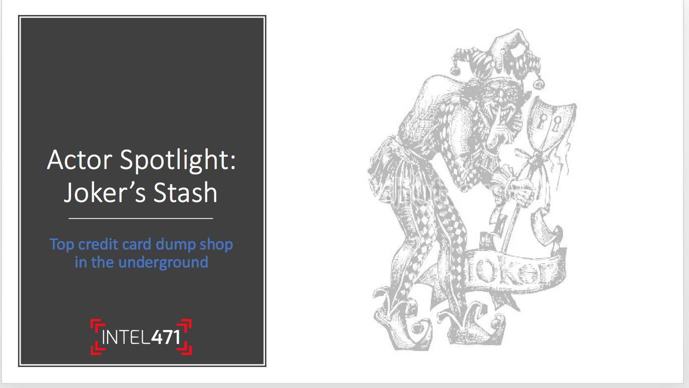

Slide 16
Joker’s Stash – New breach release?
June 17 – JokerStash hinting at a new breach release for Sept

Slide 17
Joker’s Stash – New breach release?
June 17 – JokerStash hinting at a new breach release for Sept
July 23 – reassures the market that new breach will be out in late Aug or Sept

Slide 18
Joker’s Stash – New breach release?
June 17 – JokerStash hinting at a new breach release for Sept
July 23 – reassures the market that new breach will be out in late Aug or Sept
Aug 28 – Provides further details on upcoming release
  5M large
  Lots of US and some EU dumps
  Hints at a Dec breach release that will be EU centric and very large

Slide 19
Joker’s Stash – New breach release?
June 17 – JokerStash hinting at a new breach release for Sept
July 23 – reassures the market that new breach will be out in late Aug or Sept
Aug 28 – Provides further details on upcoming release
  5M large
  Lots of US and some EU dumps
  Hints at a Dec breach release that will be EU centric and very large
Sept 5 - Announces that release is imminent

Slide 20
FireTigerr Released!!!
As expected Joker’s Stash released the FireTigerrr breach release on Sept 18
Our monitoring picked up on this on June 17
We provided intelligence to our financial services clients that helped lead to the identification of the source of the breach
  Sonic
  Whole Foods (Amazon)

Slide 23
What do we know from targeting Joker’s Stash?
Appears FIN7 and Joker’s Stash have a working relationship
FireTigerr released with ~5M dumps well before any breach victim knew
Late December: EU centric with larger than Hakunamatata (>10M dumps)

