Slide 1

51st Colombian Banking Summit, June 2nd, 2016 Cartagena de Indias
Perspectives of Risk and Liquidity for the New Global Economy Scenario
Sylvester Eijffinger
Tilburg University (PPP, CentER)

Slide 2
Balance sheet of the Fed (Assets side)
Source: Federal Reserve System.

Slide 3
Balance sheet of Bank of Japan (Assets side)
Source: Bank of Japan.

Slide 4
Balance sheet of European Central Bank (Assets side)
Source: European Central Bank.

Slide 5
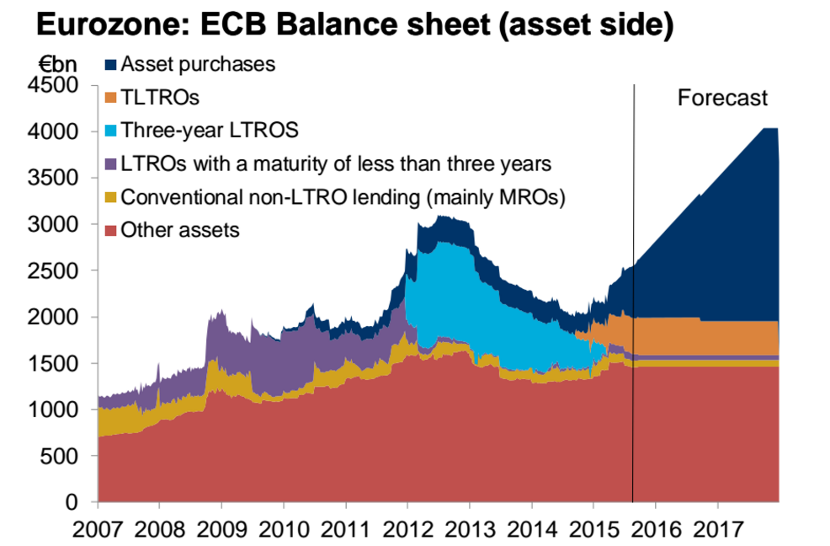
Balance sheet of European Central Bank (Assets side)
Source: European Central Bank.

Slide 6
Balance sheet of European Central Bank (Assets side)
Source: Bank of England.

Slide 7
Interest rates in United States
Source: Federal Reserve System.

Slide 8
Interest rates in Japan
Source: Bank of Japan.

Slide 9
Interest rates in Euro Zone
Source: European Central Bank.

Slide 10
Interest rates in UK
Source: Bank of England.

Slide 11
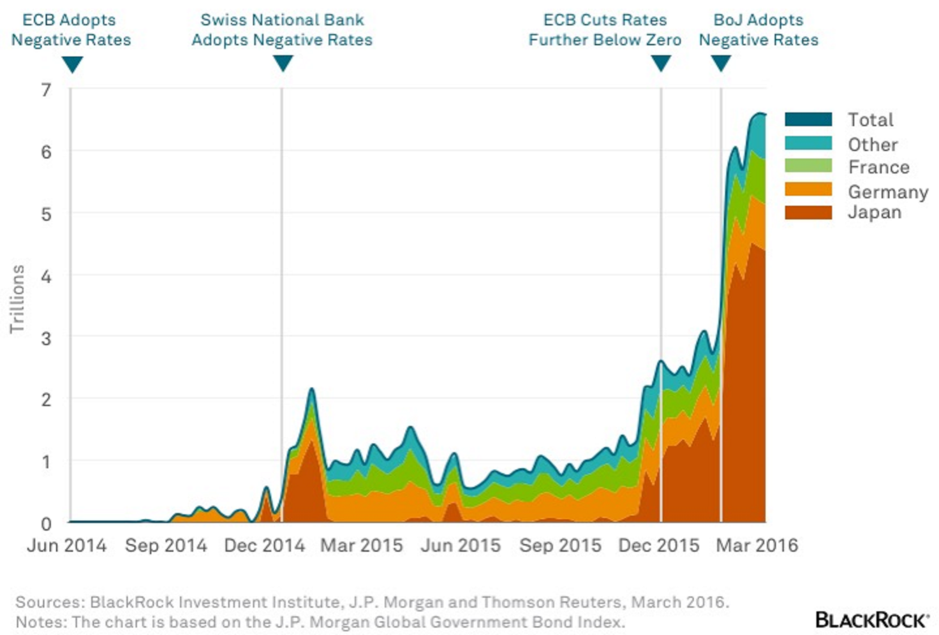
Government Bonds with Negative Yields 2104-2016
Source: BlackRock.

