Slide 1

FinTech and Regulation
September 22, 2016
Kim Prior

Slide 2
Agenda
FinTech Overview – what is FinTech? Types of FinTech products and services
How is FinTech Regulated?
Regulatory Iniatives to Promote FinTech
Effect of FinTech on Existing Financial Insitutions

Slide 3
FinTech Overview

Slide 4
What is FinTech?
Payments
Describes the intersection between software and technology to deliver financial services.
May refer to technical innovation applied in a traditional financial services context or to innovative financial services offerings that disrupt the existing financial services market.
Financing
Investments
FinTech
Big Data
Advisory
Insurance
Notes:
What is FinTech?
FinTech – a contraction of “finance” and “technology” is the use of technology in the financial services industry resulting in the introduction of new and innovative products and services, primarily through software. At the same time however, FinTech disrupts and challenges the way conventional financial services and products are offered by granting access to untrodden markets through alternative services backed by technology.
FinTech has resulted in the emergence of alternative financing through peer-to-peer lending and merchant financing by electronic marketplace operators to merchants. Other FinTech advances include equity crowdfunding; digital currencies which operate independent of any central authority or banks; payment and remittance systems which bypass traditional banking channels; and the use of big data and analytics to maximise available customer data to further leverage on customer relationships.

Slide 5
Growth of FinTech
Statistics:
  Forcasted that over $4.7 trillion of revenue at traditional financial services companies is at risk of disruption by FinTech companies
  FinTech firms attracted $19 billion in investment in 2015
FinTech has emerged due to:
  technology (social networks, big data)
  favorable regulatory environment
  demographics (rise of the millenials)
  mobile financial services provide cheap banking solutions to the unbanked

Slide 6
Where Fintechs are (EY study)
Place | Market Size | Investment | Fintech staff | Characteristics
NYC | 7.5bn | 1.9bn | 57,000 | close to markets 1st generation incubators & accelerators
California | 6.3bn | 4.8bn | 74,000 | mature FinTech community established connections large VC funds
UK | 8.9bn | 707m | 61,000 | global financial hub progressive government & reg. effective network of hubs
Germany | 2.4bn | 524m | 13,000 | mostly credit & lending increasing focus on b2b complex startup environment
Hong Kong | 0.9bn | 62m | 8,000 | relatively nascent market community focused on capital markets
Singapore | 0.9bn | 50m | 7,000 | gateway to Asia easy to do business, English dedicated team at regulator
Australia | 0.8bn | 267m | 10,000 | emerging Fintech ecosystem 0.9bn commitment to innovation

Slide 7


Examples of FinTech
Peer to peer or marketplace lending platforms
lending to individuals or businesses through online services that match lenders directly with borrowers
operation of lending platform may be regulated
Equity crowdfunding
funding a project or venture by raising money from a large number of people
may be regulated for arranging securities transactions or operating an unregulated investment fund
crowdfunder
Roboadvice
automated financial advice (computer based algorithms and decision trees)
may be subject to adviser registration/regulation

Slide 8


Examples of FinTech
Virtual currencies
Bitcoin etc. might constitute currencies if the trading in them is regulated; also raises AML issues
On-line payment accounts
accounts through which you can send money, make payments online, and receive money
may be regulated as non-bank payment institutions
Payment initiation services
service used to initiate a payment to another party

Slide 9
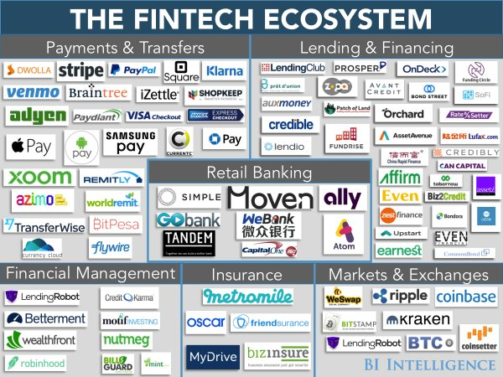

Slide 10
Marketplace Lending
Typical model for marketplace lending:
  borrowers apply for a loan on a marketplace platform;
  accepted loan applications are then originated by a partner bank (LendingClub and Prosper use Utah-based WebBank);
  the MPL performs the underwriting of the loans, using criteria agreed with the partner bank
  platforms purchase the loan from the partner bank;
  the platform issues a note to lenders, instead of a contract.
Marketplace or “peer-to-peer” lending platforms make a profit from arrangment fees rather than the spread between lending and deposit rates
Marketplace lending has grown due to low interest rates, low default rates, improved lending process and scarcity of consumer credit

Slide 11
Marketplace Lending
Partnerships between banks and MPLs are becoming increasingly common in the US. BBVA Compass bank, for example, partners with OnDeck to originate small business loans through the platform by referring customers for smaller loan amounts.
Other bank partnerships focus on funding, i.e. rather than simply referring the loan on to an MPL, the bank provides the funding themselves. For example, LendingClub and Citigroup announced a partnership in April 2015 in which Citigroup provides borrowers on the platform with funding through the Varadero Capital hedge fund, which takes on the first loss risk.
These arrangements allow banks to provide funding to higher risk individuals or SMEs, while passing much of the credit risk on to investors.

Slide 12

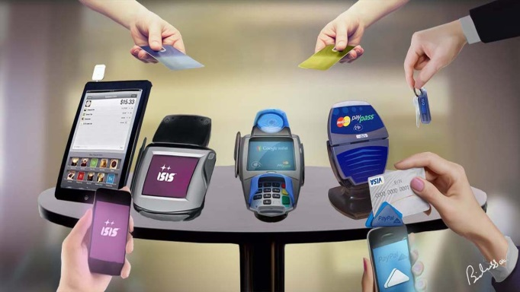
Mobile Payments
Figures show the largest usage of mobile payments
are those who do not have a bank account (45%).
Likely that those combining hardware and software,
such as Apple Pay and Samsung Pay, will be the
dominant players.
The following factors might increase the
use of mobile wallets:
  more Global Mobile Wallet
  Providers
  more Smartphones
  more Merchant acceptance
  of contactless payments
Notes:
More Global Mobile Wallet Providers (with value added services). With the addition of Android Pay and Samsung Pay to Apple Pay, virtually everyone with a smartphone has a mobile wallet option and a reason to use their phone instead of their plastic.
More Smartphones. There will be more smartphones with both NFC and biometric capabilities. By 2020, there will be 6 billion in the global market (with most having biometric security features). That’s a stark difference from the 2.6 billion smartphones in today’s market – most of which do not have biometric capabilities.
More Merchant acceptance of contactless payments. Many of the new terminals that merchants are implementing support both contactless payments and EMV chip. Many European countries are seeing high growth in contactless payments once the terminals are in place. The U.S. will see similar growth.

Slide 13
Mobile Payments
Mobile payment solutions may involve a mobile
network operator (MNO) participating in the offering
along with a financial institution.
For some mobile payment solutions, the handset is
simply a device for authentication and there may be
no wider involvement of the MNO.
Examples of new innovations:
  NFC terminals
  Mobile POS
  Retailer Mobile Apps
  Digital Wallets
  Peer to peer mobile payments
Notes:
What is a mobile payment?
It is the ability to use a mobile phone (or a sticker attached to a mobile phone) to make contactless (or "near-field communication" (NFC)) payments for goods and services at the point of sale. The payments are made from a stored value (or electronic money) account held with a financial institution. The service will be accessed through an app downloaded onto the mobile phone, typically into a "wallet" provided by the mobile network operator, and/or a website operated by the financial institution.

Slide 14
Blockchain Technology
A ‘blockchain’ is the cryptographic technology
that underlies bitcoin. It is effectively a public ledger of all transactions that have ever been executed with that bitcoin.
Blockchain technology has other applications, for example, the NASDAQ exchange will soon start using a blockchain-based system to record trades in privately held companies.
Blockchain technology introduced in the back-office in order to settle transactions and keep track of money flows in real-time has the potential to be the efficiency innovation in payments.

Slide 15
InvesTech
“Robo Adviser” for investments – automated wealth managers offering financial advice
Based on KYC information, they offer tailor-made investment solutions, typically based on mutual funds / ETFs
More sophisticated models are being deployed using artificial intelligence
Typically, a license is required to provide these services

Slide 16
Big Data
“Big Data” means:
  using new or expanded datasets and data, including data from unconventional sources such as social media
  adopting the technologies required to generate, collect and store these new forms of data
  using advanced data processing technologies
  using sophisticated analytical techniques such as predictive analytics
  applying this data knowledge in business decisions and activities
By analyzing payment information, firms can build an insight into customer intelligence and behaviors that they may be able to monetize.

Slide 17
Big Data
Offers can be driven by analytics into a combination of historical payments information and big data analysis of demographics, location positioning and peer group analysis.
By understanding customer behavior, firms can target new customers and cross-sell to existing customers.
Firms can incorporate transactional-level data analysis
within credit risk model development.
Firms can give customers access to their own data, and
help them manage their finances via apps that make use
of the data.
Big Data can be used to identify problems, for example,
how credit lines are being used against agreed limits and
to identify payments patterns of potential interest.

Slide 18
RegTech
RegTech broadly means technologies that facilitate
the delivery of regulatory requirements.
Deutsche Bank, JP Morgan, Santander and HSBC have
all allocated teams to explore investment opportunities
in the RegTech sector.
Governments are beginning to work with companies to identify ways to support the adoption of new technologies to facilitate the delivery of regulatory requirements.
RegTech can reduce a client’s regulatory and compliance costs, automate the certain compliance tasks and reduce risks.

Slide 19
Benefits
User anonymity: Privacy
Transparency of transactions
Cheaper and faster transactions
Cyber-crime defense
Financial inclusion
Risk
User anonymity: Crime
Lack of government intervention
Volatility
Low consumer protection
Terrorist financing

Slide 20
Additional Risks from FinTech
Businesses focused on the “Tech” and not the “Fin”
may lack banking experience
Cybercrime
Data security/data protection
Potential user anonymity/AML risk
Volatility created by ease and speed of transfer of funds
Increasing regulatory scrutiny

Slide 21
Regulation of FinTech

Slide 22
Principles Underlying FinTech Regulation
Regulators’ responses to technological developments in the financial services industry derive from a number of often-competing principles and objectives.
Consumer Protection
Privacy
Data Security
Anti-Money Laundering
Anti-Terrorism Financing
Cybersecurity
Tax Evasion
Promoting Innovation
Access to Finance
Fair Lending
Job Creation

Slide 23
Factors Impacting Regulatory Authority
A combination of various factors and elements relevant to any individual FinTech company will determine how regulations will impact its business.
Company Domicile
Activities & Practices
Product Offerings
Size
Customer Type
Transaction Location
Regulatory Agency Authority
Applicable Laws & Regulations
Licensure & Registration Requirements
Permitted Activities
Compliance Requirements
Disclosure Requirements

Slide 24
Approaches to FinTech Regulation
Active Approch:
  Regulators work closely with startups to understand new fintech developments and upcoming obstacles and to help startups address these challenges
    Examples: early collaboration with industry in drafting regulation; regular feedback/explanations of rationale during regulation process, collaboration with startups to help develop their product aligned with regulation
  Requires intensive use of regulatory resources and risk that agencies will become overwhelmed
  UK’s Financial Conduct Authority (FCA) uses an active approach

Slide 25
Approaches to FinTech Regulation
Passive Approach:
  National regulators do not play an active role in trying to make fintech companies succees, but they don’t stand in their way. German regulator, BaFin, has historically taken this approach
Restrictive Approach:
  Governments that are risk averse, have large bureaucracies or fear regulatory capture by the industry may take this approach. The United States is an example.

Slide 26
Regulatory framework in the U.K.
Regulation can facilitate but also be a barrier to entry
light touch regimes assist new entrants with lower regulatory costs than mainstream banks
regulatory status builds credibility
but regulation is now being extended to previously unregulated areas
EU “lighter touch” regimes: The Payment Services Directive and The Electronic Money Directive
Permit e.g., payment accounts/prepaid cards

Slide 27
Regulatory framework in the U.K. (cont.)
The new Payment Services Directive (PSD2) will extend regulation to payment initiation services.
Lending platforms have also been brought into the regulatory net.
The UK, for example, makes it a regulated activity to operate an electronic system in relation to lending.
The area of payments is subject to increasing regulation, for example, the Interchange Fee Regulation.

Slide 28
Regulatory Framework in Singapore
Crowdfunding – MAS issued a consultation paper in Feb 2015
to propose “lighter touch” regulation for equity crowdfunding entities,
which are currently required to hold a capital markets services licence
  In June 2016, MAS moved to improve access to crowdfunding for startups and small and medium enterprises by:
    allowing operators of securities based crowdfunding (SCF) to rely on existing regulations for small offers, raise funds from retail investors and reduce the necessary vetting of retail investors; and
    reducing the financial requirements for SCF platform operators that want to raise funds through SCF only from accredited and institutional investors.
Bitcoins – MAS regulates virtual currencies for AML/CFT risks. Proposed regulation of digital currency exchanges under provision for startups that provide money transmission and conversion services in August 2016.

Slide 29
Regulatory Framework in Singapore (cont.)
Digital payments – innovation among banks with regulatory support
  Fast and Secure Transfers (“FAST”) in March 2014 – participating banks make domestic fund transfers to another almost instantaneously from computers or mobile devices.
  Retail banks have their own mobile wallets or mobile payment applications
    DBS PayLah!, UOB Mobile Cash, OCBC Pay Anyone, StanChart Dash, Maybank Mobile Money
    MAS wants to reduce the role of cash and checks in its economy by encouraging switch to digital payments. MAS is asking banks to pass on to consumers the full cost of paper-intensive services, like check processing.
Disruptive innovation center
  MetLife LumenLab launched in July 2015 with support of government and EDB to develop disruptive business models in wellness, wealth and retirement
  Looking glass @ MAS launched August 2016 to allow MAS to experiment with FinTech solutions for financial institutions, startups and technology vendors

Slide 30
Regulatory Framework in Hong Kong
Stored value facilities and retail payment systems
  New licensing regime introduced Nov 2015 to regulate both
  physical and non-physical device-based forms of SVFs; and
  designated RPSs (eg. larger payment card schemes, merchant acquirers, payment gateways and mobile infrastructure)
Digital payments –
  HKMA revised supervisory policy Sept 2015 enabling licensed lenders to provide P2P small-value payment and mobile services
  Banking sector has adopted enhanced retail payment services:
  e-Cheque, Electronic Bill Presentment and Payment (“EBPP”) system, and Near Field Communication (“NFC”) mobile payments
  SFC/ HKMA guidance notes/ circulars –
    e.g.: Potential risks and regulations applicable to crowdfunding; AML risks associated with Virtual Commodities (Bitcoin) etc.
Notes:
P2P mobile services: bank customers will no longer be required to go through double verifications to transfer small amount of funds to a third party’s clients via internet banking. HKMA is also allowing, for the first time, bank clients to use mobile devices such as smartphones to transfer funds to a non-preregistered account of a third party’s clients.
The new policy will enable individuals to channel funds among friends. Account registration on smart phone will take one day to be effective as a security precaution
e-Cheque: Launched December 2015, the e-Cheque initiative aims to turn the cheque writing and presentment processes totally online. The e-Cheque, with similar image layout of the paper cheque and exists in PDF format, can be issued any time anywhere, removes the need for physical delivery and deposit, supports a high level of system automation to allow enhanced processing efficiency, is environmentally friendly, and carries enhanced security features.
EBPP platform: Launched December 2013, supports a wide range of services including (a) business-to-customer e-billing and e-payments; (b) online charity donations and electronic donation receipts; (c) cross-border e-billing and e-payments; and (d) business-to-business e-billing and e-payments.
NFC mobile payments,: HKMA, published a set of common standards and recommended best practices in November 2013, laying foundation for the banks and payment services providers to develop such a service.

Slide 31
US Financial Regulatory System: Overview
Fragmented Structure
Industry
The US financial regulatory system is a multi-layered, fragmented system.
5 federal agencies directly examine and supervise financial institutions, and 20+ federal agencies regulate various aspects of financial products.
Many parallel regulatory agencies exist in each of the individual states.
Consumer
Mandate
Determinants of Regulatory Authority
Location
Activity
Product

Slide 32
FinTech Regulation in the US
Any financial institution (including a FinTech company) is likely to be impacted by multiple federal and state regulatory authorities.
In addition to the federal regulations, regulations at the individual state level may apply to specific businesses or activities, such as:
  Money transmitter licensure requirements
  Consumer lender registration requirements
  Investment advisor regulations
There is no unified definition or scope of FinTech regulation today in the U.S., though regulators are considering possibilities, including a special Fintech charter.
Each FinTech company must evaluate its regulatory environment on an individual basis in order to identify which regulatory agencies have authority over the company and which laws and regulations apply to the company and its activities.

Slide 33
Regulatory Initiatives to Encourage FinTech

Slide 34
Regulatory Sandbox
A “regulatory sandbox” is a safe space where businesses
can test innovative products without immediately incurring the
normal regulatory consequences (e.g., no enforcement actions).
In the UK, the FCA will authorize sandbox firms with restrictions (non-banks only), allowing them to test their ideas. However, there have been doubts over how effective this will be as firms will still need
to be authorized, which requires time and resources.
Singapore also issued guidance to establish a regulatory sandbox in June 2016 , though the sandbox will have little involvement by regulators
Australia and Hong Kong are also in the process of developing a regulatory sandbox
One US regulator is considering a sandbox, though no safe harbors from regulation would be available

Slide 35
Passport System
Allows a company to “passport” its business to another country without applying for a separate license in that country.
System used by the UK and EU (should be watched as a result of Brexit)
Encourges innovation by significantly reducing the costs of duplicative applications, audits, and reporting requirements in multiple jurisdictions
U.S. does not have this concept throughout the many states

Slide 36
FinTech Bridges
Fintech bridges are cooperation agreements or partnerships between countries for the purpose of making it easier for FinTech companies to pursue new opportunities in both countries and attract investment.
Makes compliance in multiple countries easier and cheaper for FinTech companies.
Recent Agreements:
  UK and Australia (March 2016)
  Australia and Singapore (April 2016)
  UK and Singapore (May 2016)

Slide 37
Tax Concessions
Governments in pro-FinTech countries are attempting to support the FinTech industry through tax concessions and/or tax incentives.
Examples:
  Australia – In March 2016, new legislation was introduced providing significant tax incentives to promote local and foreign investment in innovative start-ups as part of the National Innovation and Science Agenda. These incentives included a capital gains tax exemption and non-refundable carry forward tax offset
  U.K. - The Seed Enterprise Investment Scheme (SEIS), Enterprise Investment Scheme (EIS), andEntrepreneurs’ Relief on capital gains tax

Slide 38
Innovation Agencies/Offices
UK and Australia both have innovation hubs to help FinTech start ups through the authorization process and to provide support in complying with regulations
Singapore also has an office designed to help startups become established in the country
The Hong Kong Monetary Authority created a fintech facilitation office to build a platform for industry liaisons, to be the bridge between the industry and supervisors and to initiate industry research
OCC in US looking at establishing Central Innovation Office

Slide 39



Regulatory Approach to Innovation – Singapore
  FIs are free to launch new ideas without first seeeking MAS’ endorsement provided they are satisfied with their own due diligence (e.g. involving their compliance people early in the innovation process)
  Innovation in a “sandbox”
  FIs can seek MAS’ guidance on conditions for the launch of their innovative products or services
  Innovation through co-creation
  MAS will engage and work together with industry players to develop rules
Ownership
Sandbox
Co-creation

Slide 40
Government Initiatives - Singapore
Smart Nation and Smart Financial Centre – Singapore
as a FinTech hub
Financial Sector Technology and Innovation (“FSTI”) - MAS commits SGD$225m ($167m) over the next 5 years to FinTech innovation
Within MAS, FinTech & Innovation Group (“FTIG”) formed on 1 Aug 2015 - responsible for regulatory policies and development strategies to facilitate the use of technology and innovation to better manage risks, enhance efficiency, and strengthen competitiveness in the financial sector.
Notes:
FSTI funds can be used for:
innovation centres: to attract FIs to set up their R&D and innovation labs in Singapore.
institution-level projects: to catalyse the development by FIs of innovative solutions that have the potential to promote growth, efficiency, or competitiveness.
industry-wide projects: to support the building of industry-wide technology infrastructure that is required for the delivery of new, integrated services.
MAS plans to attract financial firms to develop R&D centres in Singapore. Current firms with R&D centers on the island include Deutsche Bank, UBS, Metlife, Citibank and Credit Suisse. In addition to those firms, Menon stated that other companies “are in the pipeline” with their developments to open technology centers.

Slide 41
Government Initiatives - Singapore
FTIG Comprised of
  Payments & Technology Solutions office - formulate regulatory policies and develop strategies for simple, swift and secure payments and other technology solutions for financial services
  Technology Infrastructure Office - responsible for regulatory policies and strategies for developing safe and efficient technology enabled infrastructures for the financial sector, in areas such as cloud computing, big data, and distributed ledgers.
  Technology Innovation Lab – to scan the horizon for cutting-edge technologies with potential application to the financial industry and work with the industry and relevant parties to test-bed innovative new solutions.
Government initiated start-up incubator or accelerator programs
Notes:
FSTI funds can be used for:
innovation centres: to attract FIs to set up their R&D and innovation labs in Singapore.
institution-level projects: to catalyse the development by FIs of innovative solutions that have the potential to promote growth, efficiency, or competitiveness.
industry-wide projects: to support the building of industry-wide technology infrastructure that is required for the delivery of new, integrated services.
MAS plans to attract financial firms to develop R&D centres in Singapore. Current firms with R&D centers on the island include Deutsche Bank, UBS, Metlife, Citibank and Credit Suisse. In addition to those firms, Menon stated that other companies “are in the pipeline” with their developments to open technology centers.

Slide 42
Regulatory Approach to Innovation – Hong Kong
  Existing rules and regulations can be adequately applied to new business models
  Offers to public to purchase securities: SFO licensing and CO registration requirements;
  existing privacy, AML,
  KYC, money-lending and
  deposit-taking requirements
  Facilitate communication between regulators and fintech community
  Establish dedicated contact points at financial regulators
  Focus on assisting new entrants to understand HK’s existing regulatory landscape
  Keep an open mind when considering whether existing rules should be amended
  Be mindful of evolving landscape and various international approaches
  Be open to changing rules to support financial innovations that benefit consumers and the business sector
Apply existing framework
Open Communication
Open Mind

Slide 43
Government Initiatives – Hong Kong
Steering Group on Financial Technologies: est. April 2015 by FSTB
Cyber security framework: HKMA to develop cyber security
framework for FIs (involving cyber maturity assessment model; cyber intelligence sharing platform and professional certification)
SFC channels:
  Fintech Contact Point (est. March 2016): a dedicated channel to encourage fintech startups to engage with the SFC
  Fintech Advisory Group (est. March 2016): to focus on opportunities, risks and regulatory implications of Fintech developments
  Incubation, Accelerator and other funding programs: targeted funding support for early/seed-stage entrepreneurs: eg, Cyberport Incubation Programme; Cyberport Accelerator Support Programme; Hong Kong Science & Technology Parks Corporation Incu-Tech and Incu-App programmes; Innovation and Technology Venture Fund.
Notes:
Funding: For early- and seed-stage entrepreneurs, pre-incubation and incubation programmes offered by Cyberport (Cyberport Creative Micro Fund “CCMF”), Cyberport Incubation Programme and Cyberport Accelerator Support Programme (“CASP”)) and HKSTPC (Incu-App Programme, for developers of mobile/web apps, and Incu-Tech Programme, for startups in IT, electronics and other technologies) provide financial support as well as access to advanced facilities and resources, mentorship, support in business development, professional consultancy including business plan, marketing, accounting and legal services, and entrepreneurship and technology training.
Others include: HKSTPC corporate venture fund; and Hong Kong Mortgage Corporation Limited’s Microfinance Scheme (ie, offers Micro Business Start-up Loans, Self-employment Loans and Self-enhancement Loans to assist people who wish to start their own businesses, become self-employed or achieve self-enhancement through training, upgrading of skills or obtaining professional certification).
Cyberport is a leading ICT hub - creative digital community with a cluster of technology and digital content tenants.
Hong Kong Science & Technology Parks Corporation:statutory body dedicated to building a vibrant innovation and technology ecosystem to connect stakeholders, foster technology talents,

Slide 44
Effect on Existing Financial Institutions

Slide 45
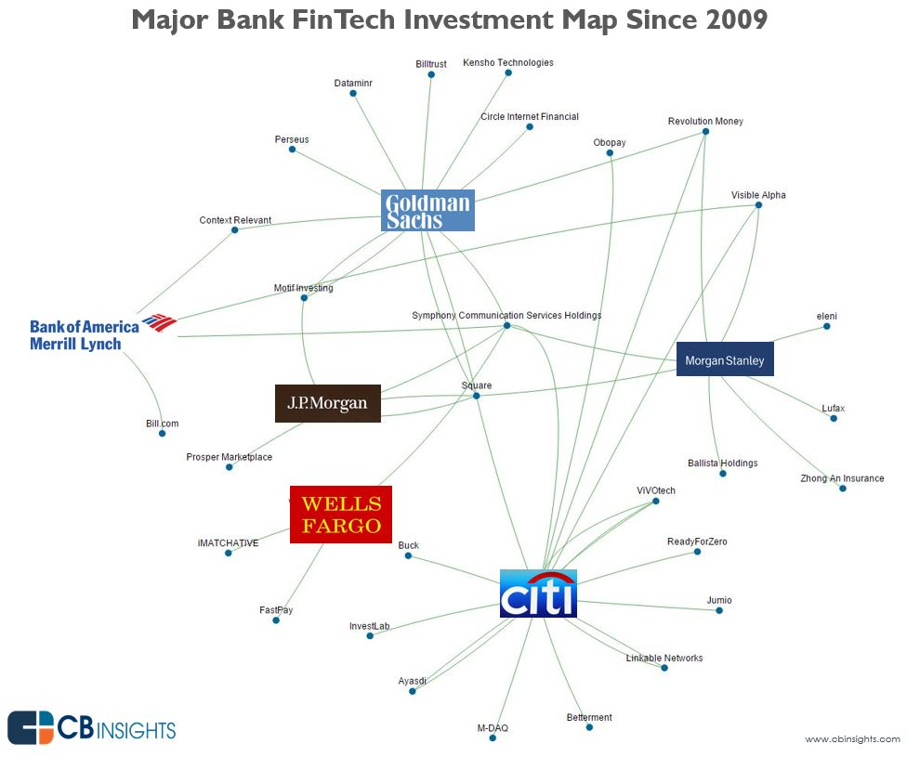
FinTech Trends in the US
  Increased activity in FinTech from the traditional banking industry
  Major banks have made strategic investments in FinTech companies that are disrupting traditional banking segments, with significant overlap among the banks’ investments.
  45 banks have joined the R3 project to develop sector-wide standards for blockchain.
  Some banks are creating their own online lending platforms (e.g. Goldman Sachs), while others are forming partnerships (e.g. JPMorgan and OnDeck).

Slide 46
Bank Investment in FinTech
Many major banks around the world now have either a startup program to incubate fintech companies, is putting aside venture capital to fund them or is partnering with, acquiring or launching their own fintech startup.
Barclays is creating a global community for fintech innovation, including opening an accelerator in New York’s Silicon Alley.
Within AsiaPacific, ANZ Bank has appointed “an international panel of technology experts” to advise its Board on the strategic application of new and emerging technologies and technological trends that could affect the bank’s strategy

Slide 47
Banks vs. Startups - Challenges
Startups:
  startups are trying to navigate the regulatory landscape
  startups will have to find a way to maintain profitability while facing increased regulations, higher costs, and larger infrastructures that will be more difficult to change and manage
Banks:
  Banks are investing more heavily in innovation, but haven’t fully diffused their innovation strategies throughout their organizations
  Banks will have to find a way to develop new platforms compatible with infrastructure
  Digital disruption has the potential to shrink the role and relevance of today’s banks, and simultaneously help them create better, faster, cheaper services that make them an even more essential part of everyday life for institutions and individuals

Slide 48
Existing FIs vs. FinTech – Regulatory Obligations
Existing FIs have defined and known regulatory licensure and compliance obligations – banking and securities
New Fintech companies, in certain jurisdictions (e.g., UK), have lighter regulation, which makes it easier and cheaper for them to compete
In other jurisdictions, such as the U.S., because of lack of regulation of certain Fintech companies, licensure and compliance obligations can be more costly and burdensome

Slide 49
Challenges Facing Fintech in U.S. – Regulatory Perspective
In the U.S., banks and financial institutions have a clear understanding of regulators and regulations.
No definitive regulations or regulators for FinTech firms yet. Proposals by regulators indicate that regulators are approaching FinTech regulation through existing structure and without coordination with other regulators, even with respect to the same technology.
U.S. regulators are asserting examination and enforcement authority without clear regulations or guidance (e.g., CFTC finding through enforcement action that bitcoin is a commodity and must be licensed/regulated to participate in bitcoin derivative transactions)

Slide 50
Advantages Banks have over FinTech
Reasons why nonbank fintech firms still face big challenges in competing with banks:
Banks have have history and trust with their customers
  Banks are far too ingrained with their customers to be removed within any foreseeable time frame. Business partners and customers have been using the services of banks since well before the technology boom. There is a history and trust that exists between banks and their customers that fintech is still years away from rivaling.
Banks have the deeper pockets
  The market capitalization of FinTech companies is significantly lower than traditional banks. Banks also usually have better name recognition. Having such a large market cap is a signal of security to customers. On the other hand, smaller cap companies are more susceptible to turbulence and market volatility — things business customers would rather avoid.

Slide 51
Bank Advantages (cont.)
Banks’ have larger sales forces and customer service infrastructure.
  Banks maintain robust sales and development programs. Although Fintech has made strides in improving the efficiency and ease of use for consumer products, traditional financial institutions have the physical sales force that is best equipped to help customers recognize and navigate technological and structural changes.
  Fintech companies usually have smaller marketing and sales organizational structures, favoring digital solutions over humans. Customers often need and prefer personal interaction and confirmation when dealing with money management and making any changes.

Slide 52
Bank Advantages (cont.)
Banks have big data.
  Although several fintech startups are exploring big data opportunities, banks still have the upper hand with respect to big data.
  After years of data collection, banks have amassed large incumbent customer bases and data records regarding customer transactions and behavior. This information is a tremendous asset that banks posses, not fintech companies. This data can be leveraged to identify customers ripe for new payment services and to mitigate and underwrite risk in innovative ways.

Slide 53
Takeaways
Banks should continue to monitor developments in the FinTech space, including regulation, new products and activities
Banks should be proactive in determining how they can compete or partner with Fintech companies to provide more efficient and desirable services to customers
Banks should look at how Fintech companies can assist with meeting regulatory obligations and reducing risk through innovative technologies

Slide 54
FinTech and Regulation

