Slide 1
diversification of payments methods
11° Congress on Security and Fraud Prevention
Hannes van Rensburg

Slide 2
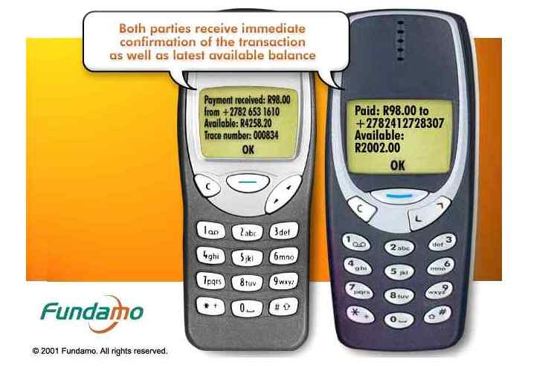
Notes:
Give some background of Fundamo and what it did to payments in emerging markets.

Slide 3
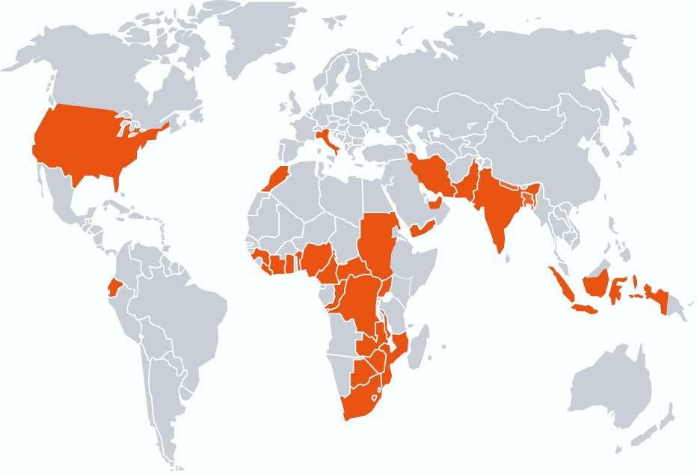
Notes:
Talk about where I have worked on payment solutions – especially difficult place and with the opportunity to leapfrog existing solutions

Slide 4
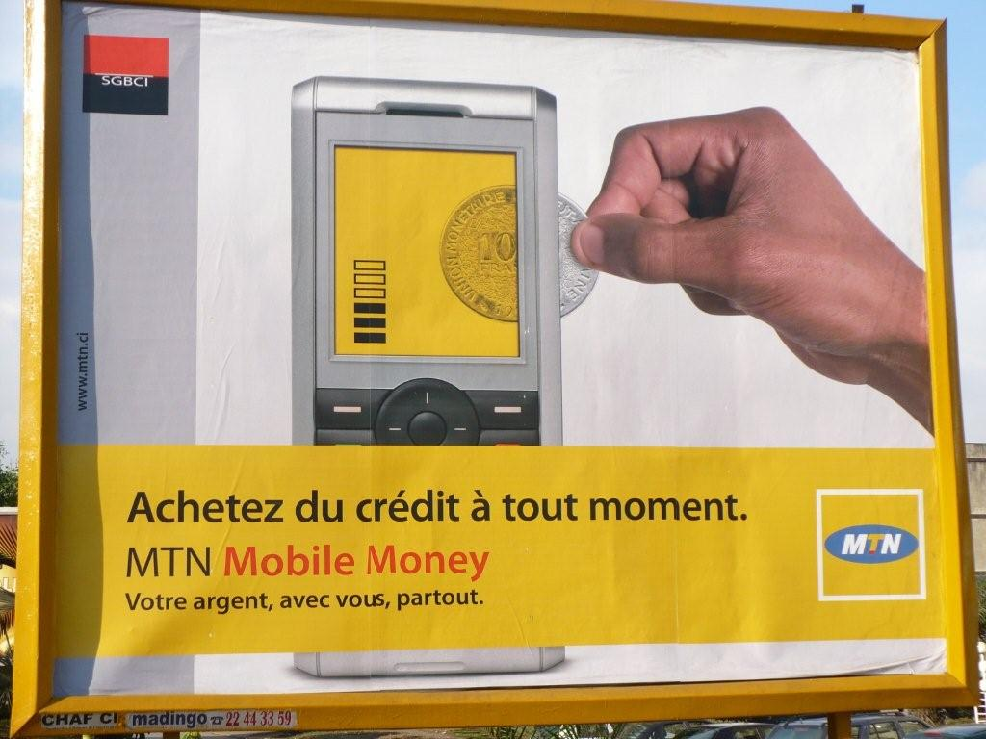
Notes:
Talk about the roll-out of MTN Mobile Money in nineteen countries in two years

Slide 5
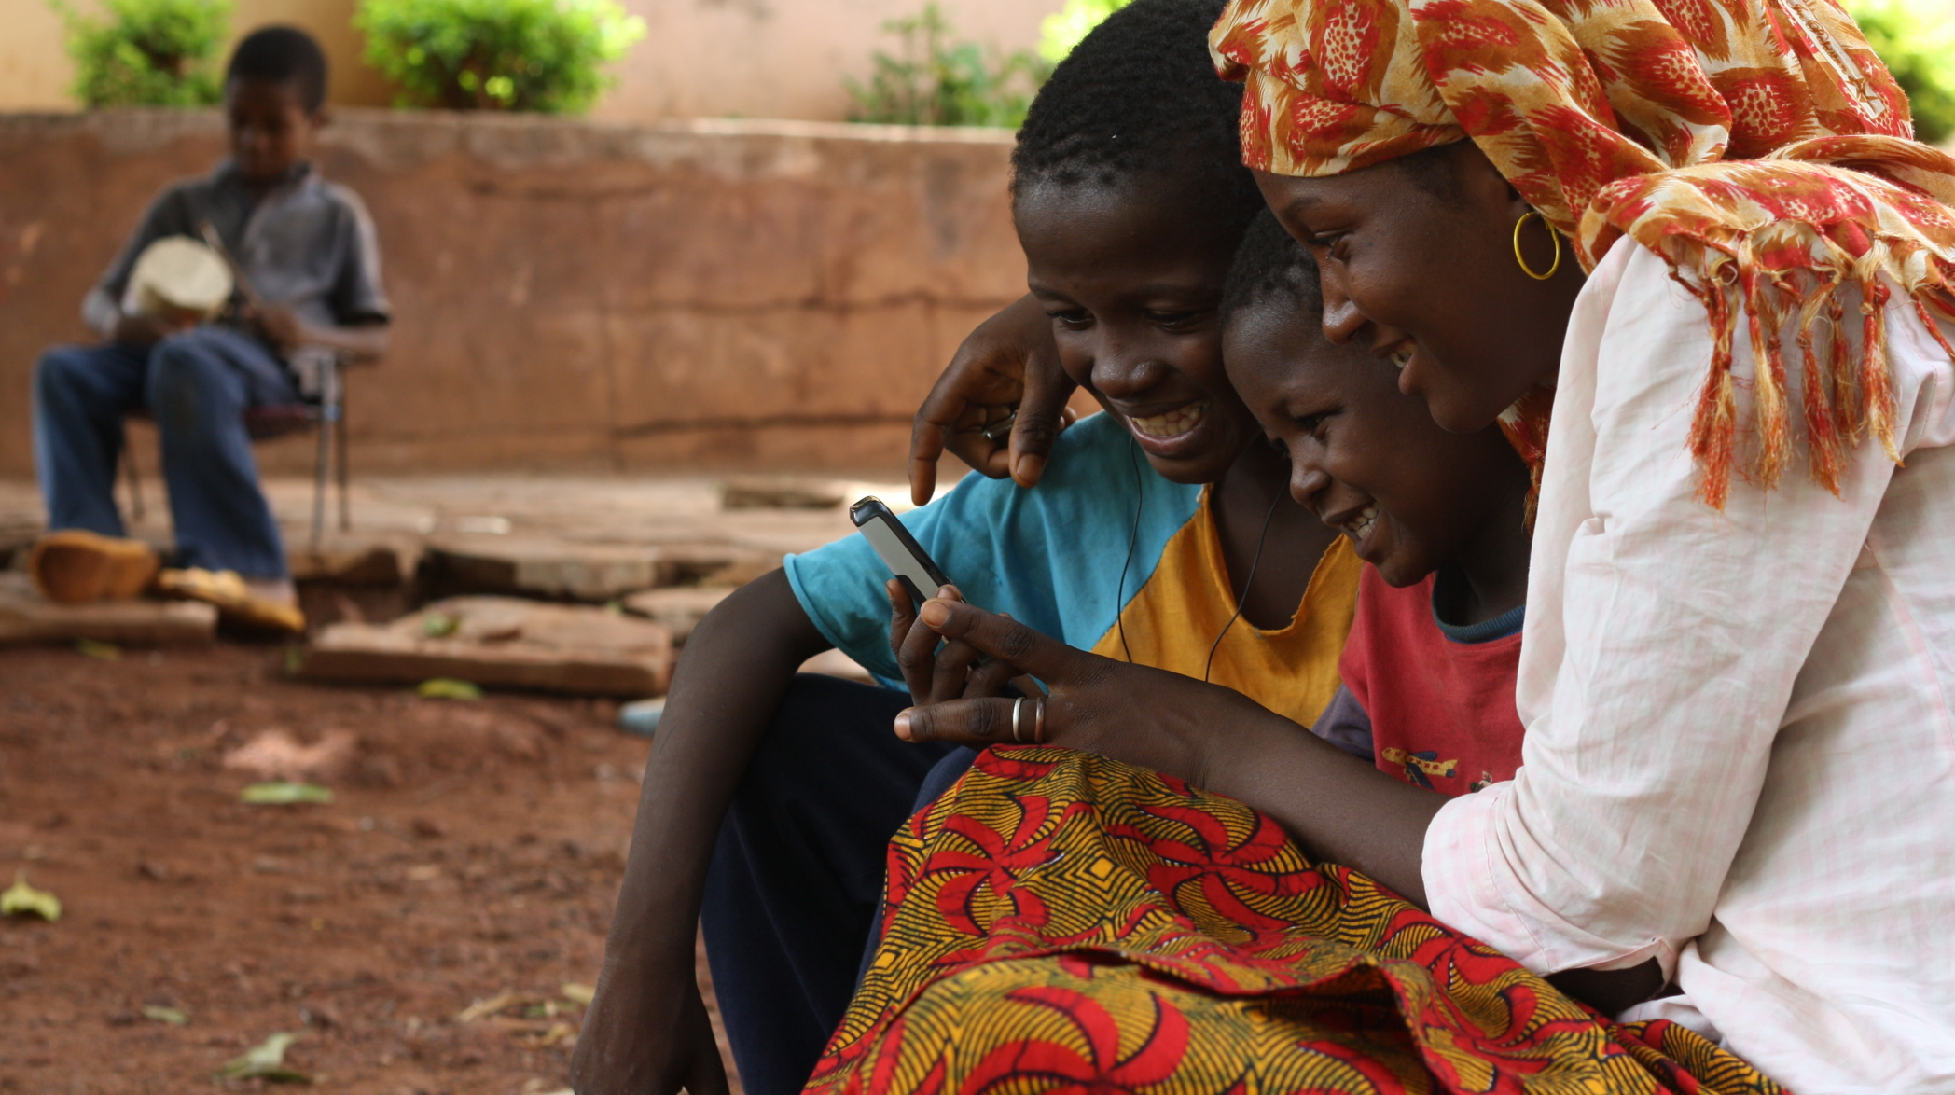



mobile money awareness
is high:
56% Aware
Ghana 93% MTN leading
Pakistan 89% easyPaisa (Telenor)
Bangladesh 53% bKash leading
Notes:
Massive growth in mobile payment solutions

Slide 6
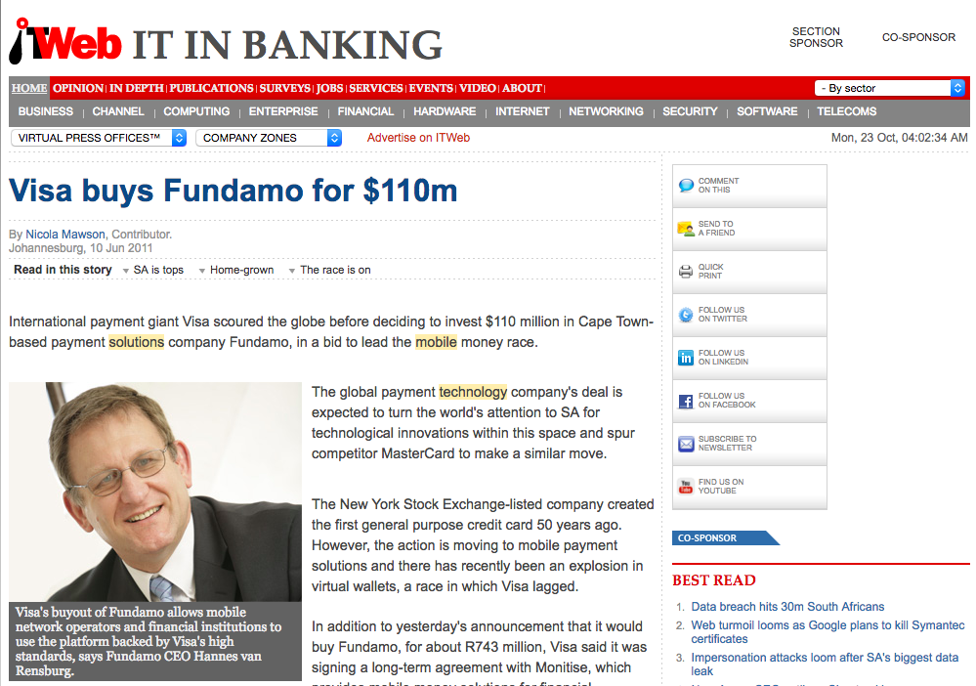
Notes:
Talk about being acquired by Visa and joining the executive team. All the products and situations that I have worked with.

Slide 7
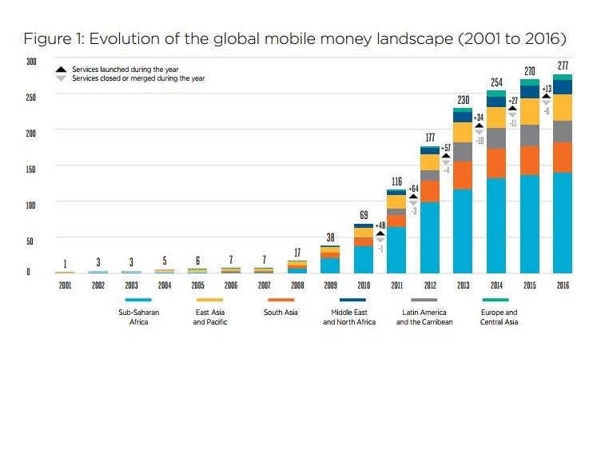
GSMA State-of-the-Industry-Report-on-Mobile-Money 2016
Notes:
Mobile money growth in emerging markets have not stopped with probably more than half a billion registered subscribers

Slide 8
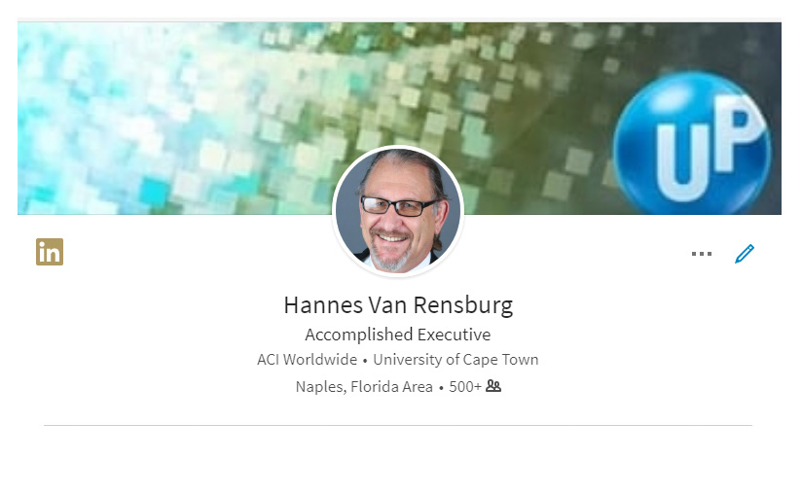
Notes:
Joined ACI in 2016 top focus on payment transformation and how to leverage the many assets that we have.

Slide 9
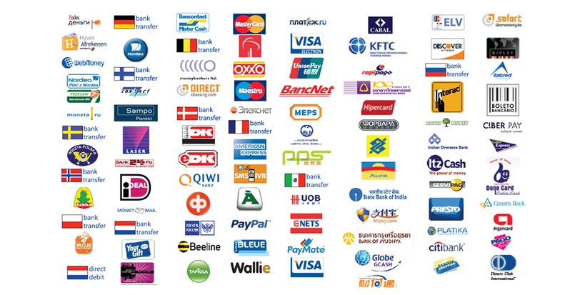
Notes:
There are so many ways to pay and it is increasing day by day. Focusing on convenience, security, ease of use, banking the unbanked etc.

Slide 10
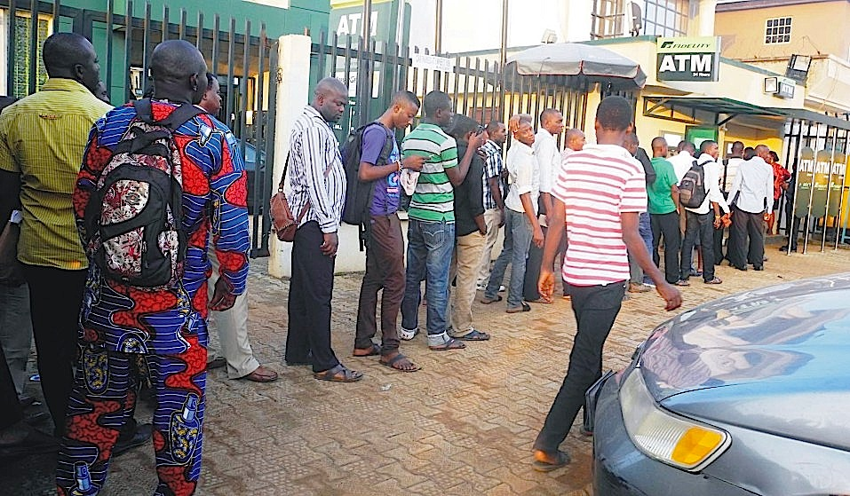
The contract defines the liability
Notes:
Fraud with EMV card used at an EMV ATM machine. Stand-in Mag-stripe transaction authorized by Issuer. One of my first fraud-situations at Visa and how it all revolve around contracting.

Slide 11
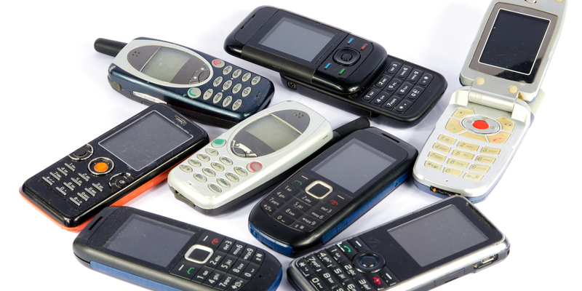
Protect identity and stop fraud
Notes:
How we used SIM-based encryption and PIN verification for each transaction as a principle – even on the most basic phones. Phones have amazing in-built security available for financial transactions.
We managed the Identity and we were very successful in eliminating fraudulent transactions.

Slide 12
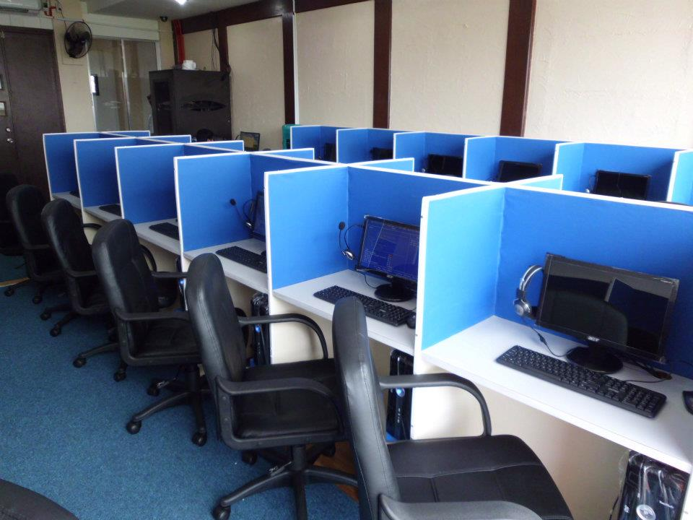
Back office fraud is the biggest risk
Notes:
Biggest fraud that was perpetrated against Fundamo systems happened in one of our clients call centers. Refunds were authorized against fake accounts and then cashed out. It required collaboration between criminal individuals employed by the client.

Slide 13
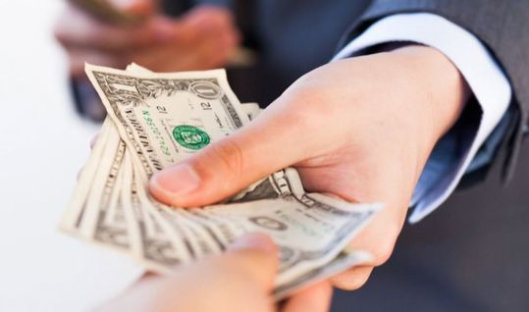
In the end it is all about trust in the system
Notes:
Always surprise me how much faith people have in cash. It is of course unfounded – can relatively easily be faked, or stolen or used to fund terrorism or crime. It can be lost or destroyed. Yet there is a lot of faith in cash.
The biggest problem with fraud is not fraud per se – it is that it leads to a lack of trust in the system.

Slide 14
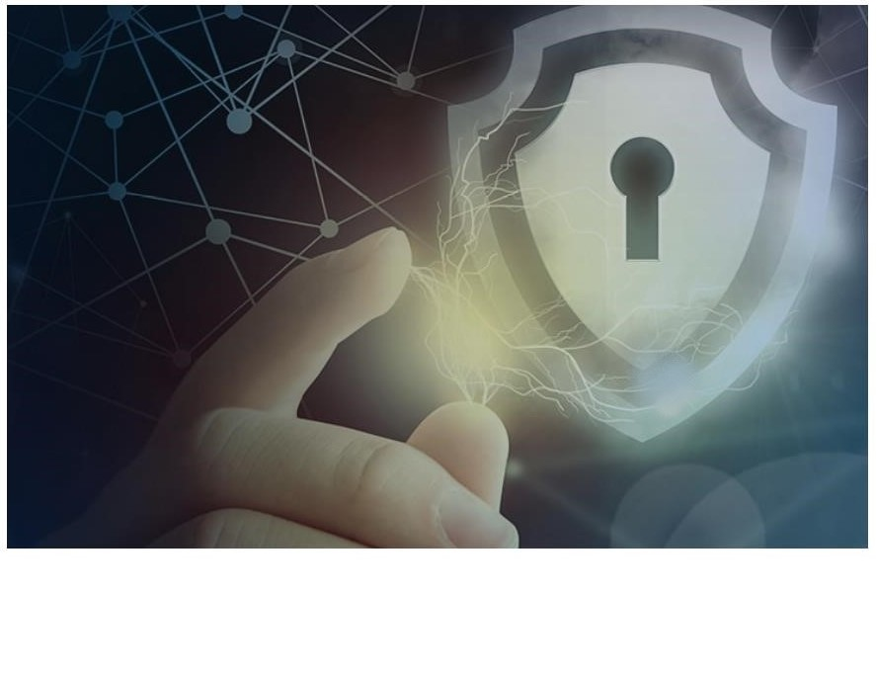
Partner with experience
Notes:
Whatever you do climb Mount Everest with some-one that has been there before.

Slide 15
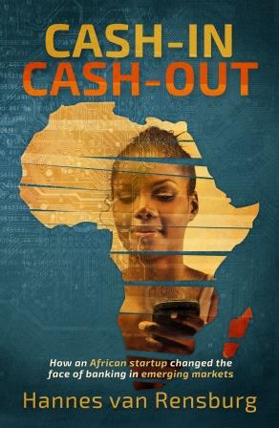
Notes:
I have written a book about my experiences at Fundamo. I have a few copies at the ACI stand and will sign them on a first come first give basis.

Slide 16
Thank you

