Slide 1
Modern Industrial Policy and Colombia
Dani Rodrik
June 2016

Slide 2
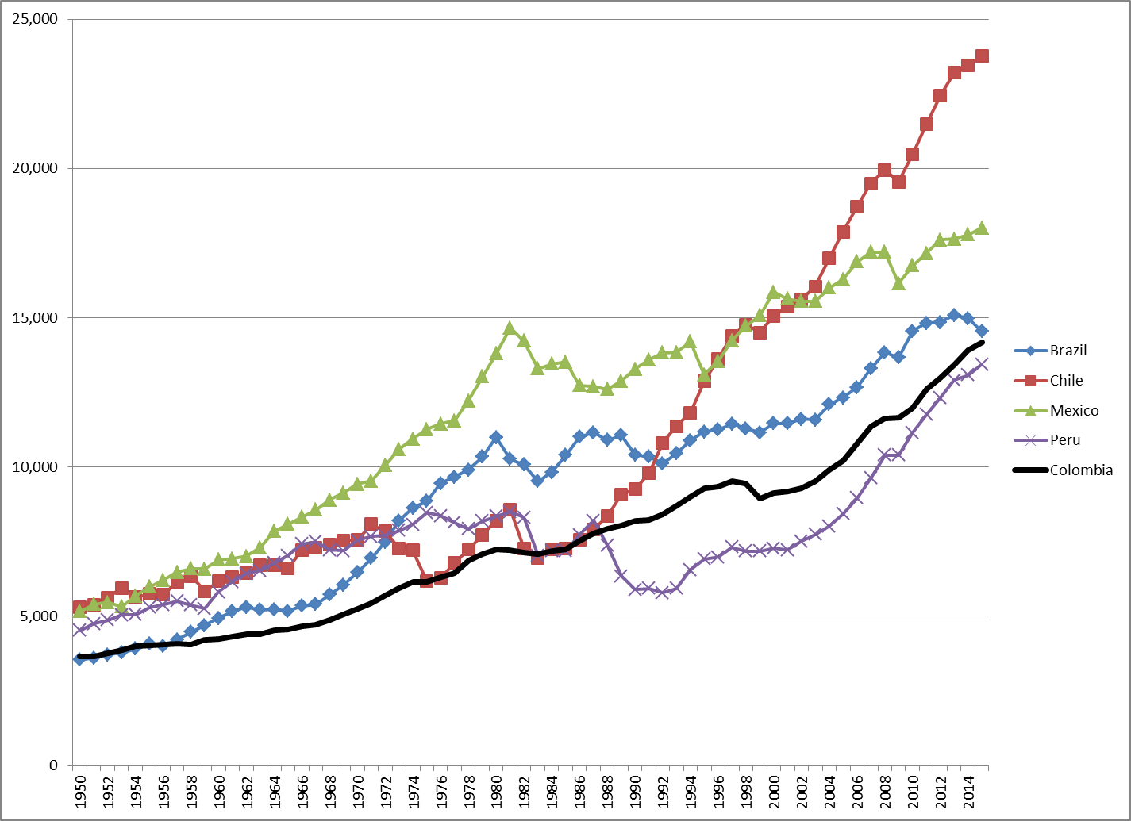
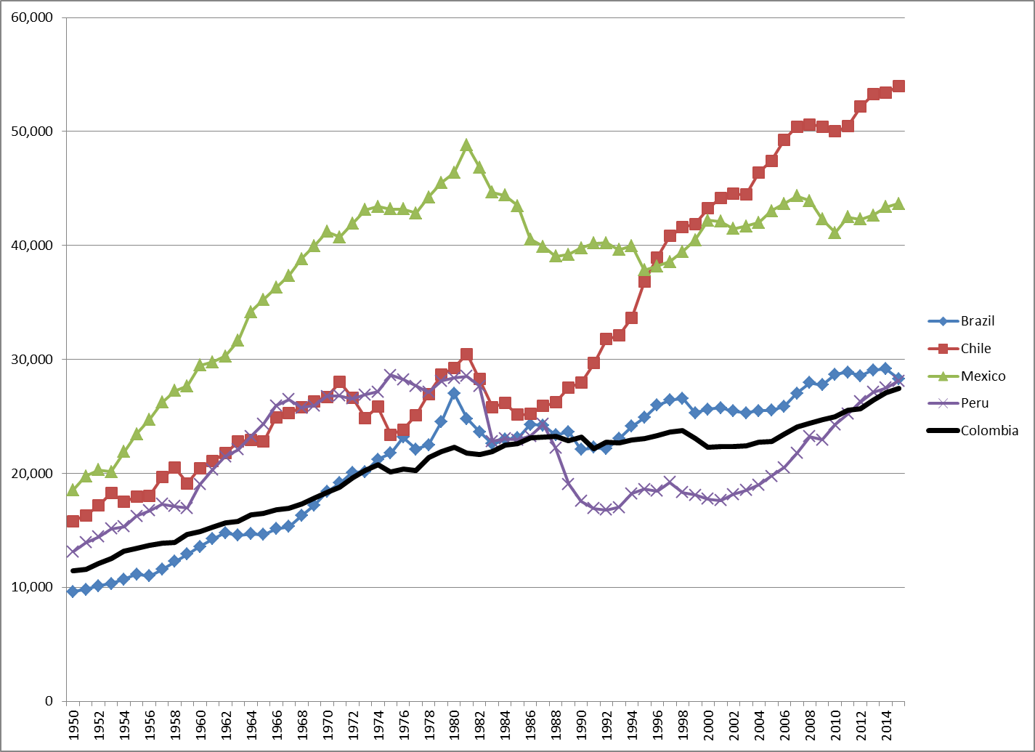
Colombian economic performance in context
GDP per capita
(in 2014 US$)
Labor productivity
(in 2014 US$)

Slide 3
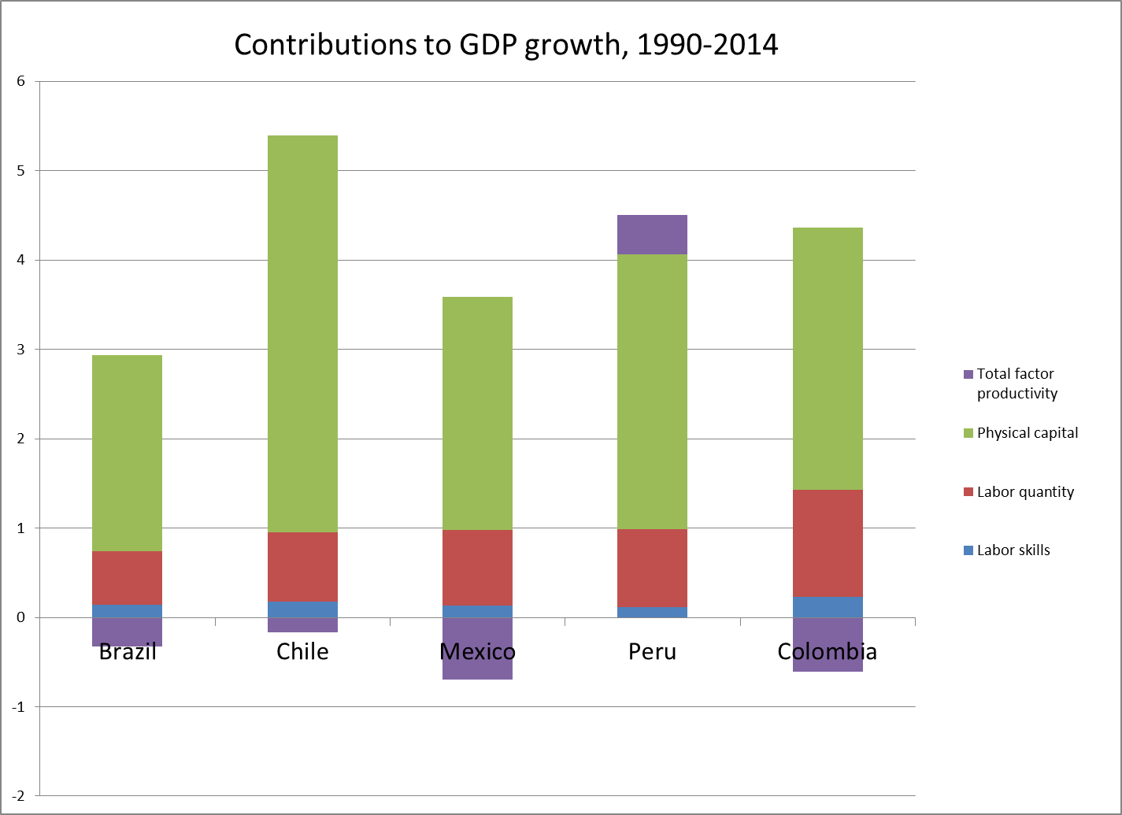
Decomposing GDP growth

Slide 4
Decomposing GDP growth

Slide 5
Models of growth for emerging economies – the bad, the good, and the turbo-charged
External borrowing
Commodity booms
Public investment
Accumulating fundamental capabilities
  human capital, institutions
Structural change (esp. industrialization)
  European periphery in 1950-1970s; East Asia since 1960s
very few sustainable examples
delivers steady, but low growth

Slide 6
Policies: how did successful countries promote rapid structural transformation?
macro “fundamentals”
  reasonably stable fiscal and monetary policies
  reasonably business-friendly policy regimes
  steady investment in human capital and institutions
    but more important for sustaining growth past middle income than launching it
pragmatic, opportunistic, often “unorthodox” government policies to stimulate industrialization and modern activities
  protection of home market, subsidization of exports, managed currencies, local-content rules, development banking, special investment zones, … with specific form varying across contexts
a development-friendly global context
  access to markets, capital and technologies of advanced countries
  benign neglect towards industrial policies in developing countries

Slide 7
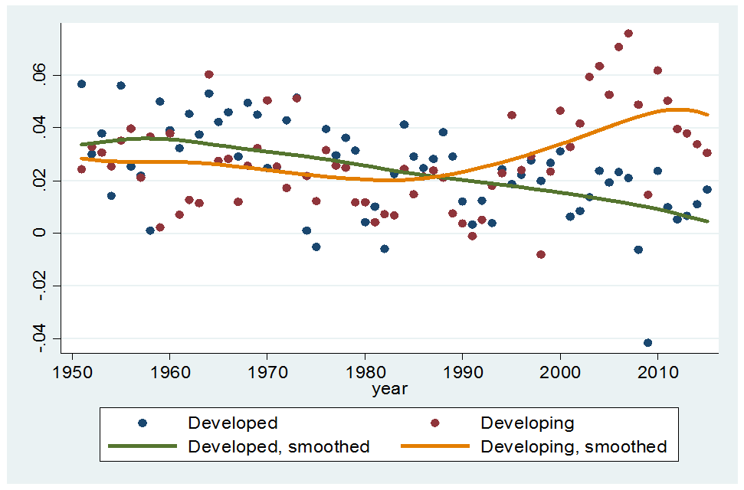
Changing global context: decline in advanced-country growth
Smoothed per-capita GDP growth rates in developed and developing countries, 1950-2015

Slide 8
Changing global context: de-globalization?
Multiple reasons: diminishing returns from slicing value chains; shift in demand towards services; local sourcing in China; higher security and other risks associated with cross-border transactions,…
Source: Lund (2016)

Slide 9
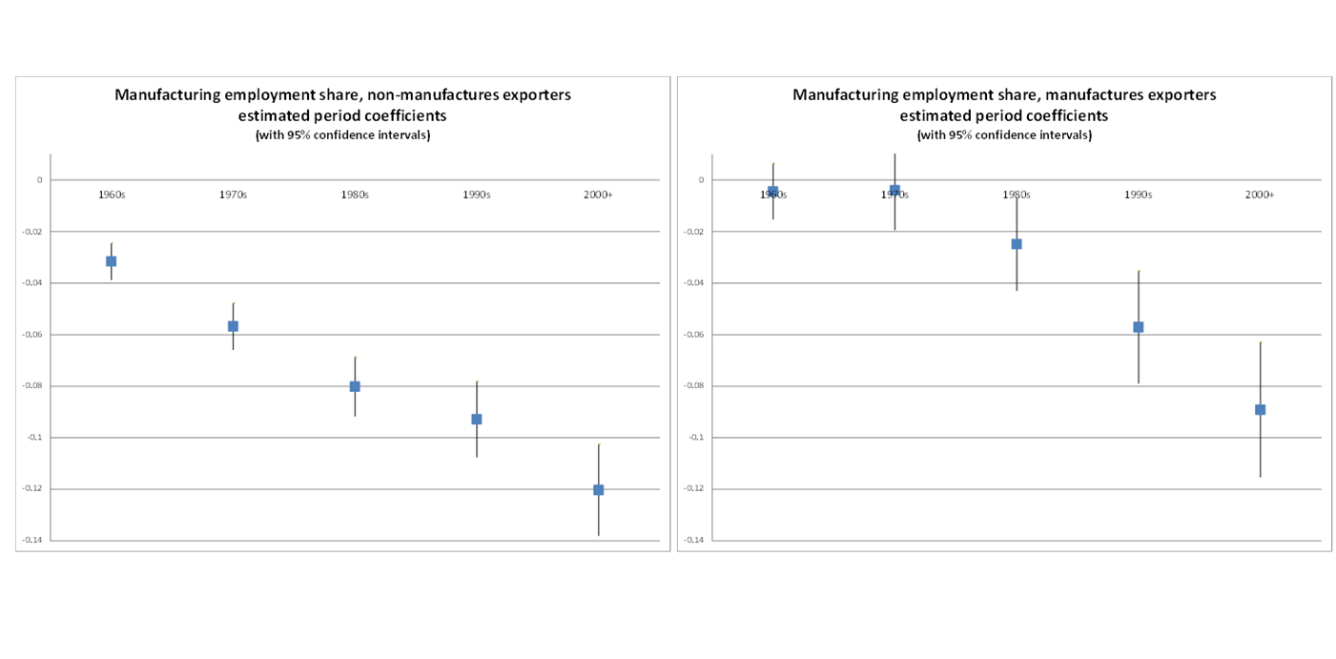
Changing global context: premature de-industrialization

Slide 10
Patterns of structural change
 | agriculture | manufacturing | services
informal
organized

Slide 11
Patterns of structural change: East Asia and advanced countries
 | agriculture | manufacturing | services
informal
organized

Slide 12
Patterns of structural change: developing countries today
 | agriculture | manufacturing | services
informal
organized

Slide 13
Why services are not like manufactures
  High-productivity (tradable) segments of services cannot absorb as much labor
    since they are typically skill-intensive
    FIRE, business services
Low productivity (non-tradable) services cannot act as growth poles
  since they cannot expand without turning their terms of trade against themselves
    constrained by domestic demand (hence incomes)
  continued expansion in one segment relies on expansion on others
  limited gains from sectoral “winners”
    e.g. hyper-markets in retail
  back to slow accumulating fundamentals (rather than structural change)

Slide 14
The employment-productivity trade-off in services
Service sectors that have best productivity performance typically shed labor; labor absorbing sectors typically have worst productivity performance.
Source: Author’s calculations from GGDC data.

Slide 15
Industrial policy for what?
Two possible motives
  promote employment growth in manufacturing
    or at least delay de-industrialization
    idea: good jobs (with high wages/high productivity) are there
    presumed market/govt. failure: barriers that create wedges in compensation and reduce labor mobility
  foster R&D and innovation
    presumed market failure: spillovers in new product/process development
… with different policy implications
  policies targeted at employment generation versus innovation
  regional/cohesion/social policies versus innovation
  no need to worry about deindustrialization per se if objective is B
  must support firms that commit to employment if objective is A
But reversing (employment) de-industrialization unlikely
  and social objectives better dealt with social policies

Slide 16
What kind of industrial policy? (1)
Distinction between horizontal versus vertical policies
  Economists’ traditional preference for horizontal policies
    education, R&D subsidies, …
  Not too useful in practice?
    even “horizontal” policies often involve choice and selection
      e.g. location/type of infrastructure investments, forms of specialized training, public procurement specifications, regulatory reform priorities

Slide 17
What kind of industrial policy? (2)
Only manufacturing? or services too?
Many services have properties of manufacturing
  innovative activity, tradability
  “servitization” of manufactures
But selective productivity improvements in services less likely to produce economy-wide benefits
  since scale effects limited by domestic market demand
Productivity improvements in services as a whole require across the board improvements in
  human capital, institutions and regulatory capacity
Mid-level tradable services as exceptions?
  tourism, call centers, …

Slide 18
What kind of industrial policy? (3)
Traditional versus modern industrial policy
  traditional IP
    a list of sectoral priorities + sectoral incentives
    top-down, relying on quality of bureaucracy (honesty, competence, implementation)
    presumes solutions are known
  modern IP:
    a process of institutionalized collaboration and dialog
    focused on identification of constraints and opportunities
    and the generation of pragmatic private-public solutions
    continuous monitoring and evaluation
    presumes only that solutions can be discovered

Slide 19
Institutional design for industrial policy
Must be built on three ideas, each of which leads to a different “design principle”:
The requisite knowledge about the existence and location of the spillovers, market failures, and constraints that block structural change are diffused widely within society
  => “embeddedness”
Businesses have strong incentives to “game” the government
  => carrots and sticks, discipline
The intended beneficiary of IP is neither bureaucrats nor business, but society at large
  => accountability

Slide 20
Design features for IP institutions: embeddedness
Economists tend to think of policy design in top-down, principal-agent terms
  takes informational incompleteness and asymmetries as given, while keeping the private-sector at arms’ length
This model has the advantage that it gives bureaucrats autonomy and protection from private sector rent-seeking…
But it has the disadvantage that it severely restricts the flow of information from below
  businesses cannot communicate information about the constraints they face other than through their actions
“Capture” model also obviously wrong, since it leaves bureaucrats in the pockets of business

Slide 21
Design features for IP institutions: embeddedness
Right model lies in between the two extremes:
  strategic collaboration and coordination between the private sector and the government with the aim of uncovering where the most significant bottlenecks are
    deliberation councils, supplier development forums, “search networks,” investment advisory councils, sectoral round-tables, private-public venture funds…
  IP as a process of discovery rather than as a list of policy instruments
    focusing on learning where the binding constraints lie, rather than on whether you should use tax breaks, R&D subsidies, credit incentives, and so on
    eliciting information on private sector’s willingness to invest subject to the removal of obstacles (or provision of incentives)
  cycles of goal-setting, monitoring, revision (e.g., PEMANDU, Sabel and Jordan 2014)
  combination of autonomy and embeddedness

Slide 22
Design features for IP institutions: carrots and sticks
Without rents for entrepreneurs, there is too little investment in cost discovery and other activities that promote structural change
  Schumpeter’s insight: entrepreneurship requires rents
  rents as second-best mechanisms to alleviate market failures in innovation
    patents are the obvious example
But open-ended rents bottle up resources in unproductive activities
Hence the need for carrots and sticks
  incentives and disciplines
conditional subsidies, sunset clauses, monitoring and evaluation,…

Slide 23
Design features for IP institutions: carrots and sticks
Can governments pick winners?
  wrong question
Success in IP is determined not by “picking winners” but by “letting losers go”
  experimentation is unavoidable
  given uncertainty, optimal policy outcomes will necessarily produce mistakes
    Solyndra versus Tesla
    must evaluate portfolio of projects, not individual projects
  trick is not to avoid mistakes altogether, but to ensure that
    mistakes are recognized as such
    and entail phasing out of support
  a much weaker requirement than “omniscience”
    governments may not be able to pick winners, but they can recognize losers

Slide 24
Design features for IP institutions: accountability
If bureaucrats monitor businesses, who monitors the bureaucrats?
Need for mechanisms of transparency and accountability
  A high-level political principal and “champion” for IP activities
    someone associated with IP activities and who can be held politically responsible
    as with education policy or monetary policy
  Mechanisms of transparency
    publication of activities
    accounting of expenditures
    processes that are open to new entrants as well as incumbents

Slide 25
Concluding words
Now that industrial policy is reborn, important not to exaggerate what it can accomplish
  it cannot reverse inevitable de-industrialization
  it cannot reignite growth in the midst of macroeconomic imbalances
  it cannot substitute for improvement in “fundamentals” needed for long-run growth
Industrial policy is a craft
  the importance of learning-by-doing, and local institutional innovation
Industrial policy is a process and a frame of mind
  not a set of policy tools and sectoral priorities
  the quality of government-business dialog is critical

