Slide 1


Fintech and its risks
Brian Knight
Notes:
Thank you for inviting me to talk with you today.

Slide 2
DISCLAIMER
This is not legal or compliance advice
This is general information – significant differences exist between companies and countries

Slide 3

Source: http://globe-views.com/dcim/dreams/bank/bank-03.jpg
Notes:
What is a bank?

Slide 4

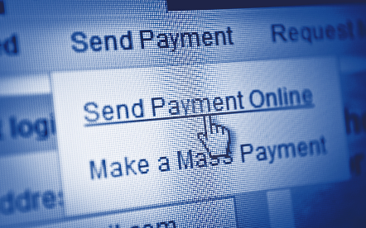

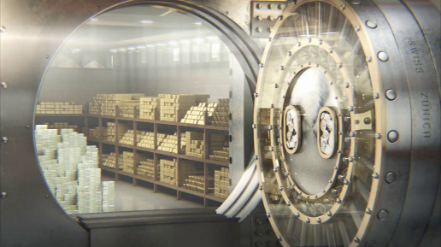

Notes:
Banks are a bundle of services, four of which I will talk about today:
Lending
Payments
Storage of Deposits
Wealth creation
And those services generate a lot of useful, and sensitive data

Slide 5
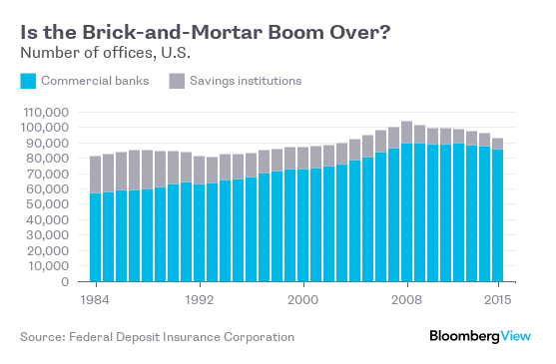
Source: Bloomberg
Notes:
Banks’ footprint is shrinking in some areas

Slide 6
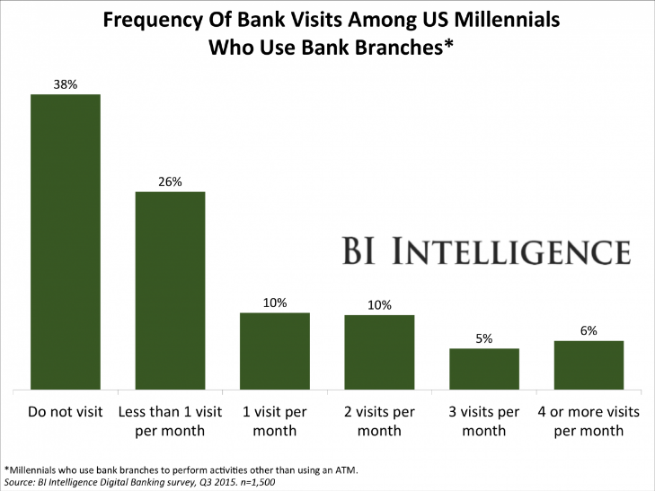
Notes:
And there may be demographic headwinds

Slide 7
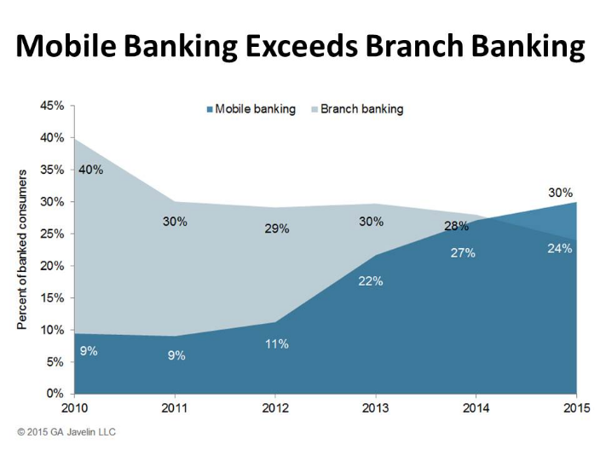
Notes:
Technology is behind a lot of this because it allows people to access financial services without going into the branch.

Slide 8
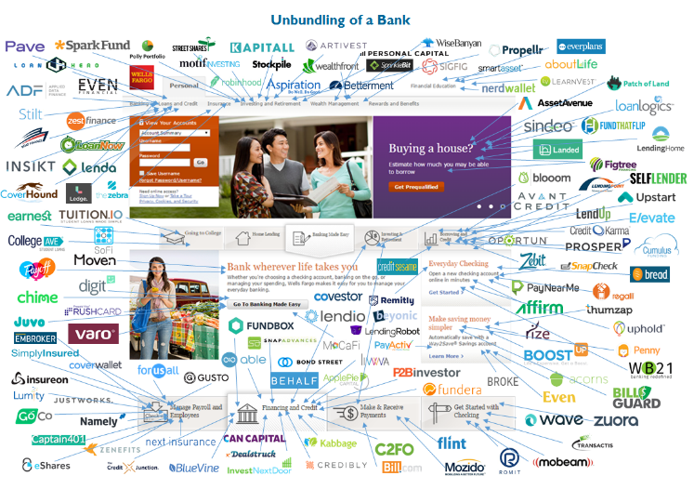
Source: Cbinsights https://www.cbinsights.com/blog/disrupting-banking-fintech-startups/
Notes:
But who says people need to get their financial services from a bank?

Slide 9
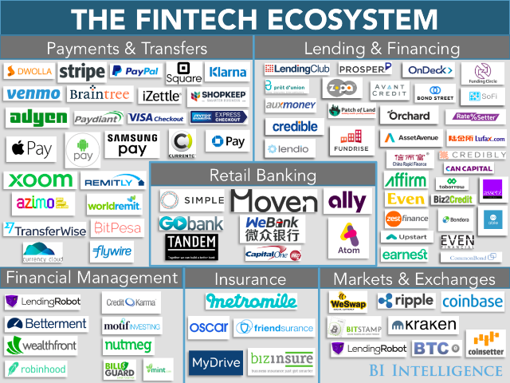
Source: Business Insider http://static3.businessinsider.com/image/56d4b8602e526553008ba64a-1200-900/bii-the%20fintech%20ecosystem.png
Notes:
There is a lot of competition emerging outside of banks

Slide 10
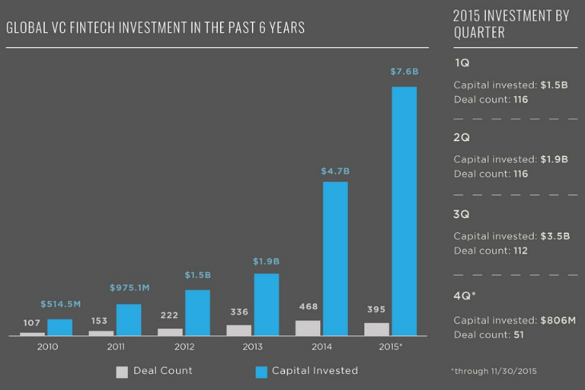
Source: http://www.valuewalk.com/wp-content/uploads/2015/12/Revealing-The-Data-Behind-VC-Fintech-Investment-Featured.jpg
Notes:
And a lot of money is being spent to disrupt the status quo

Slide 11

LENDING
Source: www.brimg.net
Notes:
Lending

Slide 12
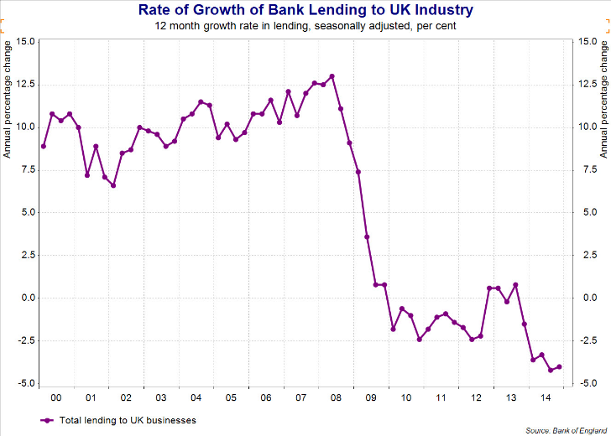
Source: http://www.tutor2u.net/economics/reference/bank-lending
Notes:
Bank lending declined in the wake of the crisis

Slide 13
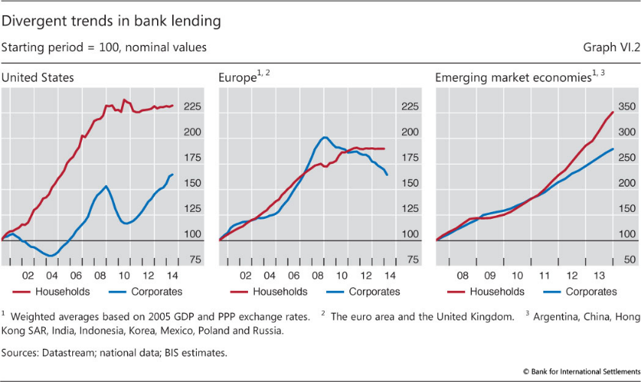
Source: Bank for International Settlements http://www.bis.org/publ/arpdf/ar2014e/images/gra6-2.jpg
Notes:
While some areas have seen recovery, others have continued to decline or plateaued

Slide 14
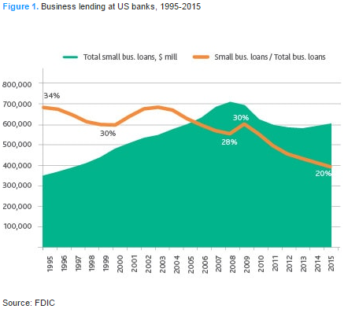
Source: http://http://colemanreport.com/wp-content/uploads/2016/08/moodysgraph.png
Notes:
Even in cases where there is recovery some groups remain disadvantaged

Slide 15
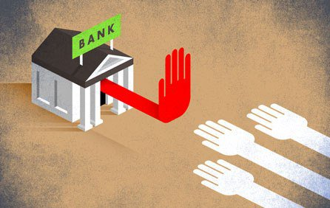
Source: American Enterprise Institute
Notes:
A lot of people are being told no by their bank

Slide 16
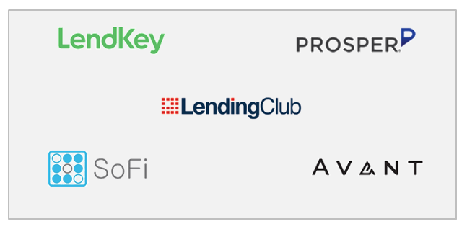
Source: Lettstalkpayments.com
Notes:
When people are told no there is an opportunity for someone to come along and say “yes”

Slide 17
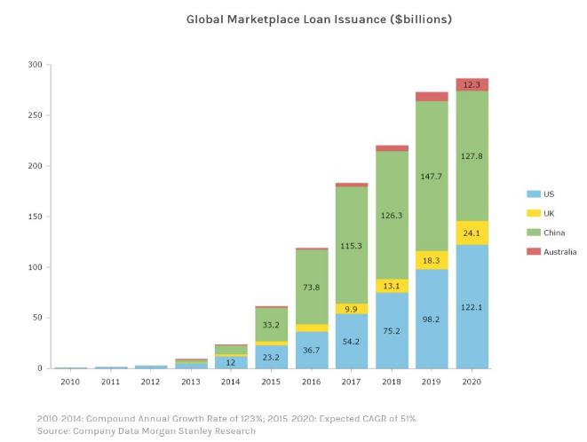
Source: Morgan Stanley “Can P2P Lending Reinvent Banking? June 2015
Notes:
Non-bank lenders, are growing

Slide 18
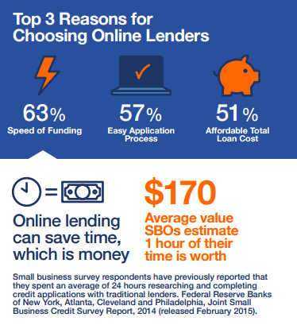
Source: Electronic Transaction Assoc. Survey of small businesses, April 12, 2016
Notes:
And it isn’t because they are cheaper (though they sometimes are)

Slide 19

Source: ghostwrittenebooks.com/peer-peer-lenders-new-big-banks/
Notes:
They are using technology to lend to people without geographic limitations

Slide 20
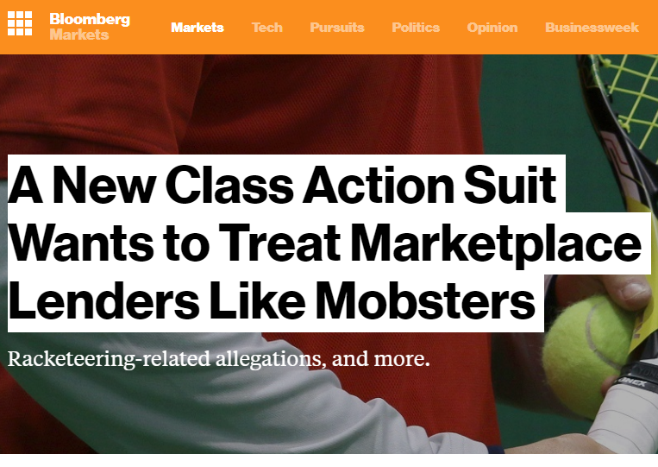
Notes:
But that doesn’t mean there aren’t jurisdictional issues

Slide 21

Source: csbcorrespondent.com
Notes:
These lenders are also trying to use “big data” to more accurately underwrite borrowers, using large and diverse data sets to make underwriting more accurate, inclusive and streamlined. They are also using machine learning to try to have algorithms self improve.

Slide 22

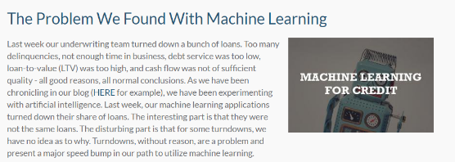
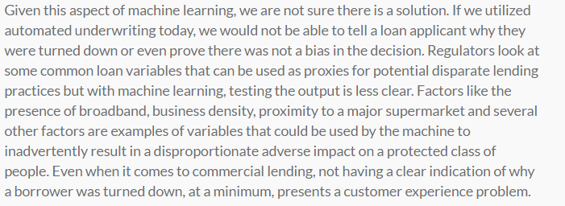
Source: csbcorrespondent.com
Notes:
But there are risks that machine learning decisions will be beyond people’s ability to understand or predict, and may create regulatory issues.

Slide 23
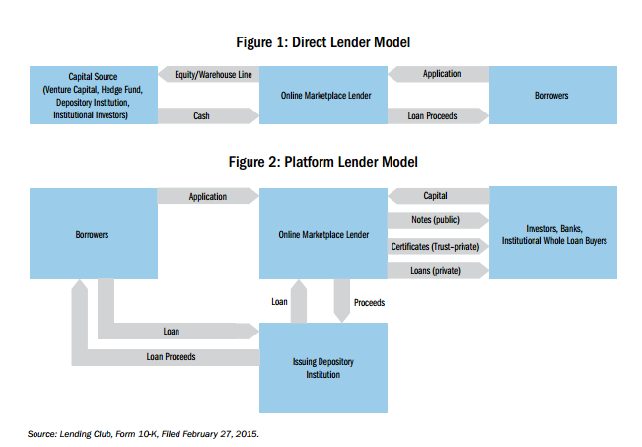
Source: U.S. Treasury
Notes:
Of course, the relationship between non-bank lenders and banks isn’t inherently adversarial, and in some cases is a lynchpin for the model to work.

Slide 24

Source: https://https://lendingalpha.com/wp-content/uploads/lendingclub-alliance-partners-partnership.png
Notes:
Smaller banks are also leveraging partnerships (also mention JP Morgan and OnDeck

Slide 25
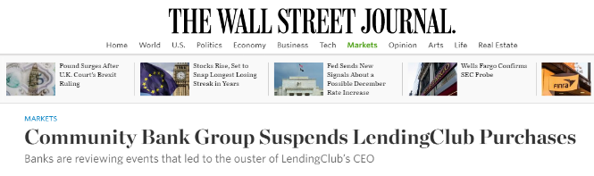
Source: https://https://lendingalpha.com/wp-content/uploads/lendingclub-alliance-partners-partnership.png
Notes:
Well, until the recent unpleasantness

Slide 26
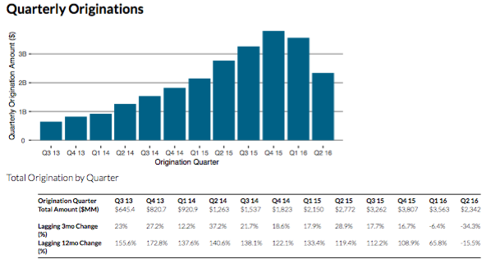
Source: http://www.lendacademy.com/wp-content/uploads/2016/08/Unsecured_Marketplace_Lending_Originations_Q2_2016.png
Notes:
And all isn’t rosy for marketplace lenders as originations and profits have been squeezed.

Slide 27

Source: http://www.sbfi.org
Notes:
But banks and marketplace lenders are also partnering in other ways, including leveraging lender tech for bank loans

Slide 28


Source: Goldman Sachs, Lightstream
Notes:
And banks are starting to compete on convenience and speed

Slide 29
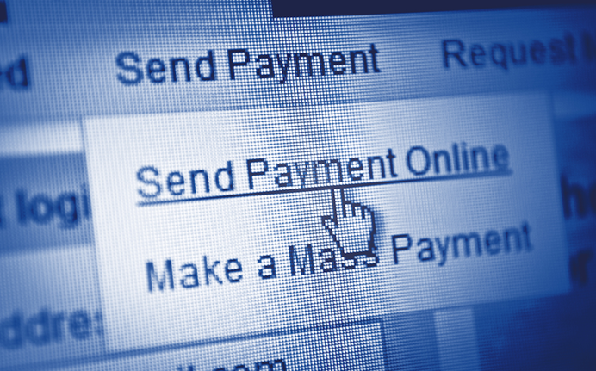
PAYMENTS
Notes:
Payments

Slide 30
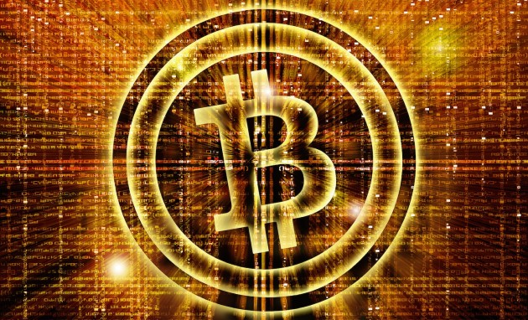
Source: Business Insider
Notes:
Bitcoin, and other virtual currencies, represent a potential seismic shift in payments.

Slide 31
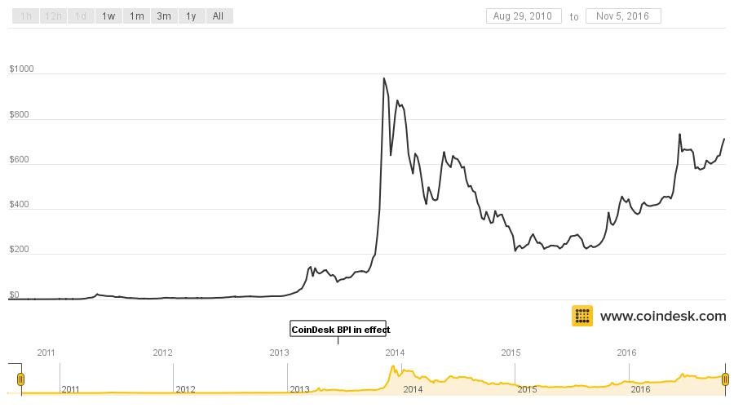
Source: Business Insider
Notes:
Bitcoin has become a legitimate store of value

Slide 32
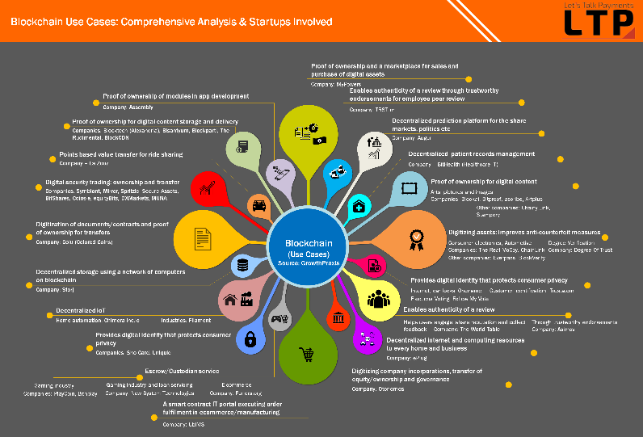
Source: Business Insider
Notes:
And is being considered for use in many applications

Slide 33
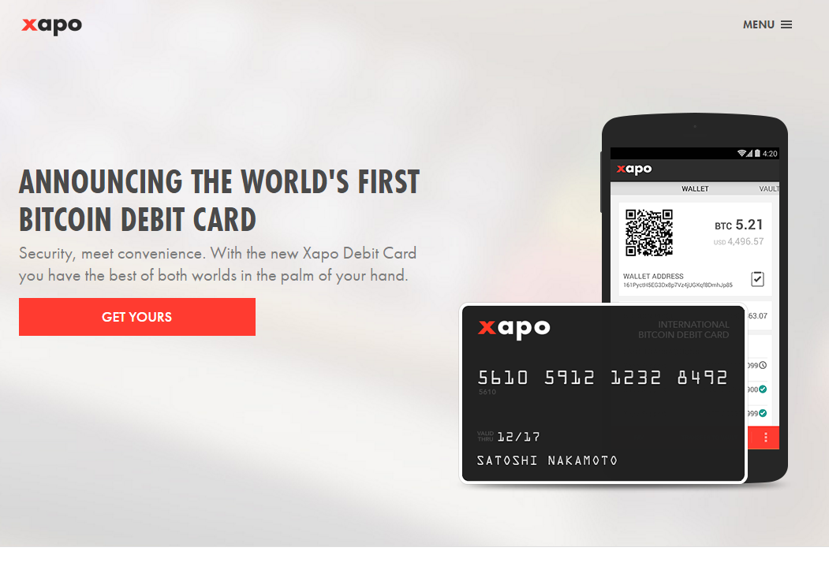
Source: Business Insider
Notes:
It is also expanding into mainstream delivery methods

Slide 34

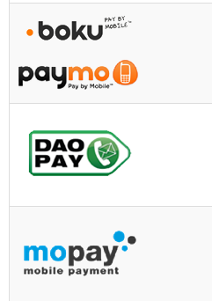

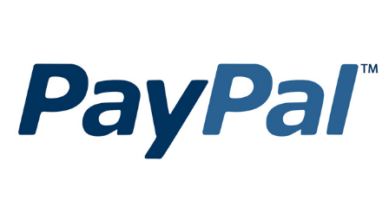
Notes:
However, Bitcoin isn’t the only payments innovation. Many innovative rails and delivery systems for fiat currency are being developed

Slide 35

Source: https://payments.amazon.com,
Notes:
Competition is coming from dedicated Fintechs and companies that operate in other, potentially adjacent spaces

Slide 36

SAFEKEEPING

Slide 37
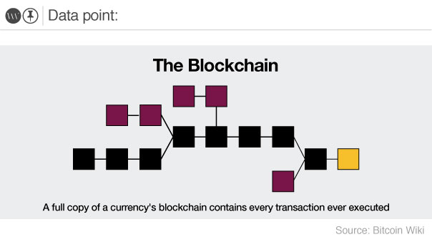
Source: http://cdn.theworldweekly.com/files/SDP_The_Blockchain.jpg
Notes:
Technology is providing a competing model for safeguarding wealth

Slide 38
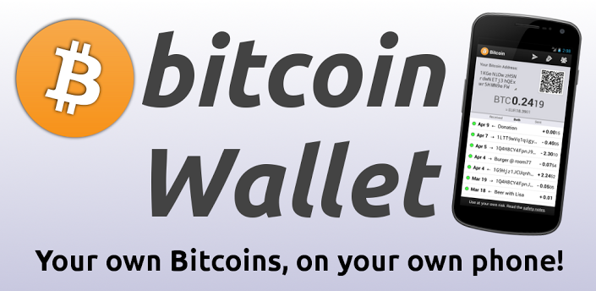
Source: http://thestatelessman.com/wp-content/uploads/2013/05/bitcoinwallet.png
Notes:
Suddenly it is possible that everyone’s phone might become their personal bank vault

Slide 39

Source: https://dribbble.com/shots/1872008-Xapo-Vault/attachments/316565
Notes:
Of course, some providers are taking security very seriously, including physical vaults

Slide 40
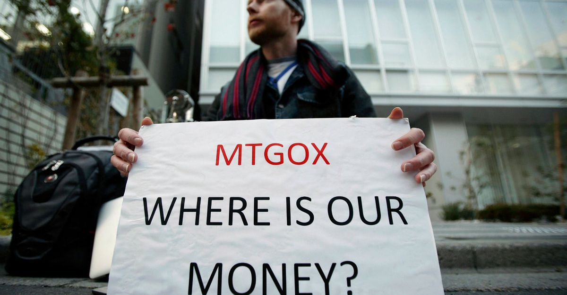
Source: Mashable
Notes:
Of course, when it goes bad it goes really bad – no deposit insurance, no deeply capitalized party to sue

Slide 41
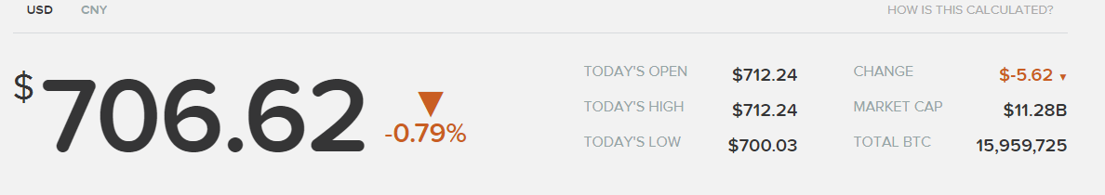
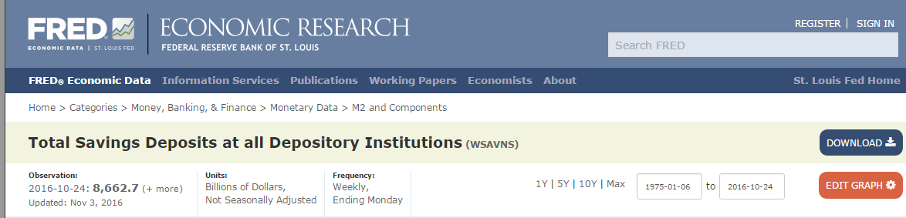
Source: http://coindesk.com
Notes:
Bitcoin has a way to go however before it gets anywhere near fiat systems

Slide 42
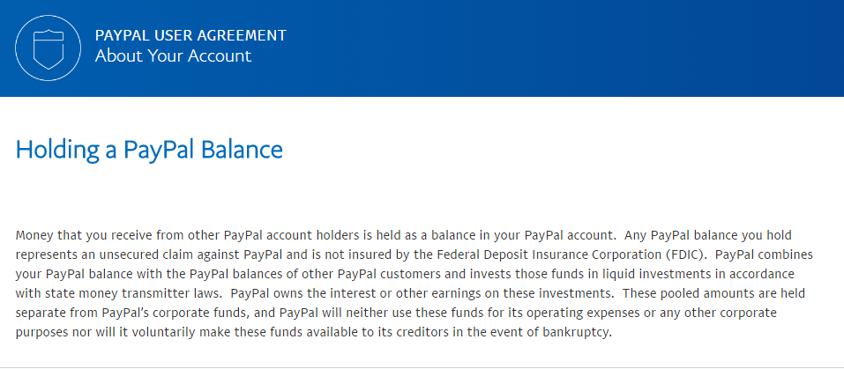
Notes:
Other service providers are also getting into the quasi-depository game, at least in some countries.

Slide 43

GROWING
Source: http://www.luxpresso.com/news-lifestyle/indian-millionaires-wealth-to-grow-by-405-by-2020/7087
Notes:
Banks are being unbundled as new companies compete for certain product lines.

Slide 44
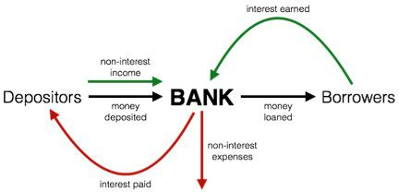
Source: The Motley Fool
Notes:
Banks pay interest on deposits, helping people grow wealth with safe assets

Slide 45
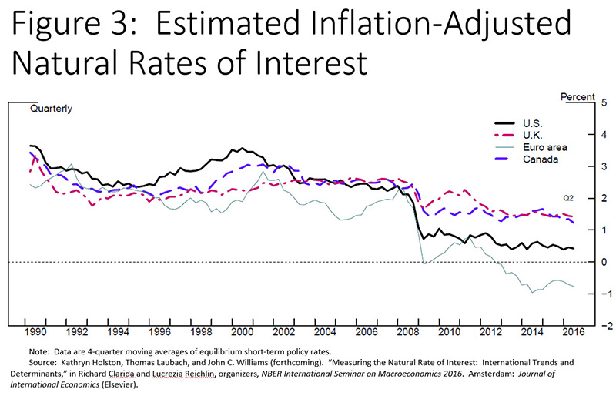
Source: U.S. Federal Reserve
Notes:
While Bitcoin may not provide interest, in many places neither do bank accounts.

Slide 46
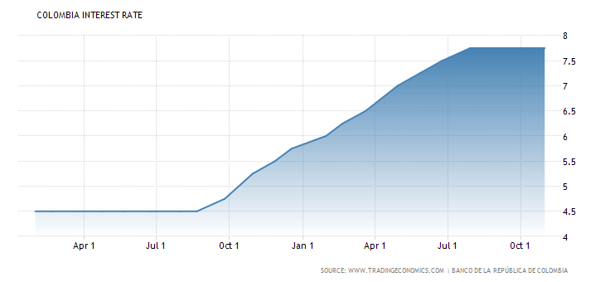
Notes:
Of course, that isn’t true everywhere

Slide 47
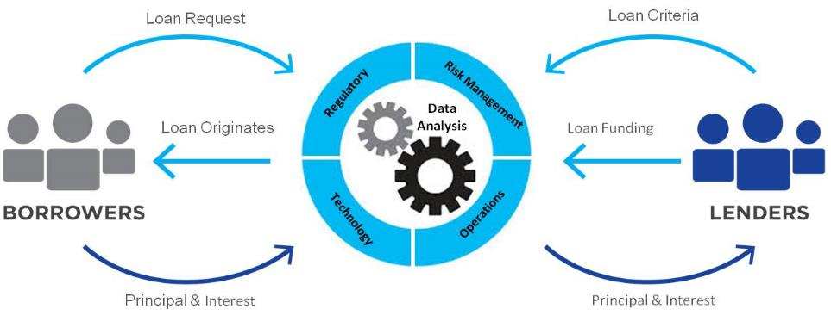
Source: dailyfintech.com/tag/prosper
Notes:
But other models are partial competitors – marketplace lending allows people to invest savings for a return – at the cost of lack of liquidity and default risk

Slide 48
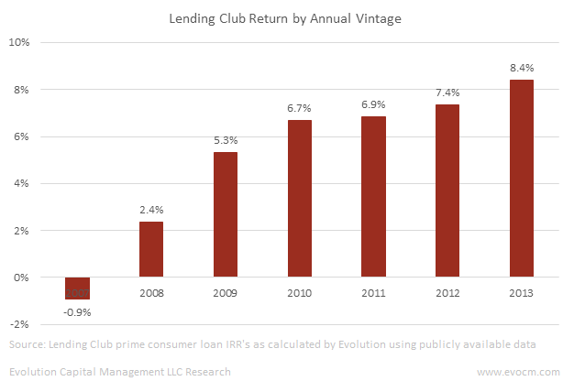
Source: http://evocm.com/the-investment-case-for-online-marketplace-loans/

Slide 49

Source: http://blogs-images.forbes.com/rogergershman/files/2015/04/roboadvisor.jpg
Notes:
Fintech is also entering the investment advise space with robo-advisors, automatic algorithms that adjust stock portfolios based on the individual’s demographic data and risk preference

Slide 50
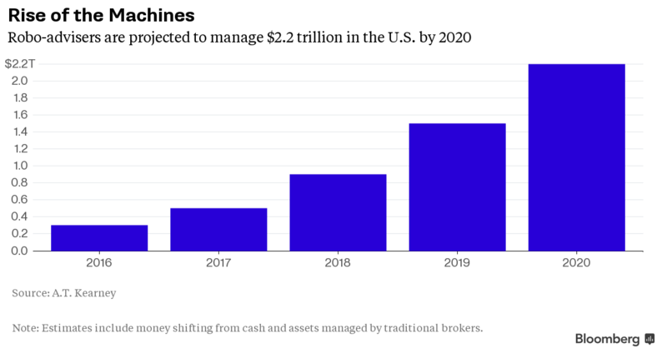
Source: http://www.advisoryhq.com/wp-content/uploads/2015/11/Top-Online-Financial-Advisors.png
Notes:
Adoption has been steady

Slide 51
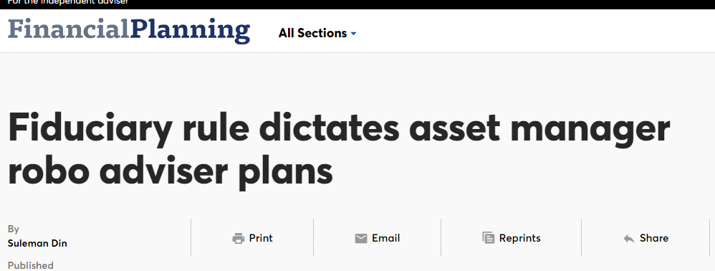
Source: http://www.financial-planning.com/news/fiduciary-rule-dictates-asset-manager-robo-plans
Notes:
But some of that is driven not by customer preference but by regulation

Slide 52
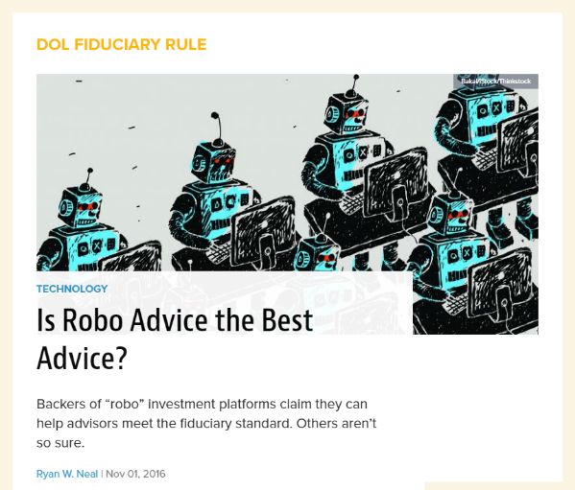
Source: http://www.wealthmanagement.com/technology/robo-advice-best-advice
Notes:
And there are questions as to quality

Slide 53
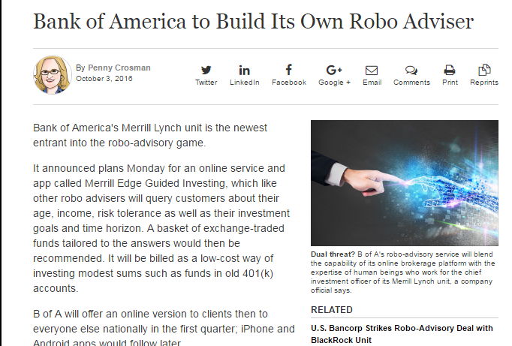
Source: http://www.americanbanker.com
Notes:
And banks are able to compete directly by building their own.

Slide 54
Source http://territori.blogs.uoc.edu/wp-content/uploads/Big_Data_UOC1.jpeg
Notes:
And banks are able to compete directly by building their own.

Slide 55


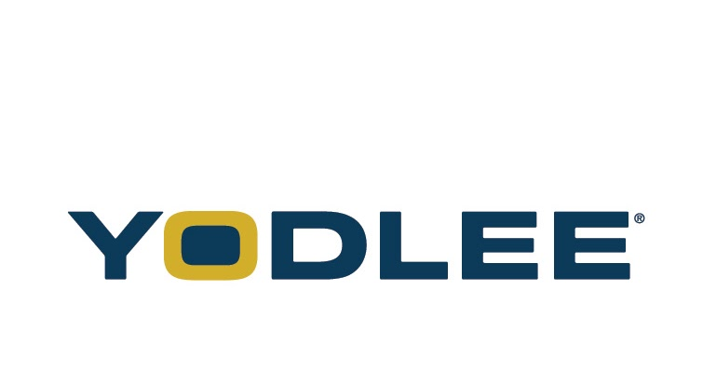
Notes:
And banks are able to compete directly by building their own.

Slide 56
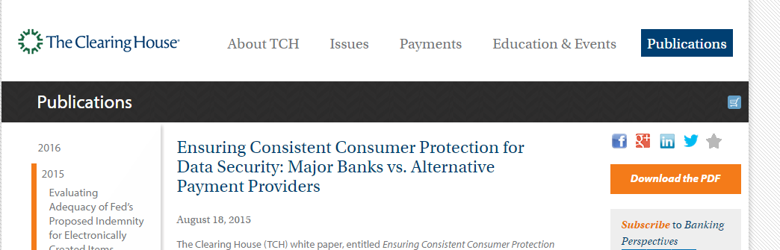
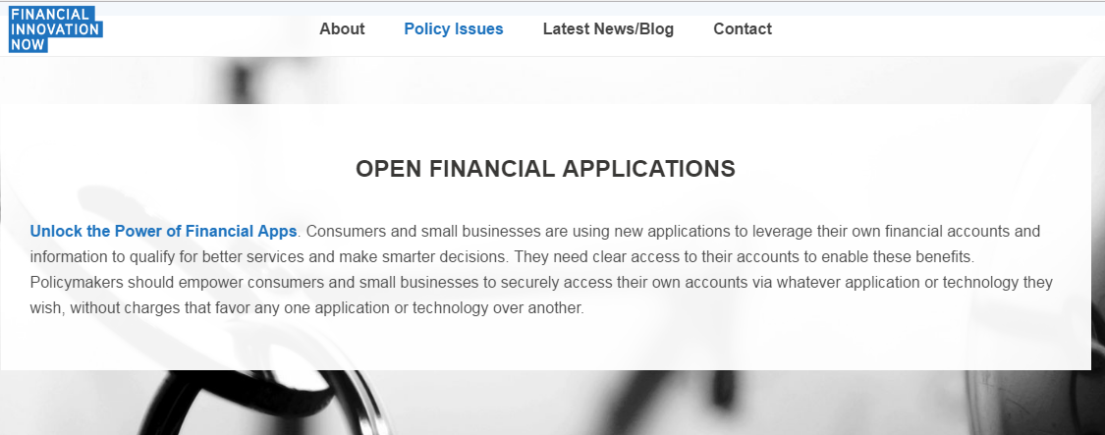
Notes:
And banks are able to compete directly by building their own.

Slide 57
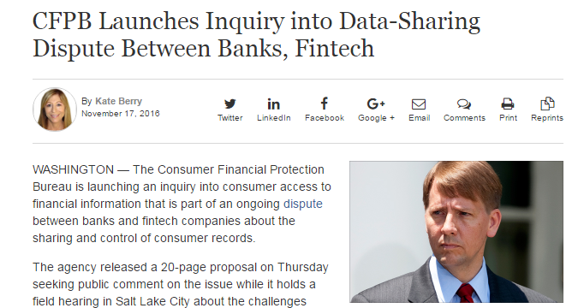
Notes:
And banks are able to compete directly by building their own.

Slide 58

HOW CAN BANKS RESPOND
Source: http://www.brandwatch.com/blog/modern-development-mvps-dev-blog/
Notes:
Banks are being unbundled as new companies compete for certain product lines.

Slide 59



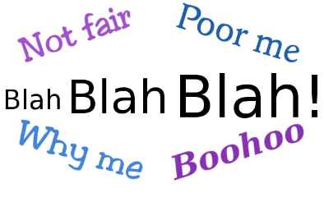
Source: http://heard.org; cnn.com; oracle.com; chocolateboxwriters.com
Notes:
Banks are being unbundled as new companies compete for certain product lines.

Slide 60
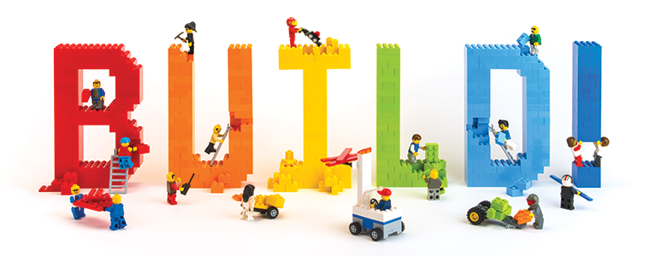
Source: http://heard.org;
Notes:
Banks are being unbundled as new companies compete for certain product lines.

Slide 61
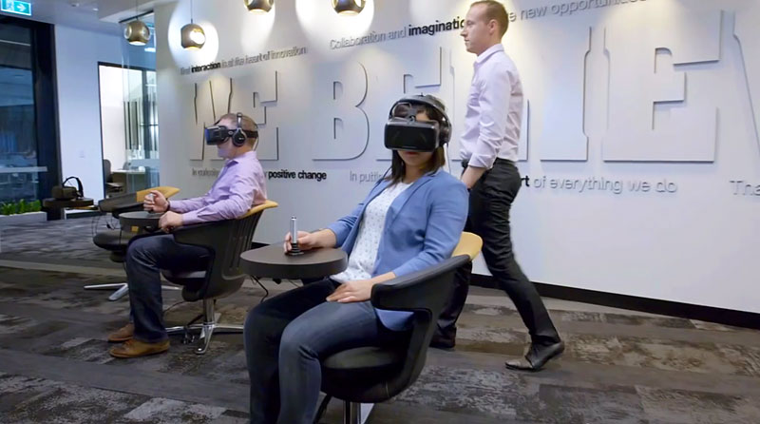
Source: http://thefinancialbrand.com
Notes:
Commonwealth bank innovation lab – banks are trying to change their internal culture to become more innovation focused, hoping to build products internally

Slide 62

Source: http://thefinancialbrand.com
Notes:
Capital One bank innovation lab

Slide 63
Should Banks Build?
Advantages
Disadvantages
Total Control
Built to Spec
Unified Responsibility
Expensive
Time Consuming
Are Banks Truly Competitive?
Source: http://thefinancialbrand.com

Slide 64

Source: http://cnn.com
Notes:
Of course, you could also buy

Slide 65

Source: http://nytimes.com

Slide 66
Should Banks Buy?
Advantages
Disadvantages
Fast
Leverage Expertise
Remove Competition
Limited Choices
Potential Integration Issues
Regulatory Implications
Source: http://thefinancialbrand.com

Slide 67

Source: http://coracle.com
Notes:
partnership

Slide 68


Source: http://americanbanker.com; dwolla.com
Notes:
Banks are being unbundled as new companies compete for certain product lines.

Slide 69
Should Banks Partner?
Advantages
Disadvantages
Fast
Flexible
Leverage Expertise
Incentives may not be aligned
Potential Integration Issues
Regulatory Implications
Source: http://thefinancialbrand.com
Notes:
Commonwealth bank innovation lab

Slide 70

Source: http://chocolateboxwriters.com
Notes:
You could complain

Slide 71
We should distinguish between legitimate grievances and strategic efforts to harm competition through regulation
If the former – by all means argue your case
If the latter…
Notes:
You could complain

Slide 72
Should Banks Complain?
Advantages
Disadvantages
Cheap (maybe)
Might Work (initially)
Alienating
Prevents Adaptation
Holds Back Progress
Source: http://thefinancialbrand.com
Notes:
Commonwealth bank innovation lab

Slide 73

Source: https://www.linkedin.com/pulse/business-risk-good-management-pascal-vander-straeten-mba-ma
Notes:
All of these options have risk

Slide 74

Source: https://bilingualbloglingual.files.wordpress.com/2014/09/tortoisegoingdown.jpg?w=611
Notes:
There is competitive risk – if you don’t compete you get lapped

Slide 75

Source: http://barrymoltz.com/wp-content/uploads/2012/05/reputation-risk-waterdrop.jpg
Notes:
Reputational risk if services are poorly received or harm customers

Slide 76







Source: http://barrymoltz.com/wp-content/uploads/2012/05/reputation-risk-waterdrop.jpg
Notes:
Of course, there is also regulatory risks

Slide 77

Source: http://innotechtoday.com/wp-content/uploads/2015/11/bulb.jpg
Notes:
Innovate – or hire/buy those who do

Slide 78

Source: http://poetryfoundation.org
Notes:
Communicate with regulators and the public about what you are doing, why, and how it works. It makes successes more salient and failures less suspect

Slide 79


Source: http://sd.keepcalm-o-matic.co.uk/i/keep-calm-and-mitigate-the-risks.png; twitter
Notes:
You need to mitigate potential risks – Wells Fargo had reason to know there was a widespread problem but didn’t take the systemic steps necessary to address them, and we saw how that worked out.

Slide 80
Brian Knight
bknight@mercatus.gmu.edu

