Slide 1
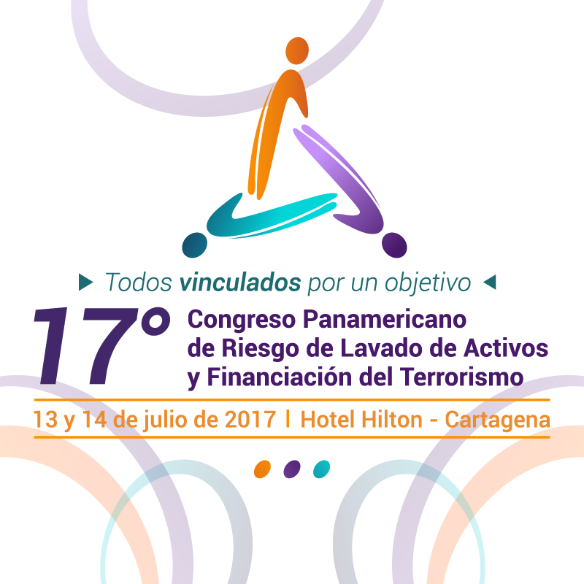
- Aprovechando la analítica y el aprendizaje automático para modernizar la supervisión ALA y el cumplimiento del estándar FATCA y CRS –
Jason Grasso,
Consultor Senior Global de Soluciones
para Crímenes Financieros,
SAS Security Intelligence Practice

Slide 2
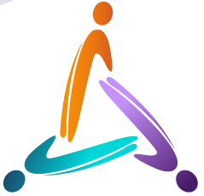
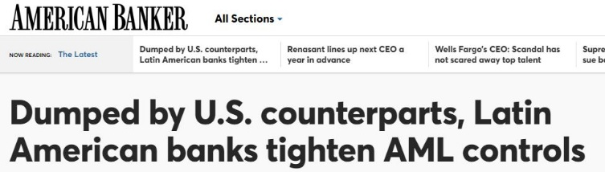
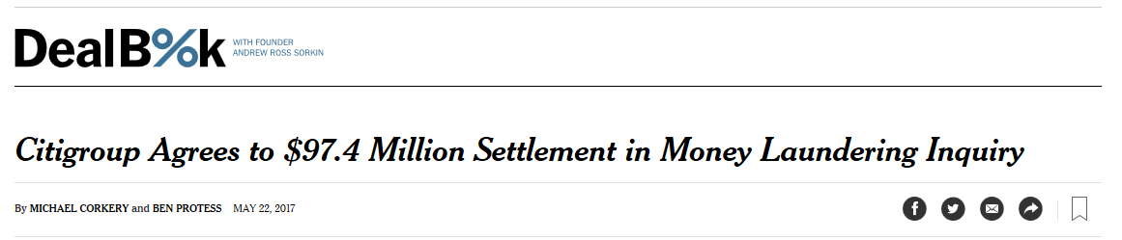
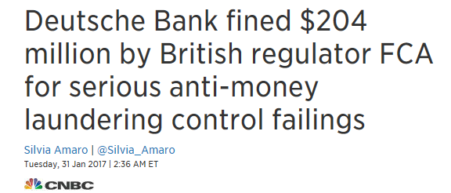
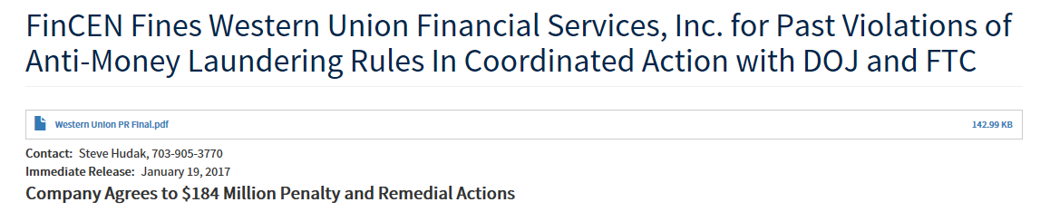
CURRENT AML CHALLENGES - THE COST OF COMPLIANCE

Slide 3
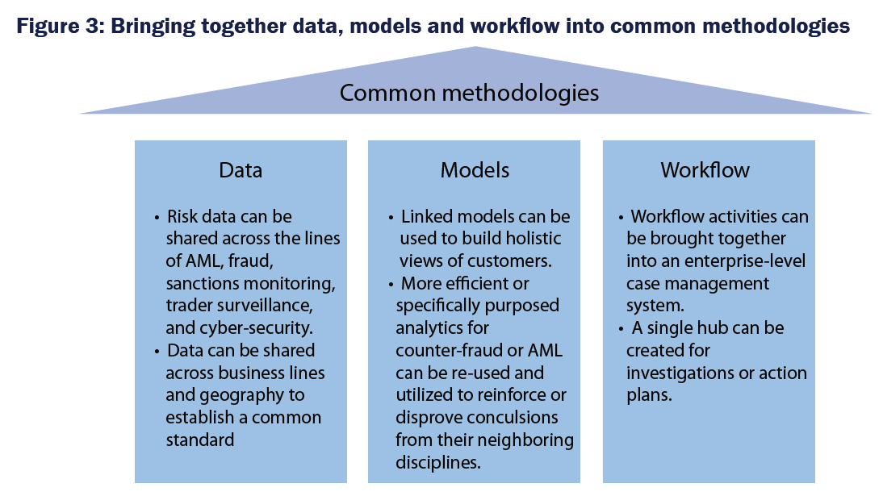
CONVERGENCE OF FINANCIAL CRIME
– AML, CDD, FATCA, CRS
Chartis Finanical Crime Risk Management Systems 2016
Financial Crimes Risk Management Systems 2016, Chartis

Slide 4
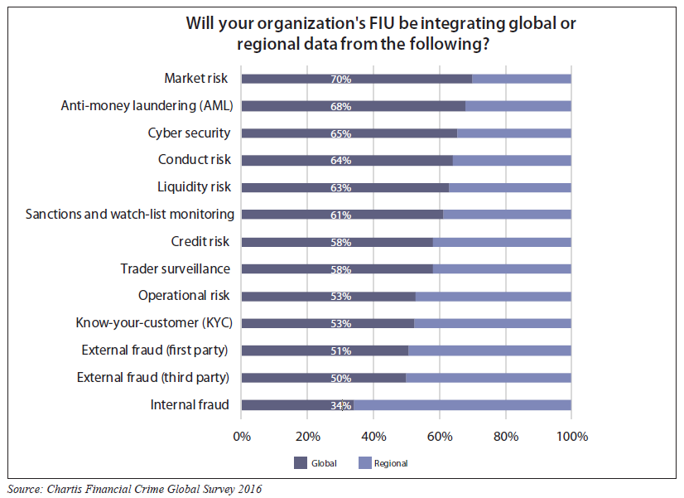
DATA SHARING ACROSS
FINANCIAL INTELLIGENCE UNITS
There is no best view – determine who the ultimate data owner(s) will be
Prioritize data sources to maximize lift
Reporting layer can be a quick win
Transactional, Demographics, Device/IP, and Third Party

Slide 5
GLOBAL MONITORING STRATGIES BEST PRACTICES
Rules
Monitoring
2000s
Model
Validation
2011
Analytics
Early Adopters
2013
Holistic Customer Monitoring
2016/2017
Financial Crimes Risk Management Systems 2016, Chartis

Slide 6
HYBRID APPROACH TO FINANCIAL CRIMES ANALYTICS
Rules
Anomaly Detection
Predictive analytics
Social network analysis
Text mining
1
2
3
4
5
Suitable for Known Patterns
Boolean logic
Easy to deploy
Prone to high false positive rates
Suitable for Unknown Patterns
Behavioral analysis
Profile analysis
Peer based anomaly detection, i.e. segmentation
Suitable for complex patterns
Numerous variables
Supervised learning where ‘target variable is known’
Neural networks
Decision trees
Regression
Suitable for associative link patterns
Demographic links
Transactional links
Hidden relationships
Geographic analysis
Necessary for unstructured data
Contextual analysis
Sentiment analysis
Social media
Simple thresholds, e.g. “large wires”, “high risk geographies”; cash structuring
Small business monitoring; commercial ACH activity; online session analysis
Credit/debit card fraud; P2P payments fraud; funds availability models
1st Party, bust-out fraud; organized crime rings
Insider threat; sanctions compliance; electronic communications
Known
Unknown
Unknowable

Slide 7
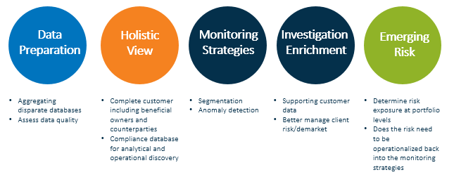
CREATING A HOLISTIC CUSTOMER VIEW
Financial Crimes Risk Management Systems 2016, Chartis

Slide 8
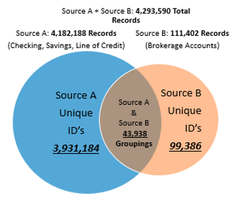
USE CASE – ENTITY RESOLUTION
AND DATA QUALITY
Designed to integrate brokerage and consumer data
Fuzzy matching techniques
Identified duplicate SSNs and EINs and other data elements
Consolidated entity records to view holistic customer profile
Leverage resolution and aggregation results across your Financial Crimes applications

Slide 9
USE CASE - CUSTOMER SEGMENTATION
Notice that the majority of the alerts are being generated for the largest customers. However these groups of customers represent a relatively small percent of the total population and have the lowest productivity rate experience.
Financial Crimes Risk Management Systems 2016, Chartis

Slide 10
USE CASE - POST CUSTOMER SEGMENTATION
The revised segmentation model produced a 4 fold increase in the scenario’s productivity rate
(from 4.9% to 20.5%).
Financial Crimes Risk Management Systems 2016, Chartis

Slide 11
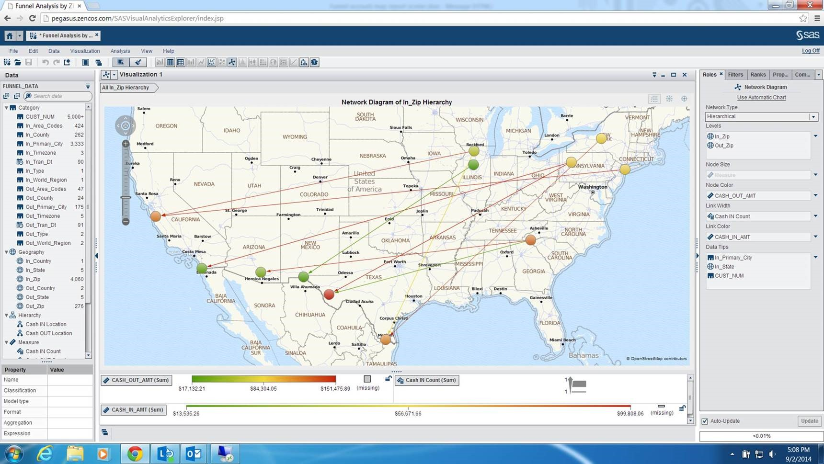
USE CASE - FUNNEL ACCOUNT ANALYSIS,
BIG DATA VISUALIZATION
Financial Crimes Risk Management Systems 2016, Chartis

Slide 12
MACHINE LEARNING AND INDUSTRY TRENDS
Machine Learning
Method of data analysis that automates analytical model building.
Using algorithms that iteratively learn from data, machine Method of data analysis that automates analytical model building.
Using algorithms that iteratively learn from data, machine learning allows computers to find hidden insights without being explicitly programmed where to look. Machine learning allows computers to find hidden insights without being explicitly programmed where to look.
Industry Trends
Build models quickly & cheaply “fail fast”
Myth that it solves data quality issues
These methods have been used in fraud for decades
Potential to auto-decision escalation of items to investigation
Financial Crimes Risk Management Systems 2016, Chartis

Slide 13
CONCLUSION – BIG DATA FOR FINANCIAL CRIMES
Proven to improve accuracy of detection and reduce false positives
In-memory visualization tools are critical to understand emerging patterns and trends in your “book of business”
Assimilate data scientists into your Financial Intelligence Units, security departments, etc.
Break down silos of fraud, compliance, security…use data sharing to provide contextual awareness
Ability to know your customers/counterparties is a competitive advantage in a digital world
Financial Crimes Risk Management Systems 2016, Chartis

