Slide 1
What keeps me up @ night
Luiz Eduardo Dos Santos
Technical Director, LATAM

Slide 2
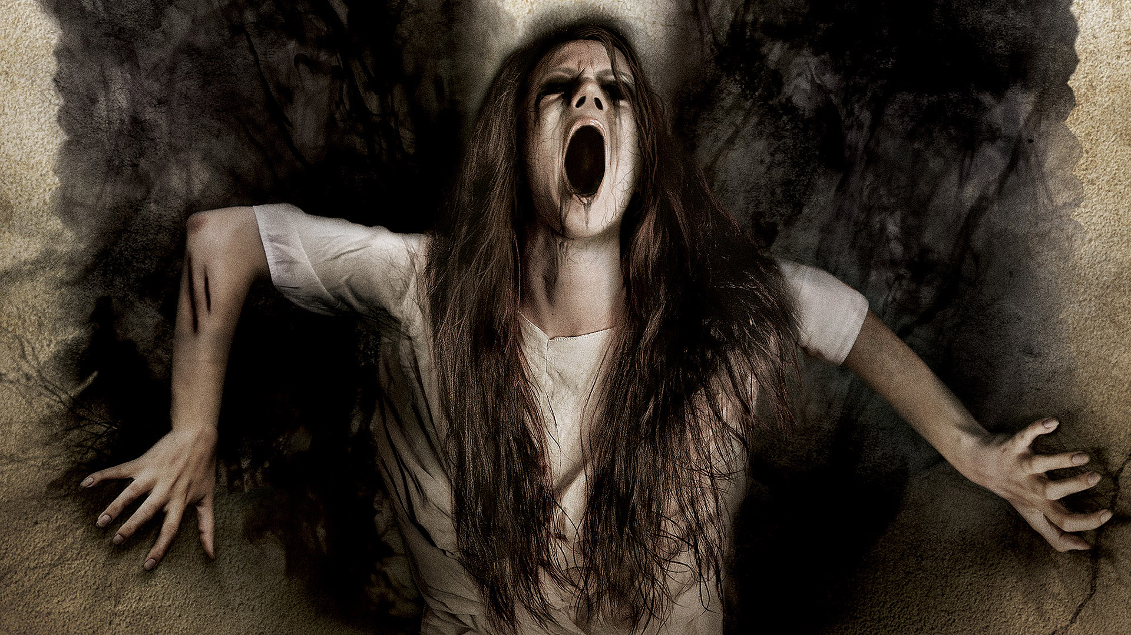
why not this talk?

Slide 3
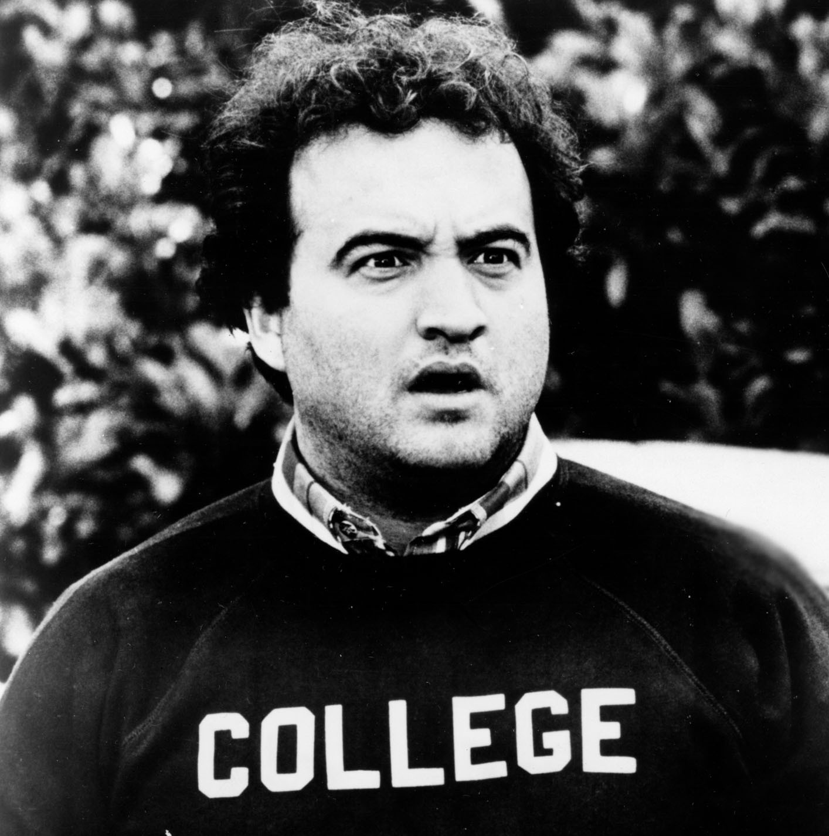






whoami

Slide 4
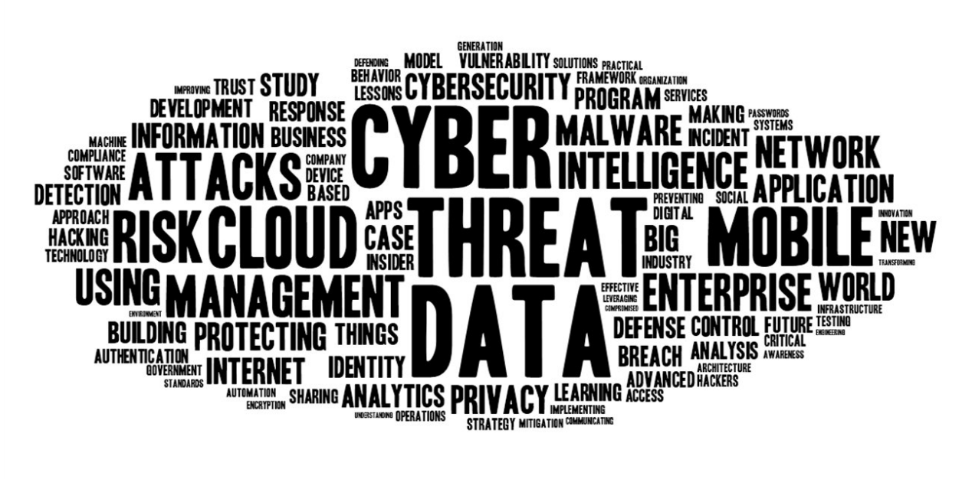
Notes:
Buying and Selling Security Infosec is a bit complicated, and sort of bipolar too many things to worry about and 1) everything we don’t want to be connected is connected, and 2) whatever we want to be connected isn’t
so, how do we deal with this? but before… this is a good industry, unless you are really really bad, you’re okay and you will be okay…
on the flipside it is a heavily reputation based industry, and based on facts.

Slide 5
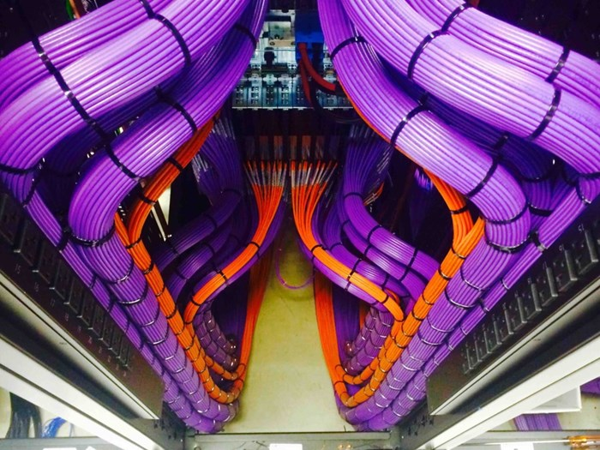

Slide 6
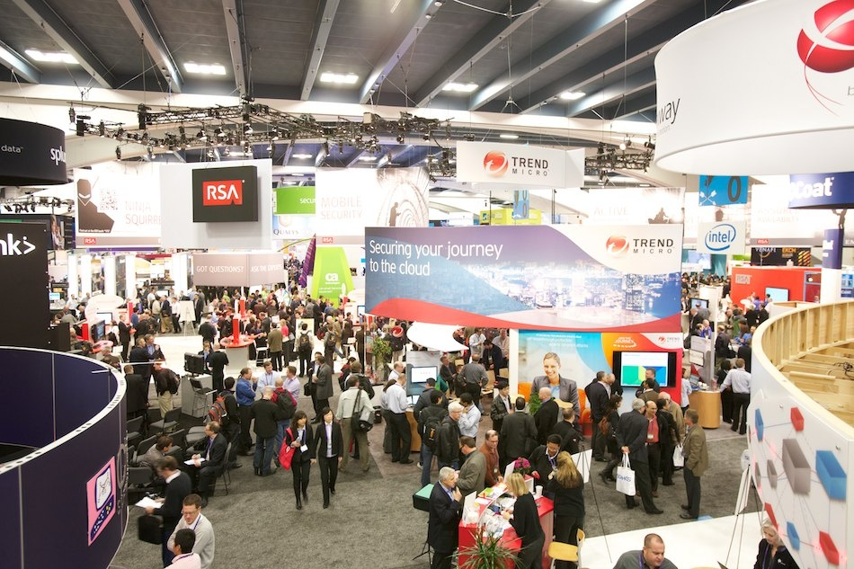
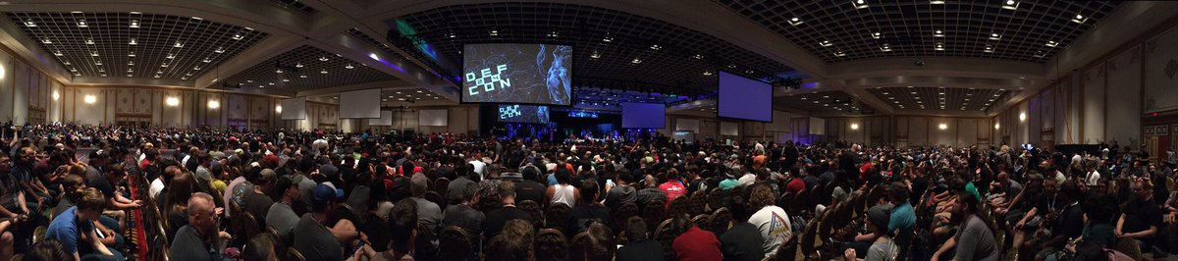
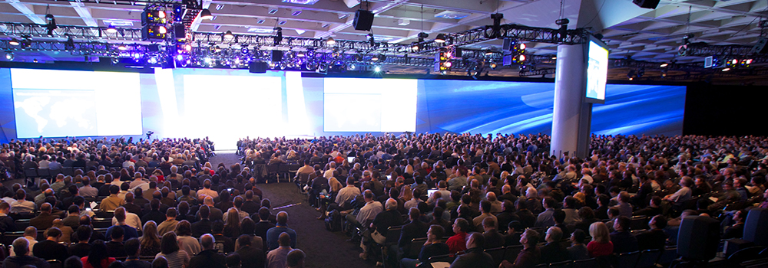
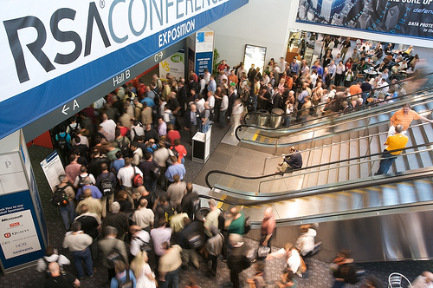

Slide 7
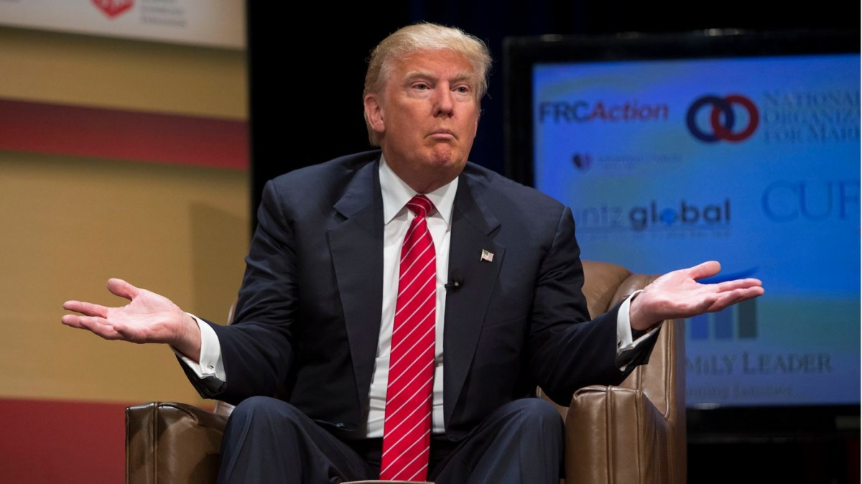

Slide 8
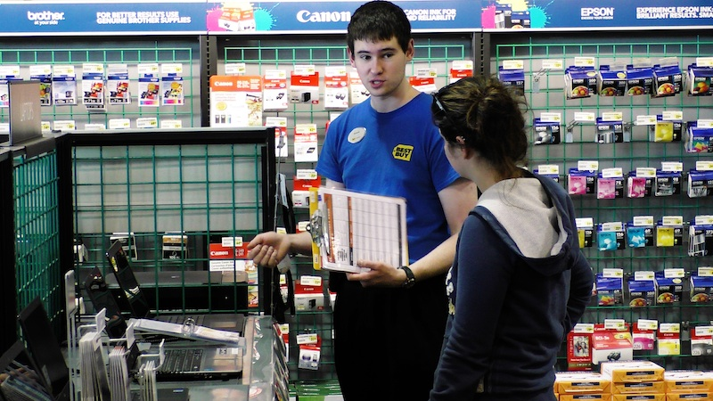

Slide 9
privacy

Slide 10







privacy / personal level

Slide 11
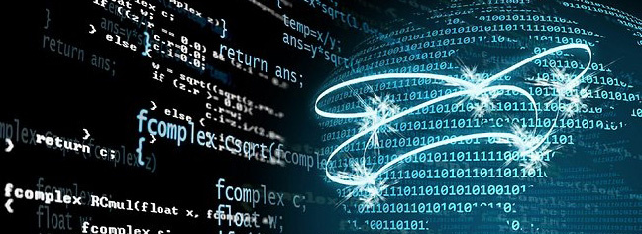
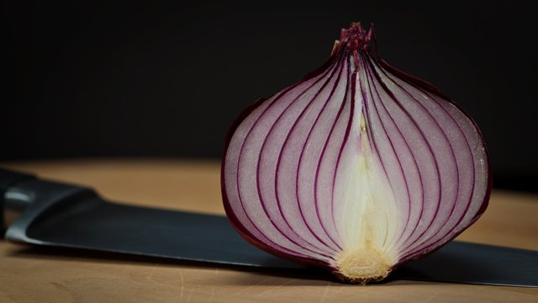

privacy / corporate level

Slide 12
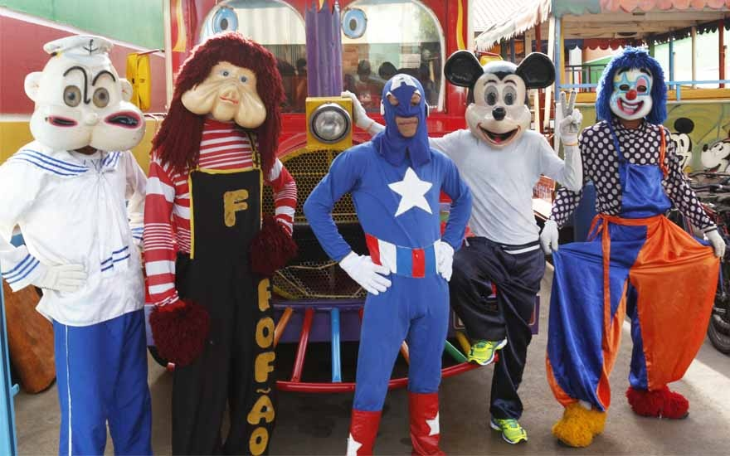
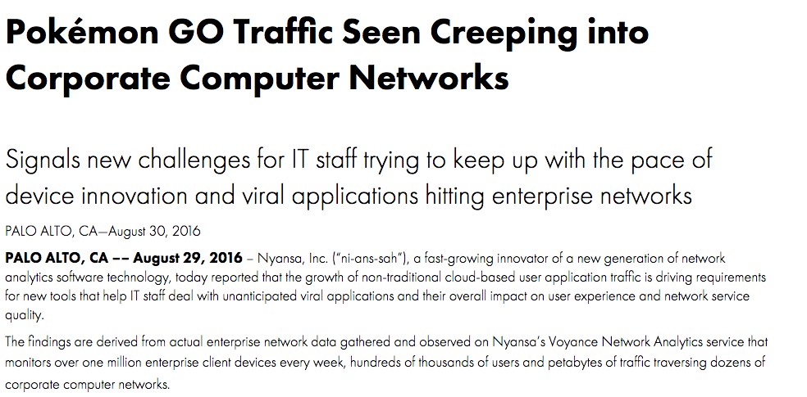
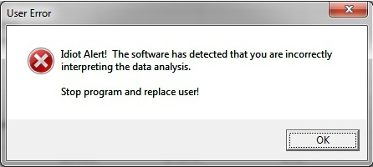

Slide 13
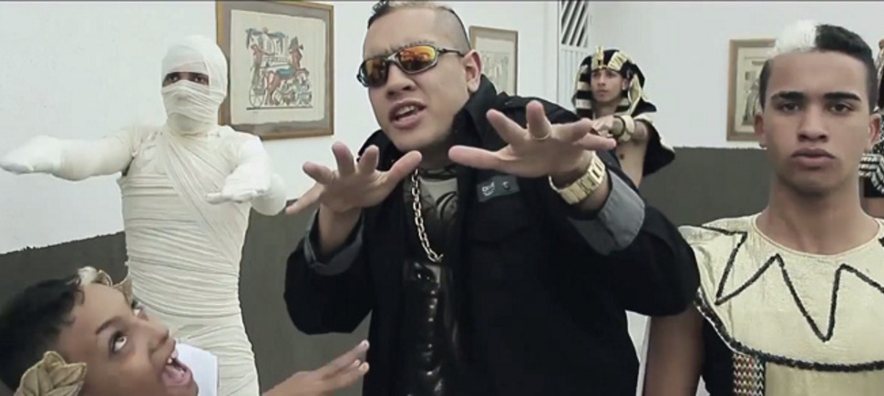

Slide 14
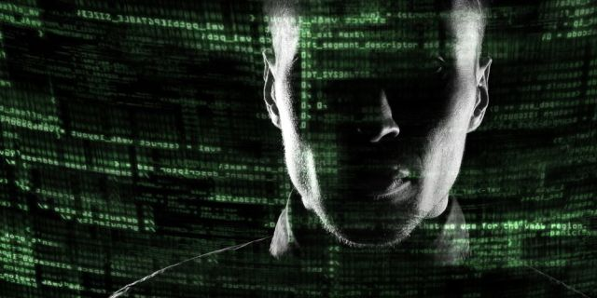
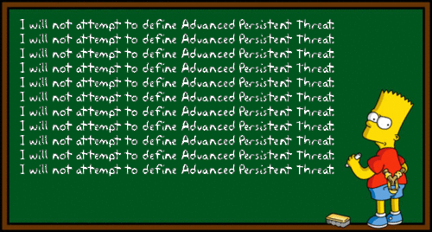

Slide 15
root@elliot:˜# root@elliot:˜# root@elliot:˜# root@elliot:˜# root@elliot:˜# root@elliot:˜# ./apt-attack start

Slide 16
[tyrell@CHD2000-PS2910]$
[tyrell@CHD2000-PS2910]$
[tyrell@CHD2000-PS2910]$ find ./ -name APT

Slide 17
[tyrell@CHD2000-PS2910]$
[tyrell@CHD2000-PS2910]$
[tyrell@CHD2000-PS2910]$ find ./ -name APT
[tyrell@CHD2000-PS2910]$ sudo rm –rf /

Slide 18

red teaming

Slide 19
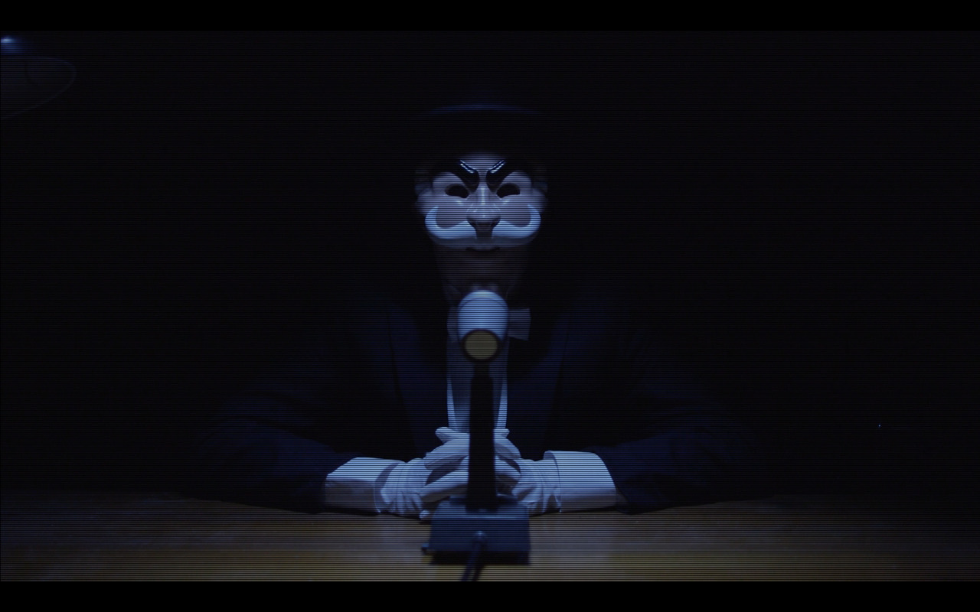

Slide 20
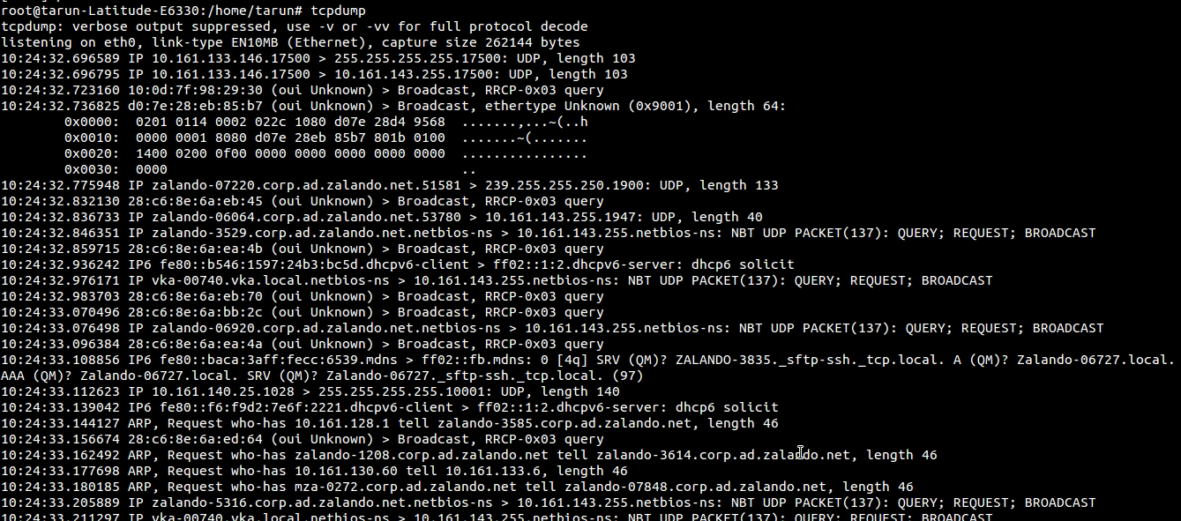
btw…

Slide 21
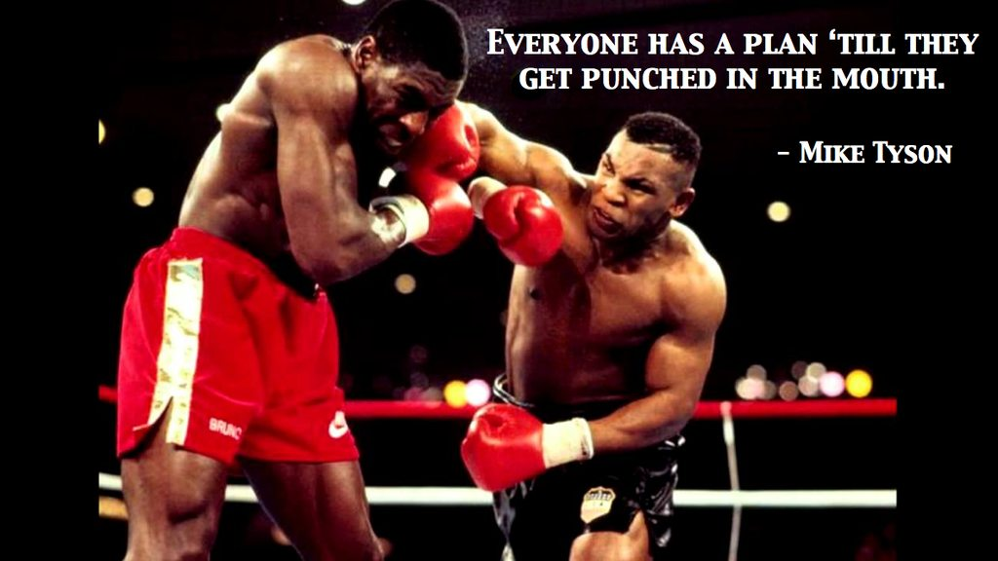
conclusions

Slide 22
Muchas Gracias!
le<at>fireeye.com
@effffn
www.fireeye.com

