Slide 1

CHAINALYSIS CONNECTING THE BITCOIN DOTS

Slide 2

AGENDA
Intro to Chainalysis
Connecting Bitcoin to traditional finance
Illicit Use of Bitcoin
Conducting Bitcoin investigations

Slide 3

CHAINALYSIS
Chainalysis is a VC-backed startup, based out of NYC, which provides leading blockchain compliance and analytics software.

Slide 4




OUR PRODUCTS
Transaction Monitoring
Real time alerts for fraud and money laundering
Data Visualization
Intuitive tools for faster manual investigations
Transaction Monitoring
Actionable insights from monthly reports

Slide 5


Bitcoin is a decentralized virtual currency
Bitcoin is virtual But users need to buy and sell virtual currencies with traditional financial instruments such as credit cards and wire transfers

Slide 6
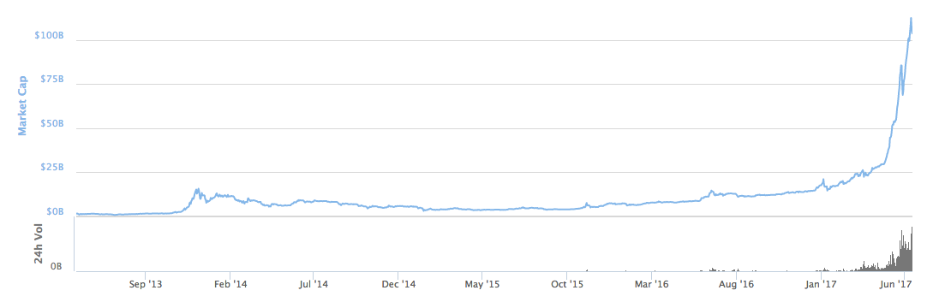
TOTAL VALUE OF CRYPTOCURRENCIES ALMOST $100 BILLION

Slide 7

THE US HAS REGULATED BITCOIN SINCE 2013
March 2013 FinCEN guidance: VC administrators and exchangers must register as MSBs, pursuant to BSA
July 2013 SEC investor warning: fraudulent investment schemes that may involve Bitcoin and other VCs
March 2014 IRS issues notice: virtual currency treated as property for federal tax purposes
June 2014 SEC charges Erik Vorhees with offering unregistered securities. Investors could pay for shares using Bitcoin
July 2013 SEC complaint: charges Trendon Shavers with allegedly running Bitcoin-denominated Ponzi scheme
Aug 2013 SEC v. Shavers appeal: Texas court rules Bitcoin is money, SEC can pursue Bitcoin-based securities charges
Aug 2014 CFPB issues warning about risks of virtual currencies. Begins accepting complaints on VC products and services.
Sept 2014 SEC v. Shavers final judgement. Ordered to pay $40.7 million for operating Bitcoin Ponzi scheme

Slide 8
REGULATORY REQUIREMENTS
Bitcoin exchanges required to register as MSBs with FinCEN
Comply with BSA/AML laws
Collect documentation on customers
MSBs file SARs with FinCEN
SAR filing requirements: $2,000
Regulatory environment in the U.S., doesn’t apply globally
Japan: in April 2017, began recognizing bitcoin as a legal method of payment

Slide 9
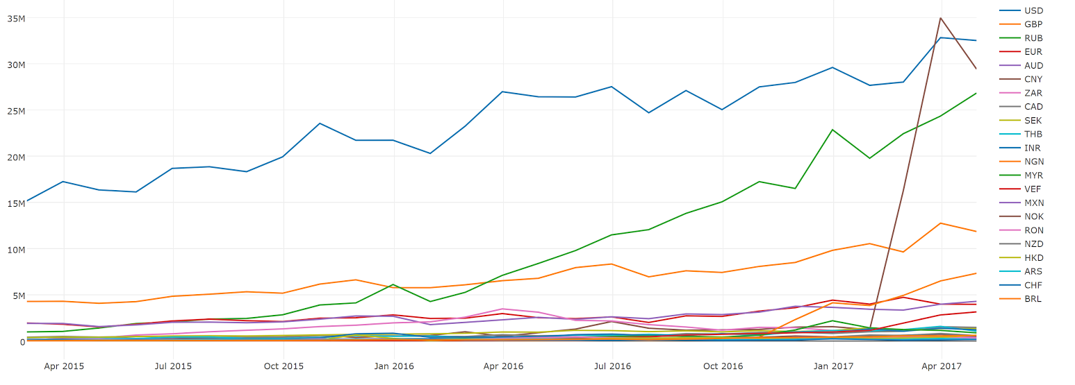
SOME REGULATORY ACTION HAS LED TO MORE PEER TO PEER ACTIVITY

Slide 10
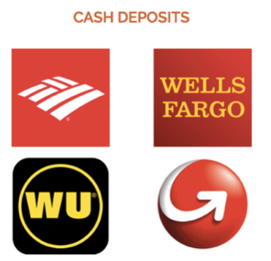
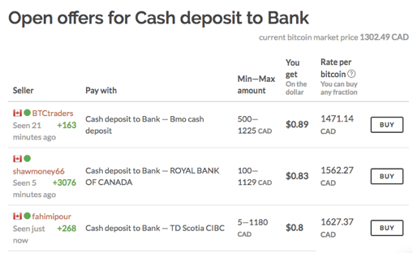
MOST BANKS DO NOT UNDERSTAND THEIR EXPOSURE

Slide 11
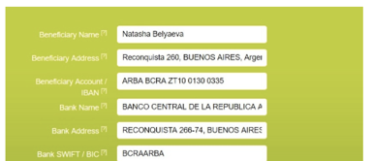
MOST BANKS DO NOT UNDERSTAND THEIR EXPOSURE

Slide 12

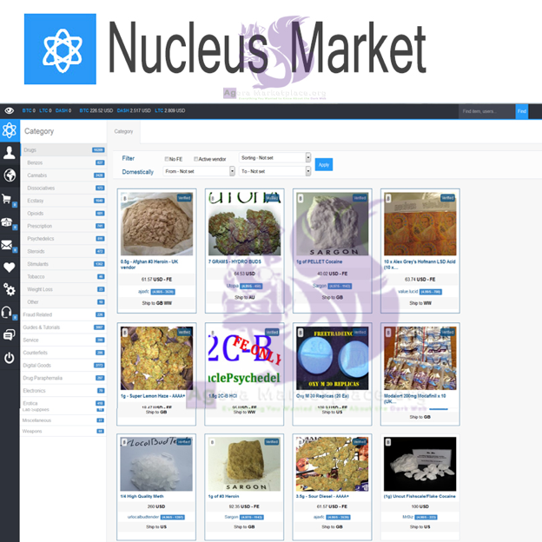
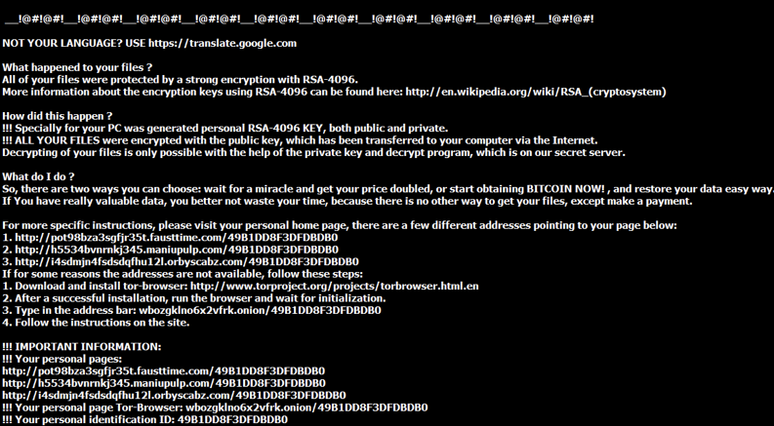
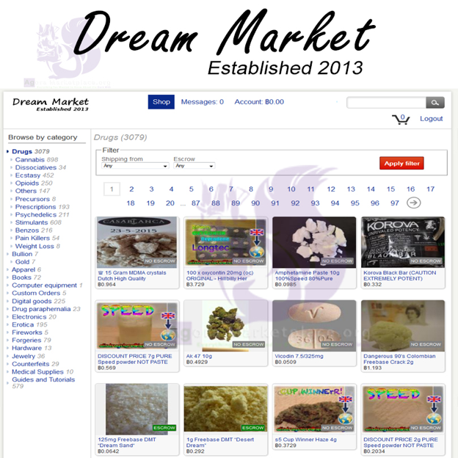
ILLICIT USE OF BITCOIN

Slide 13

WHAT DOES CHAINALYSIS DO
Clusters Bitcoin Transactions
Using proprietary heuristics, Chainalysis takes the history of Bitcoin transactions and identifies those which have been done by the same entity.
Attribution
Chainalysis analysts actively transact on the Bitcoin network to tie clusters to real world services.
Visualization
Based off the real-time backend, Chainalysis provides a web interface for users to spot connections between Bitcoin services.

Slide 14

UNDERSTANDING HEURISTICS TO IDENTIFY BITCOIN WALLETS
?
?
?
Tie these digital entities to real world entities
Group Bitcoin addresses into entities

Slide 15
UNDERSTANDING HEURISTICS TO GROUP ADDRESSES TO ENTITIES
Inputs are from the same entity
Keys for each address that is contributing an input must be present to sign the transaction

Slide 16
GETTING ATTRIBUTION TO REAL WORLD SERVICES
Bitcoin Service A
Deposit address
Chainalysis Deposit address

Slide 17
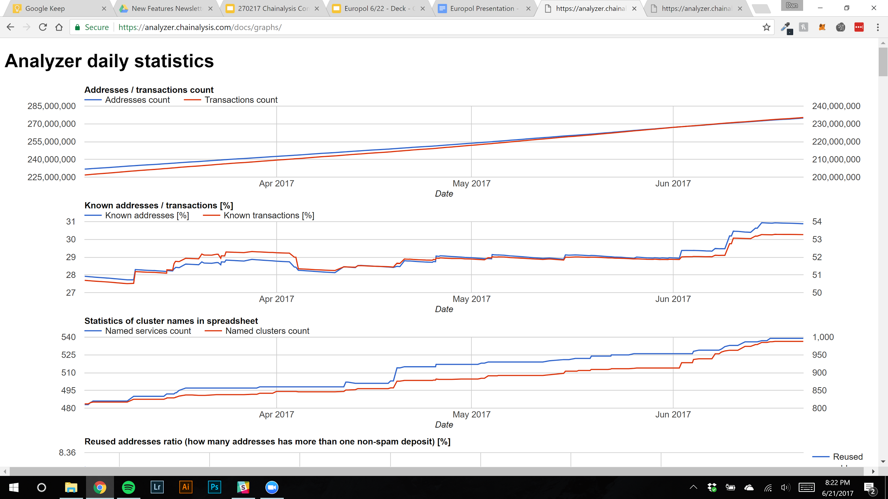
ATTRIBUTING THESE WALLETS TO SERVICES REQUIRES ONGOING RESEARCH

Slide 18

CHAINALYSIS CUSTOMERS CAN SHARE INFORMATION
Exchange
Merchant
Processor
Bank
Cyber Security
Company
Law
Enforcement
Law
Enforcement

Slide 19
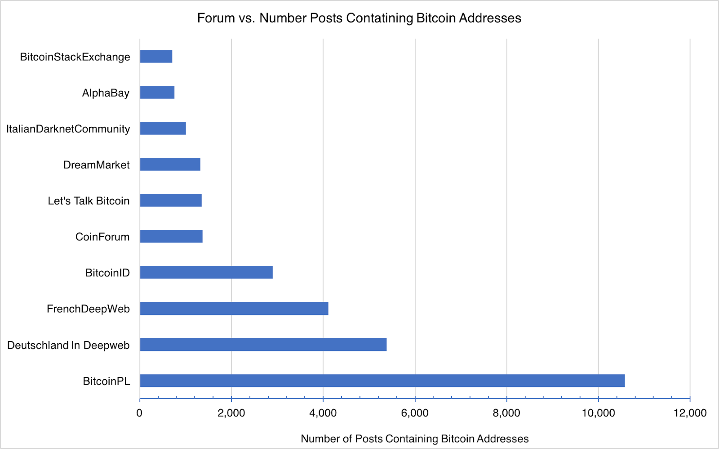
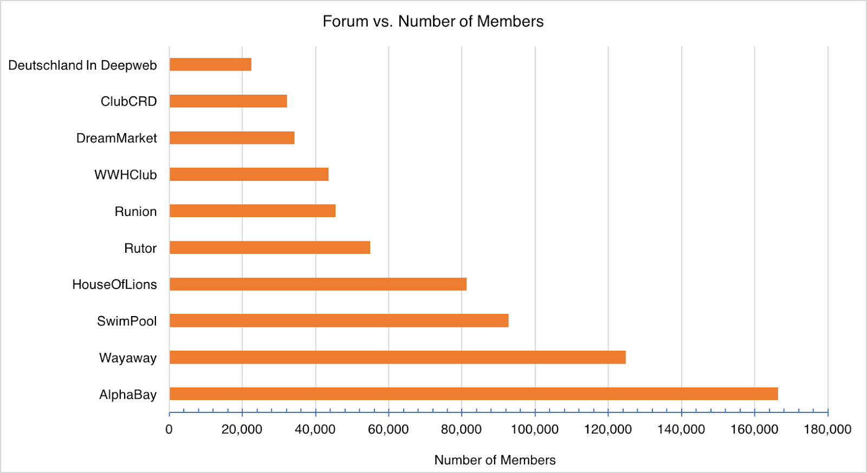
BITCOIN IS MORE VIRAL THEN OTHER FINANCIAL INSTRUMENTS

Slide 20
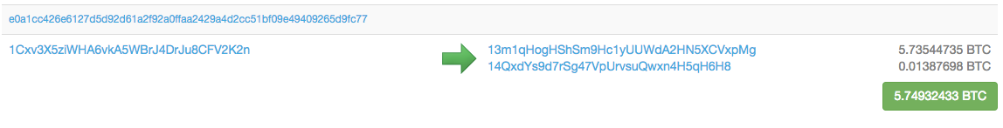
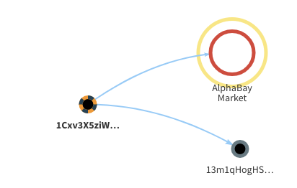
CONDUCTING INVESTIGATIONS
Transaction in the Chainalysis tool:

Slide 21
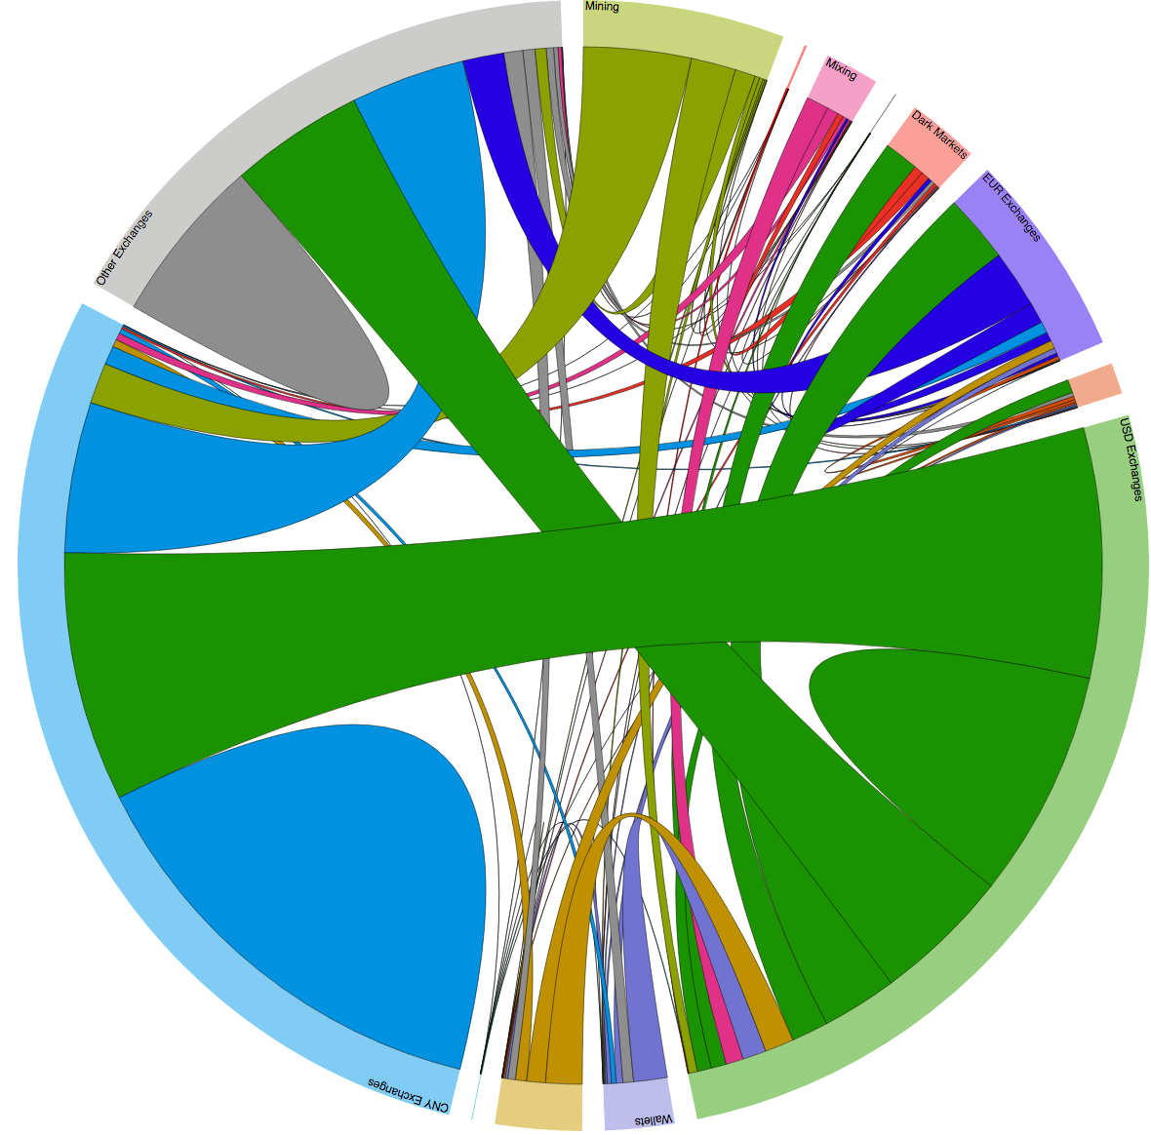
MAPPING ALL FINANCIAL FLOWS IN BITCOIN IN 2016

Slide 22
THANK YOU
Jonathan Levin
CoFounder CHAINALYSIS
jonathan@chainalysis.com

