Slide 1


Equity Markets’ Clustering and the Global Financial Crisis

Slide 2
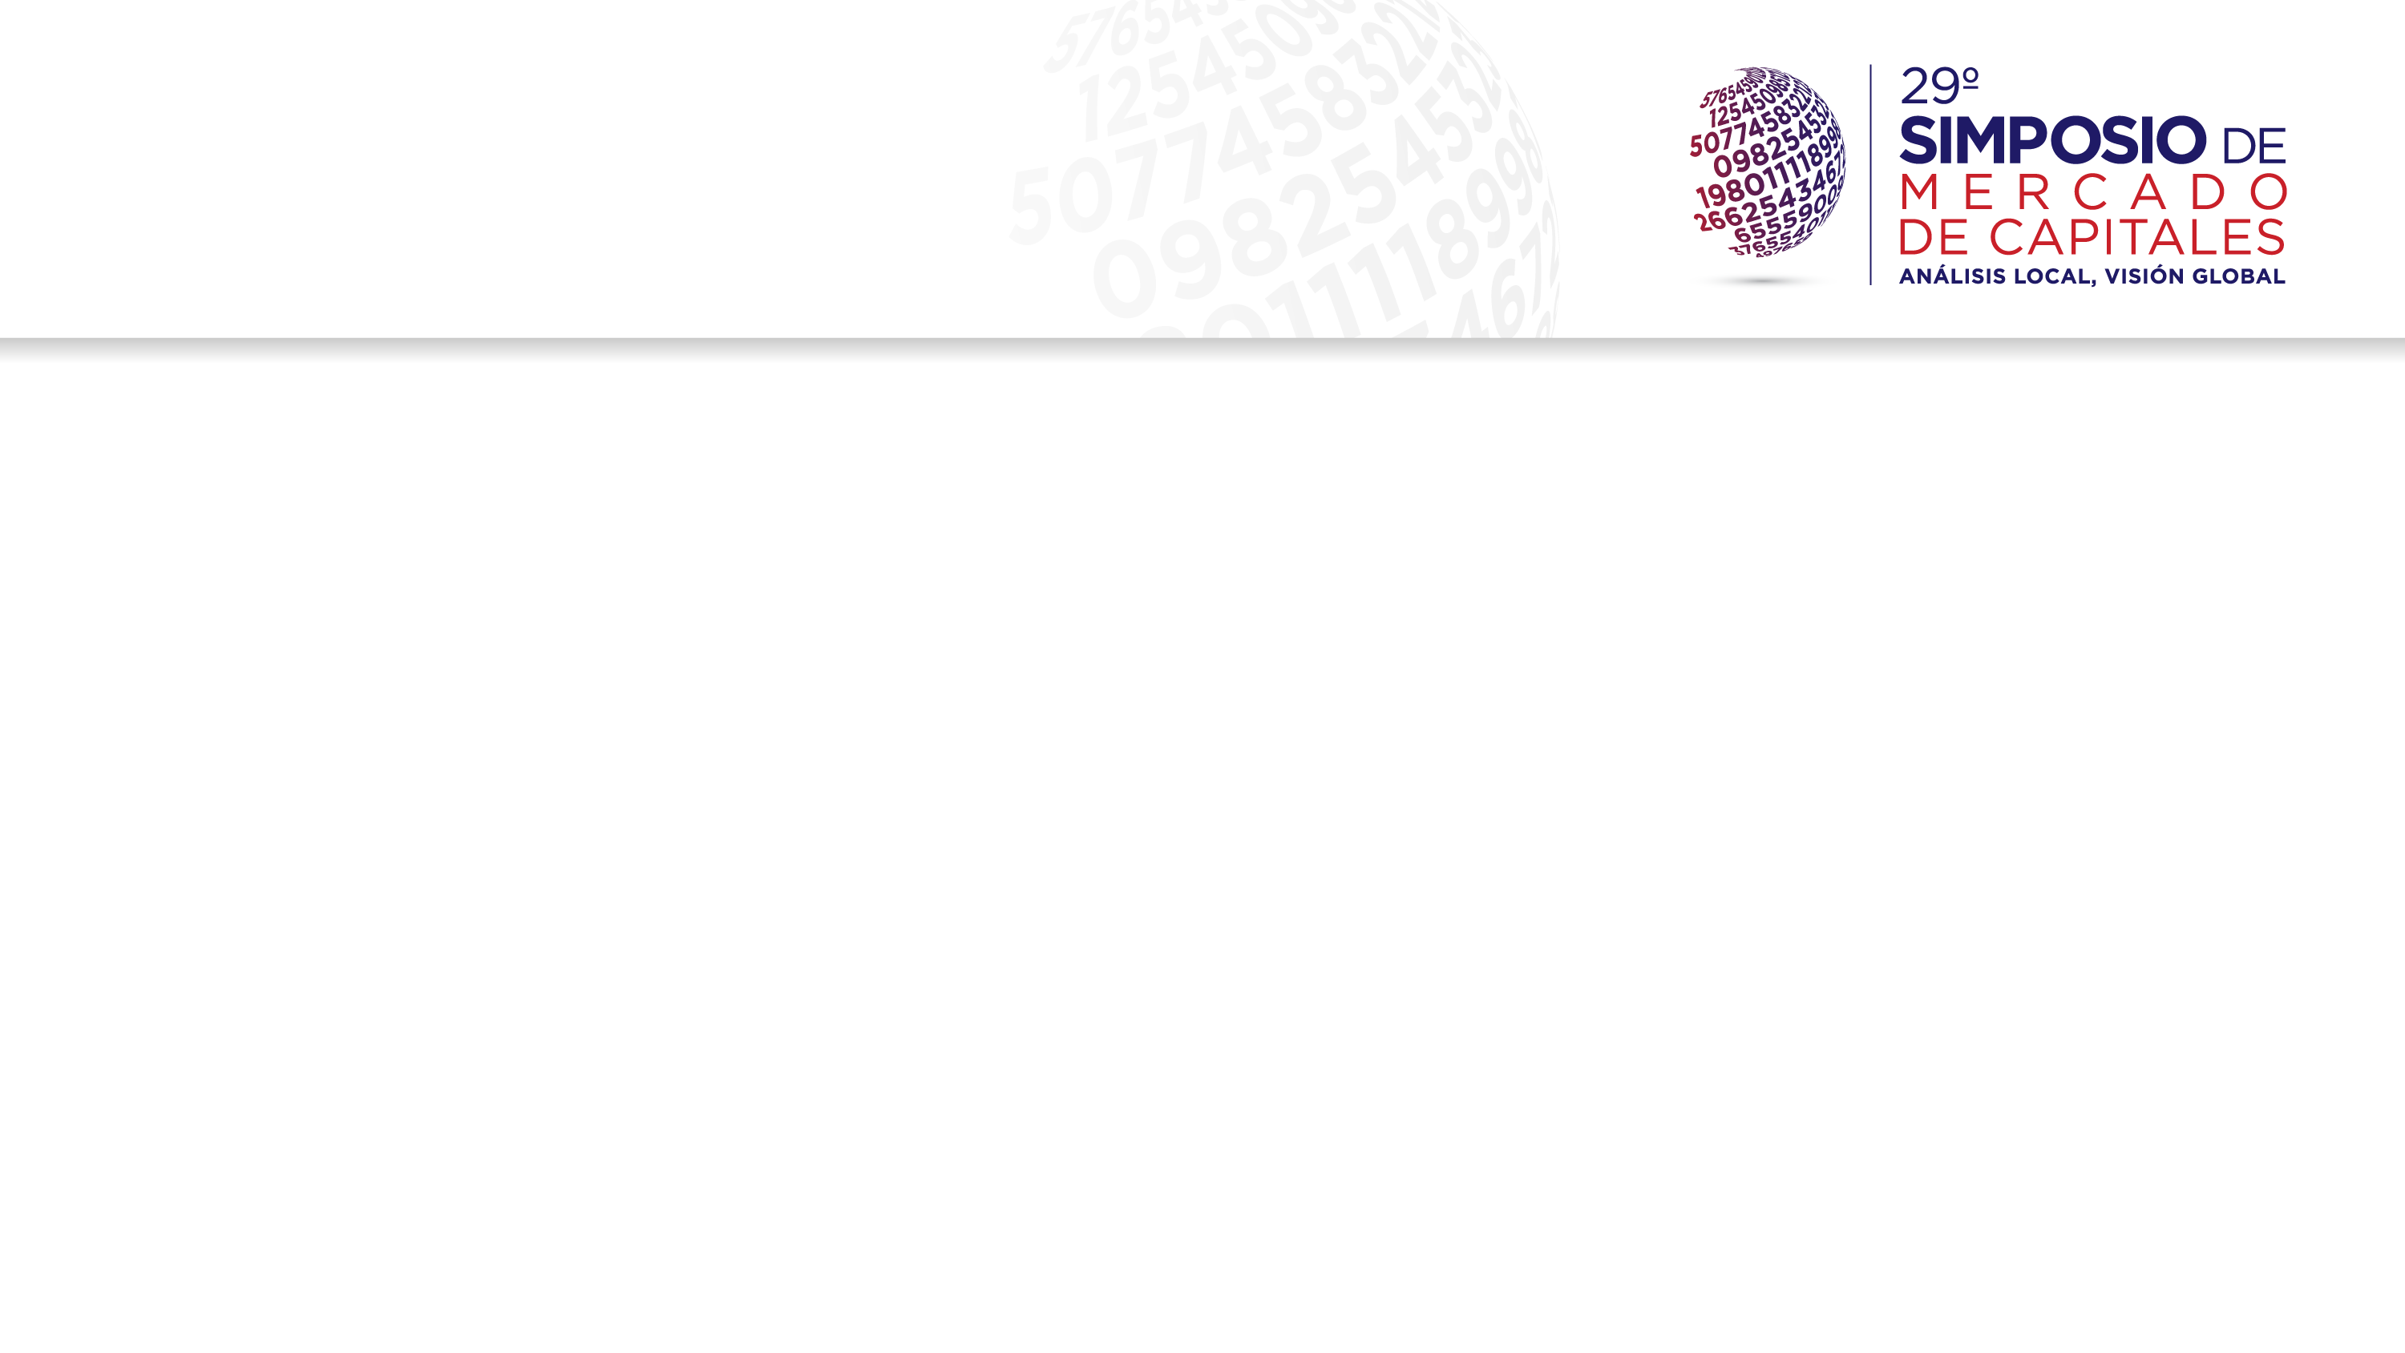
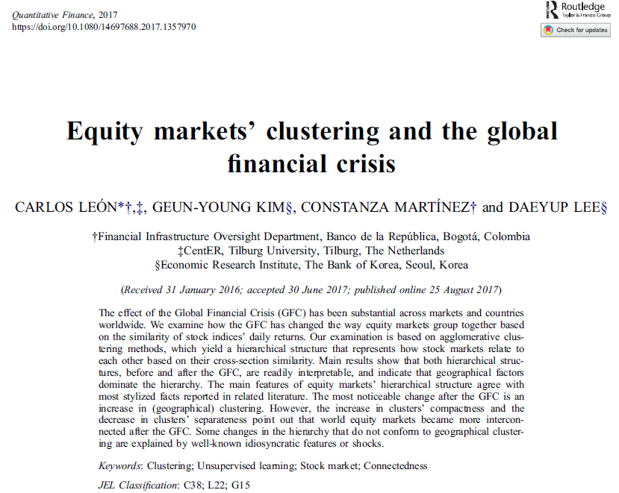
Good news first…
Recently accepted in Quantitative Finance
http://dx.doi.org/10.1080/14697688.2017.1357970

Slide 3
Disclaimer
The opinions and statements in this article are the sole responsibility of the authors, and do not represent neither those of Banco de la República nor The Bank of Korea.
We are thankful to Peter Sarlin and the two reviewers for their contributive comments and suggestions. We are grateful to Hernando Vargas, Pamela Cardozo, Clara Machado, Alejandro Reveiz, Esteban Gómez, Sandra Benítez, Sebastián Rojas, Daniel Osorio, Fredy Gamboa, José Fernando Moreno, Andrés Ortiz, Brian Lesmes and Diego Roa for their comments to an early version of the article. Any remaining errors are the authors’ own.

Slide 4
Take home messages…
We implement an agglomerative clustering algorithm to examine how 80 equity markets interrelate before and after the Global Financial Crisis (GFC).
The algorithm yields a hierarchical structure that represents how stock markets relate to each other based on their cross-section similarity.
The main features of equity markets’ hierarchical structures agree with most stylized facts reported in related literature (e.g. dominance of geographical factors).
The most noticeable change after the GFC is a stronger geographical clustering, along with less distance between clusters; it is a more interconnected equity market.
Some changes in the hierarchy that do not conform to geographical clustering are explained by well-known idiosyncratic features or shocks.

Slide 5
Outline
Introduction
Literature review
Agglomerative clustering
The data
Main results
  The resulting hierarchies
  About stylized facts
  Main changes after the GFC
Final remarks

Slide 6
Introduction
Interconnectedness and interdependence have become fundamental concepts to understand the nature of Global Financial Crisis (GFC) and market dynamics.
Our aim is to…
  Examine the hierarchical structure of world equity markets in order to disentangle how this structure reveals differences among distinct regions and countries in terms of their interdependence,
  And to examine how such interdependence changed with the GFC.
How? … Agglomerative clustering
  This is an unsupervised learning method that discovers by itself how data may be organized (Sumathi & Sivanandam, 2006).
  The main concern is to reveal the organization patterns into “sensible groups”, which allows to discover similarities and differences, and to derive useful conclusions about them (Halkidi et al., 2001).

Slide 7
Outline
Introduction
Literature review
Agglomerative clustering
The data
Main results
  The resulting hierarchies
  About stylized facts
  Main changes after the GFC
Final remarks

Slide 8
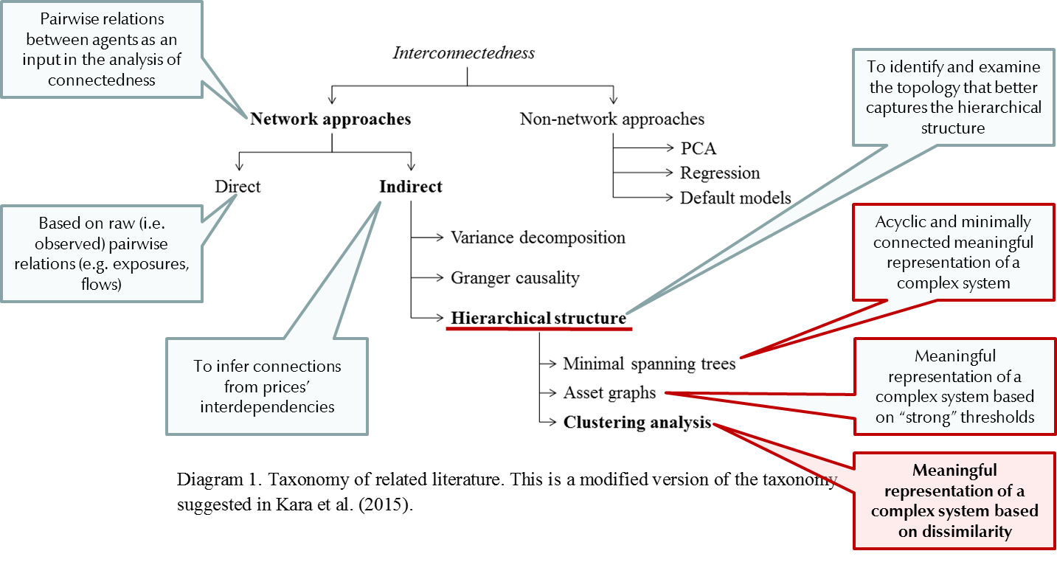
Literature review

Slide 9
Literature review
Most literature on the hierarchical structure of world markets is based on minimal spanning trees (Bonanno et al., 2004, Coelho et al., 2007, Gilmore et al., 2008, Eryigit & Eryigit, 2009).
Some based on asset graphs (Sandoval, 2013) or clustering (Panton et al., 1976).
Most based on correlation-into-distance transformations (see Mantegna (1999) and many that followed the same path).
They all identify geographical organizing principles –stylized fact.
Literature on other markets agree on geographical clustering, but with particularities.
  Sovereign bonds (Gilmore et al. ,2010)
  Sovereign CDS (León et al., 2014)
  FX (Mizuno et al., 2006)

Slide 10
Outline
Introduction
Literature review
Agglomerative clustering
The data
Main results
  The resulting hierarchies
  About stylized facts
  Main changes after the GFC
Final remarks

Slide 11
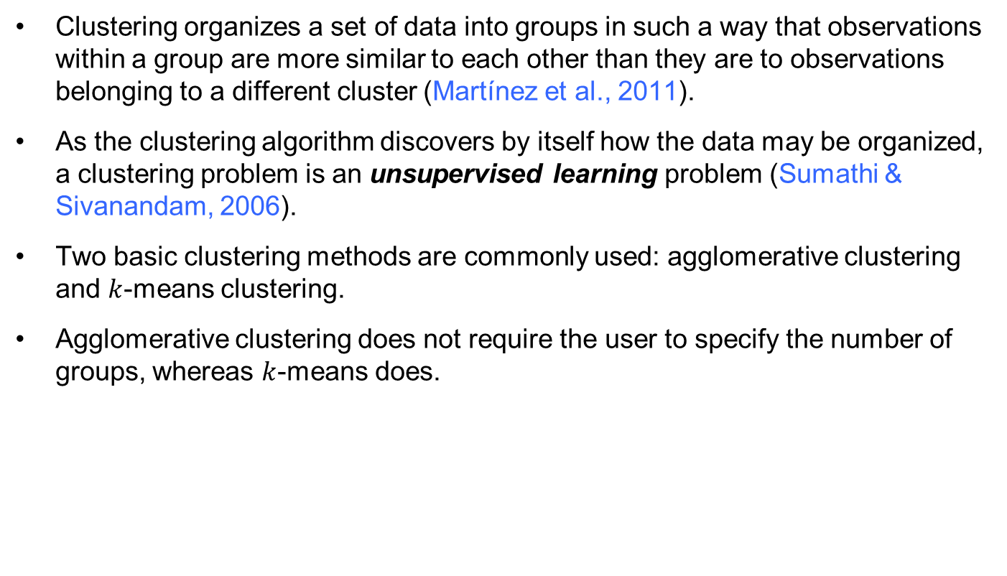
Agglomerative clustering
Clustering organizes a set of data into groups in such a way that observations within a group are more similar to each other than they are to observations belonging to a different cluster (Martínez et al., 2011).
As the clustering algorithm discovers by itself how the data may be organized, a clustering problem is an unsupervised learning problem (Sumathi & Sivanandam, 2006).
Two basic clustering methods are commonly used: agglomerative clustering and $k$-means clustering.
Agglomerative clustering does not require the user to specify the number of groups, whereas $k$-means does.

Slide 12
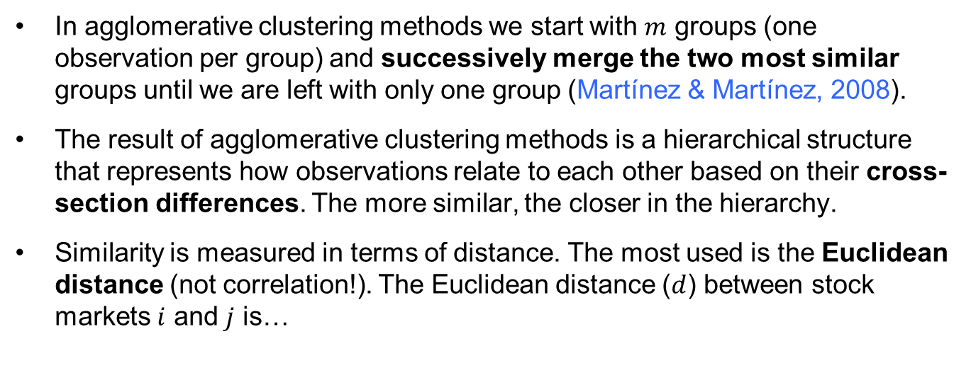
Agglomerative clustering
In agglomerative clustering methods we start with $m$ groups (one observation per group) and successively merge the two most similar groups until we are left with only one group (Martínez & Martínez, 2008).
The result of agglomerative clustering methods is a hierarchical structure that represents how observations relate to each other based on their cross-section differences. The more similar, the closer in the hierarchy.
Similarity is measured in terms of distance. The most used is the Euclidean distance (not correlation!). The Euclidean distance ($d$) between stock markets $i$ and $j$ is…

Slide 13
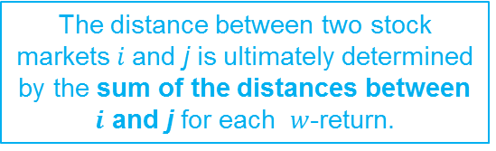


Agglomerative clustering
The $w$-th return of the $i$-th stock market
$w$ returns
The interpoint distance matrix
The distance between two stock markets $i$and j is ultimately determined by the sum of the distances between $i$ and j for each $w$-return.

Slide 14
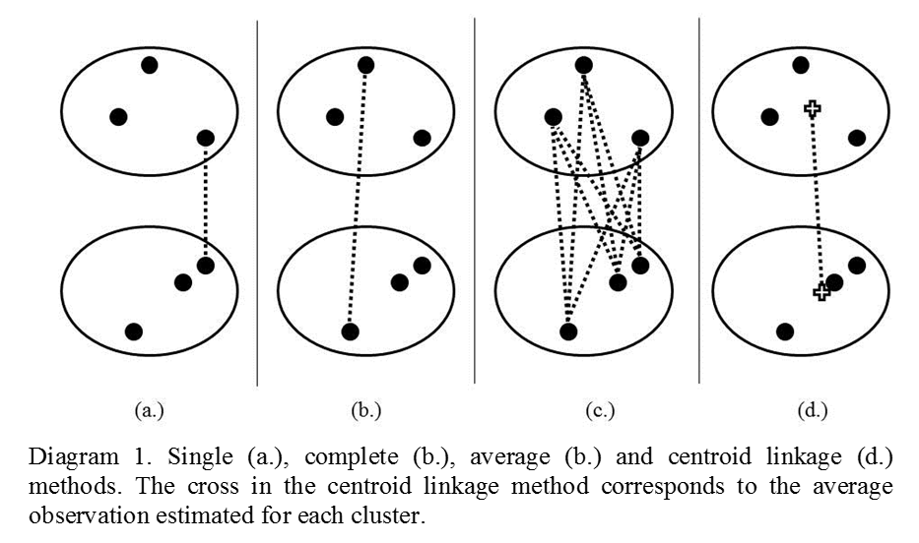
Agglomerative clustering
Merging groups follows a selected criteria (i.e. the linkage method): distance between groups.
Ward (1963): linkage method based on minimizing the loss of information by means of minimizing the increase in intragroup variance that results from merging to groups.

Slide 15
Agglomerative clustering
Empirical (unrelated) studies tend to favor Ward’s, average and complete linkage methods (see Ferreira & Hitchcock, 2009, Everitt et al., 2011, Hossen et al., 2015).
Calinkski & Harabasz (1974) validity criterion:
  Clustering methods should search for clusters whose members are close to each other (i.e. compact) and well-separated (Halkidi et al., 2001).
  CH index is the ratio of the between-cluster sum of squares (i.e. separateness) to the within-cluster sum of squares (i.e. compactness).
  The larger the index, the better the clustering solution.
Based on CH index, and supported by empirical studies and the interpretability of the hierarchical structure, Ward’s is our selected linkage method…

Slide 16
Agglomerative clustering

Slide 17
Outline
Introduction
Literature review
Agglomerative clustering
The data
Main results
  The resulting hierarchies
  About stylized facts
  Main changes after the GFC
Final remarks

Slide 18
The data
Daily data of 80 stock market indexes from 80 countries, in local currency.
  Panton et al. (1976): 12 ind. USD numeraire
  Bonnano et al. (2004): 51 Local currency
  Coehlo et al. (2007): 53 USD numeraire
  Gilmore et al. (2008): 21 USD numeraire
  Eryigit & Eryigit (2009): 59 Local currency
  Sandoval (2013): 91 Local currency
Two periods, before and after GFC (daily data, 1941 obs):
  January 10, 2005 – August 29, 2008
  November 3, 2008 – June 22, 2012
Usual adjustments to data: two-day rolling log-returns for synchronicity (Forbes & Rigobon, 2002); z-score standardization (Martínez et al., 2011); international holidays as 20% of the observations.
Focus on the topology of equity markets
Equivalent to assuming a fully hedged international investor (i.e. only seeking exposure to equity)

Slide 19
Outline
Introduction
Literature review
Agglomerative clustering
The data
Main results
  The resulting hierarchies
  About stylized facts
  Main changes after the GFC
Final remarks

Slide 20
The resulting hierarchies
The hierarchical classifications produced by agglomerative clustering are represented by a dendrogram or tree diagram, which illustrates the successive merges made at each stage of the procedure (Everitt et al., 2011).
The hierarchical structure provides a basic but meaningful map of interdependencies among equity markets that may sharpen our understanding of financial markets’ connectedness.

Slide 21
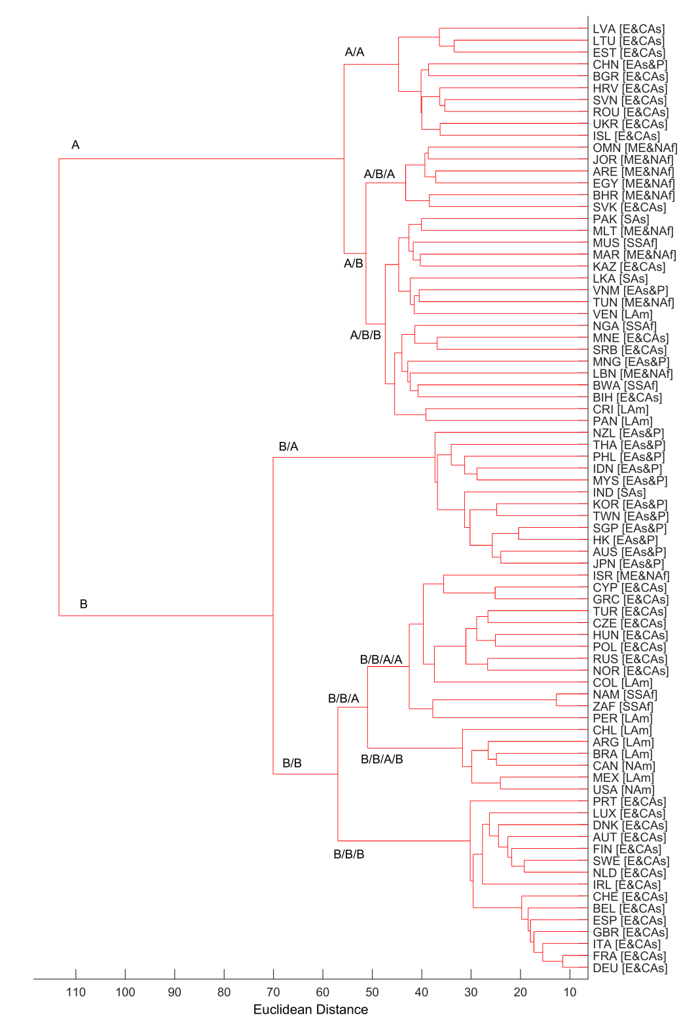
The resulting hierarchies
Cluster A: 34 countries
  Mostly from Eastern Europe & Central Asia and Middle East & North Africa.
  A few from Latin America (3), East Asia & Pacific (3), Sub Saharan Africa (3) and South Asia (2).
  Outliers: Iceland, Costa Rica, Panama, Venezuela.
Cluster B: 46 countries
  Mostly from Western Europe & Central Asia, East & Asia Pacific, Latin America, and North America.
  All Western Europe (but Iceland) in B/B/B, plus Eastern Europe major economies (Czech R., Hungary, Poland, Russia).
  A few from Middle East & North Africa (1), South Asia (1), Sub Saharan Africa (2).
  Outliers: Namibia, South Africa, Israel.
  Interesting: Colombia & Peru outside Latin America; Greece and Cyprus outside Western Europe.
Before GFC
Dendrogram before the GFC (January 10, 2005 – August 29, 2008). In brackets the region each country pertains to according to World Bank’s Lending Groups: E&CAs (Europe & Central Asia), EA&P (East Asia & Pacific), ME&NAf (Middle East & North Africa), SAs (South Asia), SSAf (Sub Saharan Africa), LAm (Latin America), NAm (North America).

Slide 22
The resulting hierarchies
Worth highlighting
  Geographical clustering is imperfect, but important.
  Western Europe is tightly interconnected.
  Distances in Cluster B are lower (higher interconnectedness)
  Cluster A is not particularly interconnected, but geographical clustering is visible.
  East Asia & Pacific is closer to Western Europe and America than to Eastern Europe and South Asia.
  United States has no large cluster of its own (stylized fact).
  China has no large cluster, and its partner is odd (stylized fact)
Before GFC
Dendrogram before the GFC (January 10, 2005 – August 29, 2008). In brackets the region each country pertains to according to World Bank’s Lending Groups: E&CAs (Europe & Central Asia), EA&P (East Asia & Pacific), ME&NAf (Middle East & North Africa), SAs (South Asia), SSAf (Sub Saharan Africa), LAm (Latin America), NAm (North America).

Slide 23
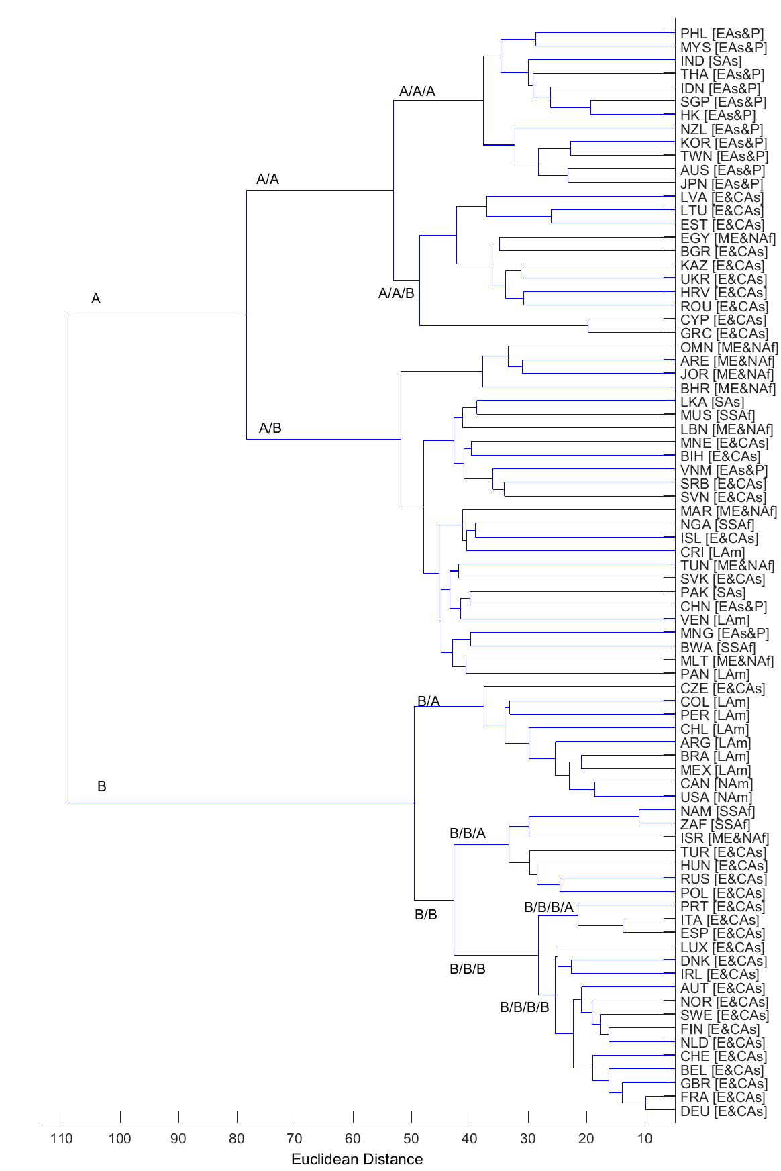
The resulting hierarchies
Cluster A: 48 countries (before, 34)
  Mostly from Eastern Europe & Central Asia, East Asia & Pacific, and Middle East & North Africa.
  A few from South Asia (3), Latin America (3), and Sub Saharan Africa (3).
  Outliers: Iceland, Costa Rica, Panama, Venezuela + Greece, Cyprus
Cluster B: 32 countries (before, 46)
  Mostly from Western Europe & Central Asia, Latin America and North America (EA&P is gone)
  All Western Europe (but Iceland, Greece, Cyprus) in B/B/B, plus Eastern Europe major economies .
  A few from Middle East & North Africa (1), Sub Sah. Africa (2).
  Outliers: Namibia, South Africa, Israel.
  Interesting: Colombia & Peru together in Latin America; Portugal, Spain and Italy in a secondary branch in Western Eur.
After GFC
Dendrogram after the GFC (November 3, 2008 – June 22, 2012). In brackets the region each country pertains to according to World Bank’s Lending Groups: E&CAs (Europe & Central Asia), EA&P (East Asia & Pacific), ME&NAf (Middle East & North Africa), SAs (South Asia), SSAf (Sub Saharan Africa), LAm (Latin America), NAm (North America).

Slide 24
The resulting hierarchies
Worth highlighting
  Geographical clustering is imperfect, but important.
  Western Europe is tightly interconnected (again), but discriminates Portugal, Spain, and Italy.
  Distances in Cluster B are lower (higher interconnectedness)
  Cluster A is not particularly interconnected, but geographical clustering is visible.
  East Asia & Pacific moved to Cluster A.
  United States is now closer to America.
  Again, China has no cluster of its own and partner is odd.
After GFC
Dendrogram after the GFC (November 3, 2008 – June 22, 2012). In brackets the region each country pertains to according to World Bank’s Lending Groups: E&CAs (Europe & Central Asia), EA&P (East Asia & Pacific), ME&NAf (Middle East & North Africa), SAs (South Asia), SSAf (Sub Saharan Africa), LAm (Latin America), NAm (North America).

Slide 25
Outline
Introduction
Literature review
Agglomerative clustering
The data
Main results
  The resulting hierarchies
  About stylized facts
  Main changes after the GFC
Final remarks

Slide 26

About stylized facts
Geographical nature of clusters (Bonanno et al., 2004, Coelho et al., 2007, Gilmore et al., 2008, Eryigit & Eryigit, 2009, Sandoval, 2013).
Strong cross-section similarity among most developed European countries (Bonanno et al., 2004, Coelho et al., 2007, Gilmore et al., 2008, Eryigit & Eryigit, 2009, Sandoval, 2013).
Decoupling of Italy, Spain, and Portugal from the core of Western Europe after the GFC in sovereign CDS and bond markets (León et al., 2014, Gilmore et al., 2010).
Loose linkage of the US equity market to other markets; the US market is not dominant in the hierarchy of world equity markets (Coehlo et al., 2007, Eryigit & Eryigit, 2009, Sandoval, 2013).
Weak integration of East Asian markets among themselves and as well to the Western markets (Coehlo et al., 2007, Eryigit & Eryigit 2009). [due to weak financial integration, home bias, entry barriers (IMF, 2014, Guimaraes-Filho & Hong, 2016)

Slide 27

About stylized facts
China’s decoupling (non-geographical and erratic clustering)
  From Bulgaria (before GFC) to Pakistan (after)
  China is a weakly connected equity market: tight state controls over equity markets, large state-owned firms, limited market liquidity, capital controls (see Mason et al., 2008, Glick & Hutchinson, 2013).
Particular cases of persistent strong bilateral similarity:
  US, Mexico, Canada | France & Germany (Coehlo et al., 2007, Sandoval, 2013)
  Greece & Cyprus | South Africa & Namibia (Sandoval, 2013)
  New Zealand and Australia (Coehlo et al., 2007, Eryigit & Eryigit, 2009)
Persistent anomalous results
  Erratic & non-geog.: Venezuela, Costa Rica, Panama, Iceland, Malta (Sandoval, 2013)
  Non-geographic: Israel coupled to Europe (Eryigit & Eryigit, 2009, Sandoval, 2013)
  Non-geographic: Colombia and Peru before GFC (Coelho et al., 2007)
  Non-geographic: Jordan (Coehlo et al., 2007, Eryigit & Eryigit, 2009)

Slide 28
Outline
Introduction
Literature review
Agglomerative clustering
The data
Main results
  The resulting hierarchies
  About stylized facts
  Main changes after the GFC
Final remarks

Slide 29
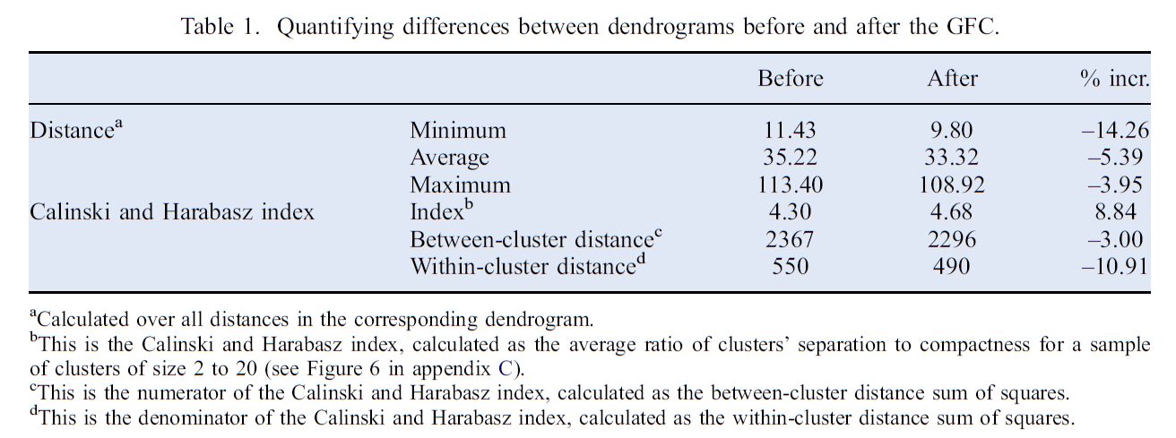
Main changes after the GFC
After GFC equity markets are more interconnected:
Distances decreased
More compact and less separated equity markets

Slide 30
Main changes after the GFC
Most visible change: East Asia & Pacific cluster moving away from Western Europe & America to Asia & Eastern Europe. But East Asia & Pacific markets remain loosely connected among them or to other clusters.
Slight approximation between China and East Asia & Pacific. This is consistent with China’s increasing importance in equity markets and intra-regional trade (Kang & Yoon (2011), Glick & Hutchinson (2013)).
An heterogeneous Western Europe cluster (European Sov. Debt Crisis 2009-):
  Italy, Spain, and Portugal decoupled within Western Europe.
  Greece and Cyprus decoupled away from Western Europe (along with Iceland)
  Remaining Western Europe is denser
Colombia and Peru got closer to the American cluster (Mellado & Escobari, 2015)

Slide 31
Outline
Introduction
Literature review
Agglomerative clustering
The data
Main results
  The resulting hierarchies
  About stylized facts
  Main changes after the GFC
Final remarks

Slide 32
Final remarks
We implement an agglomerative clustering algorithm to examine how 80 equity markets interrelate before and after the GFC.
The algorithm yields a hierarchical structure that represents how stock markets relate to each other based on their cross-section similarity.
The main features of equity markets’ hierarchical structures agree with most stylized facts reported in related literature (e.g. dominance of geographical factors).
The most noticeable change after the GFC is a stronger geographical clustering, along with less distance between clusters; it is a more interconnected equity market.
Some changes in the hierarchy that do not conform to geographical clustering are explained by well-known idiosyncratic features or shocks.

Slide 33
Final remarks
Run the hierarchical clustering algorithm with recent data: the end of QE, China’s equity market augmented importance in 2015…
Transmission channels:
  We visualize and analyze how interdependent equity markets are, and contribute to the discovery of a rationale for such interdependence (i.e. exploratory data analysis)
  We do not measure significance (i.e. confirmatory analysis)
Implementing other approaches to hierarchical analysis for equity markets
Implementing causality networks (i.e. instead of “plain interconenctedness”, work on significant causal relations)

Slide 34
Equity Markets’ Clustering and the Global Financial Crisis

