Slide 1
United States Housing: A Public/Private Network to Tackle Poverty
John Moon
September 14, 2017

Slide 2
Agenda
USA housing market context
USA housing policy foundation
Housing network as a platform to tackle poverty

Slide 3
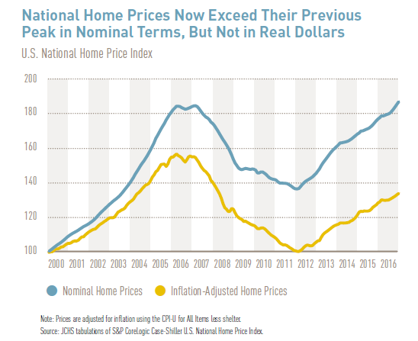
US Housing Market Trends

Slide 4
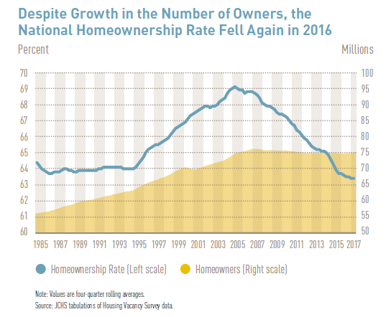
Homeownership is Falling

Slide 5
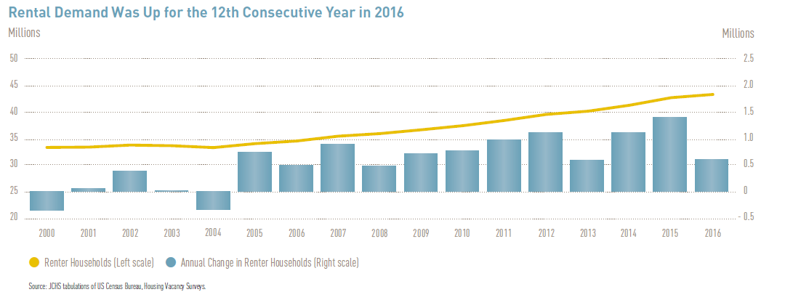
Rental Housing Is Picking Up the Slack

Slide 6
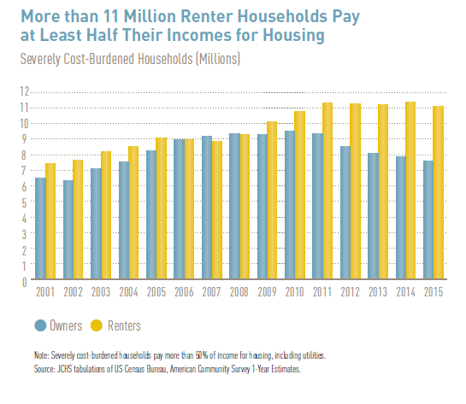
Rental Housing Costs Rising

Slide 7
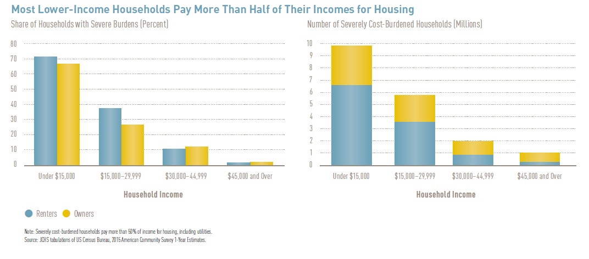
Low-Income Rental Burden

Slide 8
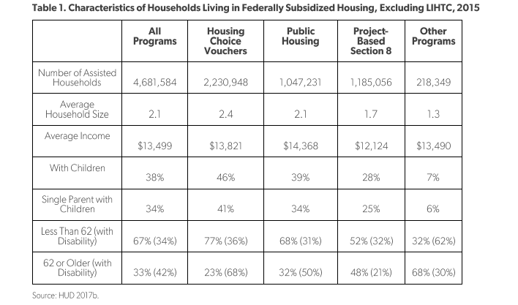
US Federal Government Programs

Slide 9
Community Reinvestment Act
Passed in 1977 to require banks to lend and provide financial services in low-income areas in response to “red-lining” in exchange to Fed’s Discount Window and FDIC depository insurance
Not specific criteria – but based on lending context for the bank
Evaluated for services, lending, and investments
CRA performance considered for applications for mergers and acquisitions
Annually, about $100B in CRA dollars in low-income communities

Slide 10
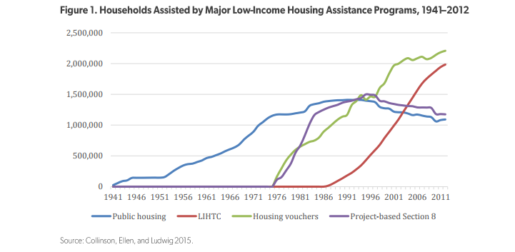
Shifting Federal Housing Programs

Slide 11

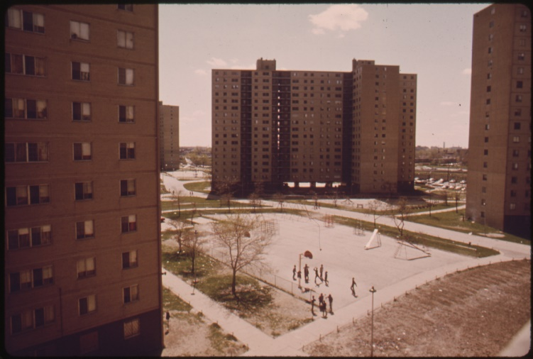
US Housing Policy – From Government Control to Public/Private Models

Slide 12
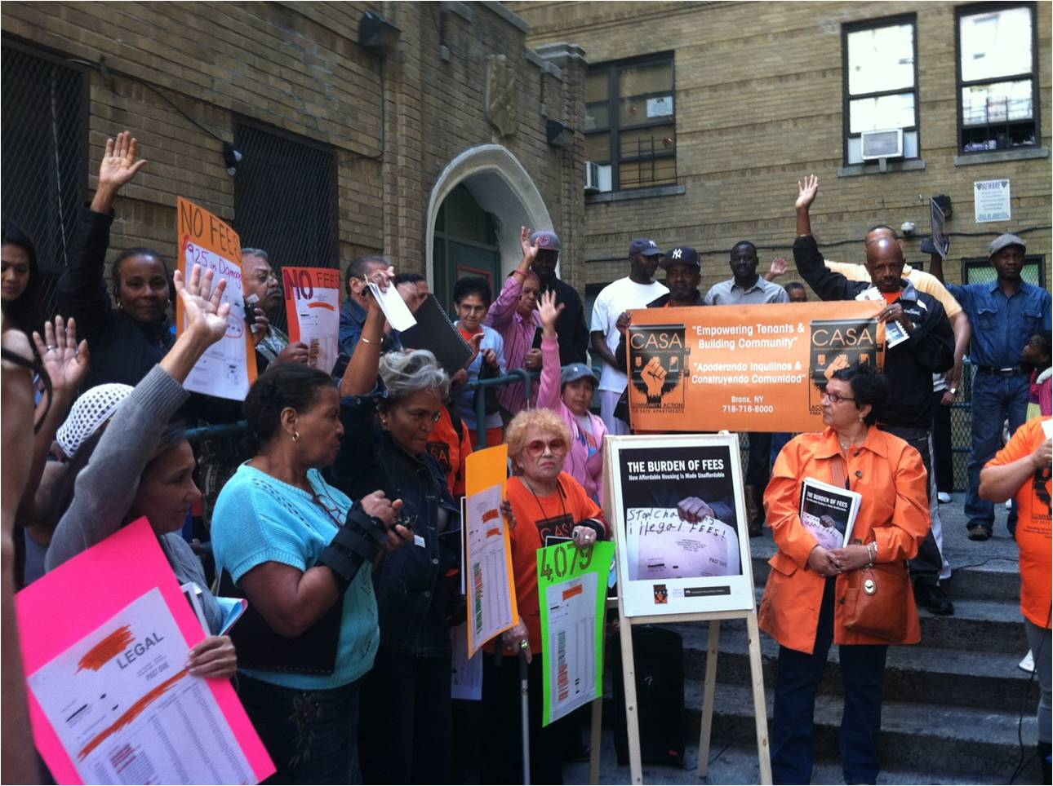

Building a Housing Network

Slide 13
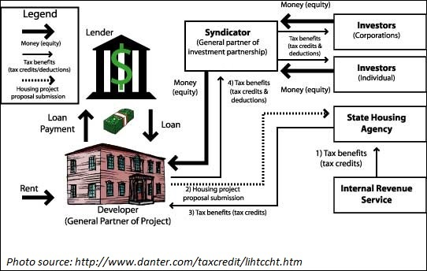
Prototypical Public/Private Housing Model:
Low Income Housing Tax Credit Program
Low Income Housing Tax Credit Structure
Total Development Cost - $10,000,000
$4,500,000 – LIHTC Equity
$1,000,000 – Federal poverty program funds
$4,500,000 – Private Bank Capital

Slide 14
Key Features of LIHTC Program
Allocation to States to prioritize local priorities
Local community-based groups instrumental in development of the units
Private lender/bank has “skin in the game” to ensure aligned management of risk and success
Long-term deal structure to ensure compliance and ongoing affordability
Provides fee income for community-based groups/NGOs

Slide 15


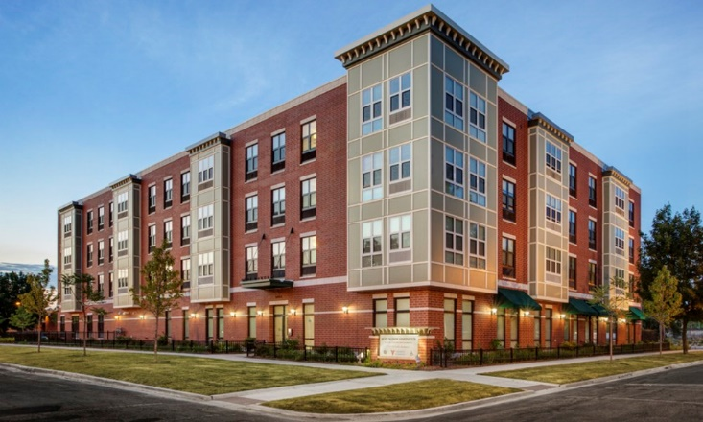



Housing Ecosystem

Slide 16
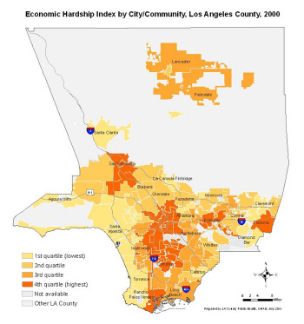
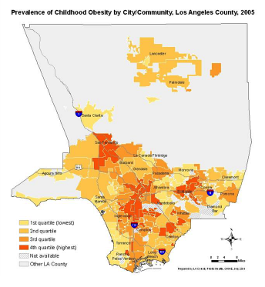
Poverty is Multi-Faceted

Slide 17
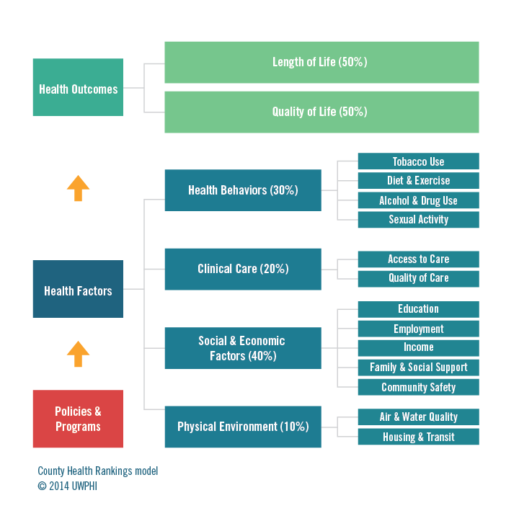

Slide 18
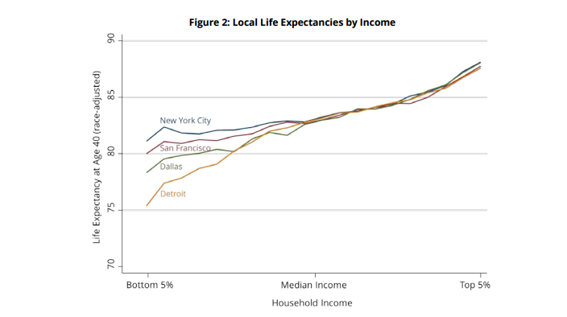
Relationship of Health, Place, and Income

Slide 19





Expanding Housing Platform Ecosystem

Slide 20
Conclusion
Public/Private partnerships allow for financial support of “public/social” problems with private market discipline
Evolving capacity and relationships of key stakeholder groups is key
Expanding the network of actors and sectors is key to combat the complex nature of poverty

