Slide 1
Magdiel Rodríguez mrodriguez@fsisac.com
Strength in Sharing – Cyber Intel for Financial Services
September 11, 2018

Slide 2
Who Are The Bad Actors?
Individuals / Small Groups
Sponsored or Nation States
“There are two kinds of big companies in the United States. There are those who've been hacked by the Chinese and those who don't know they've been hacked by the Chinese.” --FBI Director, James Comey, on CBS’ 60 Minutes
Organized Crime
“By the end of 2010, organized crime world-wide was making more money from Internet crimes, than from narcotics.” --FBI

Slide 3
How are Global Corporations Responding to the Threats?
Budgets Shrinking, Breaches Growing
Despite greater awareness of cyber security incidents, globally, information security budgets actually decreased 4%. It costs much more to remediate cyber incidents than prevent them, so it seems counterintuitive that organisations would choose to invest less overall. –PwC

Slide 4
Purpose
Protect and enable through exceptional execution of essential information security practices
Accomplished by delivering on four primary objectives:
Proactively mitigating information security threats
Identifying and managing information security risk across the enterprise
Supporting the business by securing and enabling emerging products and markets
Maintaining industry and regulatory compliance within the information security program

Slide 5
Cyber Security – What is ‘Cyber’?
Cyber security is the protection of information and systems in cyberspace
Cyberspace includes digital devices which may be networked together.
Cyber security covers the interaction between people and cyberspace.
Cyber security is primarily associated with defence against large scale or targeted cyber attacks.
Cyber attacks can be designed to:
Collect corporate information
Disrupt IT systems
Steal funds
Cause adverse publicity
Manipulate personnel
State sponsored
A successful cyber attack depends on:
Exploitation of human, technology or process vulnerabilities
A determined and skilled attacker
Attacker sophistication
Disgruntled Ex-IT Admin
Organised crime
Lone Hacker/ hobbyist
Disgruntled customer
Hacker collectives
Accidental
Malware/ Insider
‘Script kiddy’
Disgruntled Ex-employee
Hacktivism
Cyber security is focussed on defending against sophisticated targeted attacks
Attacker determination
Notes:
Cyber combines elements of securing digital services, and personnel interacting with digital services (not all attacks are exclusively over the internet)
It is global, and focus is attacks that are advanced, and therefore from organised groups
It is not infosec, which covers basic good practices, it is more involved and intensive

Slide 6
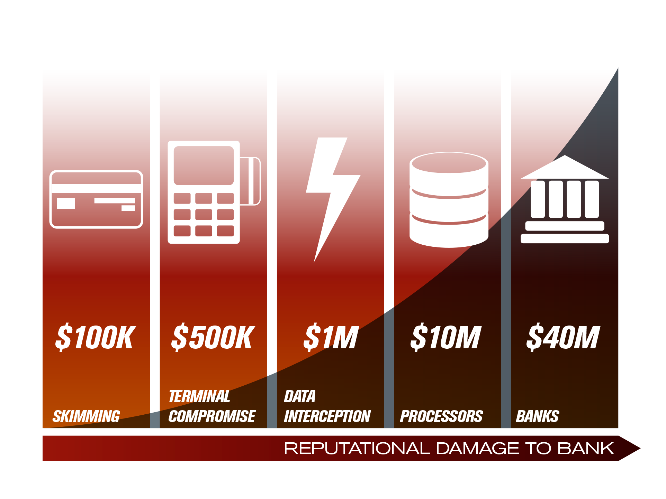
The Threat Evolution
* Numbers are illustrative to depict the relative differences between attack vectors
* Numbers are illustrative to depict the relative differences between attack vectors

Slide 7
Cyber Security – Why it is critical
Cyber security protect nations, companies and individuals
High profile cyber attacks in recent years continue to have significant impact
Carbanak – global banks and financial services
targeted accounts and ATMs with individual losses ranging $7-10m
Target – retailer suffers cyber attack
loss of 70 million customer records, POS malware attack
eBay – 145 million user accounts were affected in a cyber attack that required users to reset their passwords
2013
2014
2015
Intellectual Property or Personal data loss
Financial loss
Reputational damage
Disruption or catastrophic failure
Further cyber attacks
Staff redundancies
Customer complaints
Reduced revenue
Litigation
Share Price drop
Regulatory fines
CEO resignation
Loss of key customer relationships
Contractual compensation
Cyber security is critical as attacks will occur amongst respected targets
Notes:
How an attack works, talk through an example
Why they are prevalent, due to increasing complexity, functionality and connectivity…more opportunities
Cyber security is critical to prevent, manage and reduce the impact of an attack
constantly under attack, can’t stop all attacks, “Reducing Risk”

Slide 8
Cyberattacks Against Financial Services Companies Are in the News
TLP Green
Notes:
Banks are so interconnected, doing business with each other and interacting with the Federal Reserve, that an attack on a community bank could eventually infect larger banks, spreading like a virus and threatening the stability of and confidence in the banking system.
Banks are among the most targeted institutions for cyberattacks. Not only do they hold vast amounts of money and sensitive personal information, but ATMs and online and mobile banking services are exposed to hackers.
“Banks are attractive targets and they are under a constant barrage of cyber threats, so purely on the basis of statistics, if there are millions of attempts every year, there is a fair chance a few major incidents will take place.”
http://fortune.com/2016/06/23/hackers-prey-on-smaller-firms-as-big-banks-harden-security/
https://itpacconsulting.com/cyber-attacks-targeting-community-banks/
http://money.cnn.com/2012/09/27/technology/bank-cyberattacks/index.html
https://www.americanbanker.com/news/how-a-phishing-scam-tripped-up-a-va-bank
http://thirdcertainty.com/videos/small-banks-and-credit-unions-increasingly-under-cyber-attack/
https://www.bostonglobe.com/business/2016/03/24/small-banks-face-greatest-risk-from-cyber-hackers/ptIWIWZh9ldFIbBxyQfx1K/story.html

Slide 9
Cyber Security – Protection
A multi-layered approach is required to reduce the risk of major impact
Manage
Prevent
Protect
Detect
Respond
Security policy & standards
Secure access control
Employee screening
Third party compliance
Training & Awareness
Encryption
Patch management
Secure builds
Security architecture
Remove legacy systems
Incident Response
Forensic investigation
Communication
Recovery
Problem management
Data Loss Prevention
Intrusion Detection
Log collection and monitoring
Penetration testing
Aware
A cyber security framework can maintain effective protection
Notes:
Layered defences - Good cyber security practices are necessary to prevent or reduce damage from cyber attack
Described in the framework for example: policies, employee screening, access control, monitoring, detection, response
Link layers to cyber events -> payments security processes
Manage – oversee, direct, strategy, operations
Aware – foundation, threat intelligence
Use of third parties within the layering – e.g. pen test, monitoring managed services is common place
What do other sectors focus on
A cyber security framework requires communication across processes and functions
What mechanisms are deployed, and what is the process for discovering, developing and implementing new solutions
Change in landscape, digital innovation, leading to agile development and opportunities to be exploited within the payments ecosystem
Recognising a new problem, implementing new solutions
Maturity - continual improvement

Slide 10
Phases of Information Sharing
Startup | Early Growth | Expansion | Optimized
General indicators shared Traffic light protocol Few members share mostly anonymously Members start to build trust 1:1 | Specific Indicators Vulnerabilities shared Circles of Trust Increase in sharing, some attribution Regional sharing Solution provider partnerships Regional coalitions | Deeper analysis (cyber, physical, geopolitical) Communities of interest Many members share Global sharing Exercises & playbooks Government & local partnerships | Cross sector sharing Automated machine to machine sharing Strategic resilience efforts in addition to core sharing Public-private exercises Regional resources added
TLP Green

Slide 11
Information Sharing: A Virtual Neighborhood Watch
Reasons to Share:
Increasing Attack Complexity
Rising Breach Costs
Growing “Noise” of threat indicators
More focus from regulators on participation in info sharing
Benefits of Sharing:
Get real-time threat intelligence
Cyber
Physical
Geopolitical
Vulnerabilities
Join communities of interest
Define appropriate defense & response based on risk
Comply with regulations, supervisory expectations
TLP Green
Notes:
Neighborhood
Harmonization
We are not just an “Analysis Center”, we are a COMMUNITY

Slide 12
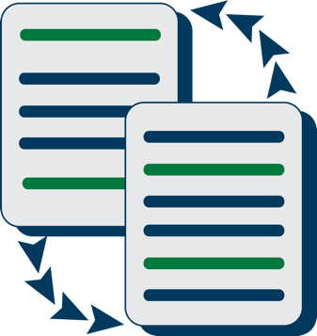
Relevant
Intelligence and Analysis
Summits and Events
Information Sharing
Education and Training
Crisis Response and Exercises
TLP Green

Slide 13
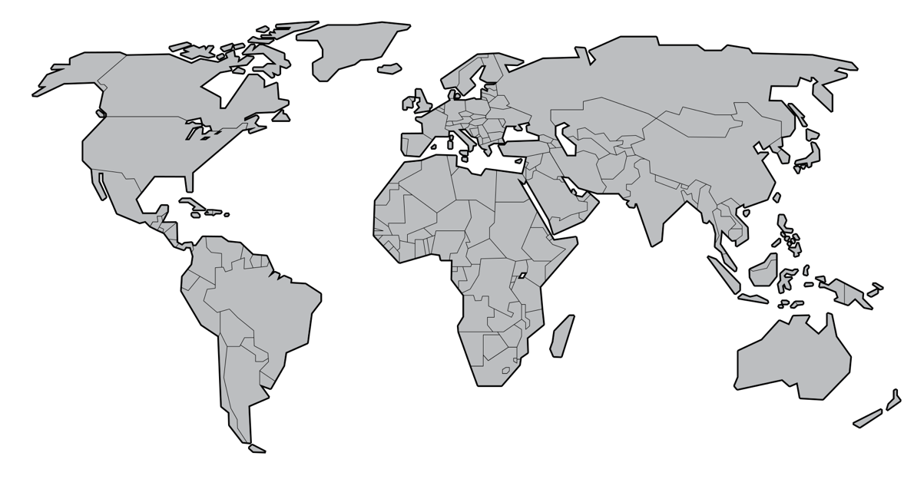
Regional Model
Americas (NA-Focused)
Threat Intelligence Committee
Business Resiliency Committee
EMEA
Threat Intelligence Committee
EMEA Strategy Committee
Business Resiliency Committee
APAC
Threat Intelligence Committee
APAC Strategy Committee
Main Activity:
Canada
USA
Brazil
Colombia
Chile
Main Activity:
UK +IE
SW Europe
N. Europe
E. Europe
Gulf
South Africa
Main Activity:
Singapore
Japan
Australia
Malaysia

Slide 14
Relationships – Members, Partners, Stakeholders
TLP Green
EMEA
Americas
APAC
Associations and agencies
Law Enforcement
Liaison Placed Onsite
CERTs

Slide 15
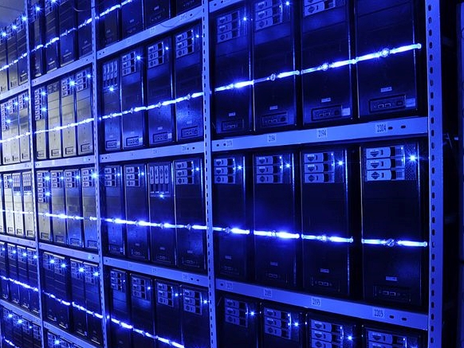
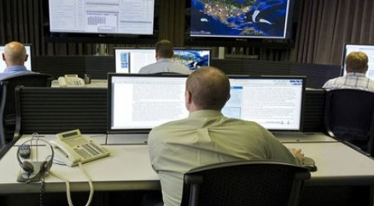
FS-ISAC Information Flow
Information Sources
FS-ISAC 24x7
ISAC Analysis Team (IAT)
Member Communications
CERTs
Information Security
FS Regulators
GOVERNMENT SOURCES
Law Enforcement
Physical Security
Business Continuity/ Disaster Response
Threat Intelligence Providers
Cross Sector (other ISACS)
Vulnerability Alerting
Fraud Investigations
CROSS SECTOR SOURCES
Malware Forensics
Open Sources (Hundreds)
PRIVATE SOURCES
Payments/ Risk
PS Incidents & Analysis
Alerts
After hours IAT support
Member Submissions
TLP Green
Notes:
This slide shows the sources of information, including from government sources, vendors the FS-ISAC contracts with to supply information and member submissions. Please know that the vast majority of information comes from FS-ISAC members voluntarily.

Slide 16
FS-ISAC Sharing in Action
TLP Green

Slide 17
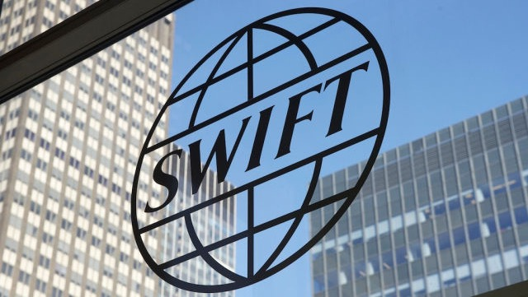
Responded to SWIFT-Related Attacks
Tracked incident updates; sent/received updates w/ members regularly via FS-ISAC Intelligence Analysis Team (IAT)
Shared indicators of compromise (IOCs) and SWIFT software updates with members
Hosted technical SWIFT briefing conference call for over 2,900 members
Published paper: “Security of Payment Network Access Points: Risk Mitigation Recommendations Related to Recent Payment Account Takeover Attacks Against Banks Leveraging the SWIFT Network”
TLP Green
Notes:
FS-ISAC’s Media Response Team, made up of communications professionals from member firms, developed media speaking points.
9 May: FS-ISAC shared Indicators of Compromise (IOCs) and software patch updates with its members.
Provided an overview document to help educate members on how SWIFT works.
FS-ISAC’s CEO and other execs took media calls and educated reporters to counterbalance “Fear, Uncertainty, Doubt” (FUD) raised by the press.
Key messages included the fact that the SWIFT Network itself was not attacked nor compromised.
FS-ISAC obtained a statement from SWIFT that it added to key messages.
FS-ISAC’s IAT (ISAC Analysis Team) tracked incident updates and sent regular updates to members.
1 June: 2,700 attendees on a member call with SWIFT, FBI and member facilitators.
7 June: FFIEC statement released to remind FIs of prudent security controls.
16 June: first draft of SWIFT video shared and approved by FS-ISAC
Next: working with SWIFT to include all SWIFT members in new information sharing construct within FS-ISAC.

Slide 18
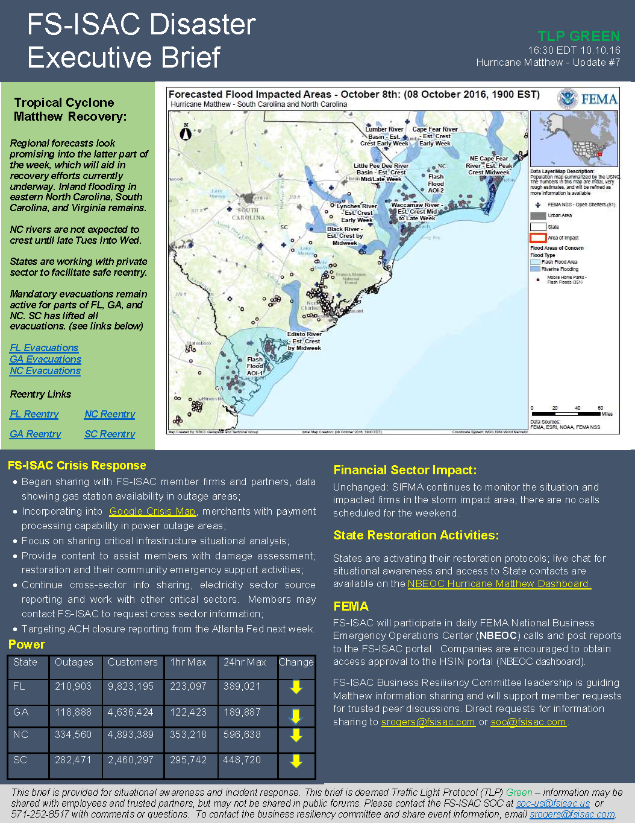
Physical Security Briefs
FS-ISAC produces a number of physical security products
Continued investments in physical security and business resiliency
FS-ISAC now employs full-time physical and geopolitical analysts
TLP Green

Slide 19
Helped Secure the 2016 Rio Olympics
2016 Olympics in Rio de Janeiro, Brazil required months of cyber planning and preparations
Dozens of organizations participated in an information sharing email list
Used Traffic Light Protocol to properly share information amongst many
Focused on both physical and cyber risks that could impact the games
Provided real-time threat intelligence to prevent financial and physical crimes or attempts to disrupt games
TLP Green

Slide 20
Conclusion
Threats are becoming more frequent
Technologies used by adversaries are more complicated, intended to prevent detection
FIs must have a plan to respond
Become active in the sharing community
Increase awareness of emerging threats and vulnerabilities
TLP Green
Notes:
Cyber risks are not abating and will actually become more complicated and challenging.
Organizations have no choice but to innovate & invest in new technologies and to effectively manage technology and cyber risks
Just look at how technology (and cyber risks) are growing with the broader use of technologies in cars, health care, home appliances, (aka “internet of things”)
Cyber talent pool is tight
Cyber risk insurance is evolving and increasingly an important risk transfer tool organizations are using
Cyber policy continues to evolve as governments impose more requirements to better secure and protect and explore new ways to support the private sector in the face of cyber attacks (especially Nation state attacks)
What is threshold for when government will take action?
What are permissible defensive measures?

Slide 21
Creating a “WIN-WIN” scenario
Balance customer ease of use with strong security
Using people, processes and technology is key
Collaboration across the globe means you’re not alone
Don’t just rely on your own data and threat intelligence
Work with vendors, partners, public sector law enforcement for broader visibility

Slide 22
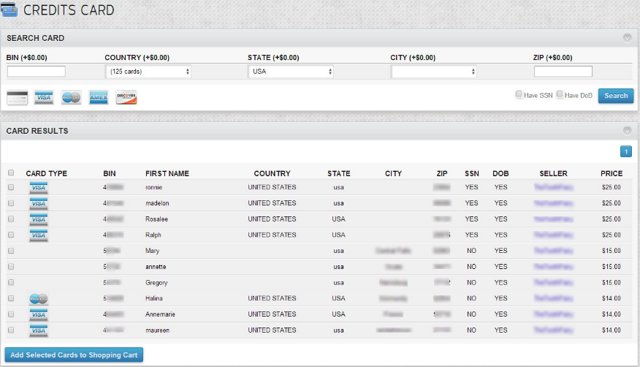
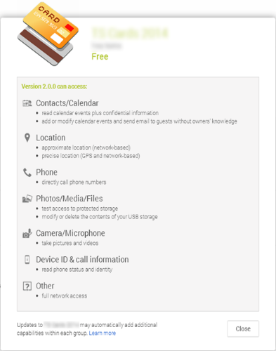
So how much are your cards worth?

Slide 23
Contact
Thank you for your partnership!
Magdiel Rodríguez, mrodriguez@fsisac.com
 +1-786-441-8502

