Slide 1
Transition to a Less Cash Economy
Kenneth Rogoff, Harvard University
Kenneth Rogoff, Harvard University
Asobancaria Banking Summit
Cartagena, Colombia, August 24, 2018

Slide 2
The case for a cash-light/less cash society
This talk is based on my recent book (and more technical writings dating back to 1990s)
The Curse of Cash: How Large Denomination Notes Aid Tax Evasion and Crime and Constraint Monetary Policy. Princeton University Press, July 2017
More broadly, the book is about the past, present and future of currency, from early coins to paper currency to digital and cryptocurrencies.
  Major innovations generally come from the private sector but eventually government regulates, and sometimes appropriates

Slide 3
INCREASING FINANCIAL INCLUSION has many benefits independent of how cash is regulated
Greatly simplifies government transfers, remittances, utility payments, etc., and makes day to day transfers safer and easier.
Reduces individuals vulnerability to cash crime
Helps families smooth consumption and invest in their education and health
Helps small businesses invest by improving access to banking sector
promotes shift from the low productivity informal sector towards high productivity formal sector.
  A shift to the formal sector helps the government budget both directly (more tax paying businesses) and through higher growth

Slide 4
Case for rethinking issuance and regulation of cash
Anonymity of cash promulgates the underground economy.
  This is even the case in advanced economies
Cash is widely used in criminal activities.
  Criminals use many transactions vehicles, but cash is King
  Use of pseudonymous cryptocurrencies can be sharply circumscribed by regulation which makes it impossible to use them legally in banks, stores etc.
In emerging markets, in particular, cash helps fuel corruption
  One of Indian prime minister Modi’s most successful early programs was to require that license payments be made online, reducing power of “license Raj”..
  Corruption in advanced economies: Donald Trump’s former lawyer Michael Cohen made a tape of Trump urging him to use cash if for a potential payoff, so it cannot be traced.
  Abscam is a famous case (memorialized in the movie “American Hustle” with Jennifer Lawrence and Bradley Cooper) where cash used to bribe members of the US Congress for immigration visas
Primary objective of policy should be to reduce large-scale tax evasion, regulatory evasion and criminal activity.

Slide 5
Underground Economy as % Official GDP: 2003-2016 average
Greece 25%,
Italy 22%
Spain 19%,
Colombia is probably higher..
Source: Rogoff 2017, updated

Slide 6
Cash-light/Less Cash is NOT equivalent to Cashless
The basic idea is to make it more difficult for people to do LARGE-SCALE transactions in cash for purposes of crime and tax evasion, but NOT to dramatically change how cash is used by ordinary people.
My research has mainly on focused on ADVANCED ECONOMIES, although includes data on some emerging markets as well as an extensive discussion of demonetization in India
Cautious on applications to emerging markets since a key component of any plan to reduce reliance on cash is to dramatically increase financial inclusion.
COMPLETE CASHLESS SOCIEITY IS A STRAW MAN
  The Curse of Cash makes the case for keeping around a physical currency indefinitely

Slide 7
The case for limiting use of cash is not a moral question but one of regulatory balance
Cash is convenient is some transactions and still important given social conventions. (tipping is an example)
It is important to be able to retain cash for privacy. The question is scale.
Opioids are widely prescribed for pain relief, but if made too freely available, there can be an epidemic.
It is one thing for the government to make it easy to use cash for small or even medium-size purchases. It is another to facilitate the use of cash in wholesale crime and tax evasion, for example, the purchase of a 40 million dollar apartment in Trump Tower.

Slide 8
Around the world, cash is being used less and less in the formal sector as payments systems improve
Alternative transactions mechanisms continually improving.
  In US, accounts for less than 9% of the value of FORMAL ECONOMY consumer transactions, in many countries it is already less than 4%.
  Except for small transactions, cash is overtaken by debit cards, credit cards, electronic transfers, checks (in US), and in some countries.
  (Legal) business to business payments already use almost no cash
Yet even as cash usage shrinks in legal transactions, the global supplies of currency are expanding, and by far the largest share is in large denomination notes (equivalent to US $50 and above)
  For Colombia, large notes total over 50% of currency supply by value)

Slide 9
Source: Rogoff, 2017, updated

Slide 10
Source: Rogoff, 2017 updated

Slide 11
Proportion large notes by value
 | Proportion of Large Notes (by Value) | Local Currency Threshold used to define large note
Australia | 92.2% | 50 Australian dollar
Japan | 91.1% | 5000 yen
Eurozone | 90.7% | 50 Euro
India (Nov 7 2016) | 86.0% | 500 Rupee
United States | 84.2% | 50 dollars
Hong Kong | 84.2% | 500 Hong Kong Dollars
Sweden | 79.2% | 500 Kroner
New Zealand | 70.7% | 50 NZ dollar
Source: Kenneth Rogoff, The Curse of Cash, 2016

Slide 12
Source: Rogoff, 2017 updated

Slide 13
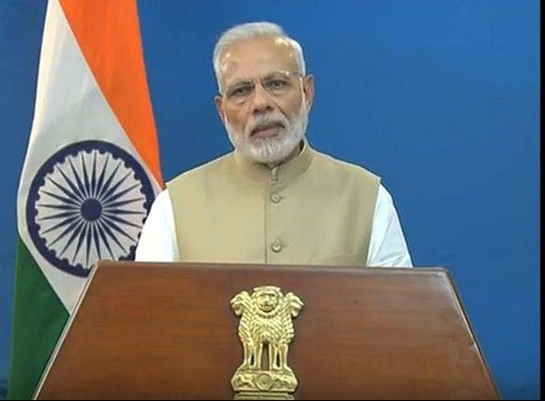
November 8 2016: Prime Minister Modi announces “demonetization” of India’s two largest notes

Slide 14
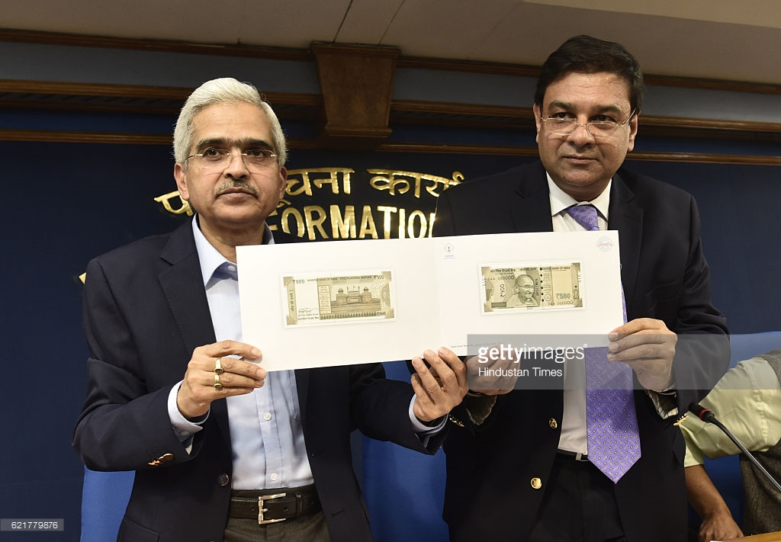
Urjit Patel, Governor of Central Bank of India with the new notes

Slide 15
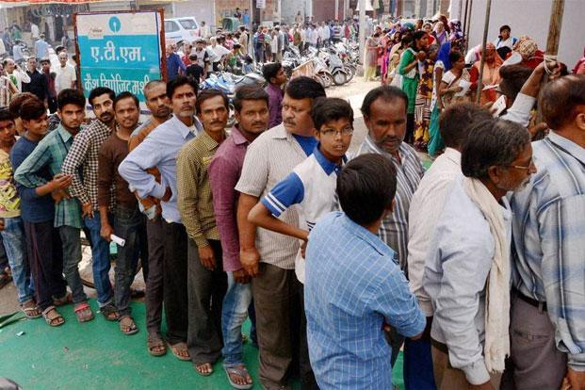
Ques for converting old rupee notes to new ones

Slide 16
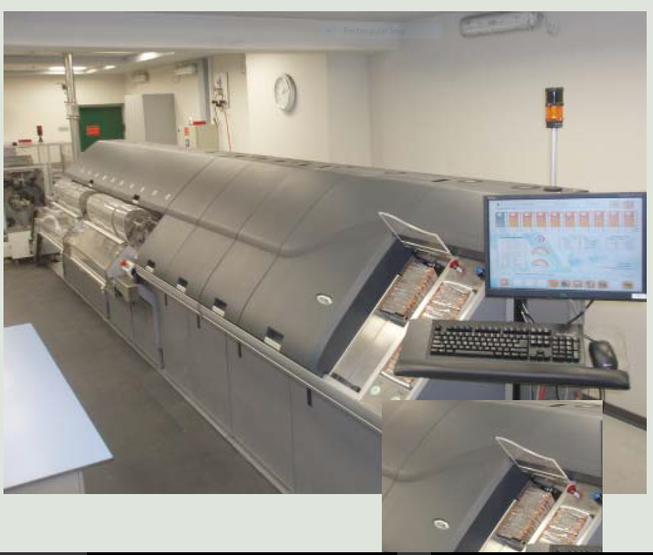
Unfortunately, modern currency very high tech, takes six months to a year to print a new supply
Note counting and sorting
Matching, Bank of Israel

Slide 17
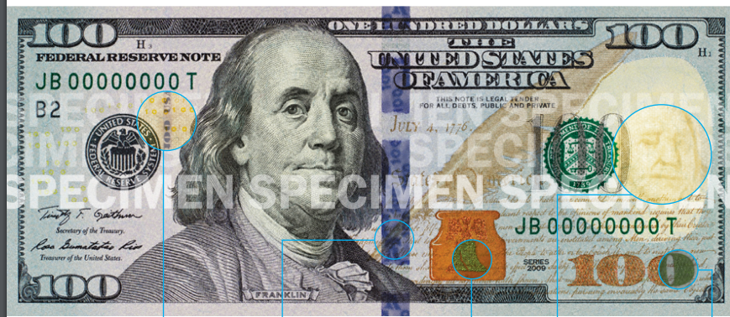
New Series (2013) US $100 Bill and Its Many Anti-Counterfeiting Features

Slide 18
India demonetization might yield long-run benefits but also shows things to avoid
In The Curse of Cash, I essentially argue “If you are a developing economy, do not try this at home”. Cost of providing financial inclusion, small in advanced economies, is too great
TCOC argues for taking five to seven years to phase out big bills. India did this almost overnight
TCOC argues only for taking LARGE BILLS out of Circulation. But 500 rupees is only $7
Few people realize that it takes six months to one year to print a new currency supply due to technical difficulties in producing counterfeit resistant currency. India’s biggest problem was that it did not have nearly enough new notes on hand to exchange for the old ones.

Slide 19
Some countries are approaching it a better way
Euro phase out of 500 euro notes, Singapore discontinuation of 10,000 Sing dollar notes, Australia panel on discontinuing the $100.
  Important to move slowly, so avoid collateral damage
Nordic Countries Approach the problem for many angles.
LESS CASH, not CASHLESS

Slide 20
Sweden
Source, Rogoff 2017, updated

Slide 22
Some policies such as tax on bank transactions expand use of cash, and these costs must be weighed again benefits of higher revenue
This is a difficult question that needs to be studied, as replacing the lost revenue would require other distorting taxes.
However, to the extent that a reduction in cash helped shift economy towards greater formalization, some of the lost taxes might be recovered
  Importantly, the transition may take time and it can be dangerous to replace revenue by borrowing (as for example Argentina tried to do when it tried to control inflation and money printing but lost seigniorage revenue)

Slide 23
There are Different Types of Financial transactions taxes
The UK has a “stamp tax” on stock transfers; raises an average of about .3% of GDP.
Some European governments are proposing a broader financial transactions tax that would also cover bond sales and derivatives, in part to account for the fact the value added tax does not currently apply to financial transactions
In 2016 Democratic candidate for US President Bernie Sanders proposed a broad financial transactions tax that, he argued, could easily raise several hundred billion dollars while making the financial system safer.
  Independent estimates (e.g., by Brookings 2015) suggest that such tax would raise a far lower amount (perhaps 50-75 billion dollars), and would not necessarily make the financial system safer.
  Costs probably not as large as opponents say, either
Latin American countries (including Colombia) have tended to favor taxes on banking transaction
  The direct effect is to raise significant revenue (over 1% of GDP)
  Indirect effects, however, may mitigate this gain by incentivizing a switch to cash transaction and the informal economy.

Slide 24
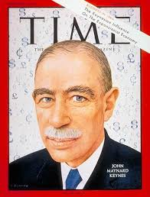
John Maynard Keynes recommended a financial transaction tax on stocks to reduce speculation

Slide 25
Bank transactions taxes can raise significant revenue but are distorting
Econometric estimates from Bank for International Settlements (Restrepo, May 2018) examines introduction of bank transactions taxes across seven Latin America implemented since 1980s:Argentina, Brazil, Bolivia, Colombia, Ecuador, Perú and Venezuela.
BIS paper finds that ratio of bank credit to GDP decreases by an estimated 4% of GDP after introduction of bank transactions tax, which is substantial given that bank credit to GDP averages under 30%. (Note: this is an econometric estimate subject to standard error.)
The ratio of cash relative to bank deposits rises (estimate) by almost a third.
There is a negative impact on growth particularly in small and medium firms dependent on bank financing.
Caution: further study required to better refine and confirm the above results
Restrepo, BIS, May 2018

Slide 26
Pauses in financial reform the norm after implementation of bank transactions taxes (red bars)
Source: Restrepo, BIS, 2018

Slide 27
Previous table is BIS 2018: The Financial Reform Index from Abiad et al (2009) is plotted in solid lines for each country. Vertical bars highlight periods where bank account debits taxes were implemented. The Financial Reform Index records financial policy changes along seven different dimensions: credit controls and reserve requirements, interest rate controls, entry barriers, state ownership policies on securities markets, banking regulations, and restrictions on the capital account.

Slide 28
Increasing Financial Inclusion

Slide 29
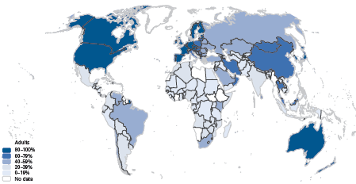
Measuring financial inclusion
Intro Measurement and Impact Public Policy Focus Areas Main Messages
Globally, about 50 % of adults have a bank account
The other 50 % (2.5 billion) remain “unbanked”
Adults with accounts at a formal financial institution
Source: Global Financial Inclusion (Global Findex) Database, worldbank.org/globalfindex
Notes:
Mention that 22 % of adults made new savings/deposits with financial institution, and 9 % received new loans in 2011.
Simply having an account does not guarantee that it will be regularly used. It is possible to create many new accounts but their real-world impact is small if they simply lie dormant. In the report, we also show a different map, illustrating frequency of use around the world.

Slide 30
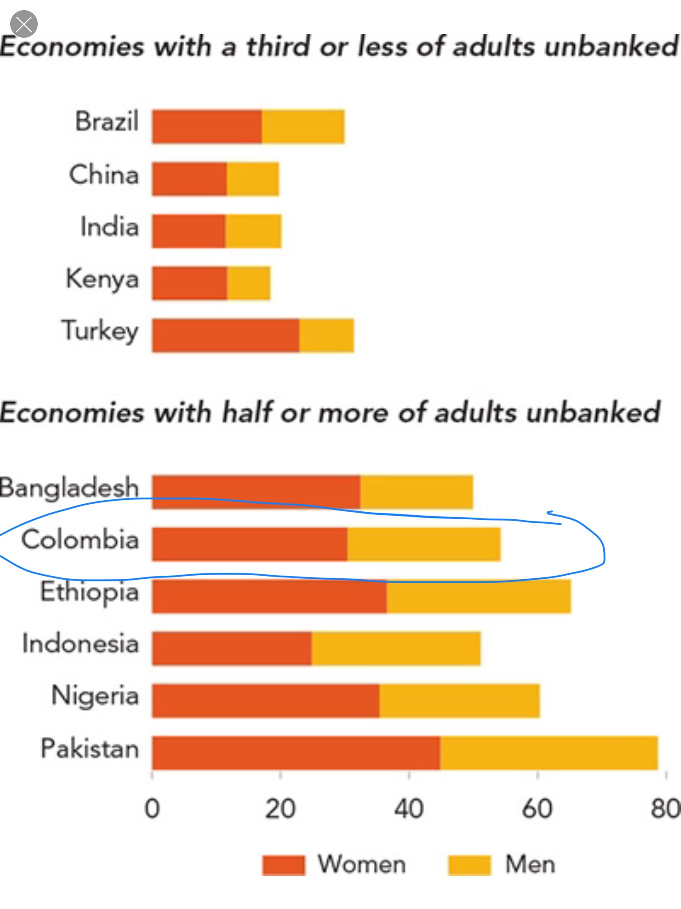
A larger fraction
Of women are
unbanked
than of men
World Bank: Global Findex Database

Slide 31
Measuring financial inclusion
Intro Measurement and Impact Public Policy Focus Areas Main Messages
Not all “unbanked” need financial services, but barriers play a key role
Source: World Bank, Global Finde
Notes:
What are the (self-reported) reasons for not having a bank account? As illustrated in this chart, the reason most frequently cited for not having a formal account is the lack of enough money to have and use one. This is the response given by 65 percent of adults who are without a formal account; 30 percent cite this as the only reason. The next most commonly cited reasons for not having an account are the expense of banks or accounts and the fact that another family member already has an account. The other reasons reported are the excessive distance of banks, a lack of the necessary documentation, a lack of trust in banks, and religious reasons.
Twenty percent of unbanked respondents cited distance as a key reason as to why they did not have a formal account. The frequency with which this barrier was cited increases sharply as one moves down the income level of countries, from 10 percent in high-income economies to 28 percent in low-income economies. Among developing economies, there is a significant relationship between distance as a self-reported barrier and objective measures of providers such as bank branch penetration. To illustrate this point: Tanzania has a large share of non–account-holders who cite distance as a reason they do not have an account—47 percent—and also ranks near the bottom in bank branch penetration, averaging less than 0.5 bank branches per 1,000 square kilometers.

Slide 32
In legal economy, moving to a cash-light society is more about the carrot than the stick
India’s Aadhaar ID project is a remarkable example of how financial inclusion can be achieved even in a low income economy.
  Remarkable technological accomplishment, with huge benefits, allowing for nearly universal financial inclusion
    Accomplished at remarkably low cost of roughly 5 USD per person (presumably would cost far more in US
  In advanced economies, mandatory biometric identification is not likely given concerns about privacy, but many factors ranging from cybercrime to terrorism are likely to change that balance in the coming decade.

Slide 33
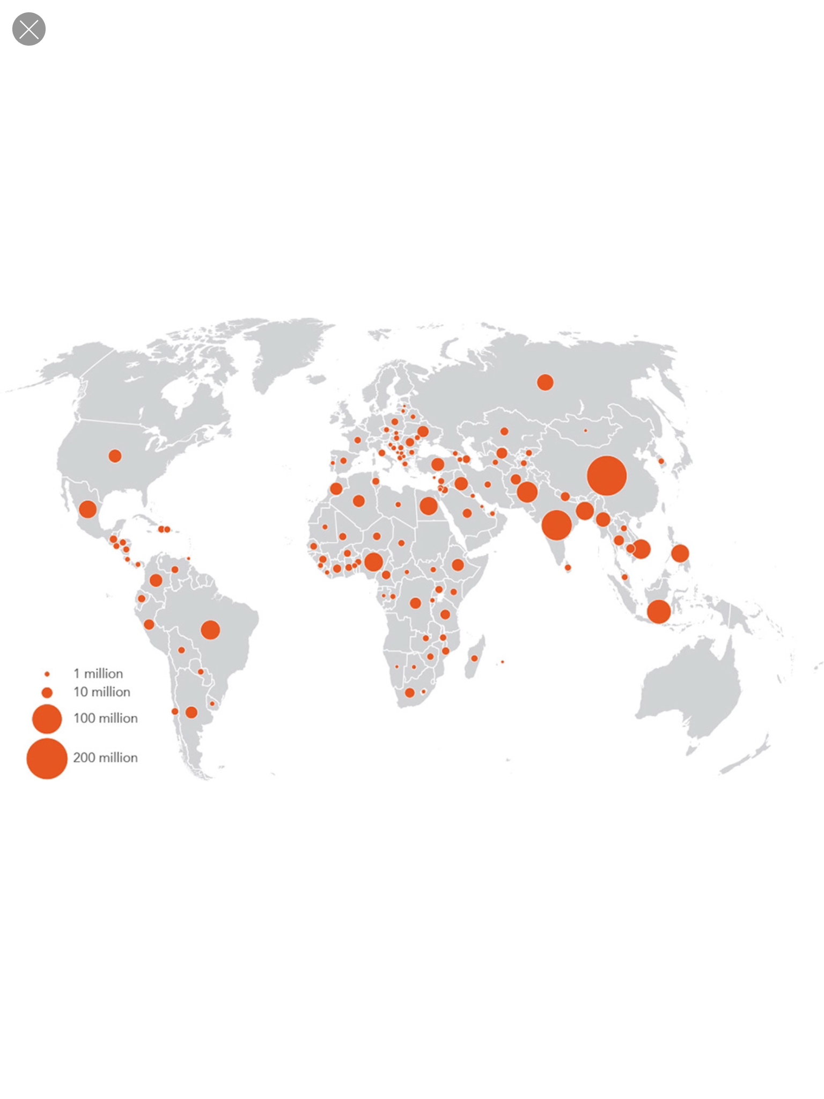
Two thirds of unbanked have a mobile phones
Source: World Bank, Global Findex Database

Slide 34
Biometric IDs and e-payment appear to have significantly reduced leakage and fraud in India
A large study involved data on 19 million people in the rural state of Andhra Pradesh (Muralidharan, Neihans and Sukhtankar, American Economic Review 2017)
Beneficiaries of Rural Employment Guarantee Scheme reported receiving 24% more subsidies at same level of government expenditures. Payments received in 1/3 the time on average
Similar results hold for pension payment
McKinsey Global Institute (Lund, 2017) estimates that developing countries could save $200 to $300 billion annually by digitizing tran

Slide 35
Source: The Value of Digitizing Government Payments in Emerging Market Economics, McKinsey Global Institute, April 2017, Susan Lund

Slide 36
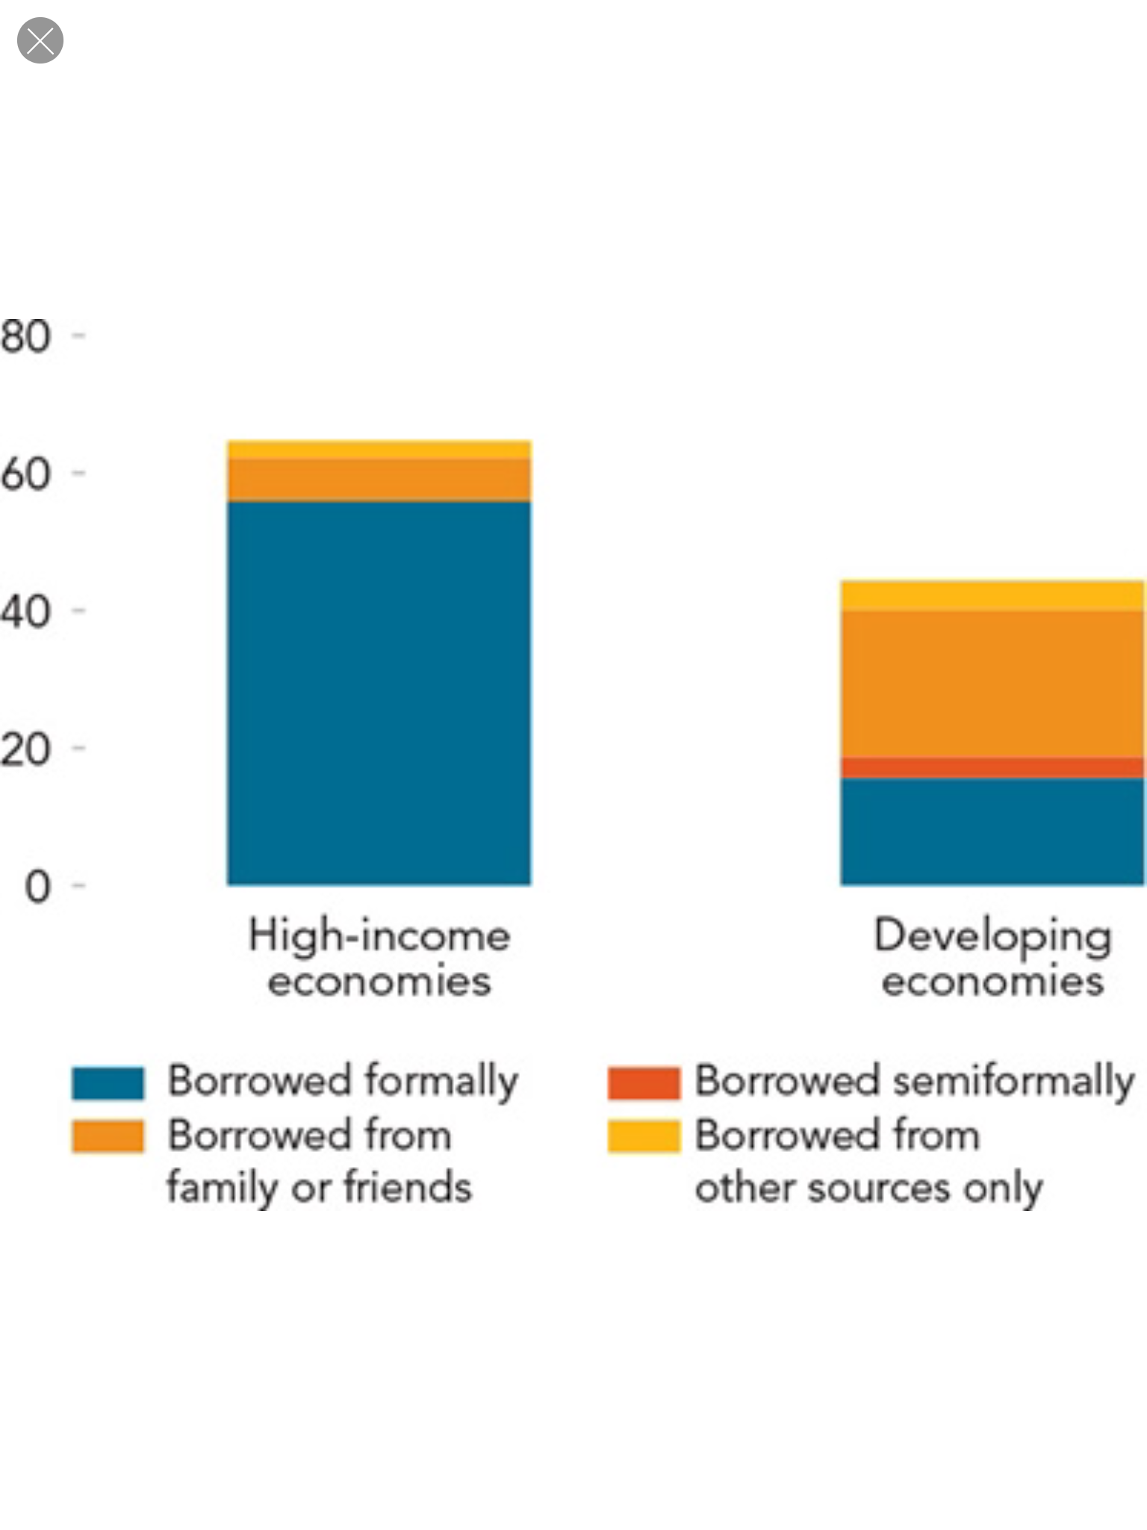
In rich countries, over half of people borrow on formal markets.

Slide 37
Intro Measurement and Impact Public Policy Focus Areas Main Messages
How to achieve Financial Inclusion: Surveys of Experts Around World
Source: World Bank, 2018. Financial Development Barometer (poll of financial sector officials and experts from 21 developed and 54 developing economies).
Notes:
The left-hand donut chart…. under the “new technologies”, the survey explicitly mentioned mobile banking and biometric borrower identification
The right-hand donut chart….
- the “more competition” category combines “policies promoting competition from foreign banks” and “policies promoting competition from domestic banks”
- the “better legal framework and credit information category” combines “better legal framework” and “policies to improve credit information”

Slide 38
Currency continues to evolve but it is naïve to think that government’s will ever surrender their monopoly on the unit of account (nor should they)
Gold, uncut diamonds are very imperfect substitutes, and so is Bitcoin, which by the way also has much too volatile a value to serve as the unit of account.

Slide 39
Cryptocurrencies
Blockchain and related cryptographic innnovations offer many potential future benefits.
There are many factors encouraging innovation, not least including a desire by some countries to weaken monopoly of the dollar (US has financial sanctions on 12 different countries at present)
But naïve to think that these are “currencies” or will ever substitute for government issued fiat currencies
They are too volatile to form a store of value

Slide 40
Source: Rogoff, 2017, updated

Slide 41
Source: Rogoff, 2017 updated

Slide 42
Other problems with crypto as currencies
Over long course of history, the private sector innovates, but the government eventually regulates and, often, appropriates new technologies
This is the case at different times in different places with both standardized coinage and paper currency, among other innovations.
Central banks will eventually issued digital currencies that can be widely held than at present (bank reserves are already largely digital
However, international coordination of regulation presents many challenges, as Japan’s misguided legalization of cryptocurrencies has illustrated.

Slide 43
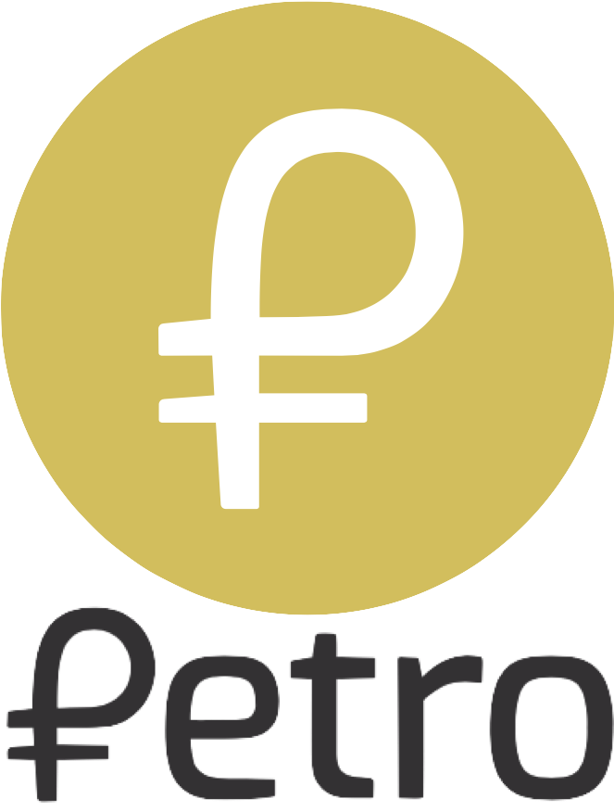
Cryptocurrencies have been a magnet for fraud
Venezuela’s crpytocurrency

Slide 44
Total market cap of all cryptocurrencies has fallen from $750 billion to $300 billion
There were been roughly 1500 “ICOs” between 2015-2017 (Cattolini, et al, MIT, 2017), of which about ¼ raised zero funds
Over 90% of cryptocurrency ICO (initial coin offering) purchases are made with other cryptocurrencies.
Obviously a major “bubble” component but that said it is possible that there will someday be 2.0 versions of today’s cryptocurrencies that have the capacity to be regulatory compliant and perform other useful functions
Blockchain has many potential applications in the financial sector that do not depend on anonymity.

Slide 45
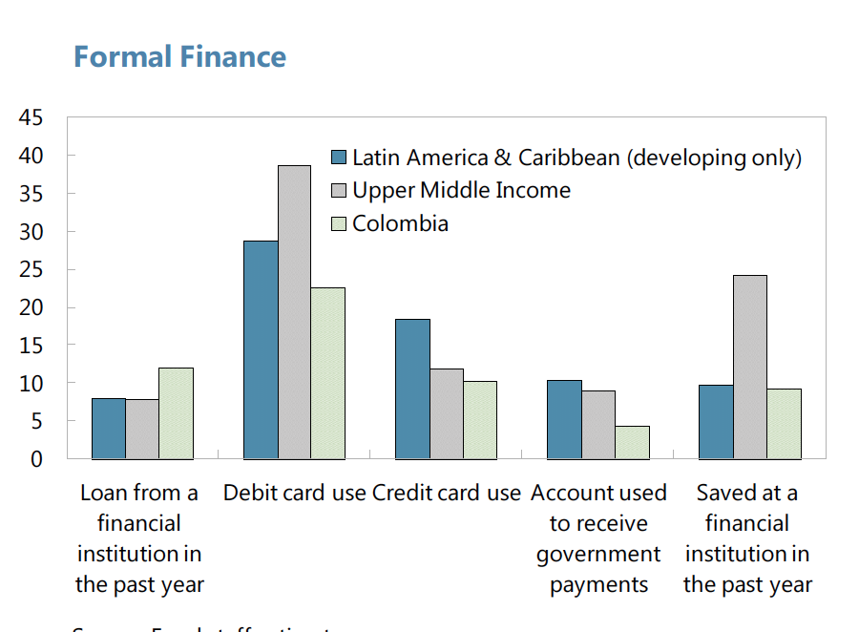
Colombia’s Financial Development Compared to Rest of Latin America
Source IMF Article IV 2014

Slide 46
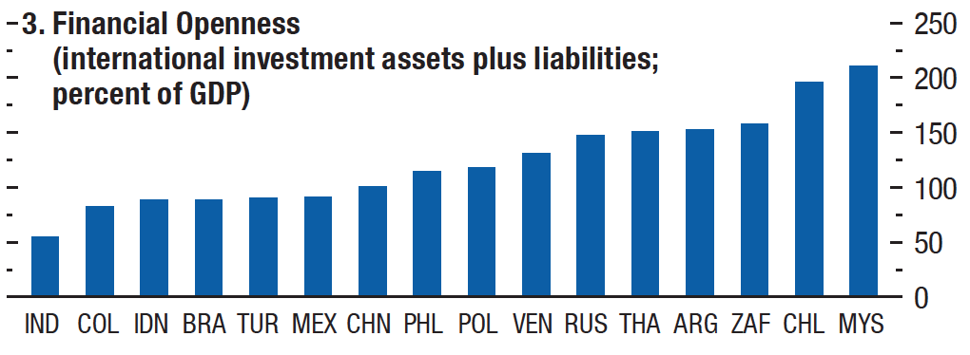
Financial Openness:
Average Country Rankings, 2000-2012
IMF, April 2012
Kenneth Rogoff, Harvard University

Slide 47
Source: Rogoff, 2017, updated

Slide 48
Expanding Digital Payments in Colombia
Financial Inclusion
  helps shield individuals from crime, to smooth expenditures, helps small businesses have access to banks. (But important to have strong digital security safeguards)
  Encourages shift of resources from the informal to the formal economy raising productivity and government revenue.
Cautionary Note: It is important to proceed with transition at a reasonable pace, so people can adjust, and so that unforeseen problems can be dealt with.
Some Components of a Multi-faceted approach
  Make it more difficult to use cash in large-scale payments.
    For small payments, the main idea is to improve digital alternatives for ordinary people, and to make them more attractive
  Help promote financial inclusion by offering free or subsidized basic debit accounts to low income individuals
  Promote competition within the payments space
  Eventually, it is highly likely all countries will adopt some form of biometric identification system perhaps along lines of India. But given broad privacy issues (which are evolving on many fronts anyway, due to Google, Facebook, etc.), the speed and pace of adoption needs to conform to a broad range of other important public issues.
  Central bank digital currencies will become more widespread in the coming one to two decades albeit they will look more like the Postal savings accounts in Japan than like cash.
  Cryptocurrencies need to be regulated.

Slide 49
Paperback edition, July 2017

