Slide 1

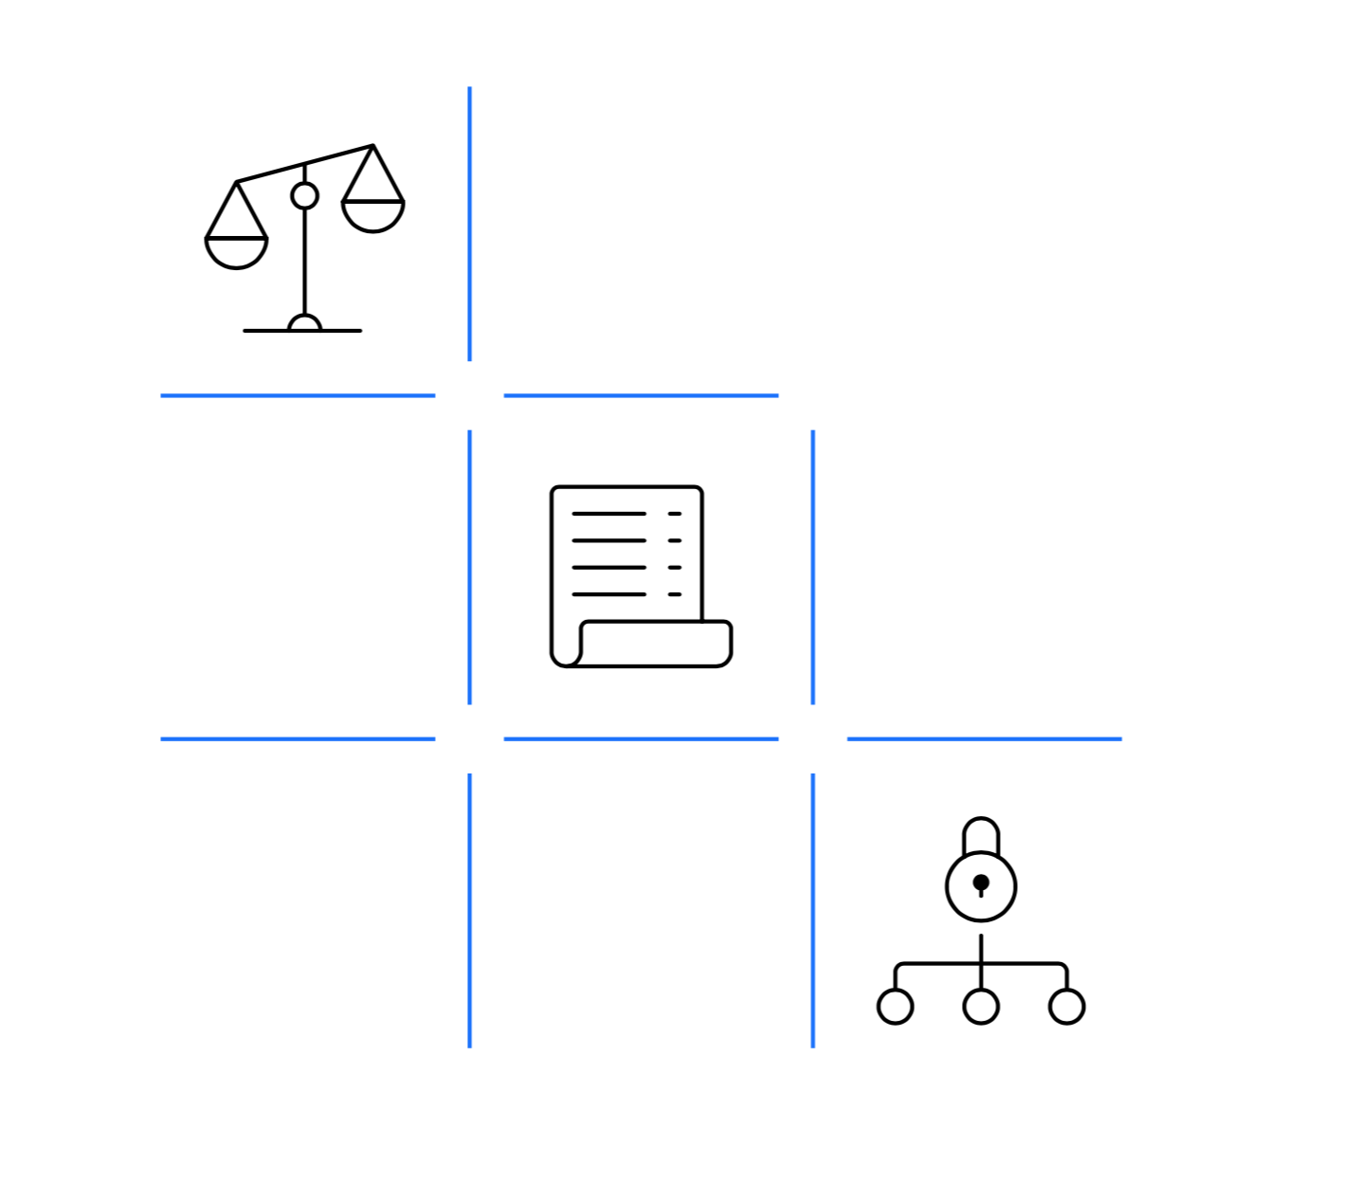
Blockchain
Desafíos Jurídicos

Slide 2

Today
most digital connections
are point to point
or through a broker

Slide 3


Blockchain
is the new
operating system
of trust

Slide 4
A new breed of Blockchain
Notes:
Although Blockchain was first Inspired by the Legacy of crypto currencies, this space has flourished into its own entity all based on the tenants of trust.
- private sector is really capitalizing on Crypto growing up. We have the tenants on accountability. Member are known to the network. 4 main characteristics: Accountability, Privacy, scalability, security

Slide 5
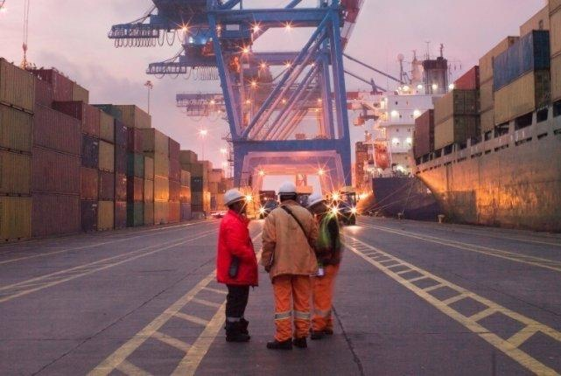


Blockchain optimizes complex transactions
Logistics
Property Records
Capital Markets
US$ 300 billion
Up to
in costs associated with each of these areas
© 2018 IBM Corporation
5

Slide 6


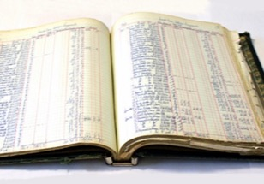





Requirements of blockchain for business
Ledger
Consensus
Business Network decides the assets to share on the ledger
Transactions provably endorsed by relevant participants
Business terms executed with the transactions
Transaction visibility is need-to-know
Privacy and Confidentiality
Smart Contracts

Slide 7











Solutions to Business Challenges
Trade Finance
Pre and Post Trade
Complex Risk Coverage
Identity / KYC
Unlisted Securities / Private Equity Fund
Incentive Program
Medicated Health Data Exchange
Government
Distributed Energy / Carbon Credit
Supply Chain
Food Safety
Provenance / Traceability
And more…

Slide 8

4 Types of Business Model
Founder-Led Network
Single company driving the initial project then others join the network

Slide 9
4 Types of Business Model
Founder-Led Network
Joint Venture Network
Single company driving the initial project then others join the network
2 or more create a JV to govern the initial network

Slide 10
4 Types of Business Model
Founder-Led Network
Joint Venture Network
Consortium Network
Single company driving the initial project then others join the network
2 or more create a JV to govern the initial network
A consortium as the initial network and governance in a specific industry or sector

Slide 11
4 Types of Business Model
Founder-Led Network
Joint Venture Network
Consortium Network
Business Ecosystem
Single company driving the initial project then others join the network
2 or more create a JV to govern the initial network
A consortium as the initial network and governance in a specific industry or sector
A Consortium Network working across multiple industries or sectors

Slide 12
4 Types of Business Model
Industry A
Member
Sprint 4
Member
Sprint 3
Member
Sprint 4
Member
Sprint 4
Member
Sprint 1
Member
Sprint 4
Member
Sprint 4
Member
Sprint 1
Member
Sprint 4
Member
Sprint 4
Member
Sprint 1
Member
Sprint 4
Industry F
Industry B
Member
Sprint 3
Member
Sprint 1
Member Sprint 2
Member
Sprint 3
Member
Sprint 3
JV Owner
JV Owner
Member
Sprint 3
Member
Sprint 3
Founding Consortium
Founding Consortium
Member
Sprint 3
Member
Sprint 3
Founding Consortium
Founding Consortium
Member
Sprint 3
JV
Member
Sprint 2
Founding Member
Member Sprint 1
Member
Sprint 2
JV Owner
Member Sprint 1
Member
Sprint 2
Founding Consortium
Member Sprint 1
Member
Sprint 2
Founding Consortium
Member Sprint 1
Member
Sprint 3
Member
Sprint 1
Member Sprint 2
Member
Sprint 3
Member
Sprint 3
Member
Sprint 1
Member Sprint 2
Member
Sprint 3
Member
Sprint 3
Member
Sprint 1
Member Sprint 2
Member
Sprint 3
Member
Sprint 3
Member
Sprint 1
Member Sprint 2
Member
Sprint 3
Member
Sprint 4
Member
Sprint 3
Member
Sprint 4
Member
Sprint 4
Member
Sprint 3
Member
Sprint 4
Member
Sprint 4
Member
Sprint 3
Member
Sprint 4
Industry E
Member
Sprint 4
Member
Sprint 3
Member
Sprint 4
Industry C
Industry D
Founder-Led Network
Joint Venture Network
Consortium Network
Business Ecosystem
Single company driving the initial project then others join the network
2 or more create a JV to govern the initial network
A consortium as the initial network and governance in a specific industry or sector
A Consortium Network working across multiple industries or sectors

Slide 13




Legal Considerations
Jurisdiction & Liability
Antitrust Law
Data Protection & Privacy
Intellectual Property

Slide 14



Slide 15
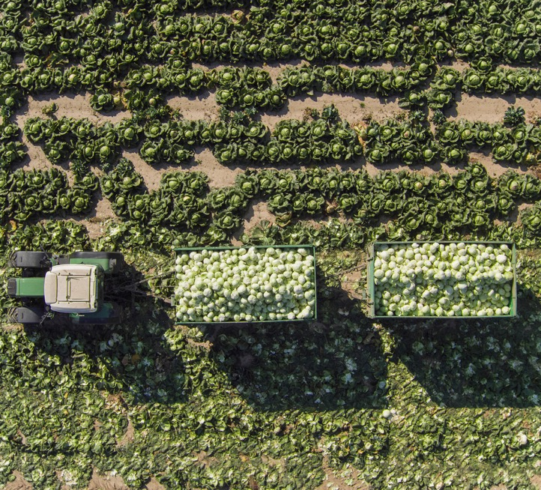










Slide 16



Slide 17



Slide 18



Slide 19





Slide 20

Martin Hagelstrom
Blockchain Leader
IBM Latin America
@mhagelstrom
© 2018 IBM Corporation
20
20

